Slide 1
Spring Boot
Spring team created SpringBoot to address the complexity of configuration.

Slide 2
Spring Boot
Spring Boot makes it easy to create stand-alone, production-grade Spring based Applications that you can "just run". We take an opinionated view of the Spring platform and third-party libraries so you can get started with minimum fuss. Most Spring Boot applications need very little Spring configuration.

Slide 3
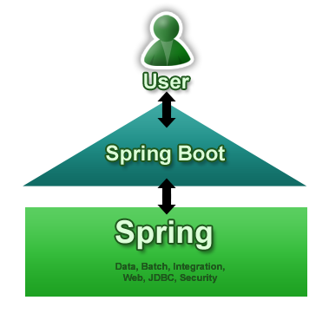
Spring Boot

Slide 4
Spring Boot - features
Create stand-alone Spring applications
Embed Tomcat, Jetty or Undertow directly (no need to deploy WAR files)
Provide opinionated 'starter' POMs to simplify your Maven configuration
Automatically configure Spring whenever possible
Provide production-ready features such as metrics, health checks and externalized configuration
Absolutely no code generation and no requirement for XML configuration

Slide 5
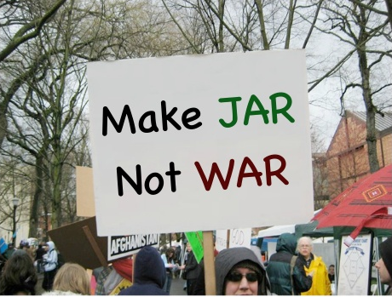
Spring Boot

Slide 6
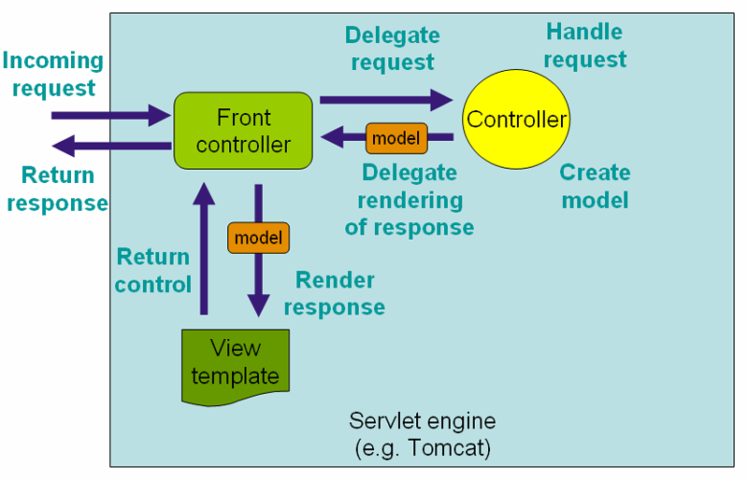
Spring Boot - SpringMVC

