Slide 1
Unit testing with Junit (and not only)
Elena Grumazescu

Slide 2
TYPES
Unit testing – Test the smallest parts of a code (classes or methods)
Integration testing – Test multiple components which are combined or integrated – checks regression
End-to-end testing – Involves testing of a complete application environment in a situation that mimics real-world use
Functional testing – Ignores the internal parts and focus on the output is as per requirement or not - Black-box
WHY?
The goal is to write tests that fail, so you can correct the errors on time
Improves the implementation via new insights
Anticipates errors - testing motivates developers to think about ways to break their code, thereby leading to more resilient applications.
Can be run automatically when needed
Multiple frameworks and instruments exist on the market, which simplify the way we write tests

Slide 3

UNIT TEST STRUCTURE
Prepare initial conditions – create objects, initialize resources
Call the methods that need to be tested
Verify methods by comparing the generated results with the expected ones
Release the used resources

Slide 4
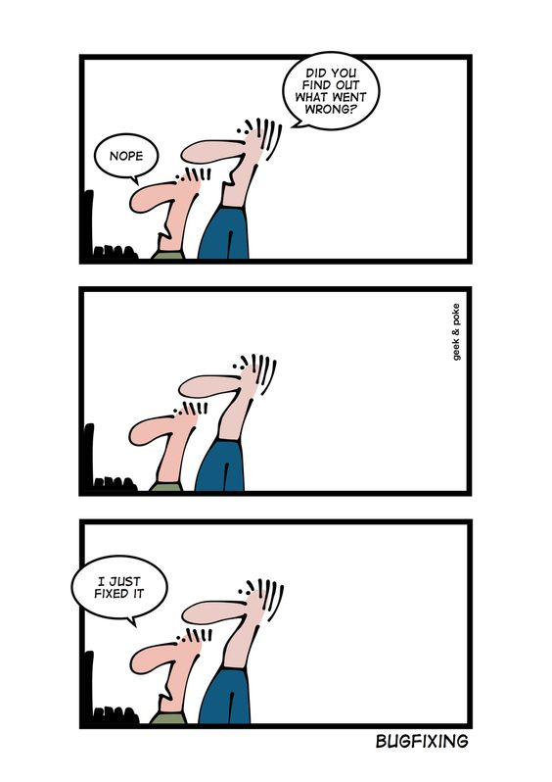
JUNIT CONCEPTS
Test class: a Java class containing one or more test methods.
Test method: a method in a Java class that contains a single unit test.
Assertion: a statement that you include in a test method to check that the results of a test are as expected.
Test fixture: a class that is used to set up state for multiple tests; typically used when the set up routines are “expensive” or take a long time to execute.
Test suite: a grouping of test classes that are run together.
Test runner: used for executing the test cases. NetBeans, Eclipse and IntelliJ IDEA have native test runners built in.

Slide 5
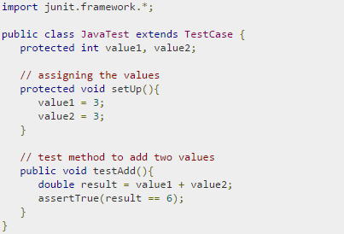
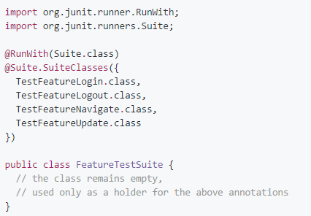
Fixture is a fixed state of a set of objects used as a baseline for running tests
A test suite bundles a few unit test cases and runs them together

Slide 6
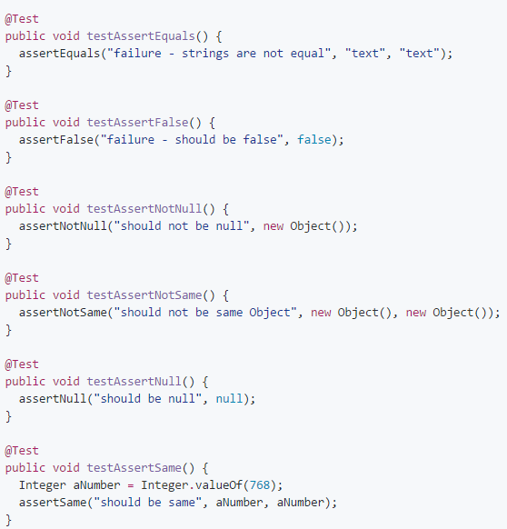
ASSERTS
Each assert method has the following parameters: message, expected-value, actual-value - the message is optional, but it is BAD PRACTICE not to use it
Examples of asserts:

Slide 7

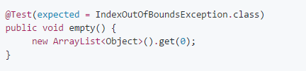
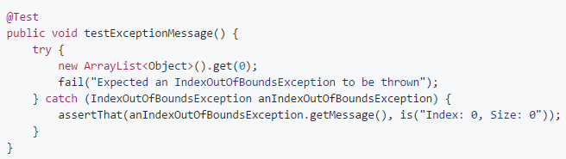
EXCEPTION TESTING
The above test will pass if any code in the method throws IndexOutOfBoundsException
Can not test the value of the message in the exception using the first example

Slide 8
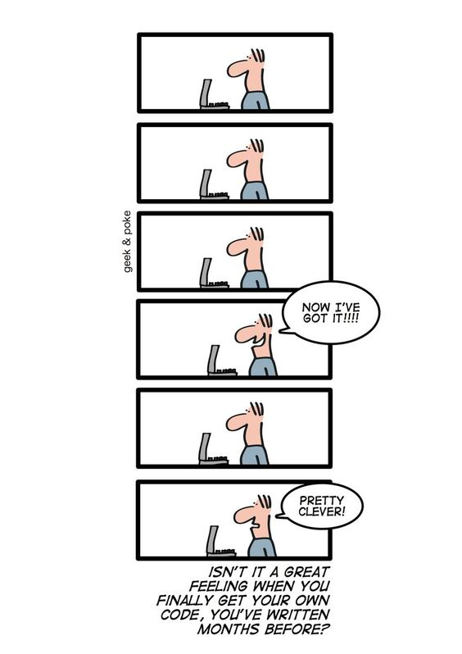
BEST PRACTICES
The name of the class is important and it must be TestSomething or SomethingTest
A unit test must evaluate a single code unit
Unit tests must be independent one from another
In a test, a single assert method should be found – a single aspect is tested, do not make unnecessary assertions
Avoid unnecessary preconditions
Name your unit tests clearly and consistently
Use descriptive messages in assert methods

Slide 9
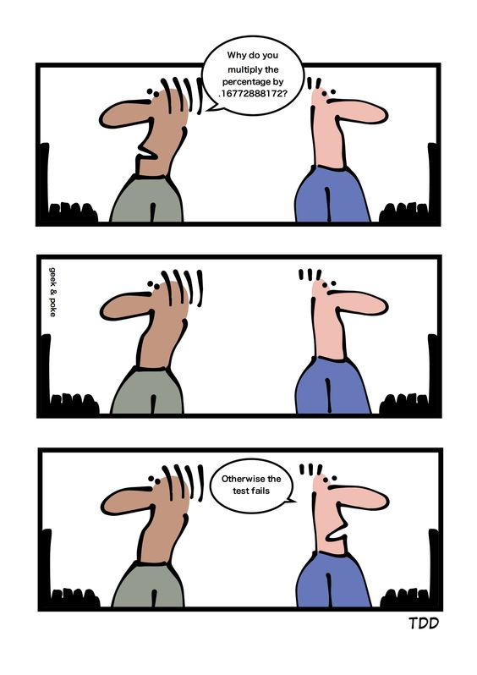
TEST DRIVEN DEVELOPMENT
TDD – Method of development that advocates writing unit tests before writing the software under test itself
STEPS:
Add a test -> Run all tests and see if the new test fails -> Write the code -> Run tests -> Refactor code -> Repeat
BENEFITS:
The programmer is concerned with the interface before the implementation
Ensures that all written code is covered by at least one test
DOWNSIDES:
Big time investment
Selling it to management or other developers

Slide 10

MUTATION TESTING
Test coverage is a useful tool for finding untested parts of a codebase‘ as Martin Fowler puts it. BUT full coverage alone testifies nothing about the quality of the underlying tests!
Mutation testing evaluates the quality of existing software tests. The idea is to modify (mutate) code covered by tests in a small way
Check whether the existing test set will detect and reject the change. If it doesn’t, it means the tests do not match the code’s complexity and leave one or more of its aspects untested.

Slide 11
THANKS ☺

