Slide 1
Formik

Slide 2
Formik
What?
Formik is a small library that helps you deal with forms in React
Why?
Managing form data
Form submission
Form validation and displaying error messages
Formik helps you deal with forms in a scalable, performant and easy way.

Slide 3
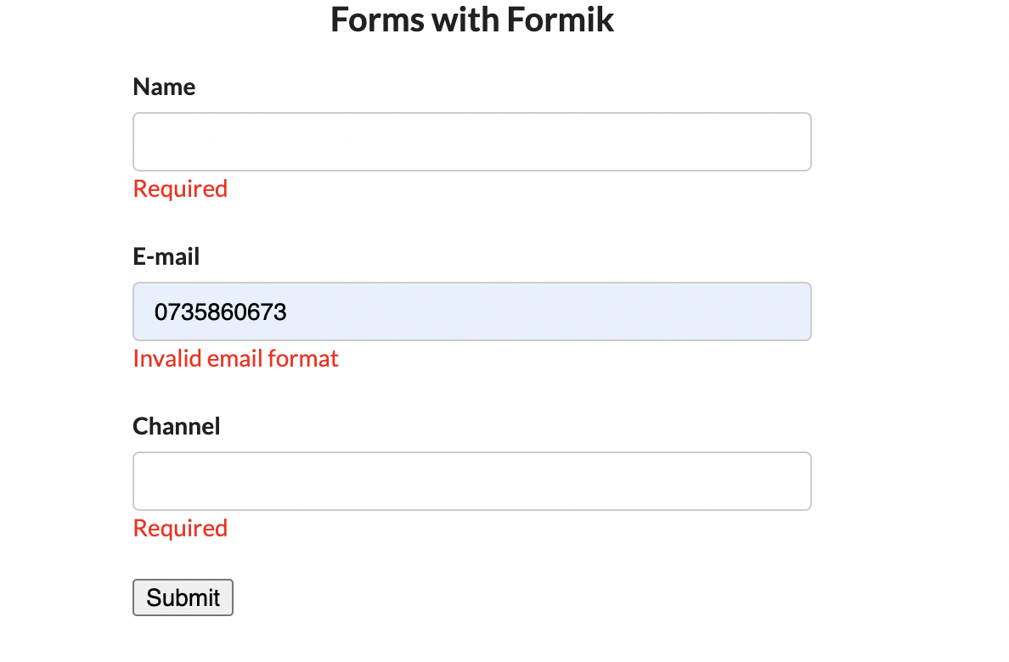
Example with formik

Slide 4
Useformik hook
npm install formik → import { useFormik } from "formik";
useFormik() is a custom React hook that will return all Formik state and helpers directly.
With useFormik hook you can define your initialValues in it
onSubmit property from useFormik gets the form’s state as its arguments
Validate function from useFormik must return an error object
handleChange is a general input change event handler that will update the values[key] where key is the event-emitting input’s name attribute
handleSubmit is the submit handler

Slide 5
documentation
https://www.youtube.com/watch?v=a94FOvaBomQ&list=PLC3y8-rFHvwiPmFbtzEWjESkqBVDbdgGu&index=2
https://formik.org/docs/overview

