Slide 1


SAVIN MIHAI-ALEXANDRU
IMDB
DATA PIPELINE

Slide 2

OBJECTIVE
BUILD AN AUTOMATED PIPELINE.
EXTRACT RAW IMDB DATASETS -> LOAD INTO A DATA WAREHOUSE -> TRANSFORM INTO A QUERY-OPTIMIZED DIMENSIONAL MODEL.
GOAL: ENABLE FAST, ACCURATE ANALYTICAL QUERIES FOR BUSINESS INTELLIGENCE.

Slide 3
THE RAW DATASET & CHALLENGES
Source: 7 daily-updated, compressed .tsv.gz files.
TITLE.BASICS: CORE METADATA (IDS, TYPE, RUNTIME, GENRES).
TITLE.RATINGS: QUANTITATIVE METRICS (AVERAGE SCORE, VOTE COUNT).
TITLE.AKAS & TITLE.EPISODE: REGIONAL NAMES AND TV HIERARCHIES.
NAME.BASICS: INDUSTRY PERSONNEL DETAILS (ACTORS, DIRECTORS, BIRTH YEARS).
TITLE.PRINCIPALS & TITLE.CREW: MAPS WHO WORKED ON WHAT, DETAILING SPECIFIC ROLES AND CHARACTERS PLAYED.
CHALLANGES:
LITERAL \N STRINGS INSTEAD OF STANDARD NULLS.
DENORMALIZED ARRAYS (E.G., COMMA-SEPARATED GENRES IN A SINGLE COLUMN).

Slide 4
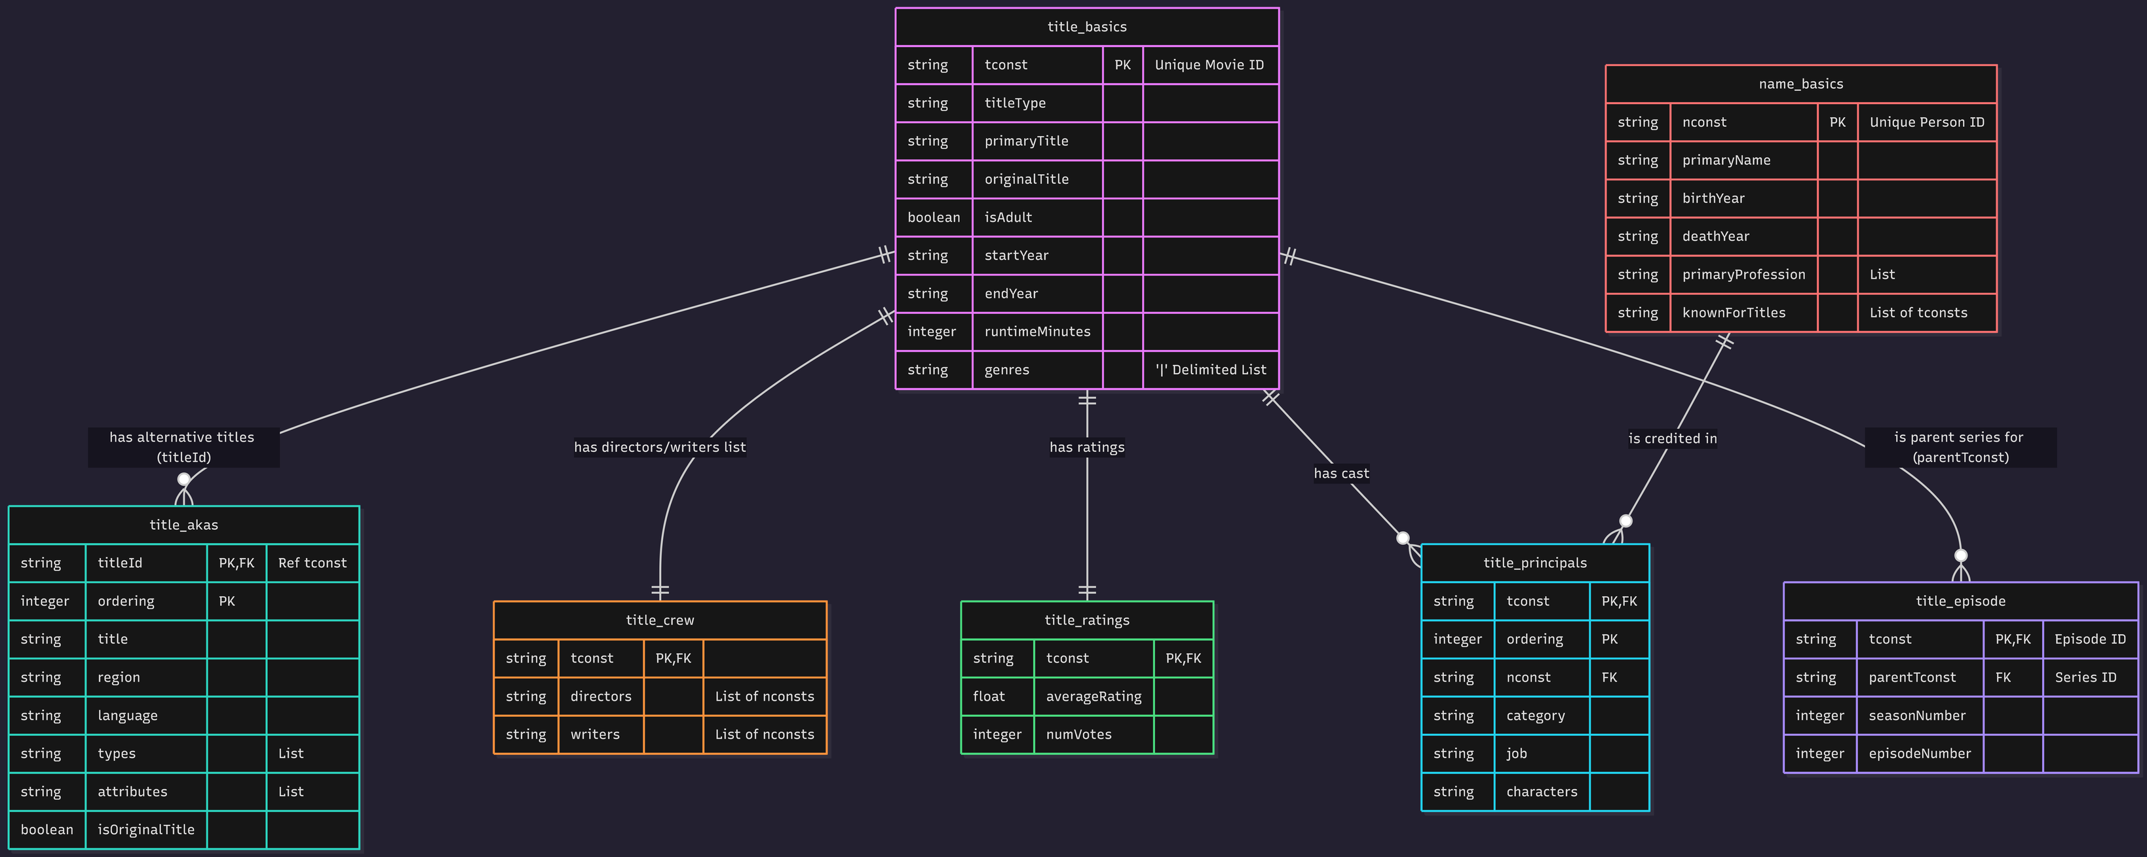

Slide 5
ARCHITECTURE
ORCHESTRATION
Apache Airflow
STORAGE
DuckDB & Parquet
TRANSFORMATION
dbt

Slide 6
PIPELINE EXECUTION (AIRFLOW DAG)

Slide 7
THE STAR SCHEMA
FACT TABLE (FCT_TITLE_RATINGS)
THE DIMENSION TABLES
RESOLVING MANY-TO-MANY RELATIONSHIPS
Provide the descriptive context used for filtering and grouping.
Examples: dim_person (actor/director details), dim_year (decades), dim_genre.
Strict Grain: 1 row = 1 title.
Fact Isolation: Limited exclusively to countable, quantitative metrics (e.g., average_rating, num_votes).
Implemented Bridge Tables (bridge_title_genres, bridge_title_crew) to safely link a single title to multiple genres or actors.
DOCUMENTARIES, SHORT FILMS, AND EXPERIMENTAL CINEMA
SLOWLY CHANGING DIMENSIONS (SCD TYPE 2)
dim_title_snapshot utilizes dbt snapshots to track historical changes in metadata.

Slide 8
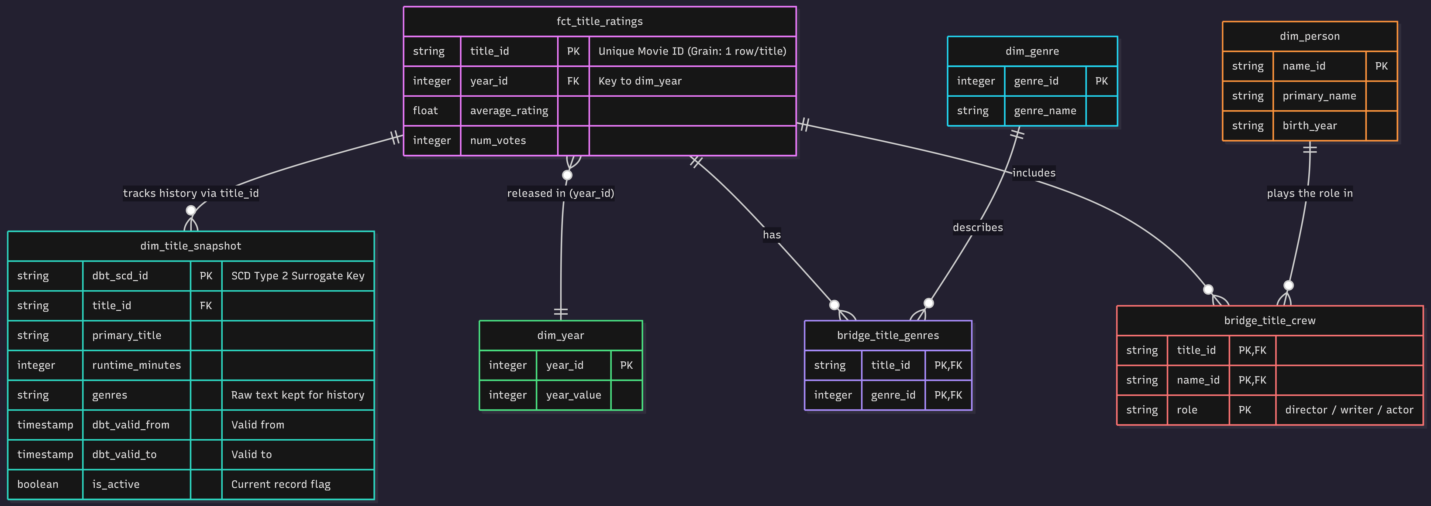
THE STAR SCHEMA

Slide 9

TRANSFORMATION & TESTING
ELT APPROACH
INTEGRATED TESTING
Staging: Cleans types and handles \N nulls.
Intermediate: Reshapes arrays and complex structures.
Marts: Finalizes the Star Schema.
Automated checks for primary/foreign keys, uniqueness, and custom business rules (e.g., ratings strictly between 0.0 and 10.0).

Slide 10
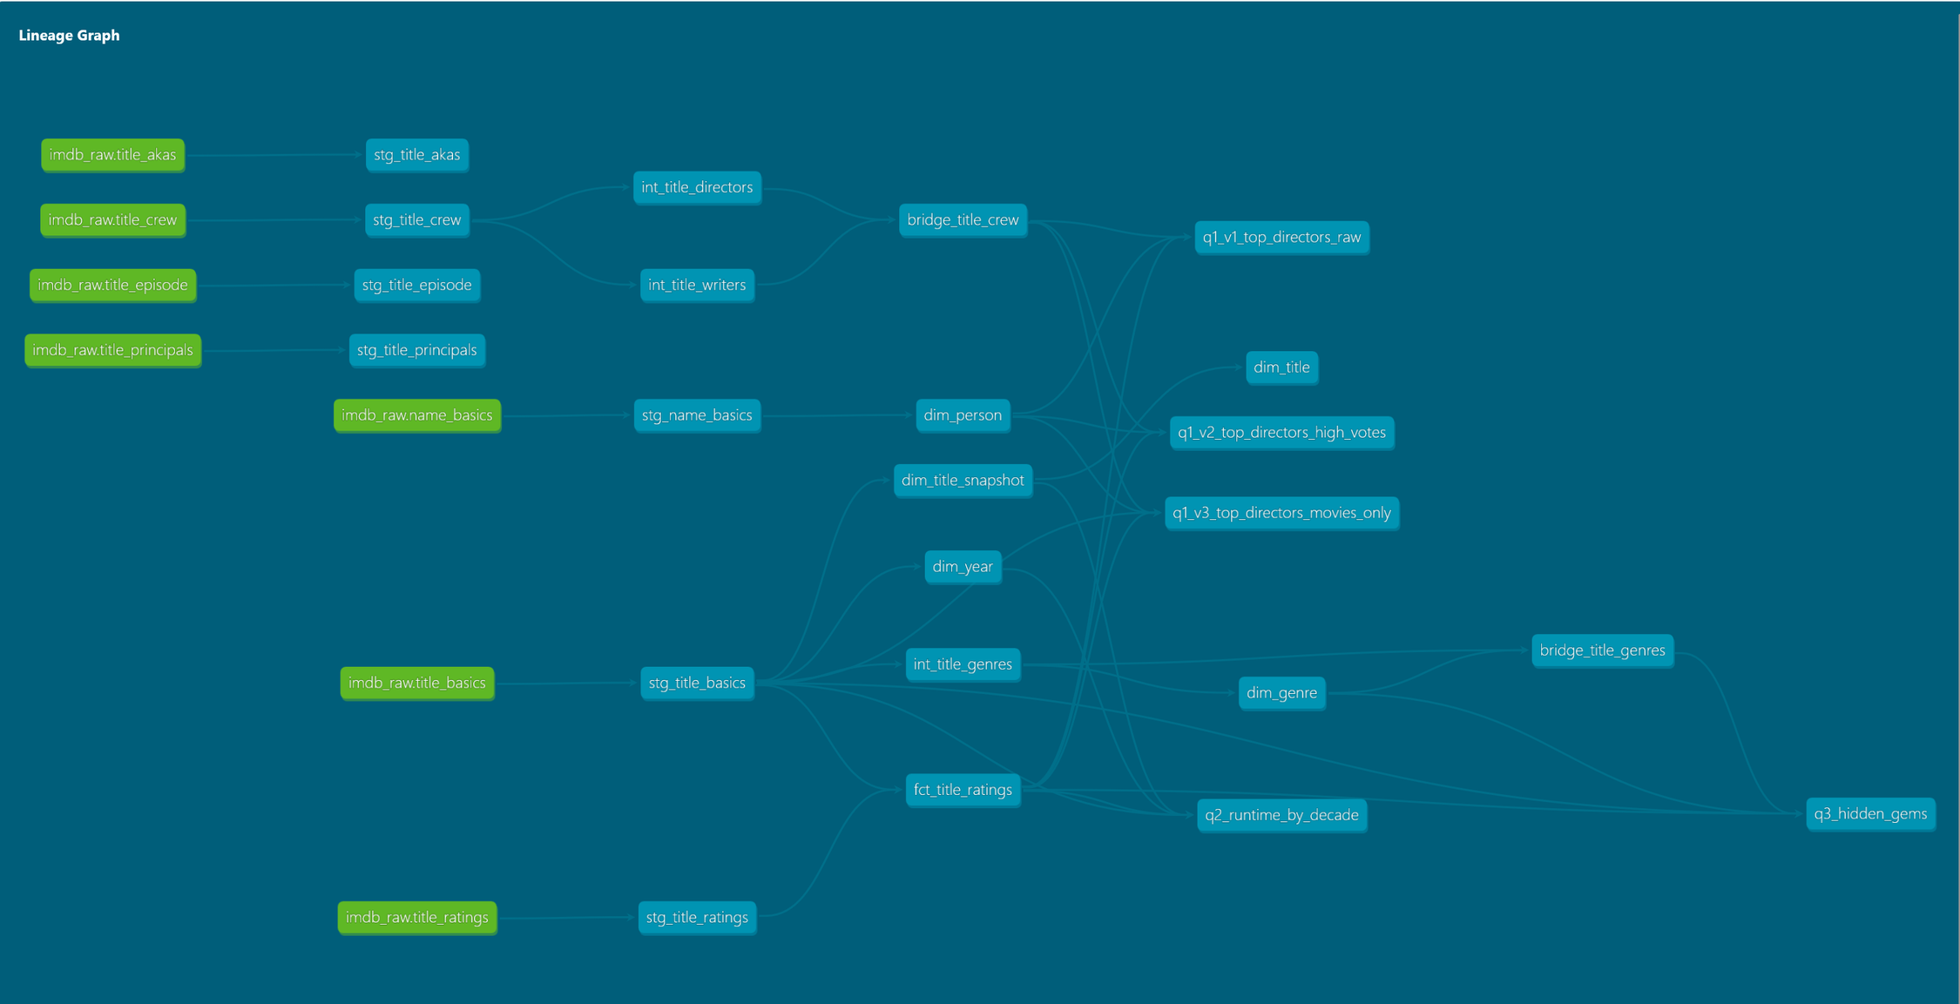

Slide 11
DELIVERABLE QUESTIONS

Slide 12
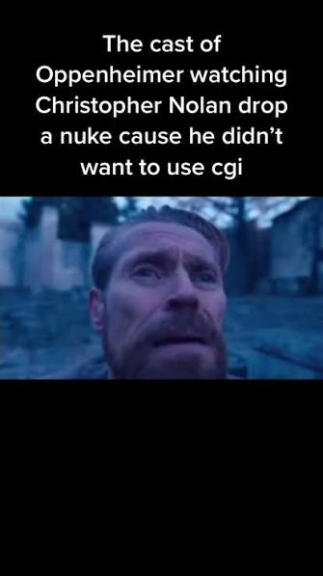
WHO ARE THE TOP 10 DIRECTORS BY AVERAGE RATING, RESTRICTED TO THOSE WITH 5+ TITLES AND 1,000+
COMBINED VOTES?

Slide 13
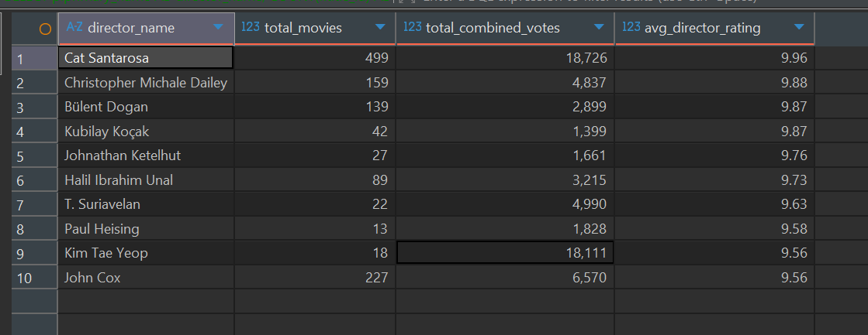

Slide 14
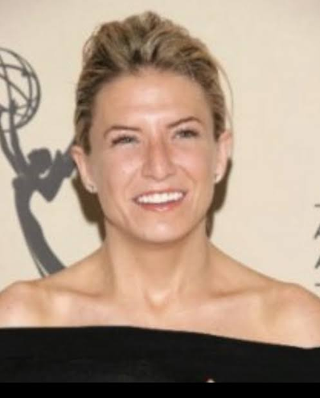
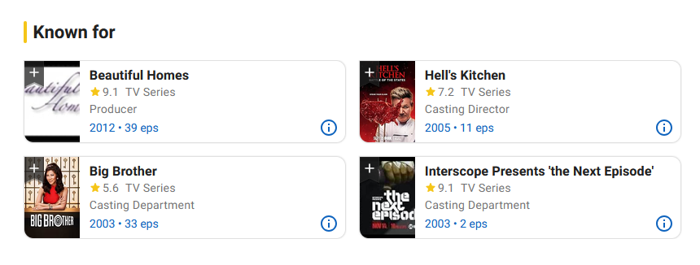
CAT SANTAROSA

Slide 15
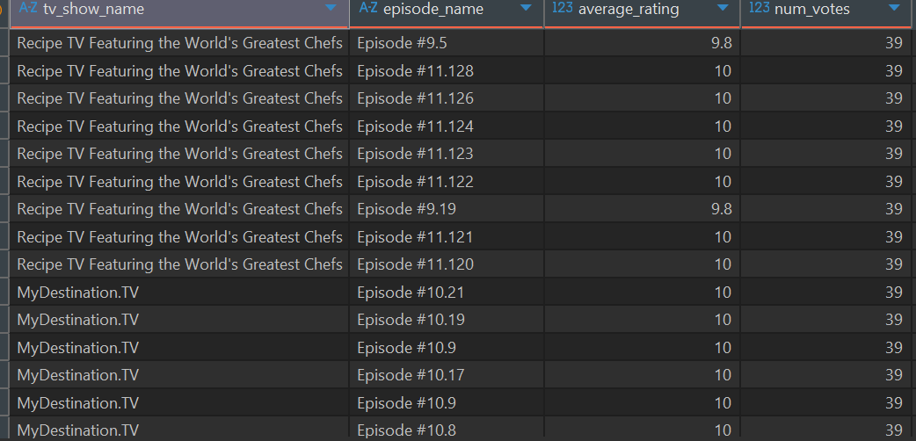

Slide 16
ATTEMPT 2: RAISE THE VOTE COUNT TO 50K

Slide 17
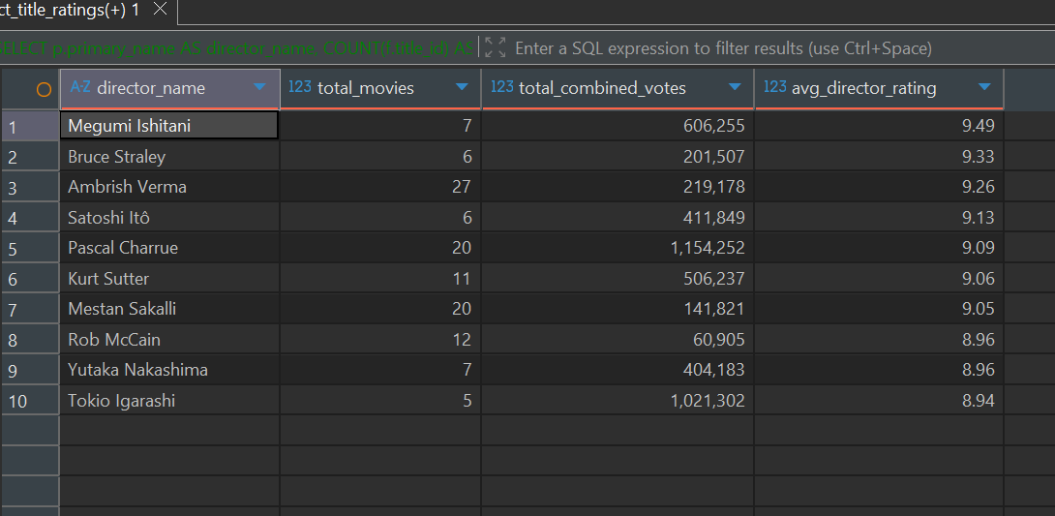

Slide 18
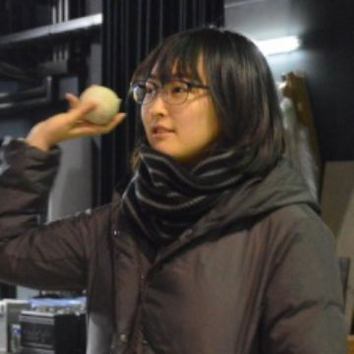
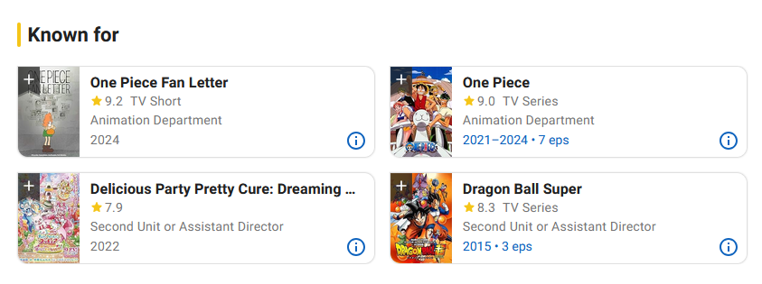
MEGUMI ISHITANI

Slide 19
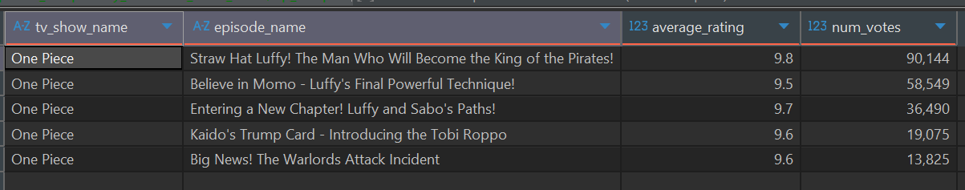

Slide 20
ATTEMPT 3: LIMIT TO MOVIES

Slide 21
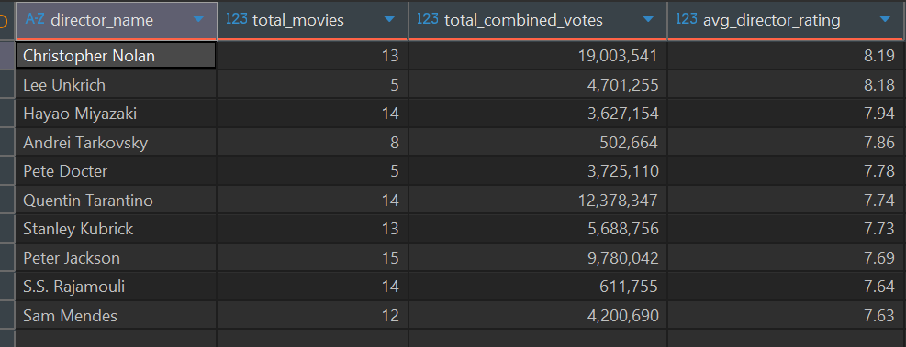

Slide 22
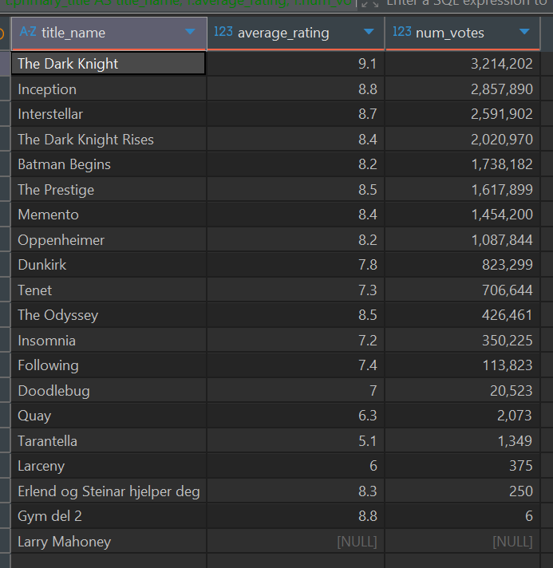

Slide 24
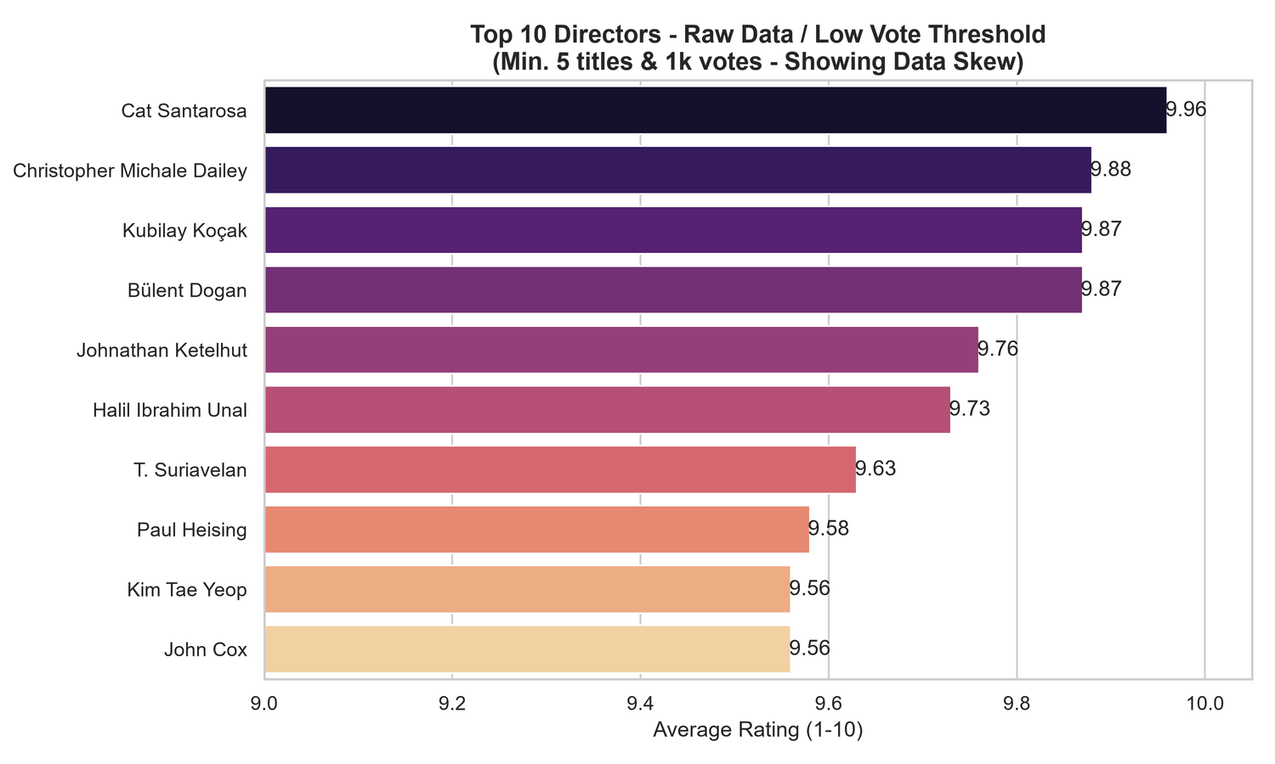

Slide 25
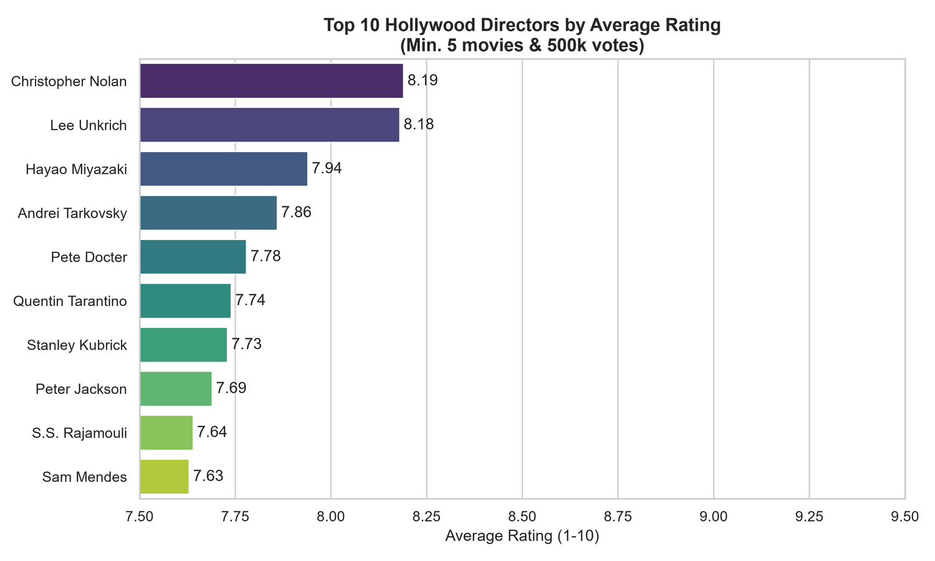

Slide 26
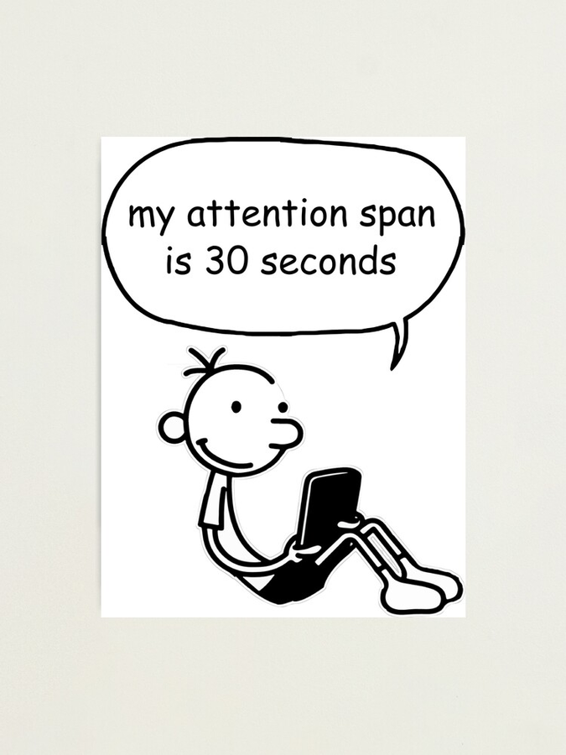
HAS THE AVERAGE MOVIE RUNTIME CHANGED BY DECADE, AND DOES RUNTIME CORRELATE WITH RATING?

Slide 27
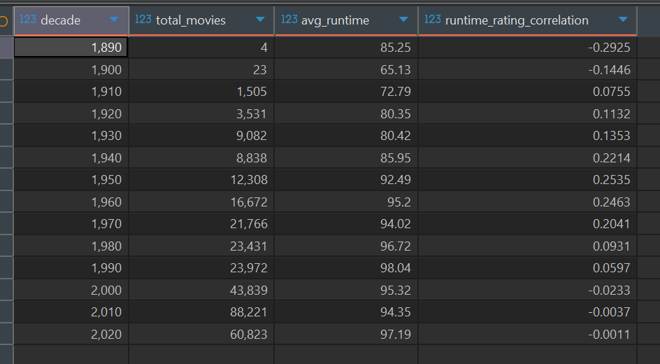

Slide 28
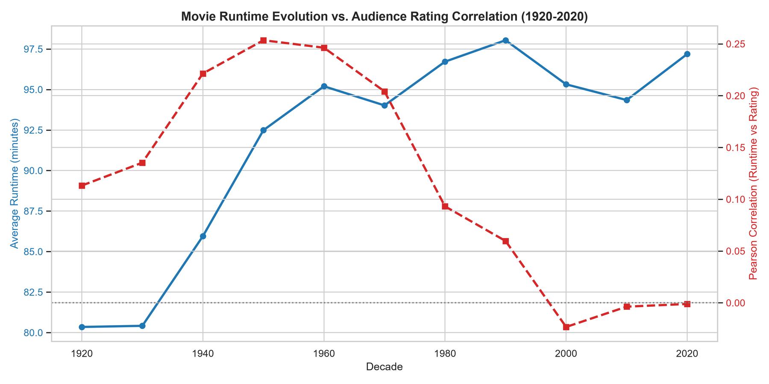

Slide 29

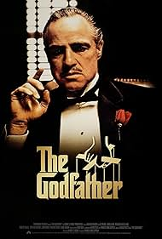
8.3 IMDB RATING
9.2 IMDB RATING
1962 - 3H 47 MIN
1972 - 2H 55 MIN

Slide 30
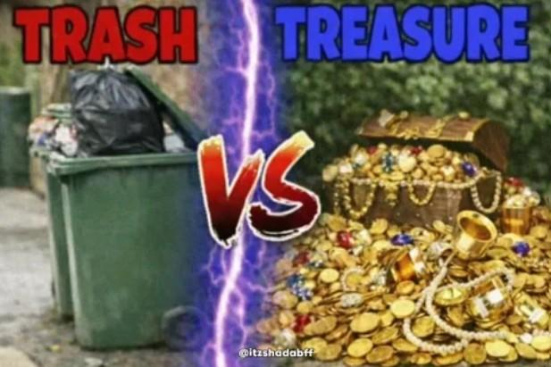
WHICH GENRES HAVE THE HIGHEST RATIO OF
“OVERRATED” TITLES (LOW RATING, HIGH VOTE COUNT)?
VERSUS
“HIDDEN GEMS” (HIGH RATING, LOW VOTE COUNT)

Slide 31
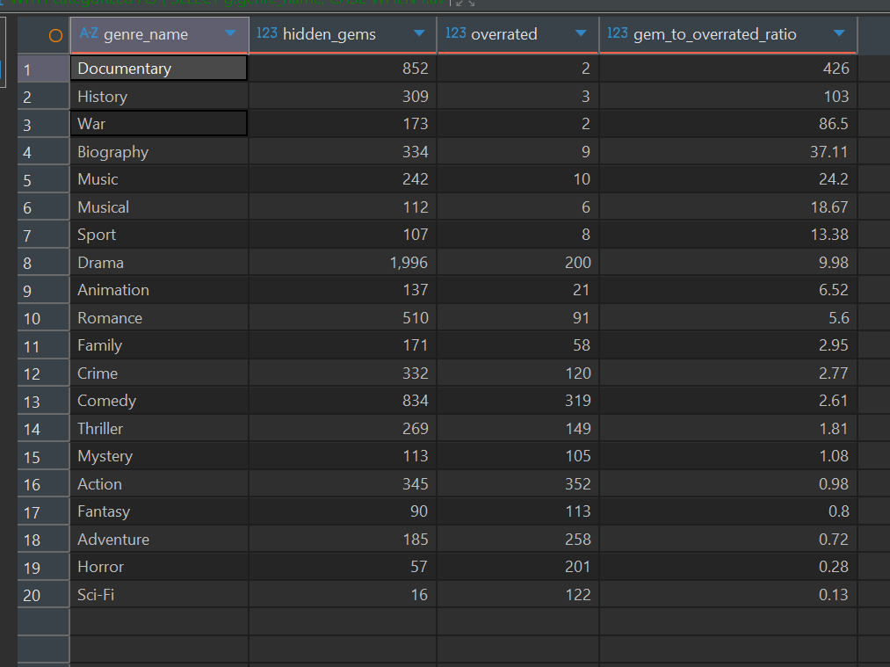

Slide 32
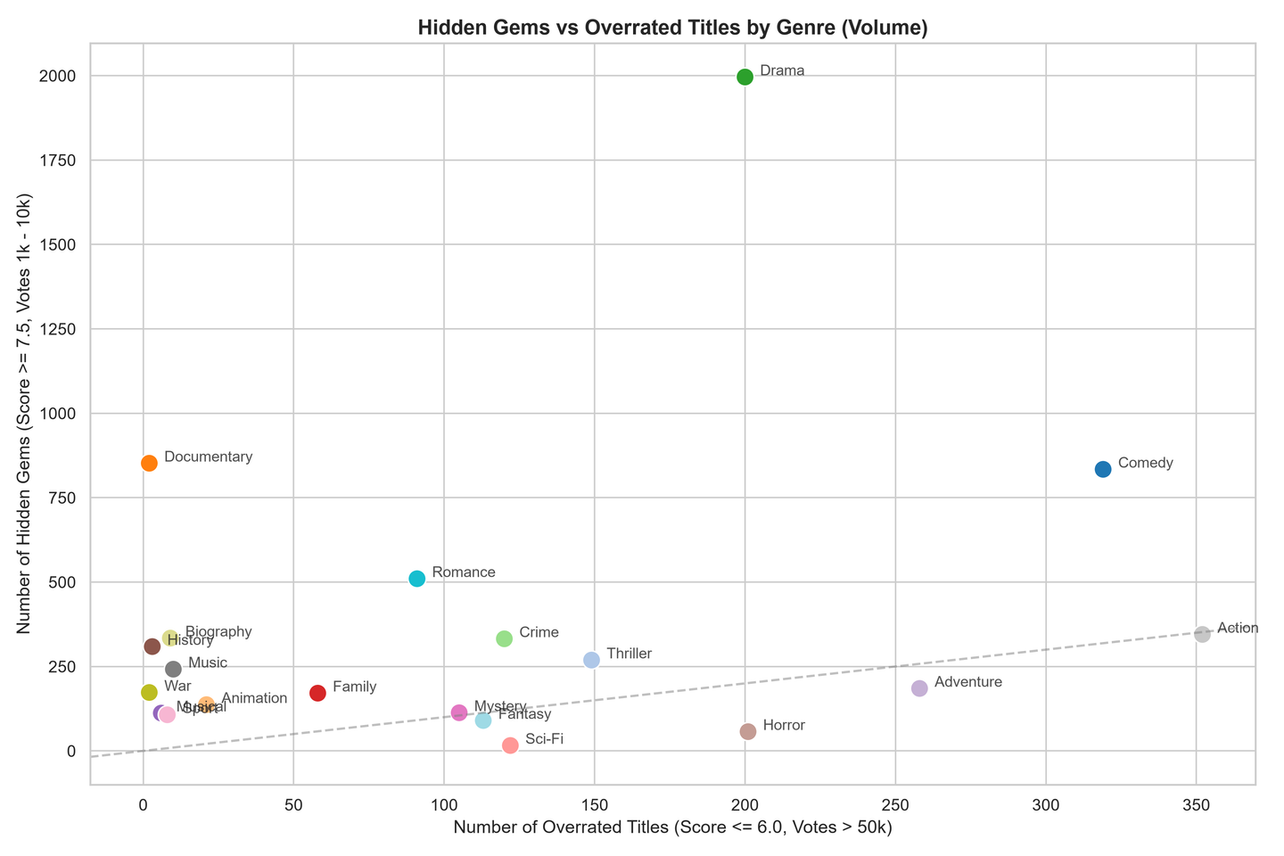

Slide 33
THANK YOU

