Slide 1
Progres de saptamana trecuta

Slide 2
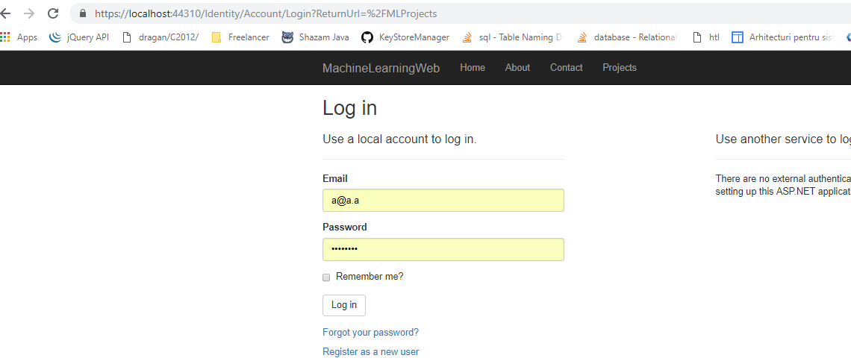
Aplicatie ASP.NET MVC core pentru upload de imagini

Slide 3
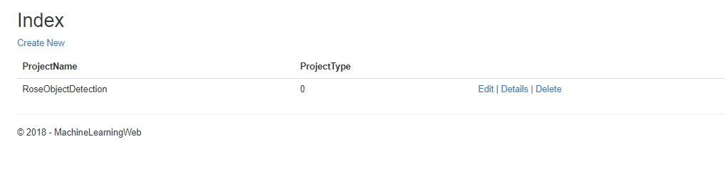
Create projects

Slide 4
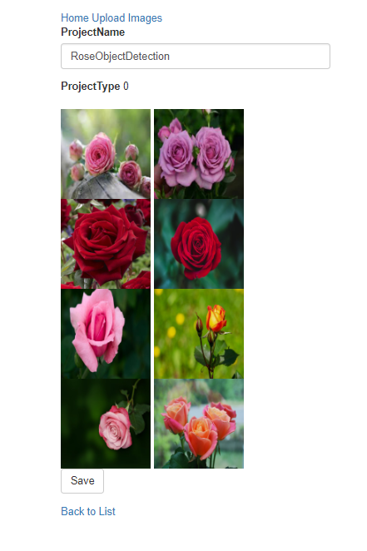
See project details

Slide 5
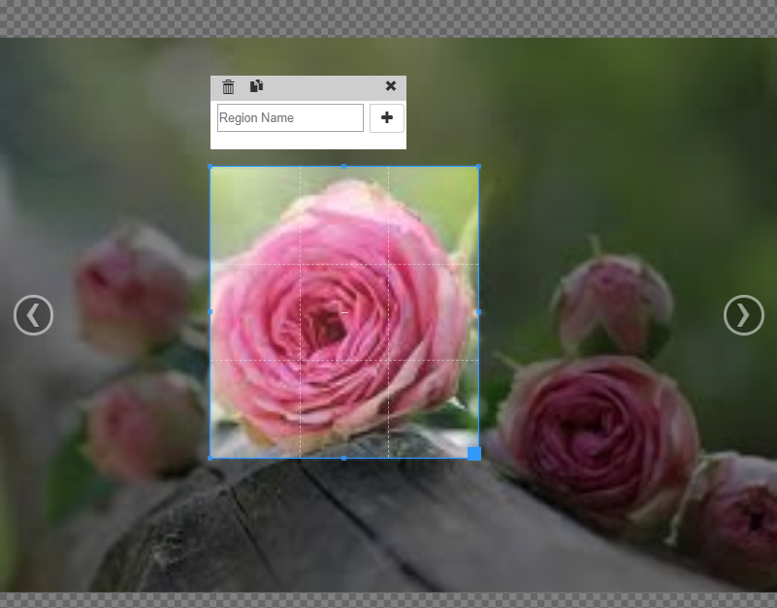
Tag image by clicking on image and selecting region

Slide 6
Navigate to next/previous image using keyboard

Slide 7
Backend for
Authorisation
Creating project
Uploading images linked to project
Getting images (authorized using memory cache)

Slide 8
To do
Save tag in database
Create default tag, so that all regions are tagged by default
Link ASP.NET Core to python app that is doing the detection
Integrate training ang suggestions in the tagging process

