Slide 1
The completed design
Z5175092
Oscar
Minhui shen

Slide 2

District 9

Slide 3
design concept
This design is to connect the two buildings of the villa and the cinema. There are many differences and exclusions between the two buildings in terms of function or form. Therefore, in the design, I will find the relationship between the two by analyzing the relationship between the two, and then some building components will be two The people are connected to form a whole building, and then the connecting part is deformed and twisted to form a special space, which becomes the third attribute space between the two buildings, removing the negativity of its space. In the understanding part, the combination of the block relationship between the two buildings is used to form the space of the third attribute. Through the control of the parameterized data, the organic building texture is created, and the two buildings are organically connected, thereby becoming a overall.

Slide 4
Design concept: "District 9" expresses the similarity and cooperation between different races. Therefore, in the design, the architectural shape with the same deformation at both ends is used, so that the two are integrated with each other. This is also reflected in the design of the skin.
The overall shape of the building adopts the concept of Mobius, which expresses the fact that the two are integrated. The entrance is placed in the middle of the twist, thus forming a concave space and increasing the affinity of the building. The interior is partially set in two floors, and the film screening hall arrives through a narrow walkway, giving people a space of delusion.
Villa design concept: The core concept of this villa design is to maximize the view of the room, make rational use of the surrounding landscape resources, and use the large-area floor-to-ceiling glass to provide a panoramic view of the outdoor landscape. In the space layout of the villa, the living room dining room and other functions are used as the core functional area, and the private space such as the bedroom, the bathroom and the study room are scattered around, forming a space centripetality and creating a sense of warmth. The master bedroom and the second bedroom are arranged on both sides of the living room to ensure the privacy of the owner, and the colleague guarantees the owner's use of space independence. The study room is the owner's exclusive space and can be reached through the living room and master bedroom. The design of the roof adopts a streamlined approach, with partial perforated openings to create modern residential features with sci-fi colours. Due to the need to consider the privacy of the room and the overall feel of the façade, the building façade uses large-area glass on the façade and a solid wall on the back façade.

Slide 5
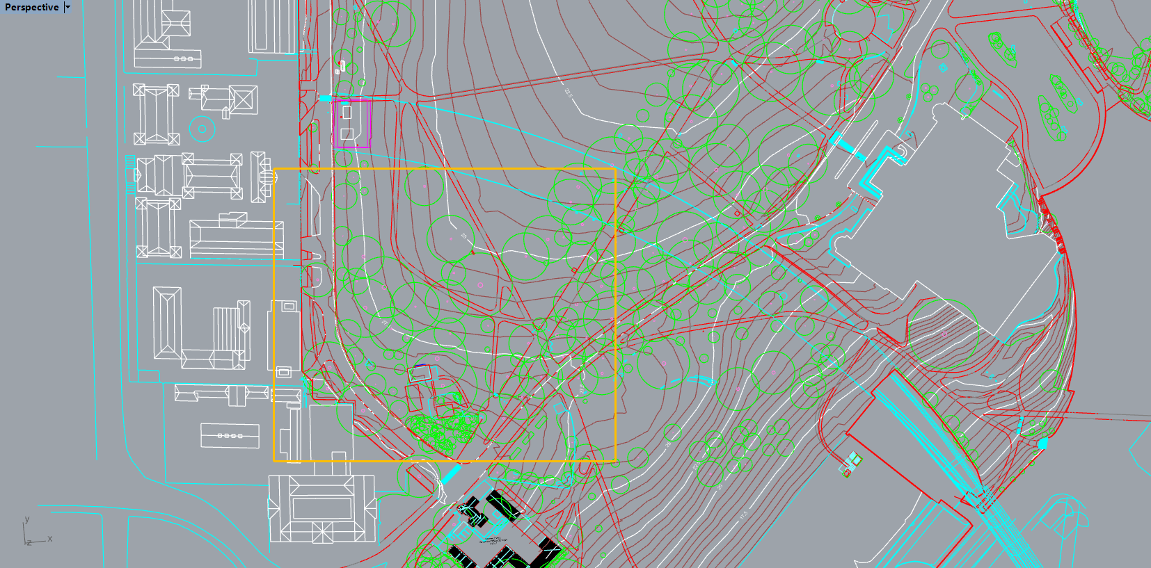
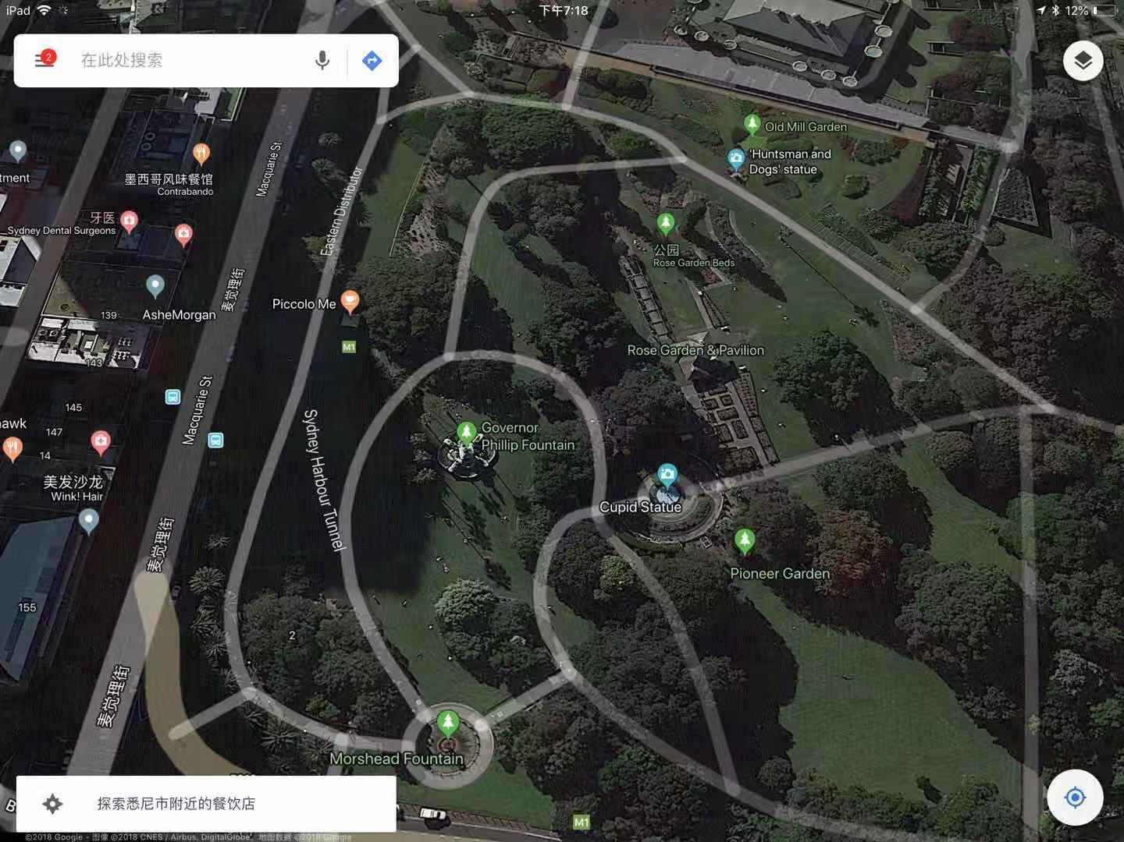
location

Slide 6
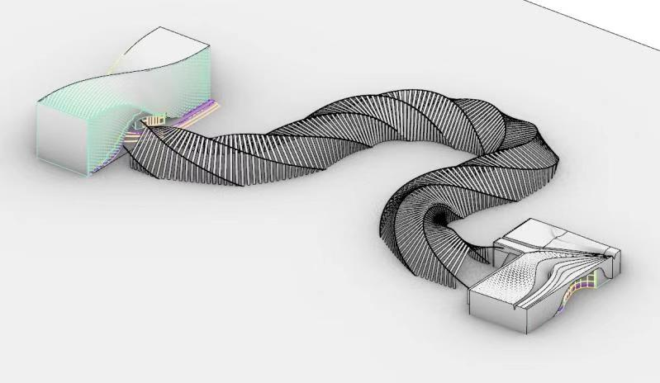
Design ideas
In this design, my first thought was to add a bridge-like link to the two buildings.

Slide 7
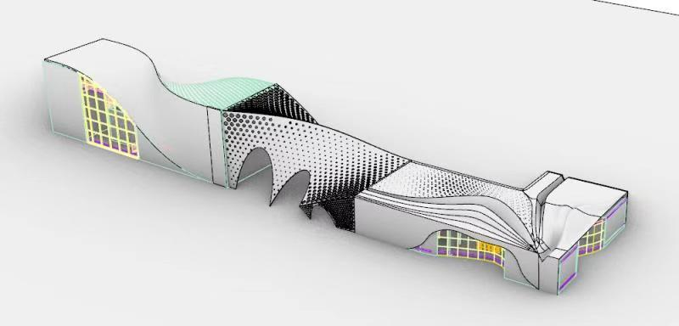
Design ideas
Later, I tried to shorten the bridge and bring the two buildings closer together.

Slide 8
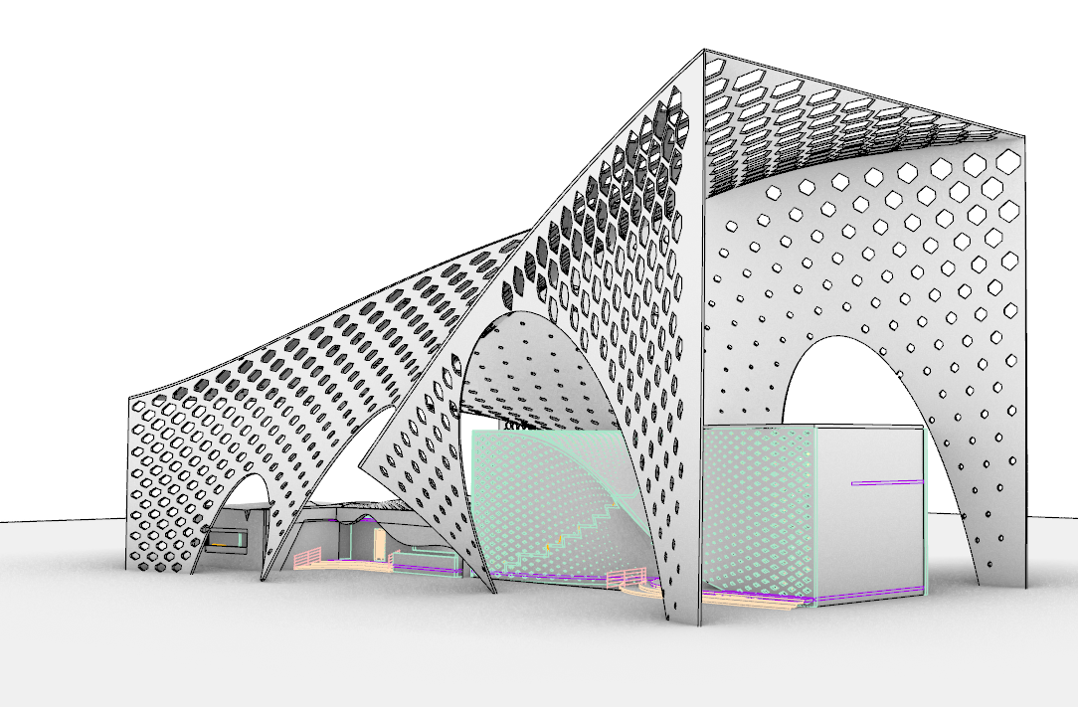
Design ideas
In the third step, I tried to put the two buildings together and add a roof.

Slide 9
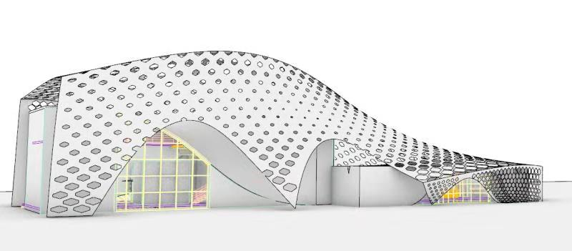
Design ideas
At the end I tried to bring the outline of the outer shell closer to the main body of the building.

Slide 10
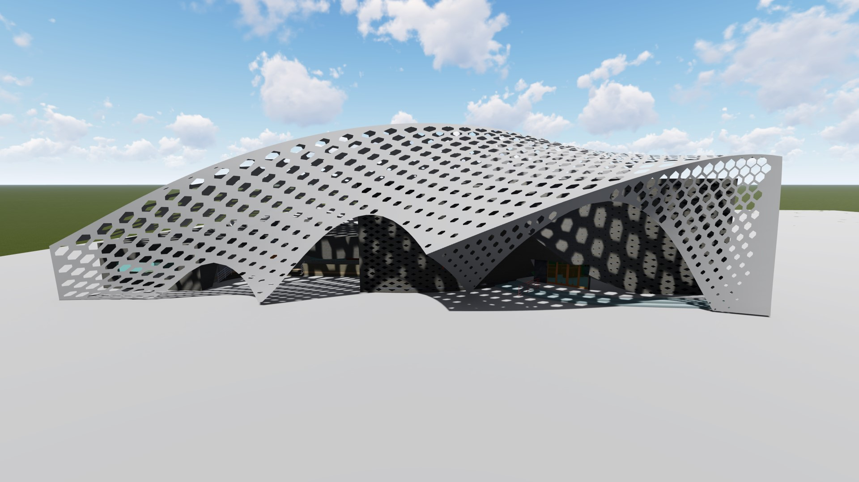
External and internal rendering photos

Slide 11
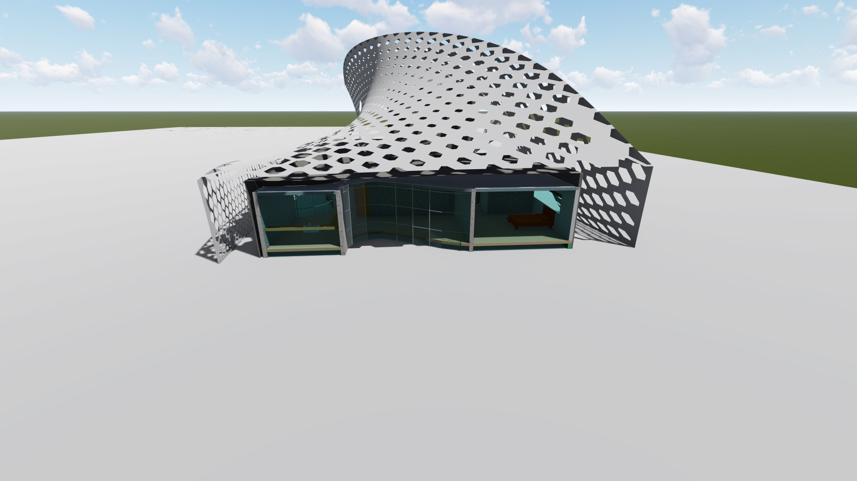
External and internal rendering photos

Slide 12
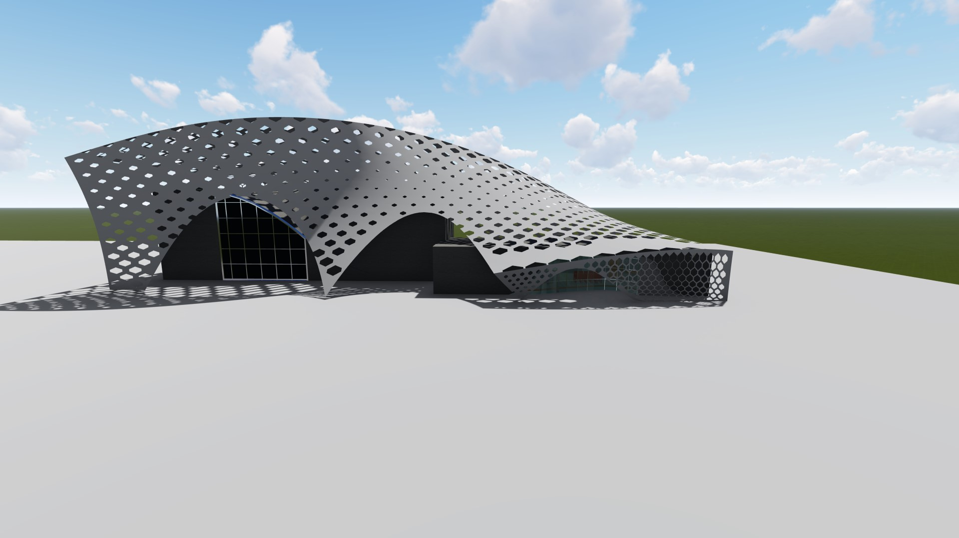
External and internal rendering photos

Slide 13
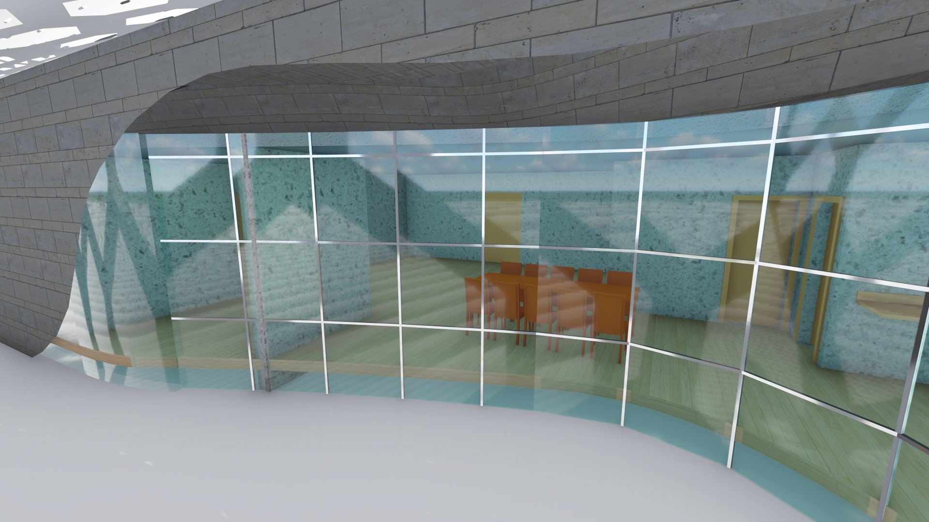
External and internal rendering photos

Slide 14
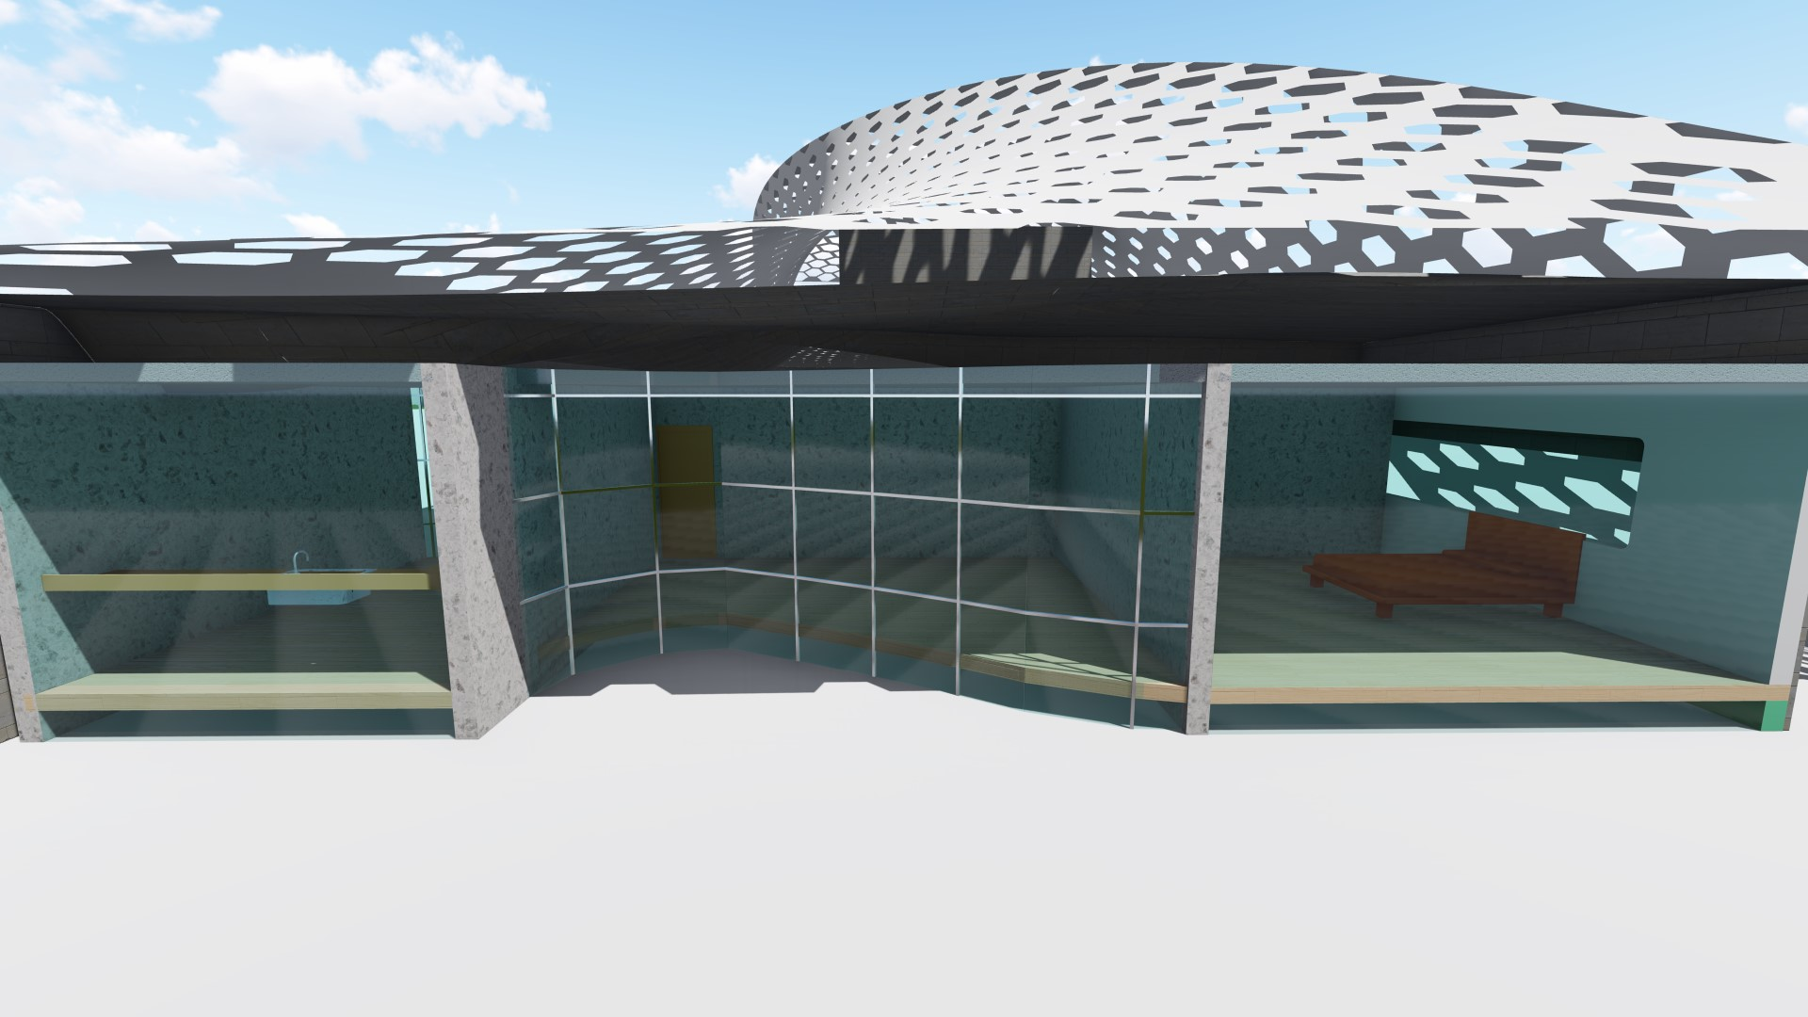
External and internal rendering photos

Slide 15
Thank you for watching ！ ！

