Slide 1
JPA introduction

Slide 2
Disclaimer
The opinions expressed in this presentation and on the following slides are solely those of the presenter and not necessarily those of Rusoft. Rusoft does not guarantee the accuracy or reliability of the information provided herein.

Slide 3
JSR 338
https://jcp.org/en/jsr/detail?id=338
570 pages

Slide 4
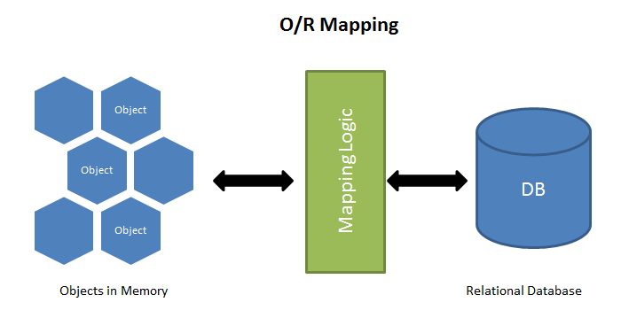
Object-relational problem
Granularity
Inheritance
Identity
Associations
Data navigation
http://hibernate.org/orm/what-is-an-orm/
Notes:
object models and relational models do not work very well together.
RDBMSs represent data in a tabular format,
object-oriented languages, represent it as an interconnected graph of objects. Loading and storing graphs of objects using a tabular relational database exposes us to 5 mismatch problems
Granularity - sometimes you will have an object model which has more classes than the number of corresponding tables in the database
Inheritance - Inheritance is a natural paradigm in object-oriented programming languages. However, RDBMSs do not define anything similar on the whole
Identity - A RDBMS defines exactly one notion of 'sameness': the primary key. Java, however, defines both object identity a==b and object equality a.equals(b)
Associations - Associations are represented as unidirectional references in Object Oriented languages whereas RDBMSs use the notion of foreign keys. If you need bidirectional relationships in Java, you must define the association twice.
Data navigation - The way you access data in Java is fundamentally different than the way you do it in a relational database. In Java, you navigate from one association to an other walking the object network. This is not an efficient way of retrieving data from a relational database. You typically want to minimize the number of SQL queries and thus load several entities via JOINs and select the targeted entities before you start walking the object network.

Slide 5
Java Support for Persistence
JDBC
First version released 1996
Latest release v4.2
Entity Beans
EJB 2.0
EJB Query Language
JDO
Inspired by Object-oriented databases (OODB)
JPA
First version released in Java EE 5
Latest version 2.1
Notes:
Java-specific version of the Object Database Connectivity (ODBC) specification.
JDBC allows Java programs to fully interact with the database. This interaction is heavily reliant on SQL. The irony of JDBC is that, although the programming interfaces are portable, the SQL language is not.
Entity Beans wants isolate Java code from SQL, but has large and complex XML vendor specific configs. A lot of overheads RMI and CORBA as remote interfaces.
EJB QL portable to any SQL dialect. It’s very complex.
Supported primarily by the object-oriented database (OODB) vendors and never really got adopted by the mainstream programming community. Solution related not-only relational databases. Ignores SQL at all.
Not supported by vendors. Query language very different than SQL.
JPA: Very simple, POJO centric, Optimized vendor specific SQL,

Slide 6
JPA implementations
EclipseLink
Hibernate
OpenJPA

Slide 7
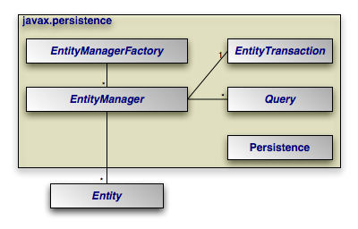
javax.persistence

Slide 8
Simple Entity
Demo # 1

Slide 9
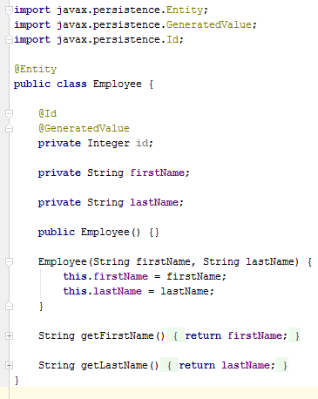
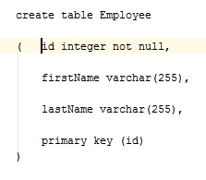
Simple Entity: Summary

Slide 10
Entity relationships
One to One
Employee has one Address
Address has one Employee
One to Many
Employee has many Phones
Many to One
Phone has only one Employee
Many to Many
Employee has many Projects
Project has many Employees

Slide 11
One to One relation
Demo # 2

Slide 12
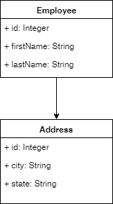
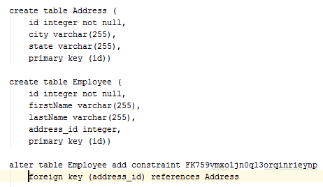
One to One relation: Summary
@OneToOne
mappedBy – field name of the source owner
@JoinColumn

Slide 13
One to Many relation
Demo # 3

Slide 14
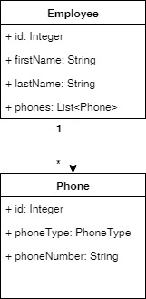
One to Many relation: Summary
Unidirectional
@OneToMany – for Employee
@JoinColumn
name – column name in target table
referencedColumnName – column name in source table
Bidirectional
Employee
@OneToMany with mappedBy attribute
Phone
@ManyToOne
@ JoinColumn

Slide 15
Many to Many relation
Demo # 4

Slide 16
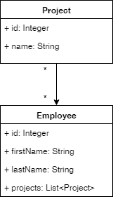
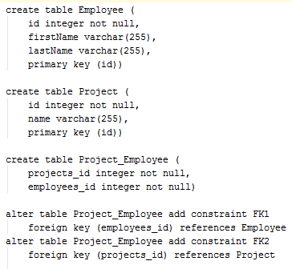
Many to Many relation: Summary
Project
@ManyToMany
@JoinTable
Employee
@ManyToMany with mappedBy attributeEmployee

Slide 17
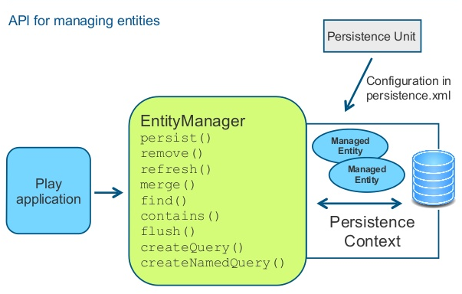
Entity Manager
Gateway to persistent classes
Enable queries
Provides transaction facility

Slide 18
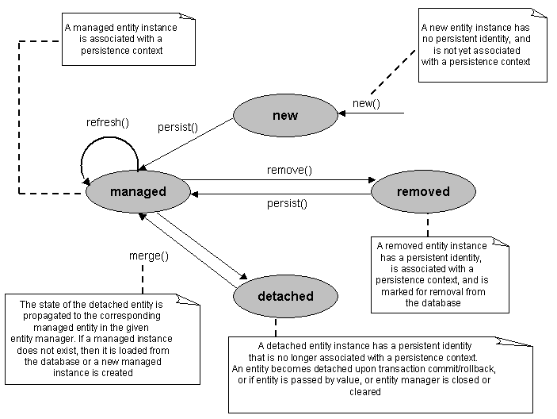
Entity Lifecycle Management

Slide 19
Entity Lifecycle Management
Demo # 5

Slide 20
Summary
Very big
Many subtlety
Read documentation
JPA is not Silver bullet

Slide 21


Slide 22


