Slide 1
Blockchain
Implications and Uses

Slide 2
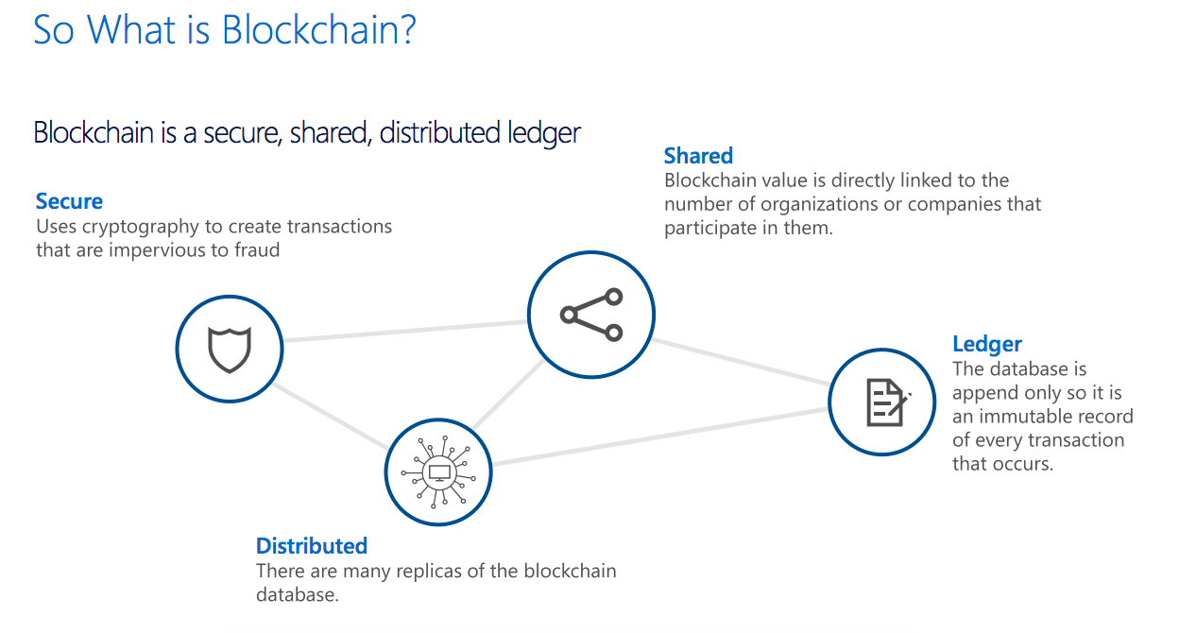
What is Blockchain?

Slide 3
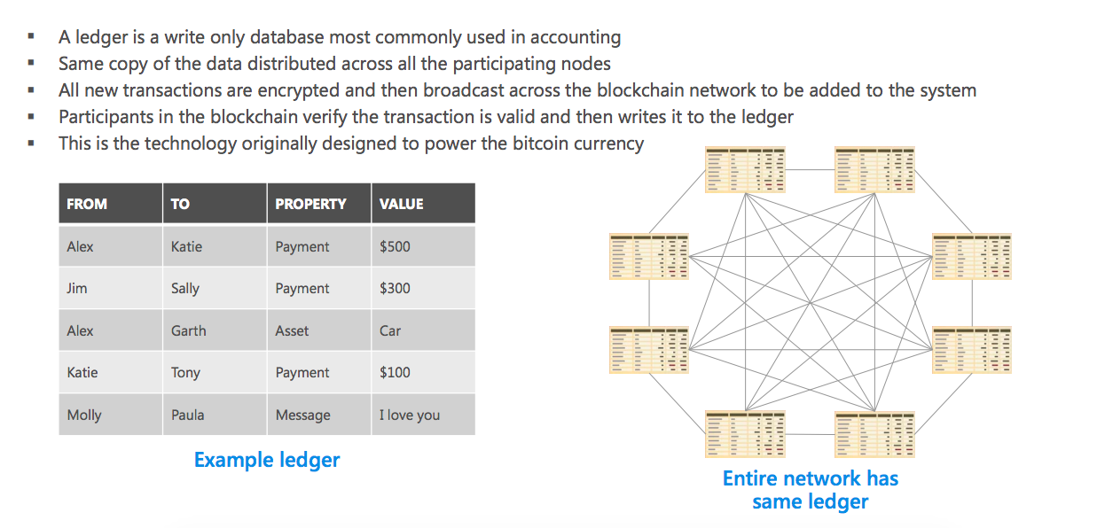
Blockchain uses a distributed ledger to track transactions

Slide 4
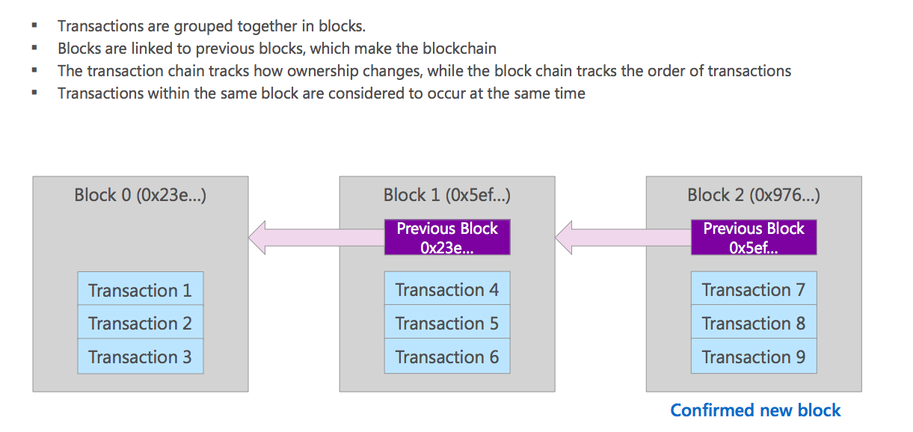
Transactions are connected within a chain of blocks

Slide 5
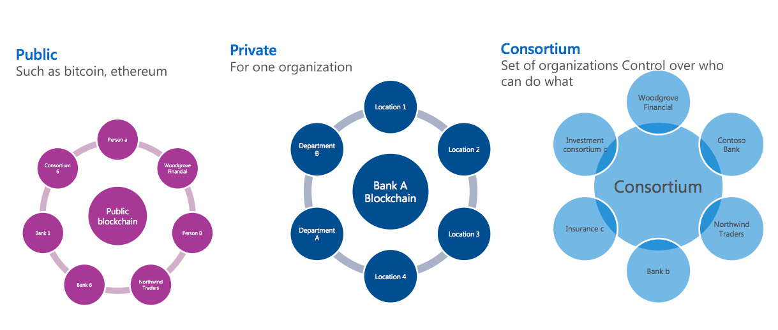
Types of blockchain networks

Slide 6
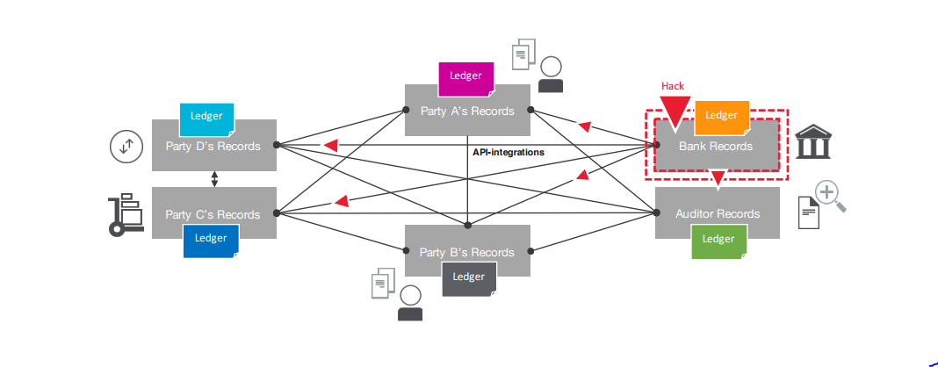
Information & Asset Exchange in business networks – Separate Ledgers
Inefficient, expensive, error sensitive and vulnerable

Slide 7
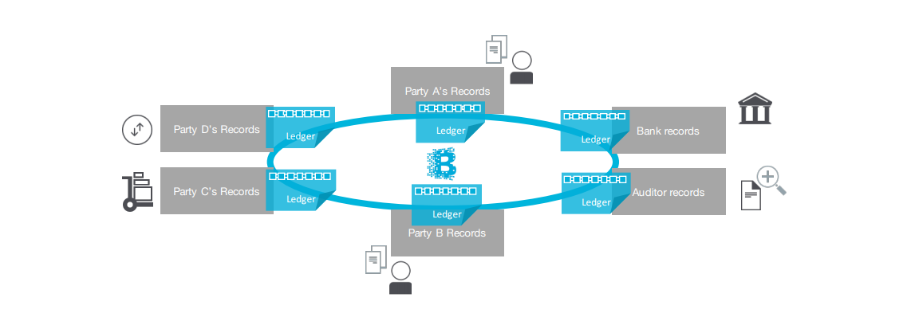
Information and Asset Exchange in Business Networks – Shared Ledger
Consistent, efficient, secure and resilient

Slide 8
4 key concepts
- Distributed Shared Ledgers
- Cryptography
- Consensus
- Smart Contracts

Slide 9
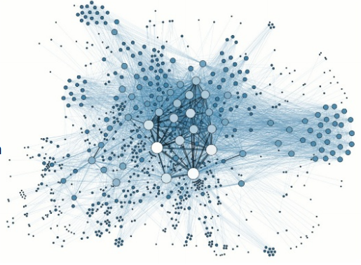
Distributed Shared Ledgers
- type of database that is shared, replicated, and synchronized among the members of a network
- every recorded transaction has a unique cryptographic signature and timestamp, thus making the ledger an auditable history of all transactions in the network
- A Node refers to a ‘full’ client - a client that owns the block chain and that is sharing blocks and transaction across the network – all nods hold all transactions

Slide 10
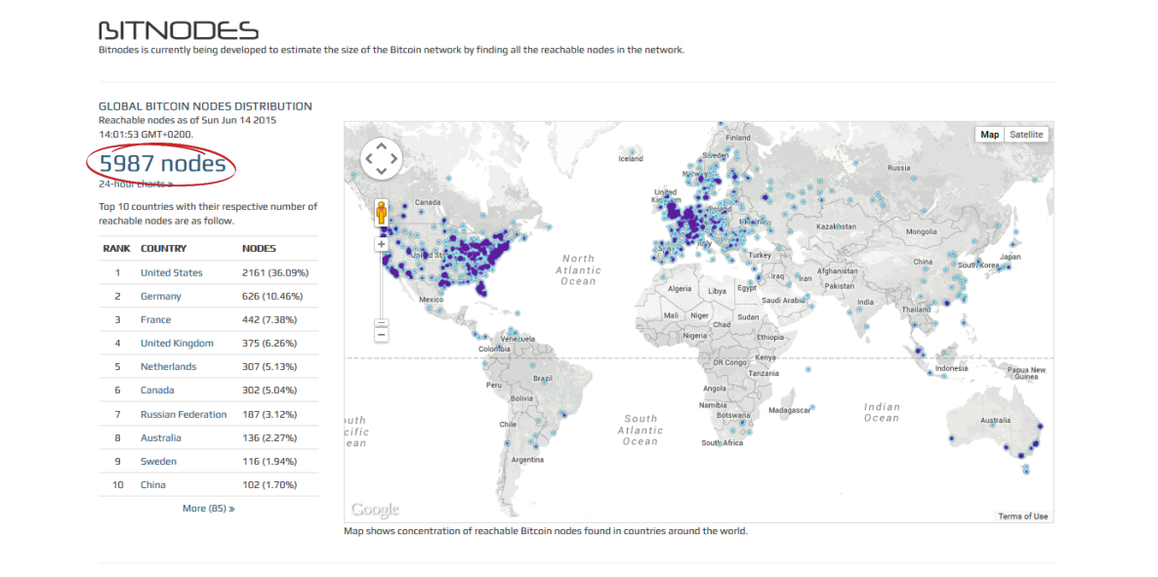

Slide 11


Slide 12
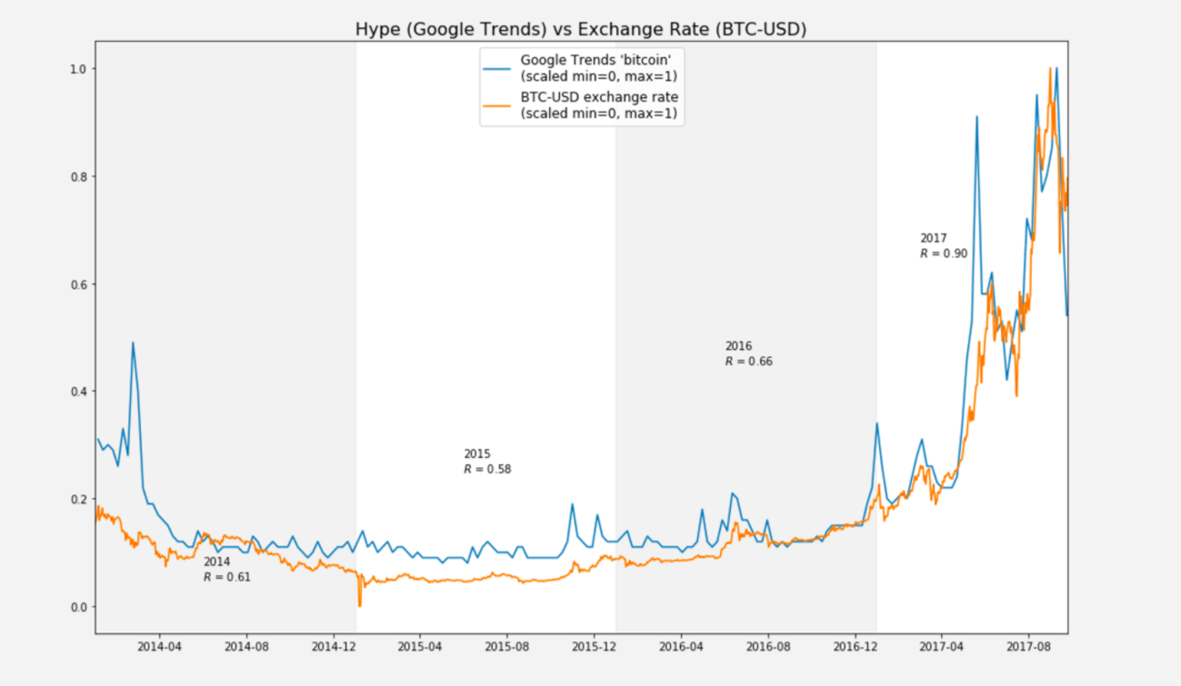

Slide 13
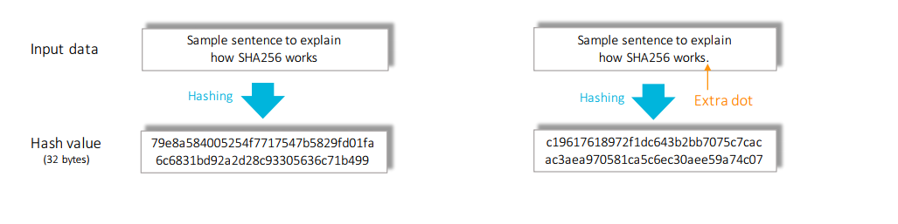
Cryptography
Hashes – Creation of a bit string representing integrity of content other string
Cryptographic hashes, such as the SHA256 computational algorithm, ensure that any alteration to transaction input — even the most minuscule change — results in a different hash value being computed, which indicates potentially compromised transaction input

Slide 14
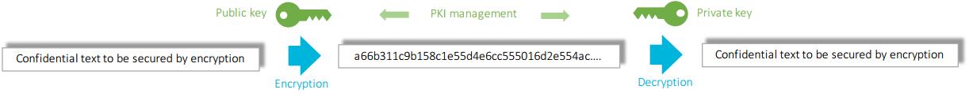
Cryptography
Keys and Wallets – A string encrypted with one key can only be decrypted with the other. One key needs to be kept private, the other one can be made publicly known so that it can be used by other parties to exchange data with you in a secure manner. Private keys need to be stored either on a personal device or remotely with a service provider (wallet) so that it is only accessible for the owner
Encryption – The scrambling of clear text with the public key of the recipient so that the holder of that private key is the only one that can descramble the message. This is used to guarantee the confidentiality of the data exchanged.

Slide 15
Cryptography
Digital signature – Encryption of hash representing of original data to be secured with the private key of the sender that is decrypted by the recipient with the public of the sender. If the decrypted hash matches the content of the original data it implies two things. First, the encryption can only be performed with the private key corresponding with public key and secondly, the original data can’t be tampered with.
Digital signatures ensure that transactions originated from senders (signed with private keys) and not imposters

Slide 16
Consensus
Consensus – majority of nodes agree on the validity of transactions
Consensus ensures that the shared ledgers are exact copies, and lowers the risk of fraudulent transactions, because tampering would have to occur across many places at exactly the same time

Slide 17
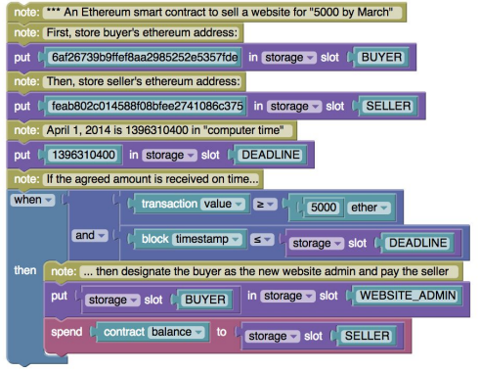
Smart Contracts
A business logic that can be assigned to a transaction on the blockchain
Acts as a notary of blockchain transactions
It holds conditions under which specified actions can/must be fulfilled
Cannot be modified without predefined permissions
When a triggering event occurs the contract executes itself

Slide 18
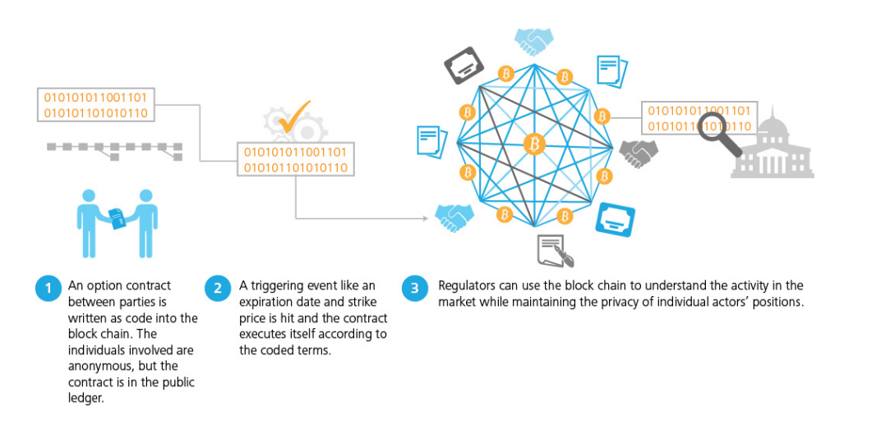
Smart Contracts

Slide 19
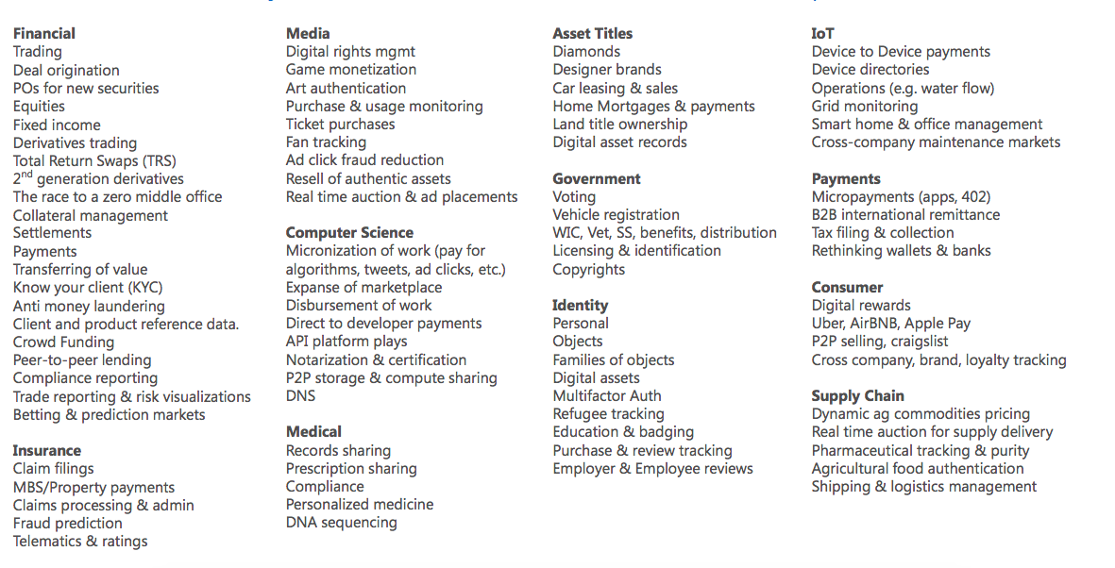
What is blockchain used for?

Slide 20
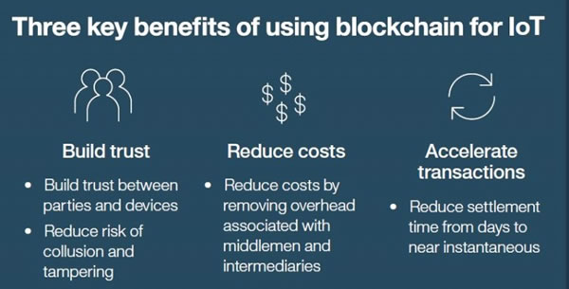
Blockchain Benefits

Slide 21
Any Questions?

