Slide 1
Offline Web Application

Slide 2
Problems of regular Web Applications
This project tackles two typical problems of web applications:
(1) they suffer a noticeable delay when fetching remote data, and
(2) are unavailable when no working internet connection is available.

Slide 3
Solution to Problem 1
Most modern browsers nowadays have the ability to store a full-featured database inside them, also known as Indexed Database, locally on a client’s computer.
We can copy the entire remote database inside our local one once the application has been loaded, and greatly diminish the time necessary to load the new data as there won’t be a need for remote AJAX calls.

Slide 4
Solution to problem 2
If we already have all the data stored locally in our browser, we can store the web application inside the browser’s cache and load it from there if we don’t have access to internet at the moment.

Slide 5
Fixing potential problems resulting from the solutions
In order to make sure that we always get the newest information and that all changes we make while offline are saved, the browser attempts to synchronize the local database with the remote one every time it has an internet connection.
Also the browser checks if the cached version of the app is also the latest one. If it’s not, then the browser caches the new version while getting rid of the old one.

Slide 6
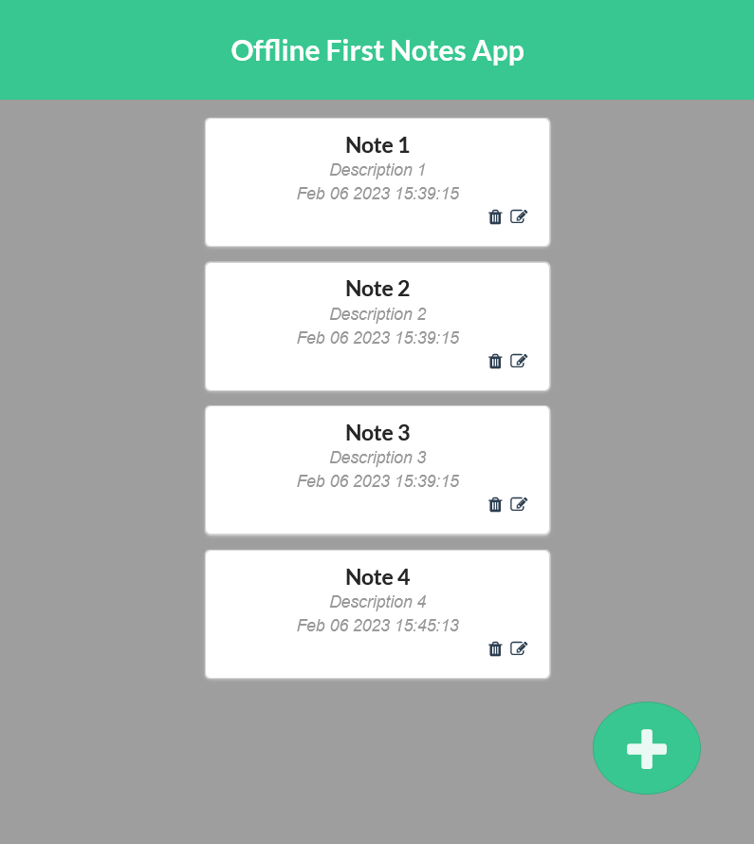
Example
Here’s an example of an offline web application.
It’s a Note App that allows user to create, read, edit and delete notes.
The notes are saved in a local database inside the browser.
Once the browser has internet access, the local database is then replicated to a remote database where all the notes are then saved.
This allows the notes to load instantly without waiting for them to be sent back from a remote server.

Slide 7
The application is divided into a couple of reusable components that makes the application easier to expand, such as: the header on top of the application, the list of notes, the notes themselves and the interface for creating new notes.

Slide 8
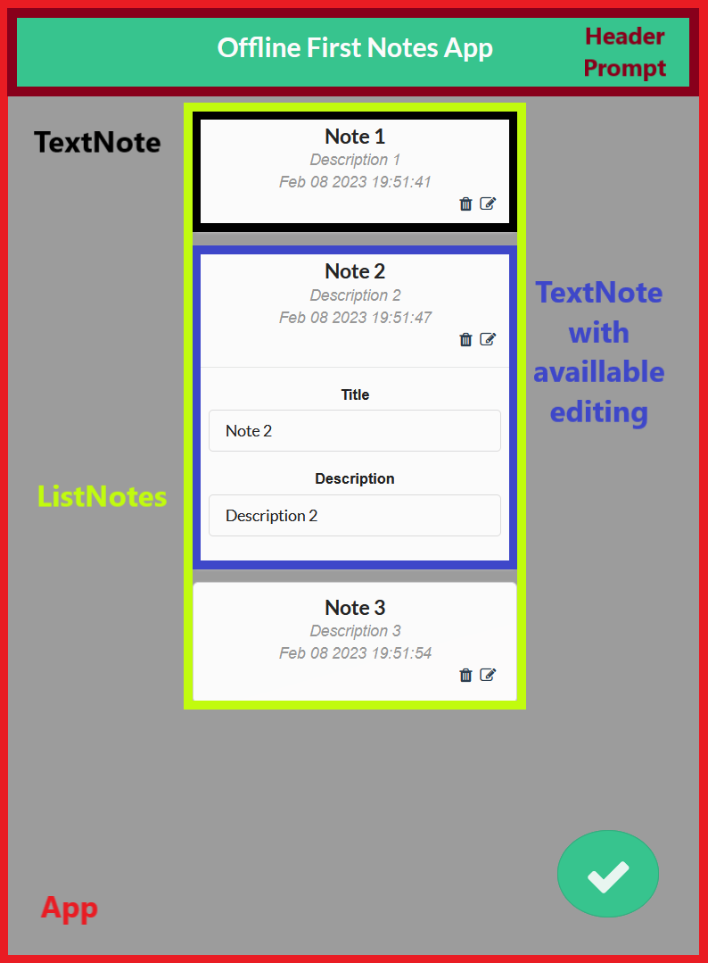
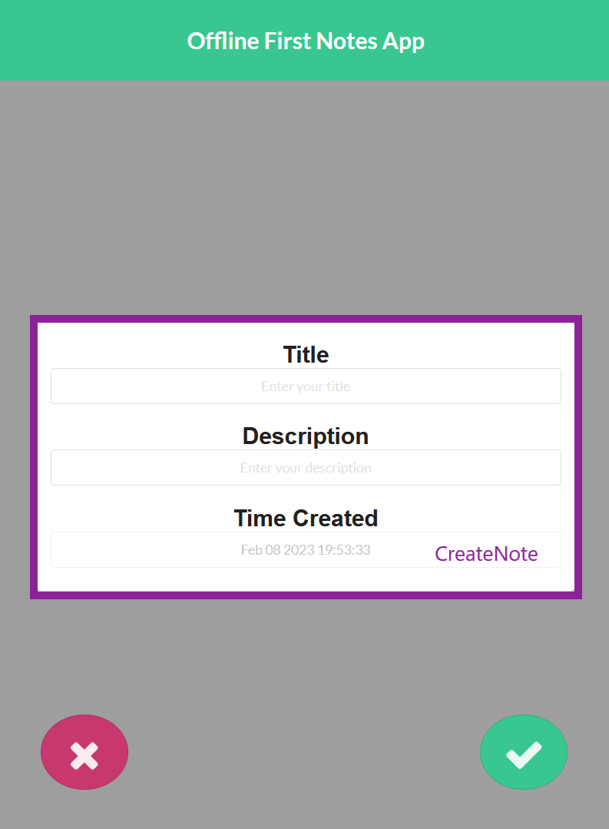
Application Components

Slide 9
Saving the data
All the notes are saved using PouchDB which is an open-source JavaScript indexed database inspired by Apache that is designed to run smoothly within the browser. If the device is connected to the internet, then the data is sent to a remote open source NoSQL document database called CouchDB developed by the same company as it allows seamless synchronization.

Slide 10
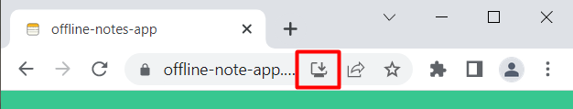
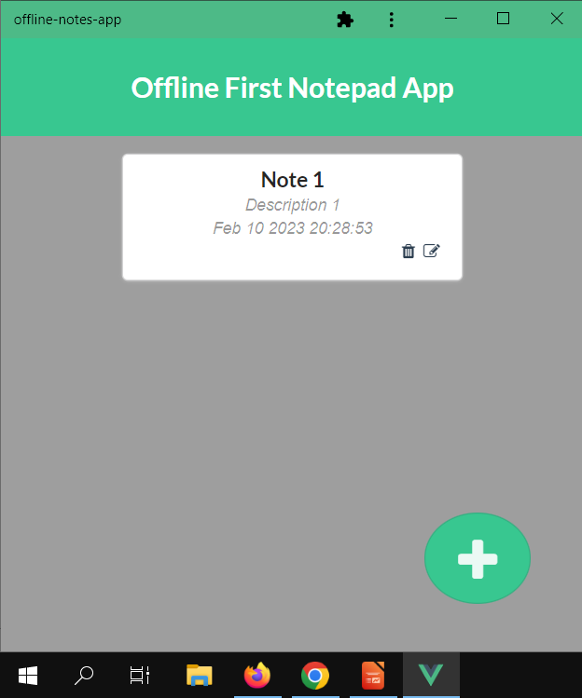
Hosting the App
The application can be found on Netlify where it can be accessed and used as a functional Notes Application by everyone.
Google Chrome allows us to download the web app as an actual application and use it as such.

