Slide 1
Server/cloud deploy

Slide 2
Что такое облако (cloud)?

Slide 3
Модели распространения ПО
On-Premise – модель, когда программы устанавливаются на оборудование клиента
То есть клиент покупает продукт, получает дистрибутив и сам развертывает на свой сервер
On-Cloud – модель, когда программы уже развёрнуты на удалённом сервере поставщика:
После покупки клиент получает не дистрибутив, а доступ к уже установленному решению, которое остаётся только настроить

Slide 4
Вроде прозрачно, но…
Куда отнести, например, сценарий
Я купил ПО и получил дистрибутив (on-premise), но развернул его в облаке Yandex Cloud (Azure, AWS, …)
Почему говорят про public и private (enterprise) cloud

Slide 5
Пойдем другим путем…

Slide 6
Классические модели хостинга
Shared Hosting
Dedicated Server
Virtual Private Server (VPS)
Virtual Dedicated Server (VDS)

Slide 7
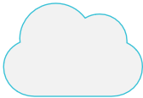
Облако
VPS on Steroids
On-demand self-service
Broad network access
Resource pooling
Rapid elasticity
Measured service
National Institute of Standards and Technology
Notes:
Самостоятельное конфигурирование сервисов по требованию (on demand self service) Универсальный сетевой доступ (broad network access) Объединение ресурсов в пул (resource pooling) Мгновенная эластичность (rapid elasticity) Измеримость сервиса (measured service)

Slide 8
«Базовые» модели обслуживания в cloud
Client
Vendor
On Premises
Infrastructure
(as a Service)
Platform
(as a Service)
Software
(as a Service)
Applications
Applications
Applications
Applications
Data
Data
Data
Data
Runtime
Runtime
Runtime
Runtime
Middleware
Middleware
Middleware
Middleware
O/S
O/S
O/S
O/S
Virtualization
Virtualization
Virtualization
Virtualization
Servers
Servers
Servers
Servers
Storage
Storage
Storage
Storage
Networking
Networking
Networking
Networking

Slide 9
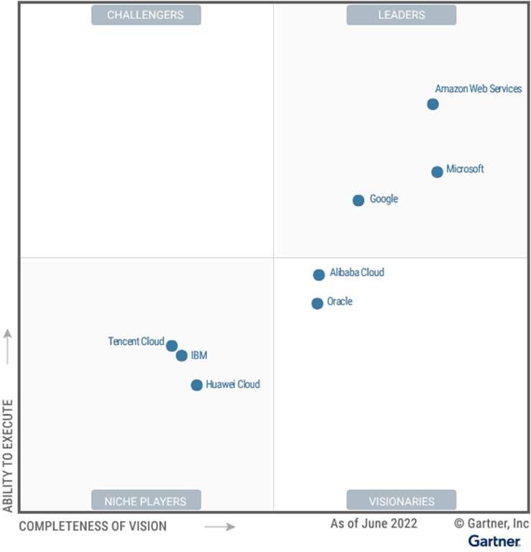
Cloud Infrastructure and Platform Services
Amazon Web Services
Microsoft
Google
Alibaba Cloud
Oracle
IBM
Huawei Cloud
Tencent Cloud
Notes:
The scope of the Magic Quadrant for CIPS includes infrastructure as a service (IaaS) and integrated platform as a service (PaaS) offerings. These include application PaaS (aPaaS), functions as a service (FaaS), database PaaS (dbPaaS), application developer PaaS (adPaaS) and industrialized distributed cloud offerings that are often deployed in enterprise data centers

Slide 10
Российские Cloud поставщики
Yandex.Cloud
SberCloud (CLOUD)
VK Cloud
Ростелеком
Selectel
…

Slide 11

Private/Public/Hybrid cloud

Slide 12



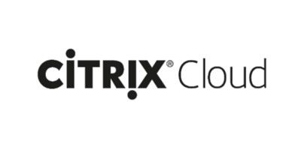

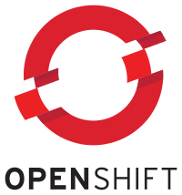


Cloud infrastructure Software (Iaas / PAAS)
Azure Stack

Slide 13
What Clouds change?

Slide 14
General points
Pricing
Architecture
Administration / Deploy

Slide 15
On-premises vs Cloud
Traditional on-premises
Modern cloud
Monolithic, centralized
Design for predictable scalability
Relational database
Strong consistency
Serial and synchronized processing
Design to avoid failures (MTBF)
Occasional big updates
Manual management
Snowflake servers
Decomposed, de-centralized
Design for elastic scale
Polyglot persistence (mix technologies)
Eventual consistency
Parallel and asynchronous processing
Design for failure (MTTR)
Frequent small updates
Automated self-management
Immutable infrastructure

Slide 16
Appropriate architecture styles
N-tier
Web-Queue-Worker
Microservices
CQRS
Event-Driven Architecture

Slide 17
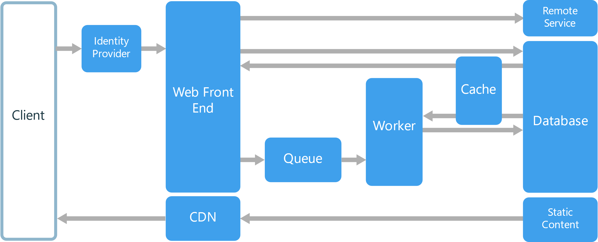
N-tier + Web-Queue-Worker

Slide 18
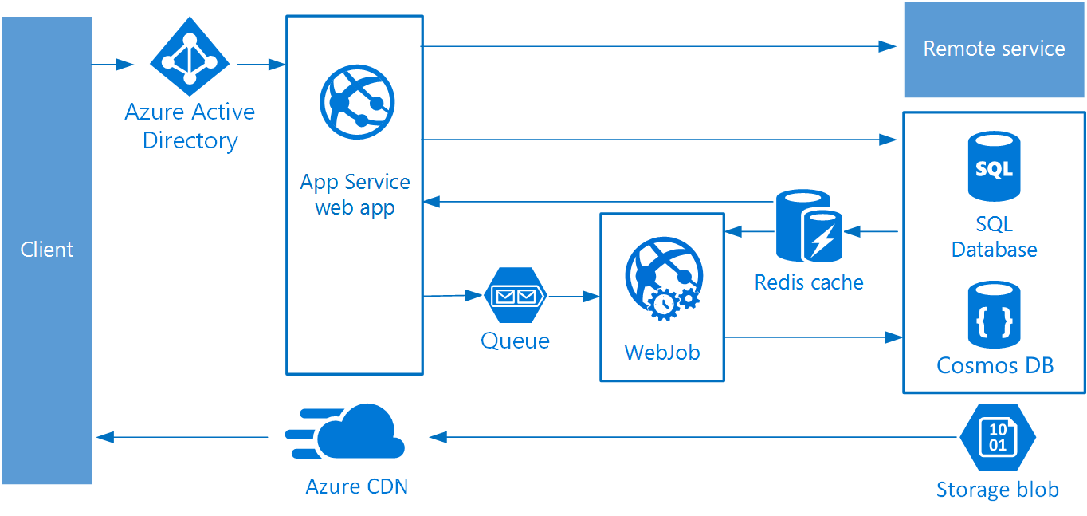
N-tier + Web-Queue-Worker

Slide 19
Pricing / Deploy
Pay-As-You-Go
DevOps

Slide 20
Infrastructure as Code

Slide 21
IaC and CCA
Infrastructure as code (IaC) is the process of managing and provisioning computer data centers through machine-readable definition files, rather than physical hardware configuration or interactive configuration tools.
Wikipedia
Ответственность
IaC – описание инфраструктуры
cеть, VMs, роутеры, БД, очереди сообщений, …
CCA – описание настройки
софт, настройки ОС, ресурсы (сертификаты, базы, …)
«как код»
хранение в VCS
версионность
тестирование
Continuous configuration automation (CCA) is the methodology or process of automating the deployment and configuration of settings and software for both physical and virtual data center equipment.
Wikipedia

Slide 22

Общая схема работы
IaC контроллер
Репозиторий
описаний

Slide 23
Представители
Tool | IaC/CCA | Method | Approach | Written in
Chef | IaC/CCA | Pull | Imperative | Ruby
Otter | IaC/CCA | Push | Declarative and imperative | -
Puppet | IaC/CCA | Push and Pull | Declarative | C++ & Clojure since 4.0, Ruby
SaltStack | IaC/CCA | Push and Pull | Declarative and imperative | Python
CFEngine | IaC/CCA | Pull | Declarative | C
Terraform | IaC/CCA | Push | Declarative | Go
Ansible / Ansible Tower | IaC/CCA | Push | Declarative and imperative | Python
Azure Resource Manager | IaC | Push | Declarative | .Net (?)
AWS CloudFormation | IaC | Push | Declarative | -
Desired State Configuration (DSC) | CCA | Push and Pull | Declarative and imperative | PowerShell
cloud-init | CCA | Pull | Declarative | Python

Slide 24
Azure RM
"$schema": "https://schema.management.azure.com/schemas/2015-01-01/deploymentTemplate.json#", "contentVersion": "1.0.0.0", "parameters": { "WebApplication1PackageFileName": { "type": "string", "minLength": 1, "metadata": { "description": "Name of the webdeploy package" }, "defaultValue": "package.zip" }, "siteName": { "type": "string", "defaultValue": "MentoringTestApp" } }, "resources": [ { "name": "[concat(parameters('siteName'), '/', 'MSDeploy')]", "type": "Microsoft.Web/sites/extensions", "location": "northeurope", "apiVersion": "2015-08-01", "dependsOn": [], "tags": { "displayName": "WebApplication1" }, "properties": { "packageUri": "[concat(parameters('_artifactsLocation’),
'/', parameters('WebApplication1PackageFolder'), '/', parameters('WebApplication1PackageFileName’),
parameters('_artifactsLocationSasToken'))]", "dbType": "None", "connectionString": "", "setParameters": { "IIS Web Application Name": "[parameters('siteName')]" } } } ], "outputs": {}

Slide 25
DSC
Configuration LinuxConfig
{
Import-DscResource -ModuleName 'nx'
Node IsPresent
{
nxPackage apache2
{
Name = 'apache2'
Ensure = 'Present'
PackageManager = 'Apt'
}
}
Node IsNotPresent
{
nxPackage apache2
{
Name = 'apache2'
Ensure = 'Absent'
}
}
}

Slide 26
Containers

Slide 27
Модели обслуживания в cloud
Client
Vendor
On Premises
Infrastructure
(as a Service)
Container
(as a Service)
Platform
(as a Service)
Function
(as a Service)
Software
(as a Service)
Applications
Applications
Applications
Applications
Applications
Applications
Data
Data
Data
Data
Data
Data
Runtime
Runtime
Runtime
Runtime
Runtime
Runtime
Middleware
Middleware
Middleware
Middleware
Middleware
Middleware
O/S
O/S
O/S
O/S
O/S
O/S
Virtualization
Virtualization
Virtualization
Virtualization
Virtualization
Virtualization
Servers
Servers
Servers
Servers
Servers
Servers
Storage
Storage
Storage
Storage
Storage
Storage
Networking
Networking
Networking
Networking
Networking
Networking

Slide 28
VMs vs Containers

Slide 29
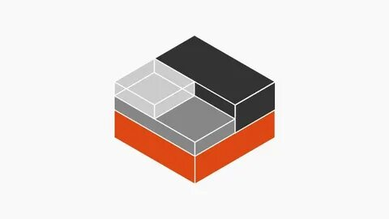
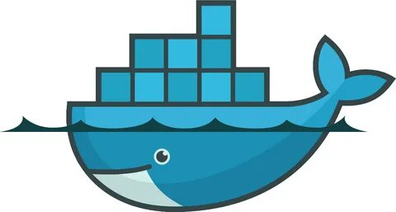
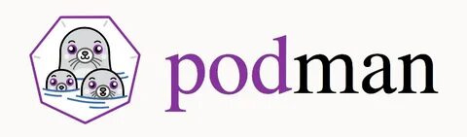
Реализации (Container engine)
Docker
Linux Containers (LXC)
Podman

Slide 30
Изоляция (уникальность ресурсов)
Пространства имен:
файловая система (mount, mnt)
идентификатор процессов (process identifier, pid)
сеть (network, net)
межпроцессное взаимодействие (ipc)
пользовательские идентификаторы (user)

Slide 31
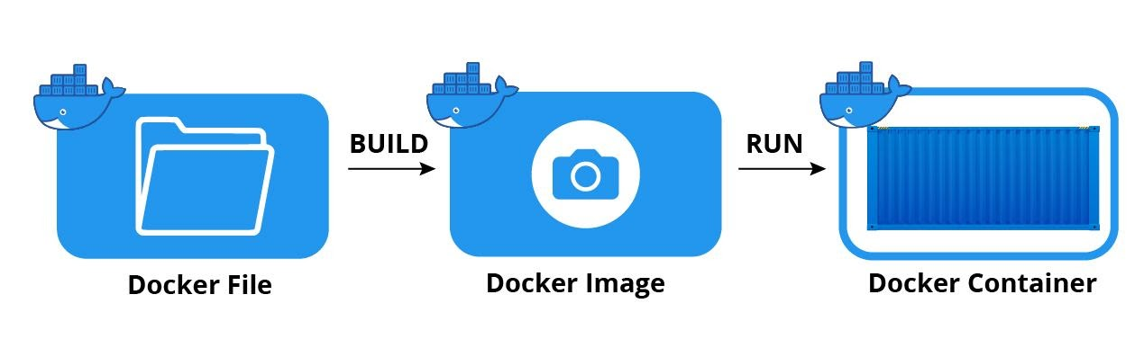
Основные понятия

Slide 32
Dockerfile sample
FROM mcr.microsoft.com/dotnet/core/sdk:2.1 AS build-env
WORKDIR /app
COPY *.csproj ./
RUN dotnet restore
COPY . ./
RUN dotnet publish -c Release -o out
FROM mcr.microsoft.com/dotnet/core/aspnet:2.1
WORKDIR /app
COPY --from=build-env /app/out .
ENTRYPOINT ["dotnet", "asp-net-getting-started.dll"]

Slide 33
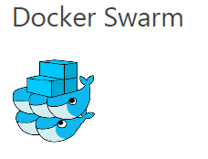
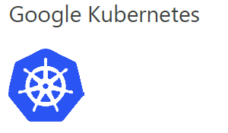
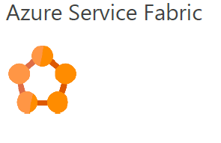
Container Orchestration
Scheduling
Affinity/Anti-affinity
Health monitoring
Failover
Scaling
Networking
Service discovery
Upgrades
Notes:
Scheduling: When given a container image and a resource request, the orchestrator finds a suitable machine on which to run the container.
Affinity/Anti-affinity: Specify whether a set of containers should run near each other for performance or far apart for availability.
Health monitoring: Watch for container failures and automatically reschedule them.
Failover: Keep track of what's running on each machine and reschedule containers from failed machines to healthy nodes.
Scaling: Add or remove container instances to match demand, manually or automatically.
Networking: Provide an overlay network that coordinates containers to communicate across multiple host machines.
Service discovery: Enable containers to locate each other automatically even as they move between host machines and change IP addresses.
Coordinated application upgrades: Manage container upgrades to avoid application down time and enable rollback if something goes wrong

