Slide 1
NuGet

Slide 2
Введение в NuGet

Slide 3
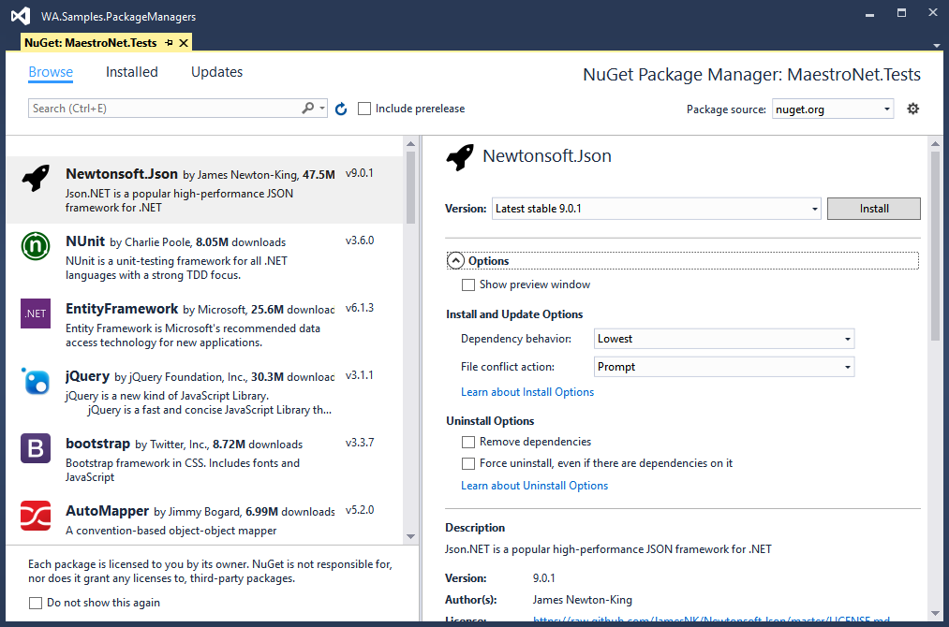
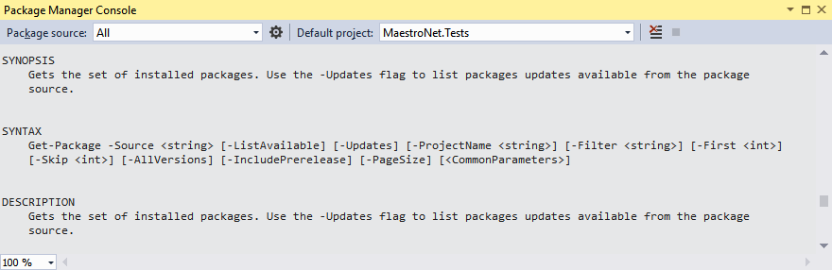
Nuget interfaces
Visual Studio UI
Package Manager Console
NuGet CLI (nuget.exe)
Dotnet (.Net Core)
add/list/remove
pack
nuget

Slide 4
Использование NuGet

Slide 5
Конфигурация
NuGet.Config
Уровень | Место
Solution | Любая папка на диске, выше по дереву, чем текущая. Чаще всего – папка солюшена
User | Профиль пользователя: %appdata%\NuGet\NuGet.Config
Computer | Папка «Program Files» %ProgramFiles(x86)%\NuGet\Config
Common NuGet configurations

Slide 6
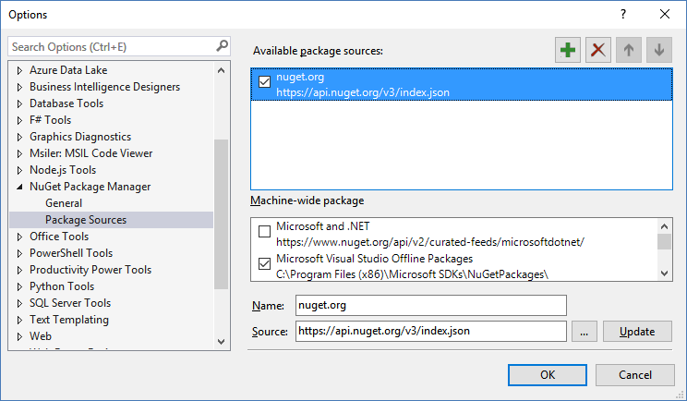
Package sources
nuget sources
dotnet nuget list source
nuget sources add
-Name "Local 2" -Source "c:\Temp"
dotnet nuget add source
-n "Local 2" c:\Temp
nuget sources remove -Name "Local 2"
dotnet nuget remove source "Local 2"
<configuration>
<packageSources>
<add key="nuget.org" value="https://api.nuget.org/v3/index.json" />
<add key="Local" value="D:\_NuGet" />
<add key="https://www.nuget.org/api/v2/" value="https://www.nuget.org/api/v2/" />
</packageSources>
<disabledPackageSources>
<add key="https://www.nuget.org/api/v2/" value="true" />
</disabledPackageSources>
</configuration>
NuGet.Config

Slide 7
Ссылки на пакеты из проектов
Non PackageReference-style проект
PackageReference-style проект
packages.config
Project file
<ItemGroup> <!-- ... --> <PackageReference Include="Newtonsoft.Json"> <Version>6.0.8</Version> </PackageReference> <!-- ... --> </ItemGroup>
<?xml version="1.0" encoding="utf-8"?> <packages> <package id="Newtonsoft.Json" version="6.0.8"
targetFramework="net45" /> </packages>

Slide 8
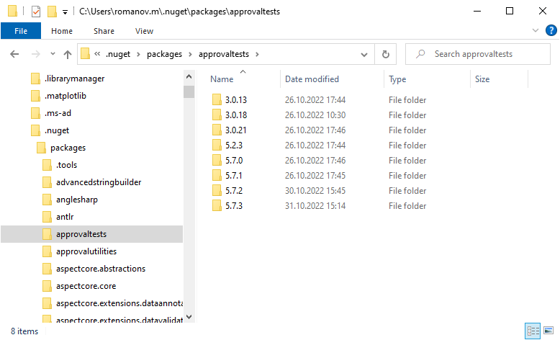
NuGet Cache
nuget locals all –list
dotnet nuget locals all -l
nuget locals global-packages –clear
dotnet nuget locals global-packages -c
В проекте
Non PackageReference-style проект
\<папка solution>\packages
PackageReference-style проект
напрямую из кэша

Slide 9
Собственные NuGet packages

Slide 10
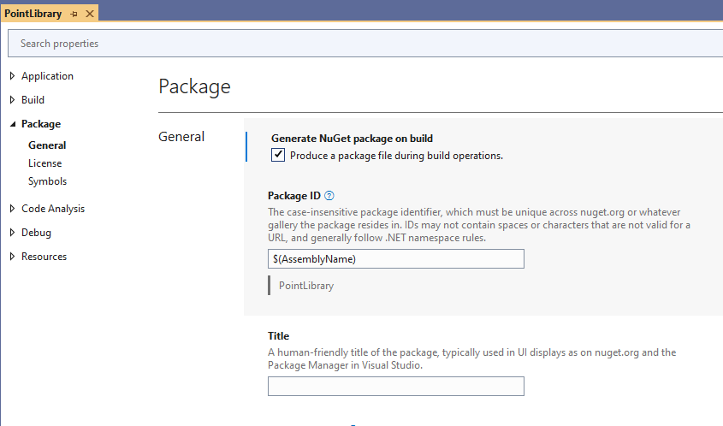
Варианты создания
nuget CLI (legacy)
dotnet CLI
MSBuild
в процессе сборки
Create packages

Slide 11
Создание NuGet пакета при сборке
<Project Sdk="Microsoft.NET.Sdk">
<PropertyGroup>
<TargetFramework>netstandard2.1</TargetFramework>
<Nullable>enable</Nullable>
<GeneratePackageOnBuild>True</GeneratePackageOnBuild>
</PropertyGroup>
</Project>

Slide 12
Simple NuGet package
Notes:
Simple NuGet package

Slide 13
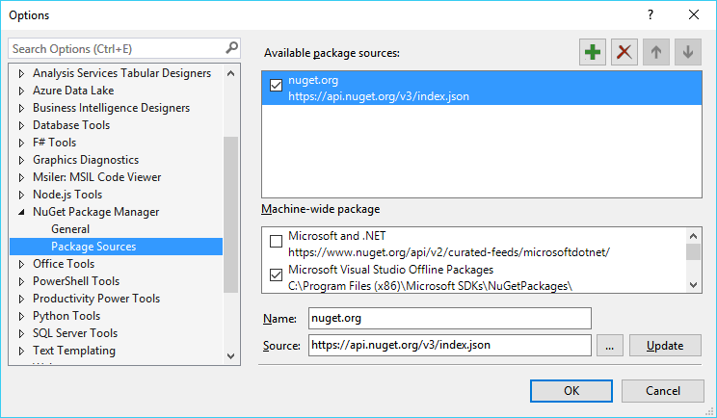
Хостинг NuGet feed
http://www.nuget.org
File System
NuGet.Server или BaGet
Third-party (SaaS)
MyGet (NuGet-as-a-Service)
GitHub Packages
Package Management from VS Team Services and TFS
Hosting Your Own NuGet Feeds

Slide 14
Локальная папка

Slide 15
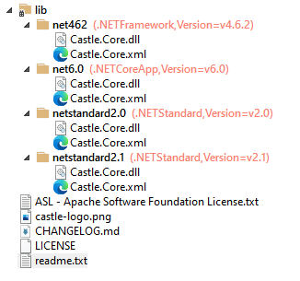
Nuget Package
Open Packaging Conventions
Zip-архив, содержащий
Папки
.\lib
.\content
.\build
.\tools
*.nuspec файл:
Метаданные (название, автор, …)
Зависимости от других пакетов
…
NuGet Package Explorer

Slide 16
<package xmlns="http://schemas.microsoft.com/packaging/2013/05/nuspec.xsd">
<metadata>
<id>Castle.Core</id>
<version>5.1.0</version>
<authors>Castle Project Contributors</authors>
<license type="expression">Apache-2.0</license>
<licenseUrl>https://licenses.nuget.org/Apache-2.0</licenseUrl>
<icon>castle-logo.png</icon>
<projectUrl>http://www.castleproject.org/</projectUrl>
<iconUrl>http://www.castleproject.org/img/castle-logo.png</iconUrl>
<description>Castle Core, including DynamicProxy, Logging Abstractions and DictionaryAdapter</description>
<copyright>Copyright (c) 2004-2022 Castle Project - http://www.castleproject.org/</copyright>
<tags>castle dynamicproxy dynamic proxy dynamicproxy2 dictionaryadapter emailsender</tags>
<repository type="git" url="https://github.com/castleproject/Core" />
<dependencies>
<group targetFramework=".NETFramework4.6.2" />
<group targetFramework="net6.0">
<dependency id="System.Diagnostics.EventLog" version="6.0.0" exclude="Build,Analyzers" />
</group>
<group targetFramework=".NETStandard2.0">
<dependency id="System.Diagnostics.EventLog" version="4.7.0" exclude="Build,Analyzers" />
<dependency id="System.Reflection.Emit" version="4.7.0" exclude="Build,Analyzers" />
</group>
<group targetFramework=".NETStandard2.1">
<dependency id="System.Diagnostics.EventLog" version="4.7.0" exclude="Build,Analyzers" />
</group>
</dependencies>
<frameworkAssemblies>
<frameworkAssembly assemblyName="System.Configuration" targetFramework=".NETFramework4.6.2" />
</frameworkAssemblies>
</metadata>
</package>
.nuspec Reference
Schema (XSD)

Slide 17
Package properties
<PropertyGroup>
<GeneratePackageOnBuild>True</GeneratePackageOnBuild>
<PackageId>Wintellect.PowerCollections</PackageId>
<Title>Wintellect.PowerCollections</Title>
<Company>Wintellect</Company>
<Product>Power Collections</Product>
<Description>The Power Collections group of collection classes</Description>
<Copyright>Copyright (c) 2004-2007, Wintellect</Copyright>
</PropertyGroup>
Set properties

Slide 18
Package Versioning
Release version: Major.Minor.Patch
Prerelease version: Major.Minor.Patch–Some
1.0.1-alpha
1.0.1-beta
1.0.1-rc2
1.0.1
Package versioning

Slide 19
Зависимости (References)
Источник
Зависимости проекта для NuGet пакета
Применяется
Как неявные зависимости в проекте, подключающем пакет
Version range | Description
1.0 | 1.0 ≤ x
(1.0, 2.0] | 1.0 < x ≤ 2.0
empty | latest version
[1.0] | x == 1.0
(,1.0) | x < 1.0
(1.0,) | 1.0 < x
Select Assemblies Referenced By Projects
Dependency Versions
How NuGet resolves package dependencies

Slide 20
.\lib folder
\lib
\net11
\MyAssembly.dll
\net20
\MyAssembly.dll
\net40
\MyAssembly.dll
\sl40
\MyAssembly.dll
Источник
Assembly – результаты сборки
Поддерживается множество target (для разных framework)
Применяется
Как явные references в проекте

Slide 21
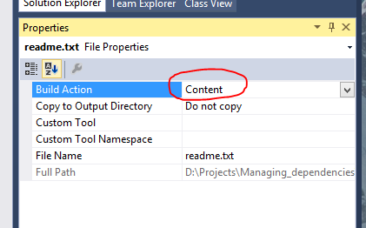
.\content folder
Источник
project items с указанным
Build Action == Content
Применяется
content files в проекте

Slide 22
Add framework references and content files
Notes:
Add framework references and content files
Sample1
Add System.Net.Http
Add Read Me files (as content)

