Slide 1

Cross-platform GUI (desktop) in .Net
Mihail Romanov

Slide 2

Mihail romanov
Senior .Net developer in SKB-Kontur
About 15 years in IT
Developer, trainer, system analyst, …
Now
.Net developer in SKB-Kontur
Speaker (as a hobby)

Slide 3
Cross-platform
desktop
Why?
in .Net

Slide 4
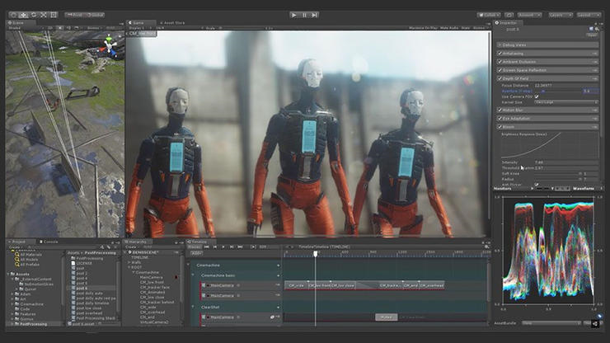
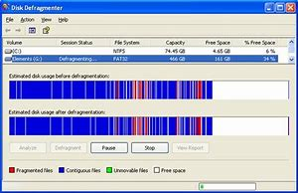
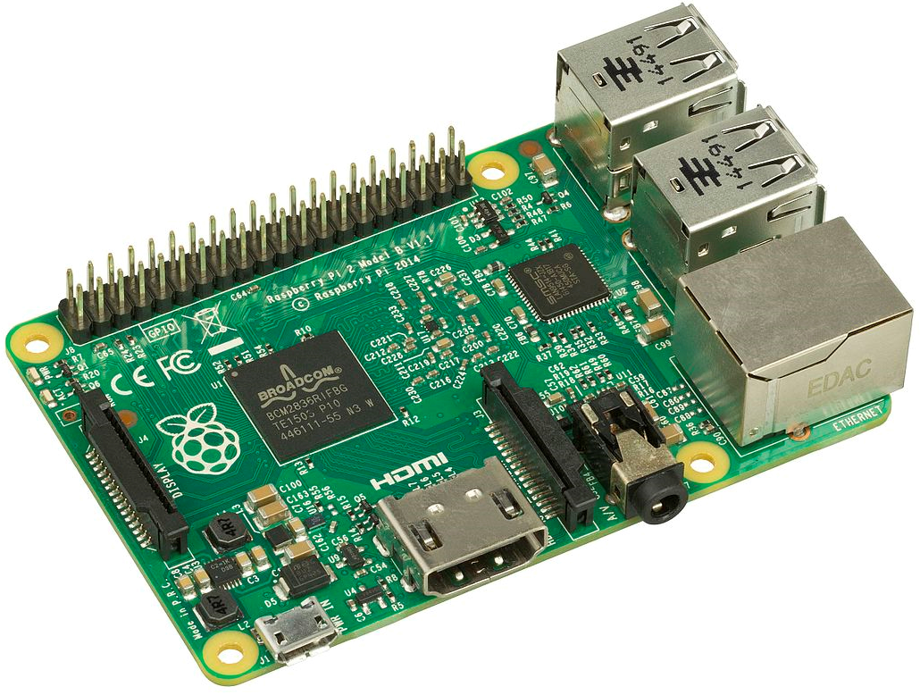
Why desktop?
Intensive graphics
Low level (OS) specific
Hardware
Customer requirements
Notes:
Intensive graphics (games, CADs, …)
Low level (OS) specific: antiviruses, system tools, …
Work with hardware: tokens, IoT development, …
Customer requirements

Slide 5


Why .Net Desktop?
Legacy
Available code
.Net-only library/API
.Net team

Slide 6
BUT… .Net Core 3

Slide 7
.Net Core 3 AND Desktop
Windows Forms
WPF
Presentation Framework
Windows Forms
Presentation Core
User32 + GDI/GDI+
DirectWriteForwarder.dll
gdi32.dll
Shell32.dll
…
User32 + Direct3D
User32.dll
AdvApi32.dll
…
Comdlg32.dll
ComCtl32.dll
d3d9.dll
d3d11.dll
Notes:
.Net Core 3 – WPF / WinForms

Slide 8
What alternatives???

Slide 9



Types of GUI libs
Wrapper (binding) for cross-platform lib
«Pure» .Net lib
HTML/CSS-based render
.Net lib
.Net binding
.Net lib
API calls
GTK/QT/…
Graphical
primitives
HTML / CSS
Direct2D
Cairo
Skia
HTML / CSS engine
Notes:
Wrapper (binding) to cross platform lib (GTK+, Qt, …)
Pure .Net lib (Avalonia, Eto.Forms, …)
HTML/CSS-based render (CEF, Electron, Sciter, …)

Slide 10
GUI libs (By types)
Wrapper (binding) for cross platform lib
«Pure» .Net lib
HTML/CSS-based render
GTK#
QtSharp
Avalonia
Eto.Forms
CEF
Electron.Net
SciterSharp
Notes:
Wrapper (binding) to cross platform lib (GTK+, Qt, …)
Pure .Net lib (Avalonia, Eto.Forms, …)
HTML/CSS-based render (CEF, Electron, Sciter, …)

Slide 11
bindings to cross platform libs

Slide 12





Popular Cross-platform GUI libraries
Library |  | Language | .Net wrappers
 | GTK / GTK+ | C | Gtk#, GtkSharp
 | Qt | C++ | QtSharp, QmlNet
 | wxWidgets | C++ | -
 | Swing | Java | -
 | SWT | Java | -
Notes:
GTK+
Qt
wxWidgets
Swing
SWT

Slide 13
GTK

Slide 14
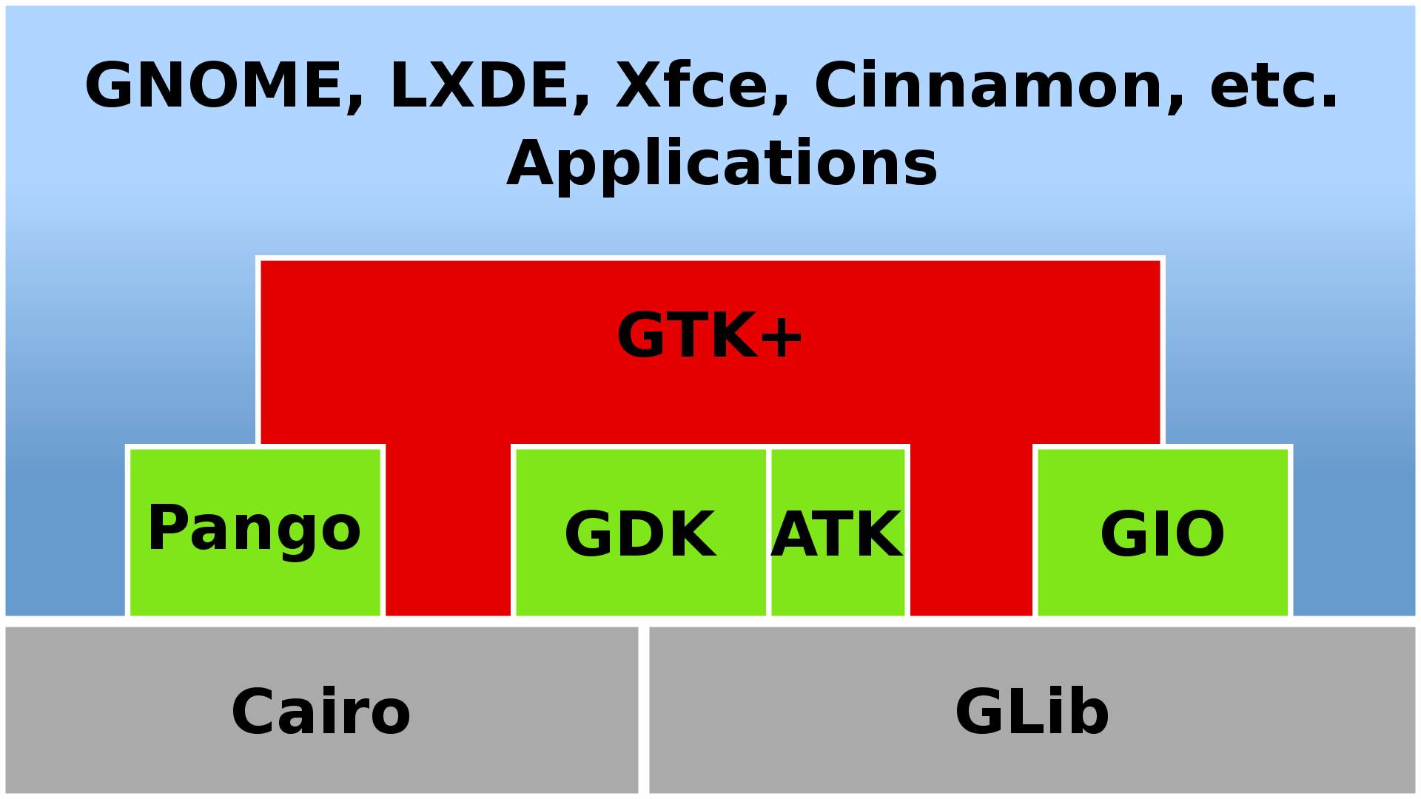
Architecture
UI / Controls
Accessible
Windowing
Cross-platform IO
Text & Fonts
OOP for C
Rendering
Notes:
Initial release: April 14, 1998
GIMP Toolkit (https://www.gtk.org/)
GTK+ — Widget toolkit for graphical interfaces
GDK — Low-level abstraction for the windowing system
Cairo — 2D, vector-based drawing for high-quality graphics
Pango — International text rendering with full Unicode support
Clutter — Animations and scene graph
WebKit — HTML5 web page rendering
ATK — Accessibility toolkit to implement support for screen readers and other tools
GIO Files — File and URI handling, asynchronous file operations, volume handling
GLib — Data structures and utilities for C programs
GObject — C-based object and type system with signals and slots

Slide 15




GTK Language Bindings (~20)
FreeBASIC
GTK+tobac
gotk3
go-gtk
Ruby/GTK3

Slide 16
GTK for .Net
Gtk#
GtkSharp
https://github.com/mono/gtk-sharp
https://github.com/GtkSharp/GtkSharp
 | Target framework | Target Gtk Version
Gtk# | .NET Framework 4.5, Mono | Gtk 2 (also Gtk 3.0 but never officially released)
GtkSharp | .NET Standard 2.0 | Gtk 3.22

Slide 17
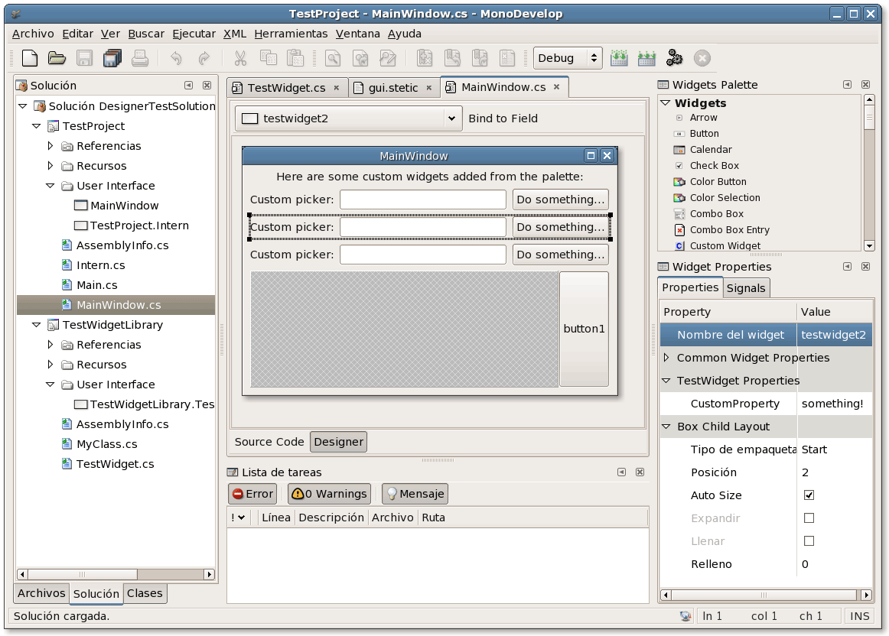
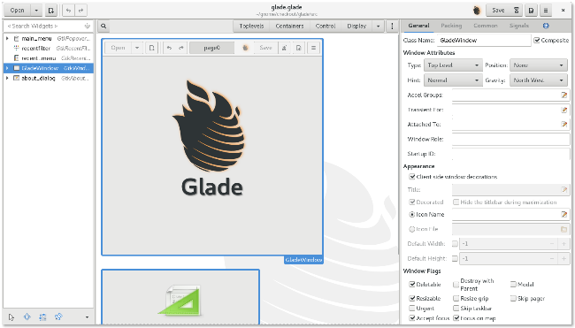
Development
Code
GUI Designer
// Setup GUI WindowPosition = WindowPosition.Center; DefaultSize = new Gdk.Size(800, 600); _headerBar = new HeaderBar(); _headerBar.ShowCloseButton = true; _headerBar.Title = "GtkSharp Sample Application"; var btnClickMe = new Button(); btnClickMe.AlwaysShowImage = true; btnClickMe.Image = Image.NewFromIconName(
"document-new-symbolic", IconSize.Button); _headerBar.PackStart(btnClickMe); Titlebar = _headerBar;
Stetic GUI Designer
(Mono Develop)
Glade
Notes:
Code
Glade

Slide 18
Demo

Slide 20
GTK# Pros & Cons
Pros
Cons
Wide platform support
Large GTK community
Many products (e.g. Linux DE: Gnome, Xfce, …) based on GTK
Small “out-of-box” control set
No Date picker, data table, …
C/C++ for control customization
No third party libraries

Slide 21
«PURE» .Net libs

Slide 22


.Net GUI Cross platform Libs
Library |  | Render(s) | Target Frameworks
 | Avalonia UI | Own (Direct2D, Skia, Cairo) | .Net Framework, .Net Core
 | Eto.Forms | WPF, WinForms, GTK | .Net Framework, .Net Core, Mono

Slide 23
Eto.Forms

Slide 24
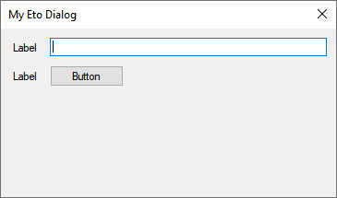
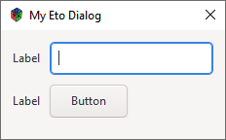
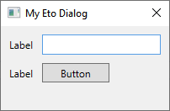
Architecture
Eto.Forms (UI),
Eto.Drawing (Graphics)
Title
text
button
WPF
WinForms
GTK

Slide 25
Development
C# / VB.Net
XAML
// create menu Menu = new MenuBar { Items = { // File submenu new ButtonMenuItem {
Text = "&File",
Items = { clickMe }
}, }, ApplicationItems = { // application (OS X) or file menu (others) new ButtonMenuItem { Text = "&Preferences..." }, }, QuitItem = quitCommand, AboutItem = aboutCommand }; // create toolbar ToolBar = new ToolBar { Items = { clickMe } };
JSON
<Form.Menu> <MenuBar> <ButtonMenuItem Text="F&amp;ile"> <ButtonMenuItem Text="Click Me!" Click="HandleClickMe" /> </ButtonMenuItem> <MenuBar.ApplicationItems> <ButtonMenuItem Text="Preferences.."
Shortcut="{On Control+O, Mac=Application+Comma}" /> </MenuBar.ApplicationItems> <MenuBar.QuitItem> <ButtonMenuItem Text="Quit"
Shortcut="CommonModifier+Q" Click="HandleQuit" /> </MenuBar.QuitItem> <MenuBar.AboutItem> <ButtonMenuItem Text="About..." Click="HandleAbout" /> </MenuBar.AboutItem> </MenuBar> </Form.Menu> <Form.ToolBar> <ToolBar> <ButtonToolItem Text="Click Me!" Click="HandleClickMe" /> </ToolBar> </Form.ToolBar>
"Menu": { "Items": [ { "$type": "ButtonMenuItem", "Text": "&File", "Items": [ { "$type": "ButtonMenuItem", "Text": "Click Me!", "Click": "HandleClickMe" } ] } ], "ApplicationItems": [ { "$type": "ButtonMenuItem", "Text": "Preferences..." } ], "QuitItem": { "$type": "ButtonMenuItem", "Text": "Quit",
"Shortcut": "CommonModifier+Q", "Click": "HandleQuit" }, "AboutItem": { "$type": "ButtonMenuItem",
"Text": "About...", "Click": "HandleAbout" } }, "ToolBar": { "Items": [ { "$type": "ButtonToolItem", "Text": "Click Me", "Click": "HandleClickMe" } ] }

Slide 26
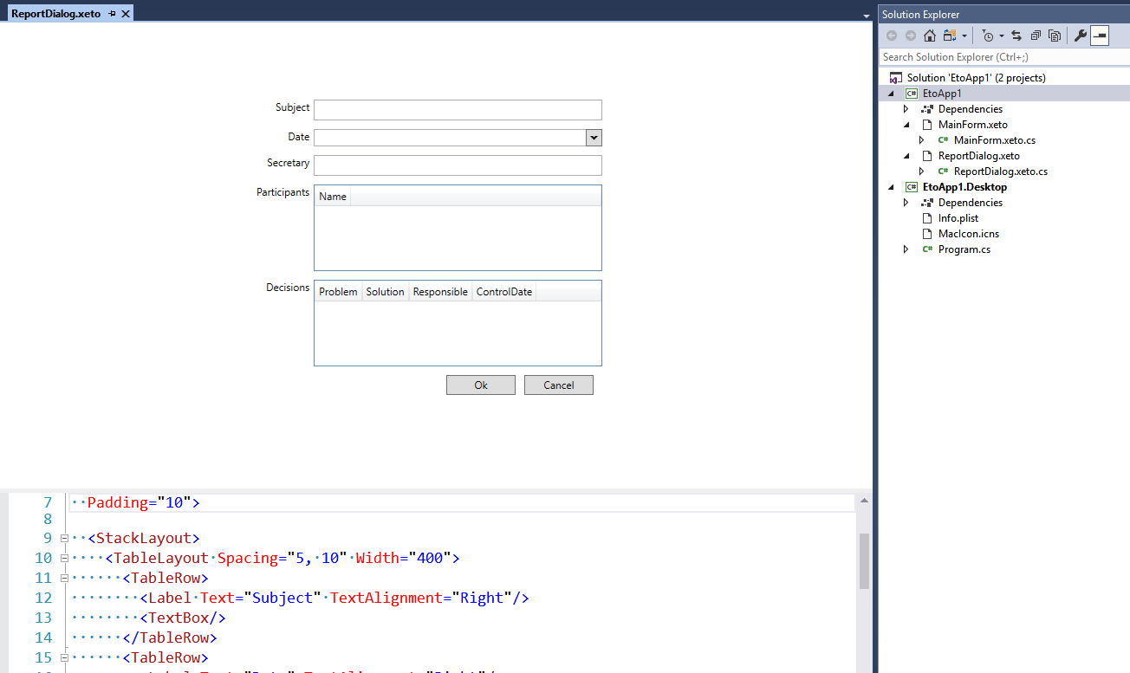
DEVELOPMENT (VS 2017)
Design Preview
Code Insight
XAML
JSON

Slide 27
Demo

Slide 28
ETO.Forms Pros & Cons
Pros
Cons
Very simple
Good .Net UX (as WinForms)
Contain all base widgets
Menu
Edit controls
Lists
One non commercial developer/supporter/maintainer
Slow progress
Weak layouts
Dependent on other GUI libraries
Can use only common features

Slide 29
Avalonia

Slide 30
Architecture
Win32
Logical / visual tree
Controls
Layouts
Styles
Animation
Input
Binding
Windowing Subsystem
GTK/GDK
…
Core
Rendering Subsystem
Skia
Direct2D
Cairo
Themes
XAML

Slide 31
Development
Like WPF, but … not WPF
class Program { public static void Main(string[] args) => BuildAvaloniaApp().Start(AppMain, args); public static AppBuilder BuildAvaloniaApp() => AppBuilder.Configure<App>() .UseDataGrid() .UsePlatformDetect() .LogToDebug(); private static void AppMain(Application app, string[] args) { app.Run(new MainWindow()); } }

Slide 32

Development
Styles == WPF + CSS
<Window.Styles> <Style Selector="TextBlock.h1"> <Setter Property="FontSize" Value="24"/> <Setter Property="FontWeight" Value="Bold"/> </Style>
<Style Selector="TextBlock.blue"> <Setter Property="Foreground" Value="Blue"/> </Style> </Window.Styles>
<TextBlock Classes="h1 blue">
Subject
</TextBlock>

Slide 33
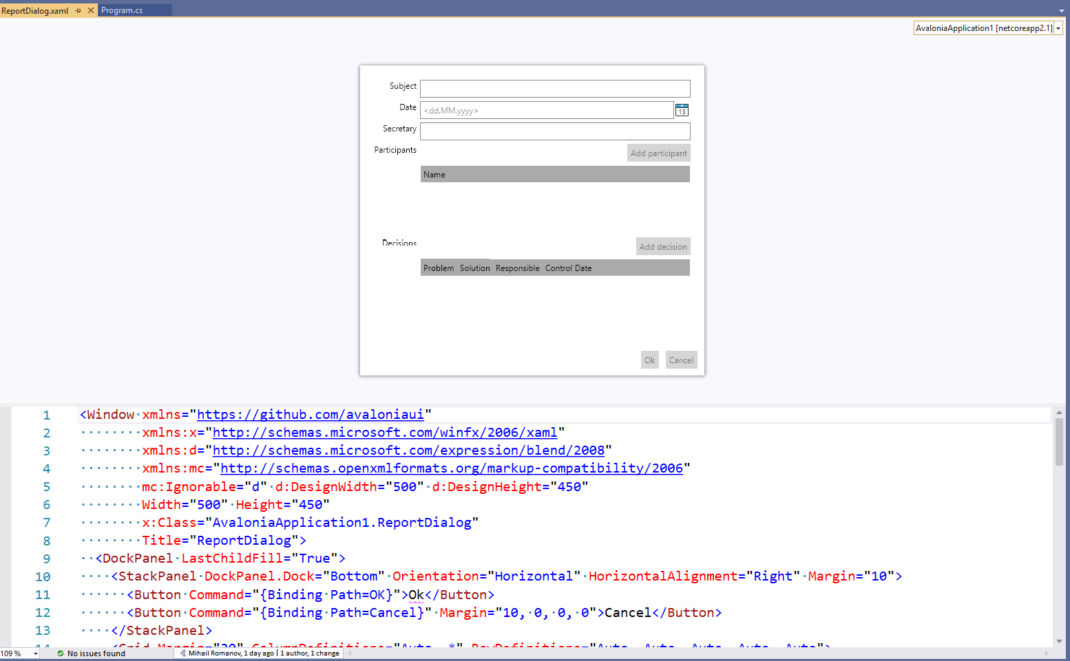
Development
Design Preview
Code Insight
XAML

Slide 34
Demo

Slide 35
Avalonia Pros & Cons
Pros
Cons
Excellent features set
Bindings
Styles
Many controls
…
WPF-like
Large community
Third-party projects (controls)
Like WPF, but not WPF
Difficult migration

Slide 36
HTML/CSS-based frameworks

Slide 37



HTML/CSS-based frameworks
Framework |  | .Net Binding
 | Chromium Embedded Framework (CEF) | CEFCharp (Windows Only)
 | Electron JS | Electron.Net
 | Sciter | SciterSharp

Slide 38
Electron.Net

Slide 39



Electron Architecture
DOM
& JS API
main.js
Windowing
Windows
Menu
Shell
Clipboard
…
Electron API
JS
HTML
Node.JS API
CSS

Slide 40
Electron.NET Architecture
bootstrapper
ASP.Net Core App
Electron API
Electron API Wrapper
Electron API Server Side
Socket
MVC / Web API controllers
.cs
.cshtml
JS
HTML
CSS

Slide 41
DEVELOPMENT
“Traditional” Web
Electron.Net style
Frontend: Any frontend and NodeJS libraries
React
Angular
…
Backend: .Net Core
MVC (API, Pages, … )
…
All logic on “server” side
“Server”
Send command (like “Open Window”, “Create menu”, …)
Handle events
“Client”
Execute command
Forward event to “Server”

Slide 42
Development
Server
Client
var menu = new MenuItem[] { new MenuItem { Label = "Файл", Submenu = new MenuItem[] { new MenuItem { Label = "Создать" } new MenuItem { Label = "Открыть" }, new MenuItem { Type = MenuType.separator }, new MenuItem { Label = "Выйти", Click = () => { Electron.App.Quit(); } } } }, new MenuItem { Label = "Генерировать", Click = async () => { await Generate(); } }, }; Electron.Menu.SetApplicationMenu(menu);
Window title
Файл Генерировать
Файл
Создать
Открыть
----------
Выйти

Slide 43
Demo

Slide 44
Electron.Net Pros & Cons
Pros
Cons
Excellent dynamic (for Electron)
Atom
VS Code
…
Sinergy of front and .Net back
Backend developer can rule frontend functionality
Easy migration for Web Apps
Full development cycle for Electron.Net (from development to distributions)
Full-stack developer (or separated roles in development team: front and back)
For complex application
Big resource consumption (memory + CPU)
Electron.Net slowly started in compare “pure” ElectronJS

Slide 45
Conclusions

Slide 46
What to choose?
Maturity
Avalonia
Electron.Net
Migrate web project
Electron.Net
Simple & «Native» look
Eto.Forms
GTK#

Slide 47
OUT OF Scope
Binding
Pure
HTML/CSS
GTK# / GTKSharp
Avalonia
Electron.Net
QtSharp
Eto.Forms
SciterSharp
QmlNet
XWT

Slide 48
Your Questions…

