Slide 1
Cross-platform GUI (desktop) in .Net
Mihail Romanov

Slide 2

Mihail romanov
Senior .Net developer in SKB-Kontur
About 15 years in IT
Developer, trainer, system analyst, …
Now
.Net developer in SKB-Kontur
Speaker (as a hobby)

Slide 3
Cross-platform
desktop
Why?
in .Net

Slide 4
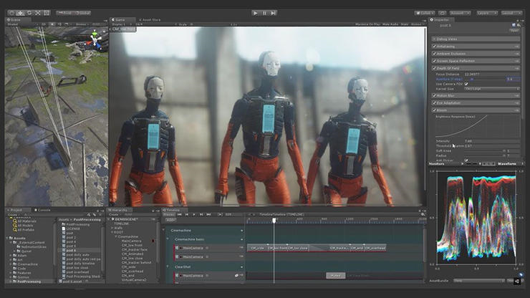
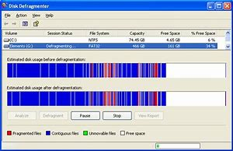
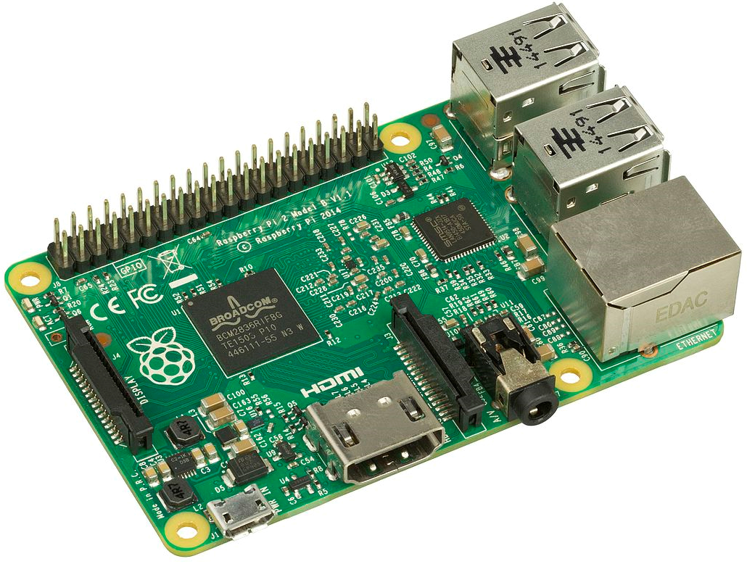
Why desktop?
Intensive graphics
Low level (OS) specific
Hardware
Customer requirements
Notes:
Intensive graphics (games, CADs, …)
Low level (OS) specific: antiviruses, system tools, …
Work with hardware: tokens, IoT development, …
Customer requirements

Slide 5


Why .Net Desktop?
Legacy
Available code
.Net-only library/API
.Net team

Slide 6
BUT… .Net Core 3

Slide 7
.Net Core 3 AND Desktop
Windows Forms
WPF
Presentation Framework
Windows Forms
Presentation Core
User32 + GDI/GDI+
DirectWriteForwarder.dll
gdi32.dll
Shell32.dll
…
User32 + Direct3D
User32.dll
AdvApi32.dll
…
Comdlg32.dll
ComCtl32.dll
d3d9.dll
d3d11.dll
Notes:
.Net Core 3 – WPF / WinForms

Slide 8
What alternatives???

Slide 9



Types of GUI libs
Wrapper (binding) for cross-platform lib
«Pure» .Net lib
HTML/CSS-based render
.Net lib
.Net binding
.Net lib
API calls
GTK/QT/…
Graphical
primitives
HTML / CSS
Direct2D
Cairo
Skia
HTML / CSS engine
Notes:
Wrapper (binding) to cross platform lib (GTK+, Qt, …)
Pure .Net lib (Avalonia, Eto.Forms, …)
HTML/CSS-based render (CEF, Electron, Sciter, …)

Slide 10
GUI libs (By types)
Wrapper (binding) for cross platform lib
«Pure» .Net lib
HTML/CSS-based render
GTK#
QtSharp
Avalonia
Eto.Forms
CEF
Electron.Net
SciterSharp
Notes:
Wrapper (binding) to cross platform lib (GTK+, Qt, …)
Pure .Net lib (Avalonia, Eto.Forms, …)
HTML/CSS-based render (CEF, Electron, Sciter, …)

Slide 11
bindings to cross platform libs

Slide 12





Popular Cross-platform GUI libraries
Library |  | Language | .Net wrappers
 | GTK / GTK+ | C | Gtk#, GtkSharp
 | Qt | C++ | QtSharp, QmlNet
 | wxWidgets | C++ | -
 | Swing | Java | -
 | SWT | Java | -
Notes:
GTK+
Qt
wxWidgets
Swing
SWT

Slide 13
GTK

Slide 14
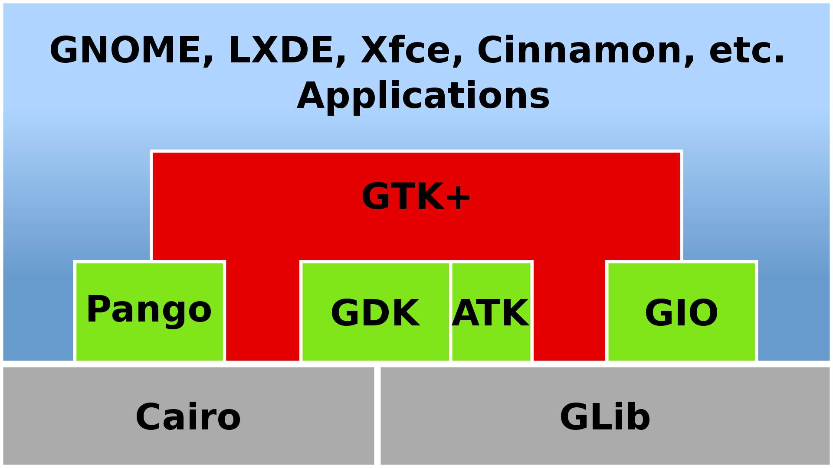
Architecture
UI / Controls
Accessible
Windowing
Cross-platform IO
Text & Fonts
OOP for C
Rendering
Notes:
Initial release: April 14, 1998
GIMP Toolkit (https://www.gtk.org/)
GTK+ — Widget toolkit for graphical interfaces
GDK — Low-level abstraction for the windowing system
Cairo — 2D, vector-based drawing for high-quality graphics
Pango — International text rendering with full Unicode support
Clutter — Animations and scene graph
WebKit — HTML5 web page rendering
ATK — Accessibility toolkit to implement support for screen readers and other tools
GIO Files — File and URI handling, asynchronous file operations, volume handling
GLib — Data structures and utilities for C programs
GObject — C-based object and type system with signals and slots

Slide 15




GTK Language Bindings (~20)
FreeBASIC
GTK+tobac
gotk3
go-gtk
Ruby/GTK3

Slide 16
GTK for .Net
Gtk#
GtkSharp
https://github.com/mono/gtk-sharp
https://github.com/GtkSharp/GtkSharp
 | Target framework | Target Gtk Version
Gtk# | .NET Framework 4.5, Mono | Gtk 2 (also Gtk 3.0 but never officially released)
GtkSharp | .NET Standard 2.0 | Gtk 3.22

Slide 17
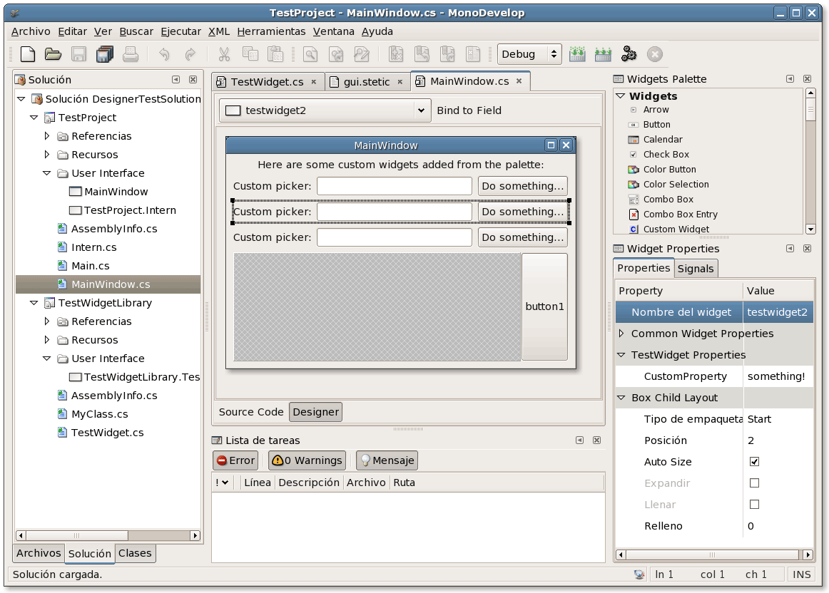
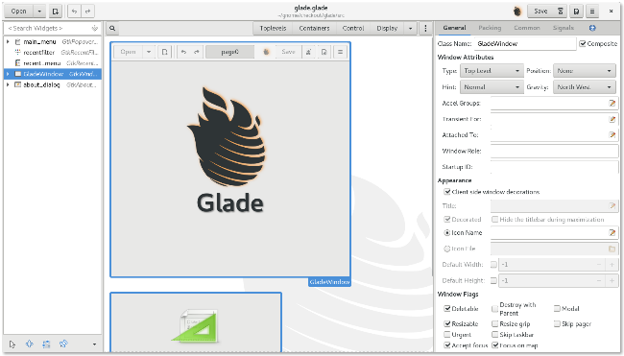
Development
Code
GUI Designer
// Setup GUI WindowPosition = WindowPosition.Center; DefaultSize = new Gdk.Size(800, 600); _headerBar = new HeaderBar(); _headerBar.ShowCloseButton = true; _headerBar.Title = "GtkSharp Sample Application"; var btnClickMe = new Button(); btnClickMe.AlwaysShowImage = true; btnClickMe.Image = Image.NewFromIconName(
"document-new-symbolic", IconSize.Button); _headerBar.PackStart(btnClickMe); Titlebar = _headerBar;
Stetic GUI Designer
(Mono Develop)
Glade
Notes:
Code
Glade

Slide 18
Demo

Slide 20
GTK# Pros & Cons
Pros
Cons
Wide platform support
Large GTK community
Many products (e.g. Linux DE: Gnome, Xfce, …) based on GTK
Small “out-of-box” control set
No Date picker, data table, …
C/C++ for control customization
No third party libraries

Slide 21
«PURE» .Net libs

Slide 22


.Net GUI Cross platform Libs
Library |  | Render(s) | Target Frameworks
 | Avalonia UI | Own (Direct2D, Skia, Cairo) | .Net Framework, .Net Core
 | Eto.Forms | WPF, WinForms, GTK | .Net Framework, .Net Core, Mono

Slide 23
Eto.Forms

Slide 24
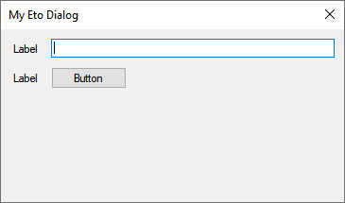
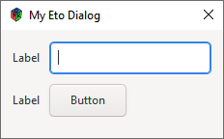
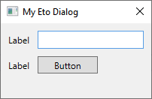
Architecture
Eto.Forms (UI),
Eto.Drawing (Graphics)
Title
text
button
WPF
WinForms
GTK

Slide 25
Development
C# / VB.Net
XAML
// create menu Menu = new MenuBar { Items = { // File submenu new ButtonMenuItem {
Text = "&File",
Items = { clickMe }
}, }, ApplicationItems = { // application (OS X) or file menu (others) new ButtonMenuItem { Text = "&Preferences..." }, }, QuitItem = quitCommand, AboutItem = aboutCommand }; // create toolbar ToolBar = new ToolBar { Items = { clickMe } };
JSON
<Form.Menu> <MenuBar> <ButtonMenuItem Text="F&amp;ile"> <ButtonMenuItem Text="Click Me!" Click="HandleClickMe" /> </ButtonMenuItem> <MenuBar.ApplicationItems> <ButtonMenuItem Text="Preferences.."
Shortcut="{On Control+O, Mac=Application+Comma}" /> </MenuBar.ApplicationItems> <MenuBar.QuitItem> <ButtonMenuItem Text="Quit"
Shortcut="CommonModifier+Q" Click="HandleQuit" /> </MenuBar.QuitItem> <MenuBar.AboutItem> <ButtonMenuItem Text="About..." Click="HandleAbout" /> </MenuBar.AboutItem> </MenuBar> </Form.Menu> <Form.ToolBar> <ToolBar> <ButtonToolItem Text="Click Me!" Click="HandleClickMe" /> </ToolBar> </Form.ToolBar>
"Menu": { "Items": [ { "$type": "ButtonMenuItem", "Text": "&File", "Items": [ { "$type": "ButtonMenuItem", "Text": "Click Me!", "Click": "HandleClickMe" } ] } ], "ApplicationItems": [ { "$type": "ButtonMenuItem", "Text": "Preferences..." } ], "QuitItem": { "$type": "ButtonMenuItem", "Text": "Quit",
"Shortcut": "CommonModifier+Q", "Click": "HandleQuit" }, "AboutItem": { "$type": "ButtonMenuItem",
"Text": "About...", "Click": "HandleAbout" } }, "ToolBar": { "Items": [ { "$type": "ButtonToolItem", "Text": "Click Me", "Click": "HandleClickMe" } ] }

Slide 26
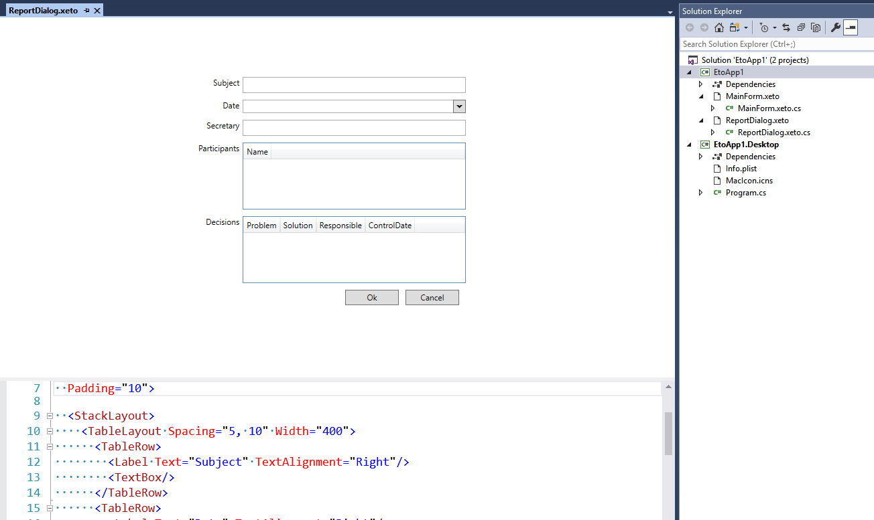
DEVELOPMENT (VS 2017)
Design Preview
Code Insight
XAML
JSON

Slide 27
Demo

Slide 28
ETO.Forms Pros & Cons
Pros
Cons
Very simple
Good .Net UX (as WinForms)
Contain all base widgets
Menu
Edit controls
Lists
One non commercial developer/supporter/maintainer
Slow progress
Weak layouts
Dependent on other GUI libraries
Can use only common features

Slide 29
Avalonia

Slide 30
Architecture
Win32
Logical / visual tree
Controls
Layouts
Styles
Animation
Input
Binding
Windowing Subsystem
GTK/GDK
…
Core
Rendering Subsystem
Skia
Direct2D
Cairo
Themes
XAML

Slide 31
Development
Like WPF, but … not WPF
class Program { public static void Main(string[] args) => BuildAvaloniaApp().Start(AppMain, args); public static AppBuilder BuildAvaloniaApp() => AppBuilder.Configure<App>() .UseDataGrid() .UsePlatformDetect() .LogToDebug(); private static void AppMain(Application app, string[] args) { app.Run(new MainWindow()); } }

Slide 32

Development
Styles == WPF + CSS
<Window.Styles> <Style Selector="TextBlock.h1"> <Setter Property="FontSize" Value="24"/> <Setter Property="FontWeight" Value="Bold"/> </Style>
<Style Selector="TextBlock.blue"> <Setter Property="Foreground" Value="Blue"/> </Style> </Window.Styles>
<TextBlock Classes="h1 blue">
Subject
</TextBlock>

Slide 33
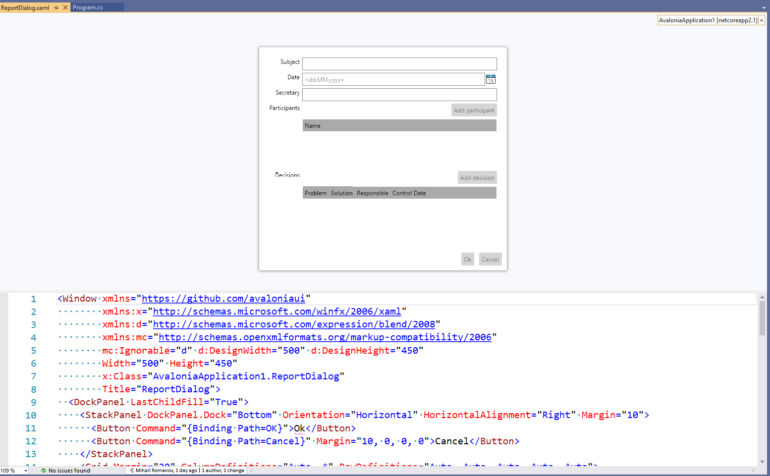
Development

Slide 34
Demo

Slide 35
Avalonia Pros & Cons
Pros
Cons

Slide 36
HTML/CSS-based frameworks

Slide 37



HTML/CSS-based frameworks
Framework |  | .Net Binding
 | Chromium Embedded Framework (CEF) | CEFCharp (Windows Only)
 | Electron JS | Electron.Net
 | Sciter | SciterSharp

Slide 38



Electron
JS
HTML
CSS

Slide 39
Electron.NET
bootstraper
ASP.Net Core App
.cshtml
.cs
JS
HTML
CSS

Slide 40
DEVELOPMENT
“Frontend”
“Backend”
Any frontend and NodeJS libraries
React
Angular
…
.Net Core
MVC (API, Pages, … )
…

Slide 41
Demo

Slide 42
Electron.Net Pros & Cons
Pros
Cons
Excellent dynamic (for Electron)
Atom
VS Code
…
Sinergy of front and .Net back
Easy migration for Web Apps
Full development cycle for Electron.Net (from development to distributions)
Full-stack developer (or separated roles in development team: front and back)
Big resource consumption (memory + CPU)
Electron.Net slowly started in compare “pure” ElectronJS

Slide 43
Conclusions

Slide 45
Your Questions…

