Slide 1
GUI in .Net
Mihail Romanov

Slide 2


Slide 3
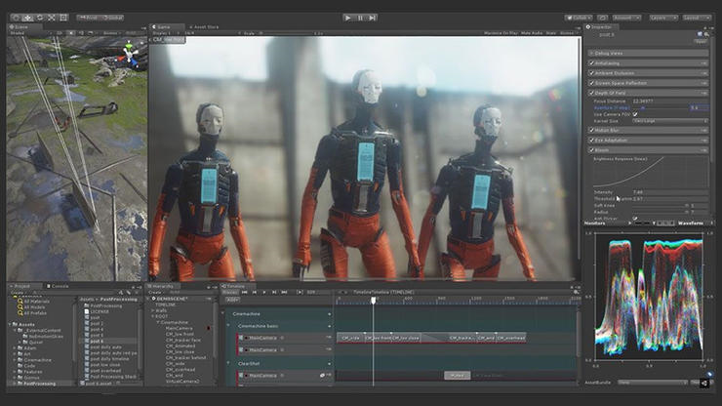
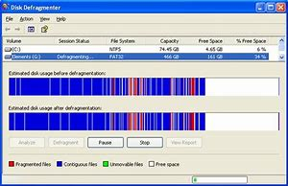
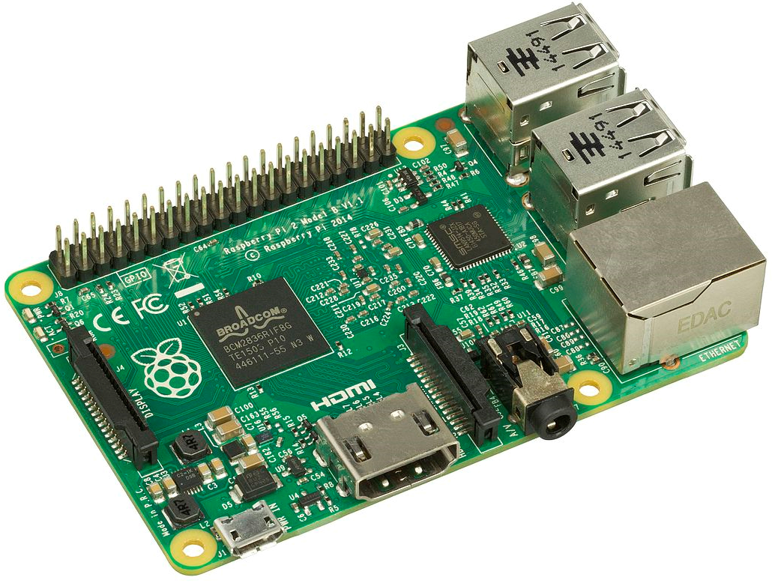
Why desktop?
Intensive graphics
Low level (OS) specific
Hardware
Customer requirements
Notes:
Intensive graphics (games, CADs, …)
Low level (OS) specific: antiviruses, system tools, …
Work with hardware: tokens, IoT development, …
Customer requirements

Slide 4


Why .Net Desktop?
Legacy
Available code
.Net-only library/API
.Net team

Slide 5
.Net Core 3 AND Desktop
Notes:
.Net Core 3 – WPF / WinForms

Slide 6
Types of GUI libs
Wrapper (binding) for cross platform lib
«Native» .Net lib
HTML/CSS-based render
GTK#
QtSharp
Avalonia
Eto.Forms
CEF
Electron.Net
SciterSharp
Notes:
Wrapper (binding) to cross platform lib (GTK+, Qt, …)
Native .Net lib (Avalonia, Eto.Forms, …)
HTML/CSS-based render (CEF, Electron, Sciter, …)

Slide 7
bindings to cross platform libs

Slide 8





Popular Cross-platform GUI libraries
Library |  | Language | .Net wrappers
 | GTK / GTK+ | C | Gtk#, GtkSharp
 | Qt | C++ | QtSharp, QmlNet
 | wxWidgets | C++ | -
 | Swing | Java | -
 | SWT | Java | -
Notes:
GTK+
Qt
wxWidgets
Swing
SWT

Slide 9
GTK

Slide 10
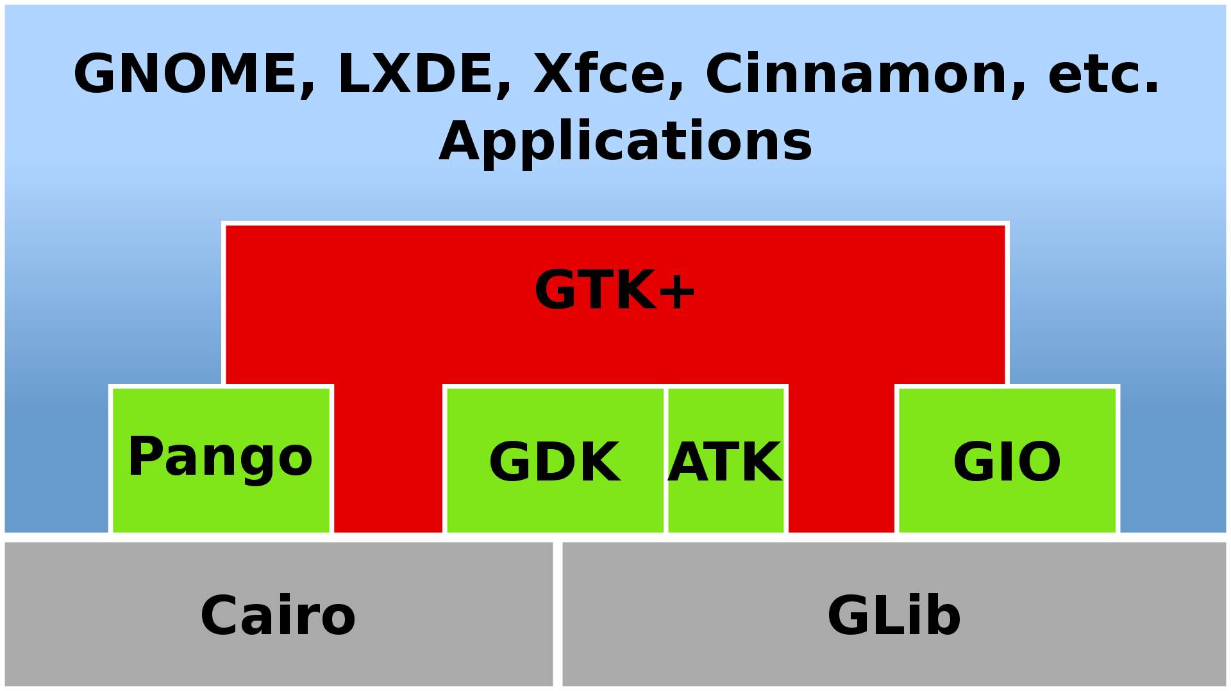
GTK
Notes:
Initial release: April 14, 1998
GIMP Toolkit (https://www.gtk.org/)
GTK+ — Widget toolkit for graphical interfaces
GDK — Low-level abstraction for the windowing system
Cairo — 2D, vector-based drawing for high-quality graphics
Pango — International text rendering with full Unicode support
Clutter — Animations and scene graph
WebKit — HTML5 web page rendering
ATK — Accessibility toolkit to implement support for screen readers and other tools
GIO Files — File and URI handling, asynchronous file operations, volume handling
GLib — Data structures and utilities for C programs
GObject — C-based object and type system with signals and slots

Slide 11
GTK for .Net
Gtk#
GtkSharp
https://github.com/mono/gtk-sharp
https://github.com/GtkSharp/GtkSharp
 | Target framework | Target Gtk Version
GtkSharp | .NET Standard 2.0 | Gtk 3.22
Gtk# | .NET Framework 4.5, Mono | Gtk 2 (also Gtk 3.0 but never officially released)

Slide 12
Development
Notes:
Code
Glade

Slide 13
Qt/Qml

Slide 14
Qml.Net
Notes:
Qt Sharp?

Slide 15
Native .Net libs

Slide 16


.Net GUI Cross platform Libs
Library |  | Render(s) | Target Frameworks
 | Avalonia UI | Own (Direct2D, Skia, Cairo) | .Net Framework, .Net Core
 | Eto.Forms | WPF, WinForms, GTK | .Net Framework, .Net Core, Mono

Slide 17
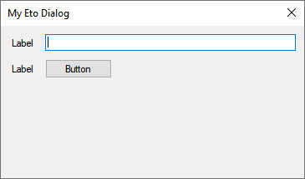
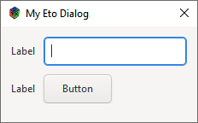
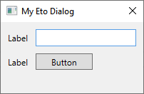



Eto
Eto.Forms (UI), Eto.Drawing (Graphics)
WPF
WinForms
GTK

Slide 18
Development

Slide 19
Avalonia

Slide 20
HTML/CSS-based frameworks

Slide 21



HTML/CSS-based frameworks

Slide 22
Electron

Slide 23
Electron.net

Slide 24
Sciter

Slide 25
SciterSharp

Slide 26
Conclusions

Slide 28
Your Questions…

