Slide 1

Static code analysis for .Net developers
from StyleCop to Roslyn
Михаил Романов, EPAM Systems
1 November 2016

Slide 2
What is it?
Static program analysis is the analysis of computer software that is performed without actually executing programs (analysis performed on executing programs is known as dynamic analysis).
Wikipedia

Slide 3

For what?
Code quality
Find complex bugs
Support code style
Symbol names spelling
…

Slide 4
How Compiler Works
Lexical/Syntax analysis
Semantic/Symbol analysis
Code generation

Slide 5
Tools
 | Syntax analysis | Symbol analysis | Generated code | Language
StyleCop | + | - | - | C#
FxCop | - | - | + | Any .Net (IL)
SSDT Static analyzer | + | + | - | SQL (T-SQL)
Roslyn | + | + | - | C# & VB.Net

Slide 6
DEMO

Slide 7

Why we should extend static code analyzer?

Slide 8
Code/IL/… Visitor
public class TransactionVisitor : TSqlFragmentVisitor
{
public override void ExplicitVisit(SaveTransactionStatement node)
{
// Some code
}
public override void ExplicitVisit(RollbackTransactionStatement node)
{
// Some code
}
}

Slide 9
StyleCop
http://stylecop.codeplex.com/
Documentation in 4.3 release

Slide 10
FxCop
No official documentation
http://binarycoder.net
Tutorial
Introspector

Slide 11
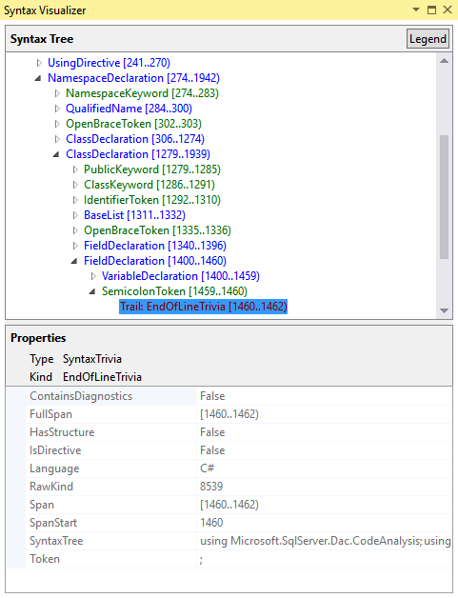
Roslyn
.NET Compiler Platform SDK
Only for VS 2015
Documentation
.NET Compiler Platform ("Roslyn") Overview

Slide 12
SSDT
Nuget package Microsoft.SqlServer.DacFx (x86 or x64)
Overview of Extensibility for Database Code Analysis Rules

Slide 13
Your questions

