Slide 1



ELITE

Slide 2



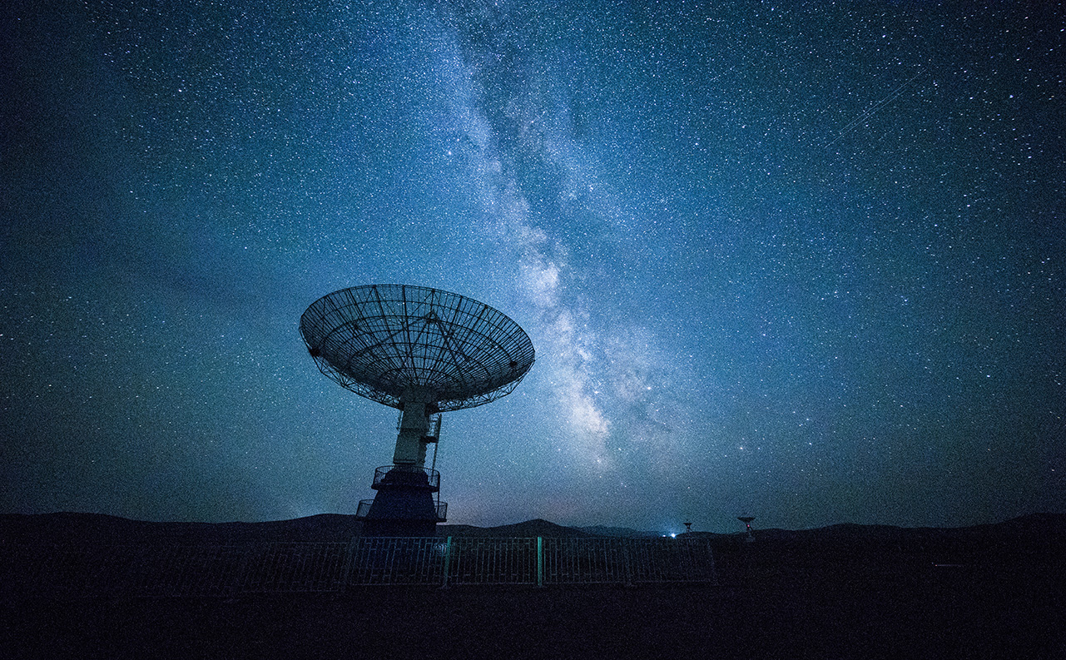
THE PROBLEM

Slide 3
WHAT WE DID
Voyaging Rover with Outstanding Omnidirectional Motion

Slide 4


Slide 5









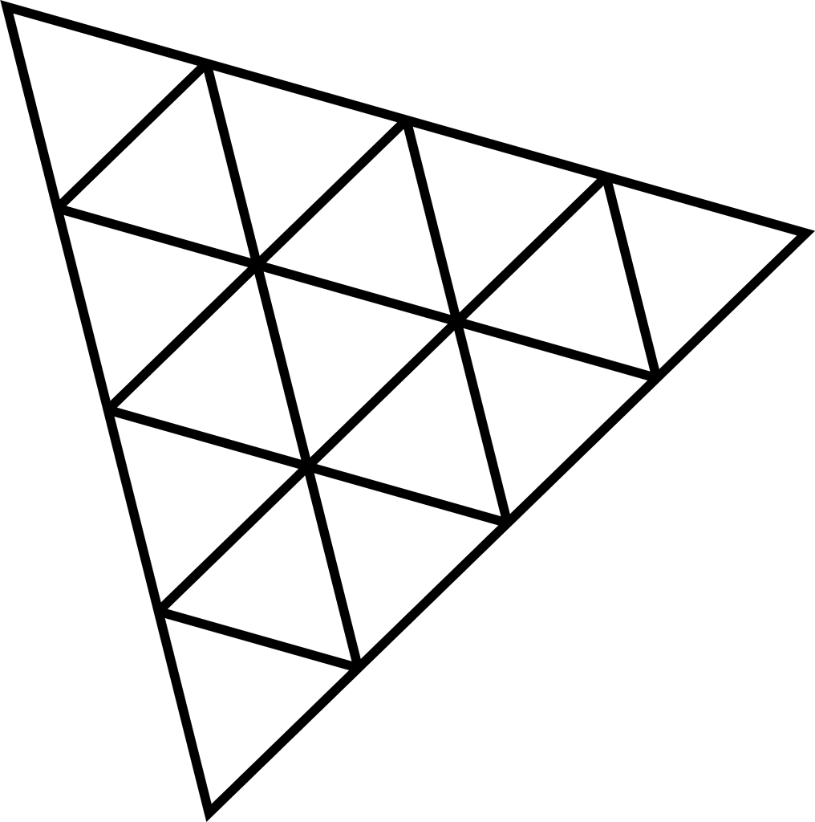

Slide 6
