Slide 1
Running sparse neural networks on FPGAs
Team 3735928559

Slide 2
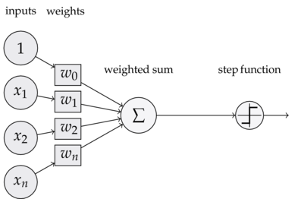
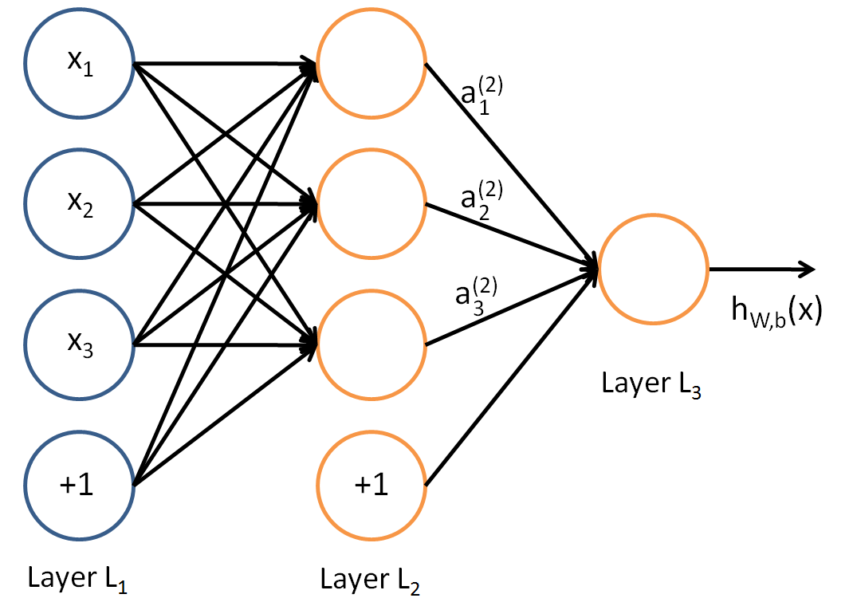
Short intro into neural networks
Sets of neurons grouped in layers, neurons connected between layers
Each connection performs one multiplication
Neurons sum inputs from all the connections

Slide 3
Overview
Neural networks are require lots of computation, power, and time
They are also pretty useful - even Uber made an AI team last week
Most neural networks are heavily overparameterized
Several approaches ease computation:
Smaller networks?
Quantizing weights to 16, 8, even 1 bit?
Pruning neurons?
Pruning connections?
Pruning connections results in sparse matrices Sparse matrix operations are not well suited to CPUS

Slide 4
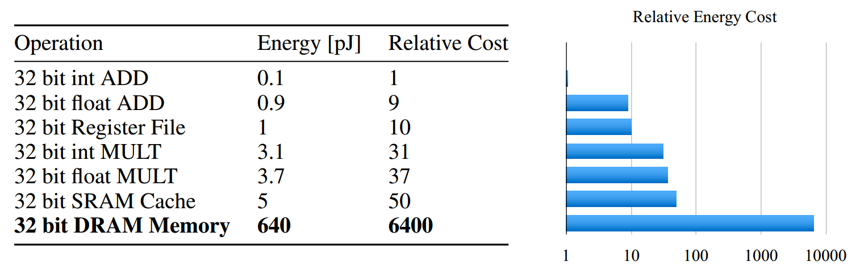
Neural network power usage
Storing weights is much more expensive than doing the calculation!

Slide 5
Project goals
Build an efficient sparse matrix - vector multiplication accelerator
Build an end-to-end solution for running neural nets on the FPGA
Design the network in software
Train the network on a GPU
Generate the verilog code for the specific network and store weights in configuration files
Allow multi-layer computation
Preferably this should be a one-click solution:
Choose layer sizes and dataset
Train the weights and biases
When done, generate verilog and conf files
Synthesize, or just update conf files if the configuration didn’t change
Flash it to the board

Slide 6
Requirements
Power consumption is the main issue
Reduce the amount of memory needed for storing weights as much as possible
Provide an easy solution for running neural nets on the FPGA, for users without FPGA knowledge
Provide a parametric design, allow choosing the tradeoff between power and accuracy
A good user interface is make-it-or-break-it for open-source projects

Slide 7
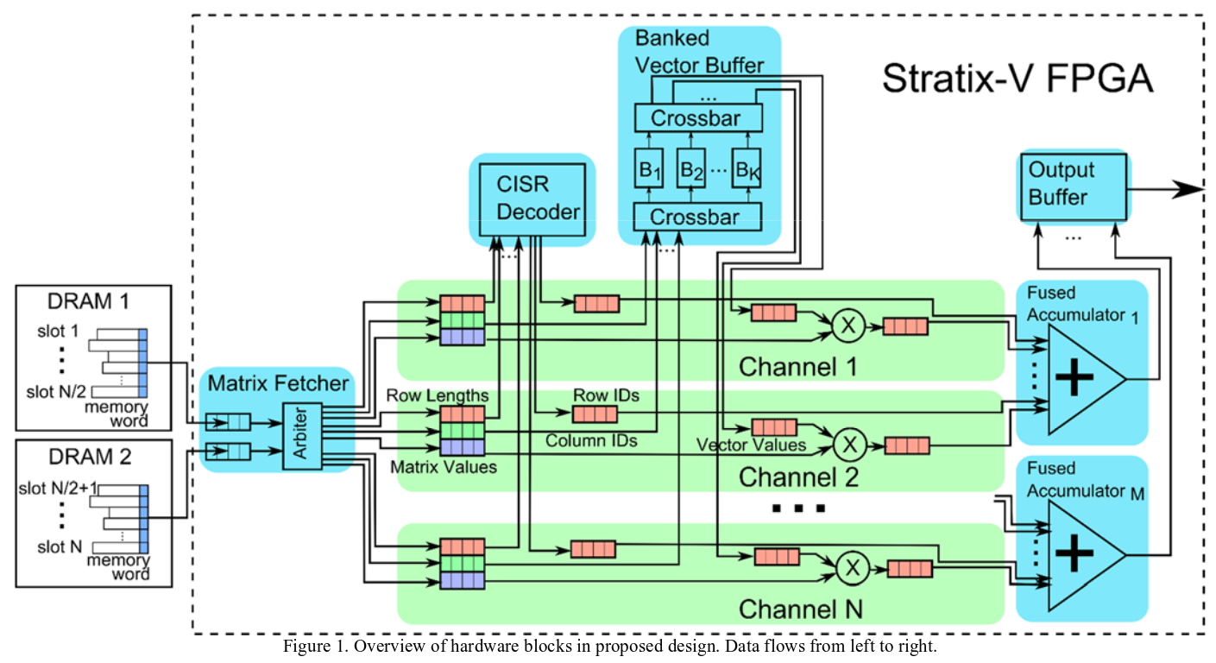

Slide 8
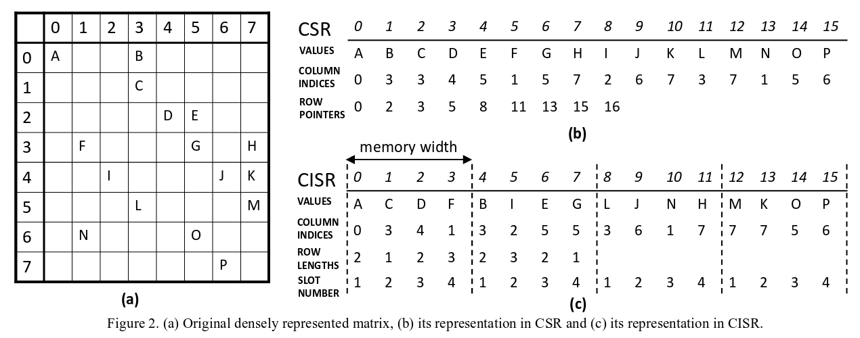
CISR encoding

Slide 9
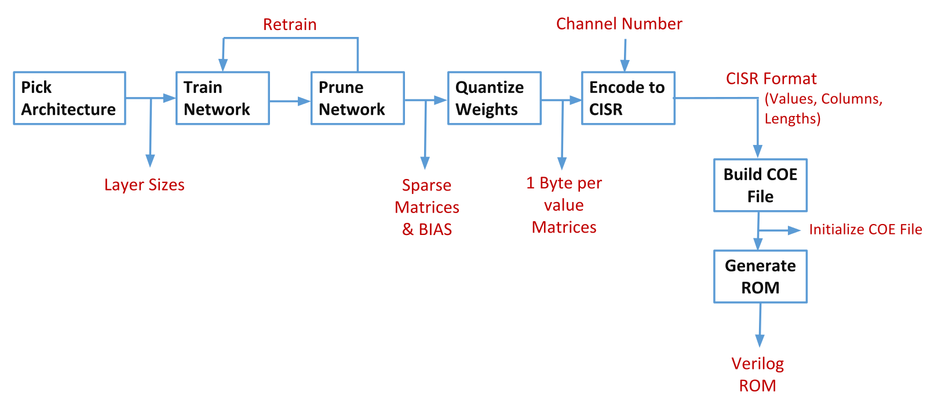
ROM generation

Slide 10
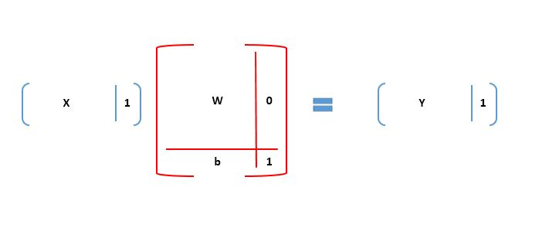
Dealing with biases

Slide 11
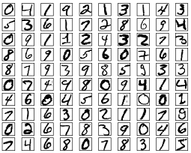
Final NN architecture
A 784-250-150-10 architecture
250 so the index fits in one byte - useful for COE storing
Trained on MNIST
1290 epochs, pruning 3% every 10 epochs
98.04% connections pruned
Max accuracy: 98.68%
Acc. after pruning: 96.24%
First layer: 3971 out of 196000 connections
Second layer: 759 out of 37500 connections
Third layer: 29 out of 1500 connections
Pruning this layer causes a lot of loss

Slide 13
CISR decoder
Controls which sum goes to which output vector cell
Assigns row IDs to channels
Problems arise when two channels finish at the same time - Have to assign IDs to both, but the lower one has to get the ID first
Notes:
This is the CISR Decoder detailed Block Diagram.
Everything is parameterized. For each channel, there will be one counter. The initial value of each counter is the index of the corresponding channel minus one.
For example, the rowID1 will have 0 as the initial value. Then these counter take rowLengths from rowLength FIFO and will generate the countVector.
If any of the counters reach 0, the FindLowestZero block will find the 0 with the lowest index and send the newRowValue to that counter.
If multiple counters reach 0 at the same time, FindLowestZero block makes sure the channel has lower index gets lower rowID.

Slide 14
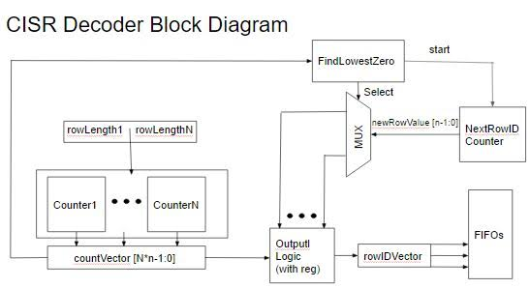
Notes:
This is the CISR Decoder detailed Block Diagram.
Everything is parameterized. For each channel, there will be one counter. The initial value of each counter is the index of the corresponding channel minus one.
For example, the rowID1 will have 0 as the initial value. Then these counter take rowLengths from rowLength FIFO and will generate the countVector.
If any of the counters reach 0, the FindLowestZero block will find the 0 with the lowest index and send the newRowValue to that counter.
If multiple counters reach 0 at the same time, FindLowestZero block makes sure the channel has lower index gets lower rowID.

Slide 16
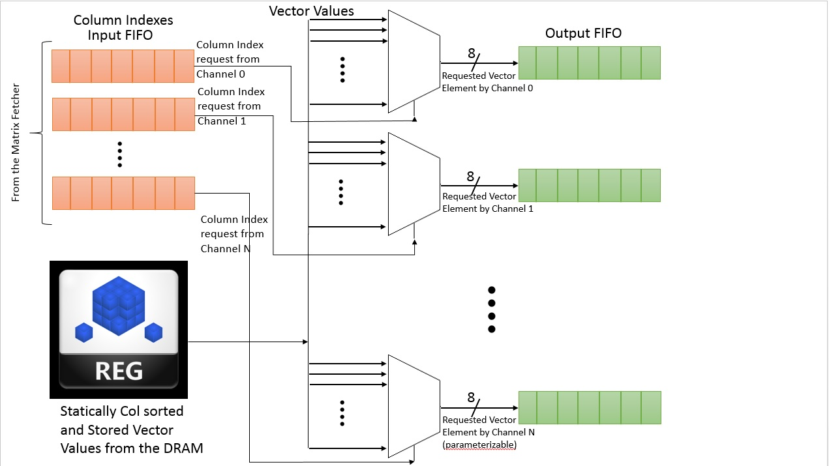
Banked vector buffer

Slide 17
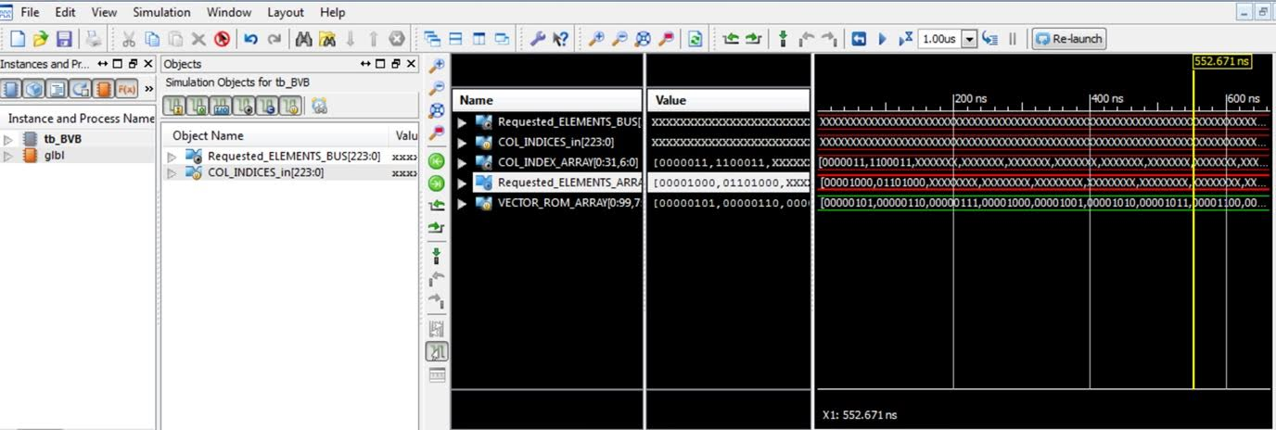
Banked vector buffer

Slide 19
Tradeoffs
Accuracy vs power
Channel number
Vector input width
#bits per weights
Severity of pruning
Implementing softmax?
Currently using 8 bit values
Could push it to 4-5
Increases design size of all components linearly
Increases latency of some components logarithmically
What works individually, breaks memory budget in integration
BRAM is a big constraint
Design can’t scale for larger networks
Need to split the input - a lot of extra logic

Slide 20
Successes & failures
CISR decoding is a lot harder than anticipated
Working with memory is easier than anticipated
Generate statements could be more powerful - some verilog that we could generate with python is not possible to make with generate statements
Softmax takes a lot more logic than anticipated - had to abandon
Where we are currently?
All modules implemented
BRAM and DRAM working
CISR working and tested
BVB working and tested
Channels and summers working and tested
But together causing problems

Slide 21
Nice-to-haves
Working on VGA output of the input images
Working on python templating the verilog files
Working on splitting the BVB so that BRAM isn’t an issue
Working on a one-push solution for generating code, synthesizing, and flashing

Slide 22
Conclusion
Amount of BRAM is a big constraint - we have logic we can’t utilize without more BRAM
FIFOs made our lives much easier - sprinkle them everywhere!
Wish we knew about the CoreGen earlier!
Integrate early! Memory will bite you!

