Slide 1
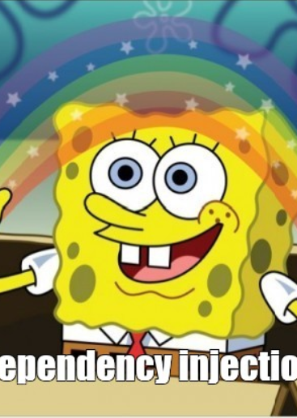

Entity framework

Slide 2
Agenda
01
03
About us
Questions
02
Entity Framework

Slide 3
ABOUT US
01
Ružica Kresoja
.NET software developer
Milan Kojadinović
.NET software developer

Slide 4
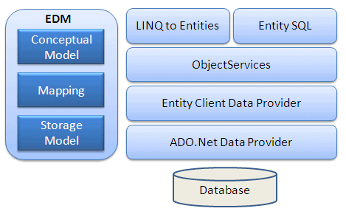
Entity framework
open-source ORM (Object Relational Mapping) Framework for the .NET applications
fits between the business entities (domain classes) and the database. It saves data stored in the properties of business entities and also retrieves data from the database and converts it to business entities objects automatically

Slide 5
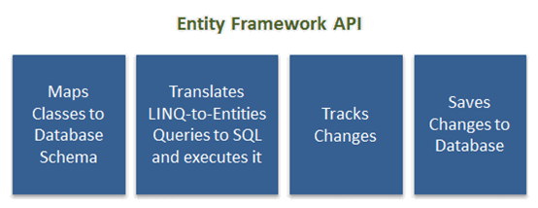
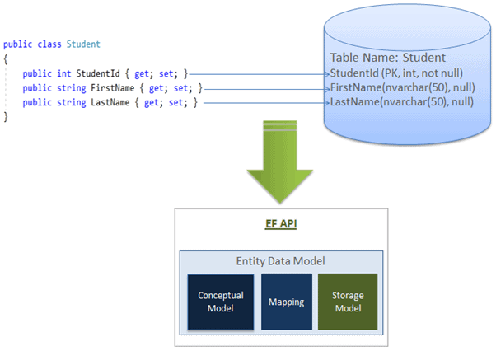
Entity framework API

Slide 6
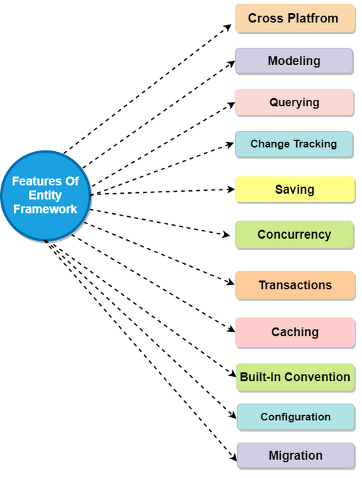

Slide 7
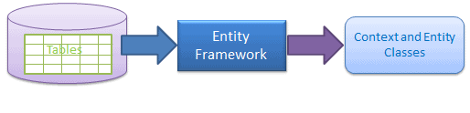
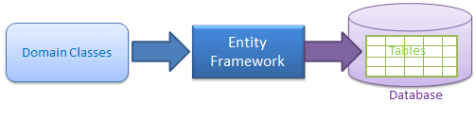
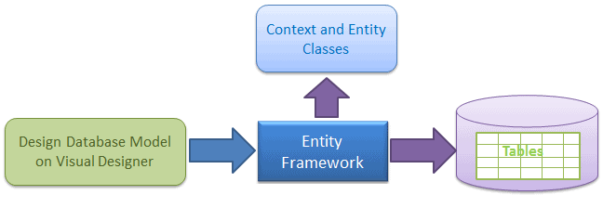
entity framework approaches
Database-first
Code-first
Model first

Slide 8
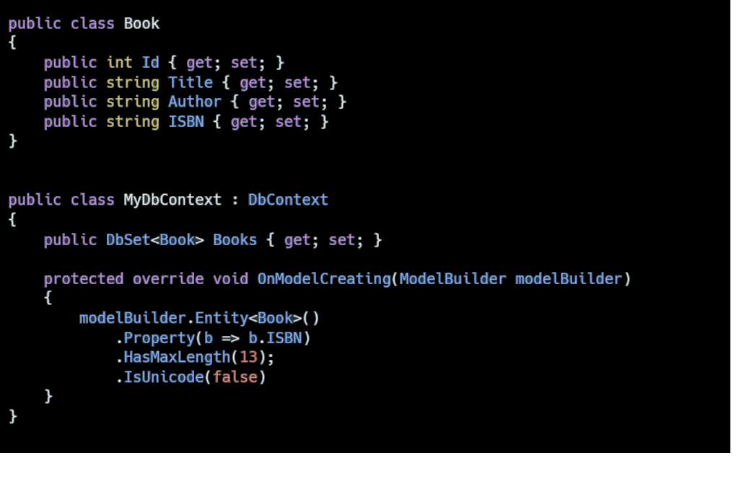
Before we start with coding….
DbContext Class
DbSet
Migrations

Slide 9
Questions

Slide 10
Thank you
SERBIA / NOVI SAD
Levi9 Global Sourcing Balkan d.o.o.
Novi Sad Offices
Trifkovićev Trg 6
21000 Novi Sad, Serbia

