Slide 1


Design Patterns

Slide 2
Agenda
01
03
About Us
Singleton
02
04
Dependency Injection
Questions

Slide 3
ABOUT US
01
Ružica Kresoja
.NET software developer
Milan Kojadinović
.NET software developer

Slide 4
Dependency injection
02
Notes:
Pattern that helps us manage dependencies in our applications, leading to more modular, testable, and maintainable code.

Slide 5
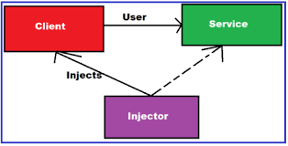
Dependency injection
Dependency Injection is a design pattern used to implement Inversion of Control (IoC) between classes and their dependencies.
Instead of a class creating its dependencies directly, they are provided from an external source.
This decouples the class from the concrete implementation of its dependencies, making the system more flexible and easier to manage.
Notes:
Pattern that helps us manage dependencies in our applications, leading to more modular, testable, and maintainable code.

Slide 6

Benefits of Dependency Injection
Decoupling
Testability
Maintainability
Configurable
.NET provides built-in support for DI, primarily through the Microsoft.Extensions.DependencyInjection namespace. This allows us to configure and resolve dependencies in a standardized way.
Notes:
Decoupling: By injecting dependencies, we reduce the direct dependency between classes, making the code more modular.
Testability: Dependencies can be easily mocked or stubbed, facilitating unit testing.
Maintainability: Changing a dependency implementation requires fewer changes in the dependent classes.
Configurable: Allows for configuration of components from outside the class, such as through configuration files or during application setup.

Slide 7
Types of Dependency Injection:
Constructor Injection
Property Injection
Method Injection
Notes:
Constructor Injection: The dependency is provided through the constructor of the class.
Property Injection: The dependency is set through a property of the class.
Method Injection: The dependency is passed as a parameter to a method of the class.

Slide 8
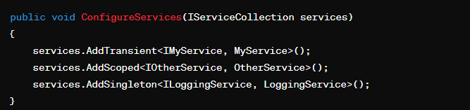
step 1 - Configure Services
Notes:
In the Startup.cs file, add dependencies to the service container within the ConfigureServices method.
Service Lifetimes:
Transient: A new instance is provided each time it's requested.
Scoped: A new instance is provided per request (useful in web applications).
Singleton: A single instance is shared throughout the application's lifetime.

Slide 9
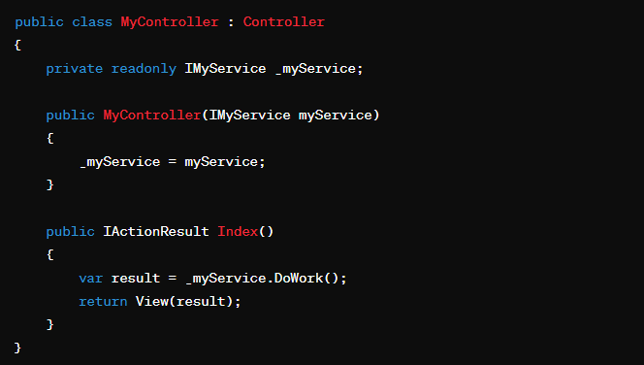
step 2 - Injecting Dependencies:
Notes:
Use constructor injection to request the dependencies where needed. For example:

Slide 10
Singleton
03

Slide 11

Singleton - Key Characteristics
Single Instance
Global Access
Lazy Initialization
For example, a Singleton can be used for managing a database connection, logging, or configuration settings.
Notes:
Today, we are going to discuss a fundamental design pattern called the Singleton. This pattern is widely used in software design to ensure that a class has only one instance and provides a global point of access to that instance.
The Singleton pattern restricts the instantiation of a class to a single object. This is useful when exactly one object is needed to coordinate actions across the system. For example, a Singleton can be used for managing a database connection, logging, or configuration settings.
Key Characteristics of Singleton
Single Instance: Ensures that a class has only one instance.
Global Access: Provides a global point of access to that instance.
Lazy Initialization: The instance is created only when it is needed, which can improve performance and resource management.

Slide 12
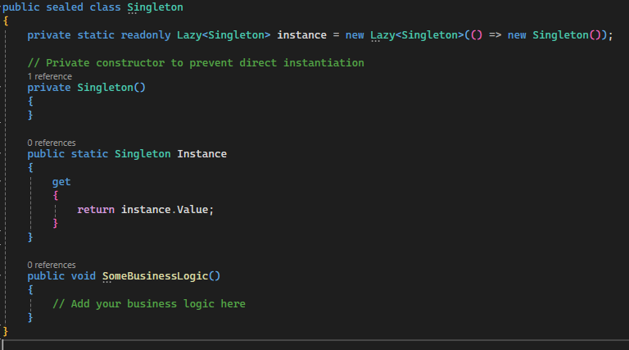
BASIC IMPLEMENTATION
Notes:
Explanation:
Private Constructor: The constructor is marked private to prevent direct instantiation using the new keyword.
Static Read-Only Instance: The instance is a static read-only field, initialized using Lazy<T> to ensure thread-safe lazy initialization.
Public Property: Instance is a public static property that provides global access to the instance. The Lazy<T> class ensures that the instance is created only when it is first accessed.

Slide 13
PROS & CONS
Benefits of Using Singleton
Controlled Access to a Single Instance
Reduced Namespace Clutter
Lazy Initialization
Potential Drawbacks
Global State
Concurrency Issues
Difficulties in Unit Testing
Notes:
Benefits of Using Singleton
Controlled Access to a Single Instance: Ensures that there is a single point of control over the instance.
Reduced Namespace Clutter: Instead of having multiple global variables, the Singleton pattern consolidates them into a single instance.
Lazy Initialization: Instances are created only when they are needed, which can improve application startup time and reduce memory footprint.
Potential Drawbacks
Global State: Singletons can introduce global state into an application, which can make it harder to understand and test.
Concurrency Issues: While the above implementation handles lazy initialization in a thread-safe manner, improper implementations can lead to concurrency problems.
Difficulties in Unit Testing: Singletons can be difficult to mock and test because they carry state across tests.
Best Practices
Use Sparingly: Only use Singleton when it is absolutely necessary.
Thread Safety: Ensure that the Singleton is thread-safe.
Testing: Design your Singleton in a way that it can be easily tested. Consider using dependency injection to manage the Singleton's lifecycle and dependencies.

Slide 14
Questions

Slide 15
Thank you
SERBIA / NOVI SAD
Levi9 Global Sourcing Balkan d.o.o.
Novi Sad Offices
Trifkovićev Trg 6
21000 Novi Sad, Serbia

