Slide 1

DIVISION OF COMPUTER SCIENCE AND ENGINEERING | SCHOOL OF ENGINEERING
COCHIN UNIVERSITY OF SCIENCE AND TECHNOLOGY (CUSAT) • OCTOBER 2026
MAJOR PROJECT DESIGN & ARCHITECTURE PRESENTATION
Robo-Root: Plant-Root-Inspired Soft Growing Robot
Pneumatic Tip Eversion, Base-Mounted Four-Tendon Steering & Vision-Assisted Autonomous Navigation
PROJECT MEMBER
Mihal Palakkal
Reg No: 20223071
PROJECT MEMBER
Rose Maria
Reg No: 20223085
PROJECT MEMBER
Ruvais P
Reg No: 20223087
PROJECT MEMBER
Mohamed Jaseeb P J
Reg No: 20223120
ACADEMIC ADVISORY & PROJECT SUPERVISION
Ms. Amrutha S Nair
Project Guide
Assistant Professor, Dept. of CSE
Dr. Sheena S
Project Coordinator
Associate Professor, Dept. of CSE
Mr. Damodaran V
Head of Division
Division of Computer Science & Engg

Slide 2
BACKGROUND & MOTIVATION | CHAPTER 01
Bio-Inspired Soft Robotics: Why Tip-Growing Systems?
Overcoming the severe physical constraints of rigid locomotion in complex and confined subterranean environments.
LIMITATIONS OF CONVENTIONAL RIGID ROBOTS
• Whole-Body Motion & Friction: Wheeled, tracked, or legged robots must drag or propel their entire body mass forward through the terrain, creating immense frictional drag in narrow passages.
• Wedging & Geometric Trapping: Rigid structures cannot deform dynamically through tortuous or collapsing cavities, leading to entrapment in disaster rubble or tight pipes.
• Subterranean Soil Resistance: Penetrating soil or sand with rigid shafts incurs exponential penetration resistance that scales drastically with penetration depth.
• High In-Tip Actuator Mass: Locating heavy drive motors or articulating joints near the front compromises balance and severely limits miniaturization.
THE ROBO-ROOT ADVANTAGE: APICAL TIP EVERSION
✔ Apical Extension (Zero Wall-Sliding Friction): Inspired by biological plant roots, material extends strictly at the tip through pneumatic eversion. The deployed body remains stationary relative to surrounding walls.
✔ Passage Through Unstructured Voids: Seamlessly adapts to tortuous pathways, squeezing through apertures narrower than the unpressurized tube diameter.
✔ Internal Working Lumen Conduit: The hollow central lumen provides a protected interior pathway for electrical wiring, sensor payloads, and air supply without environmental exposure.
✔ High Expansion-to-Mass Ratio: Lightweight polymer membranes can achieve dramatic extensions (several meters) while base station bears the actuator weight.
TARGET APPLICATIONS:
Urban Search & Rescue in collapsed structures, industrial pipeline and duct inspection, underground sensor deployment, and non-destructive soil probing.
Robo-Root: Plant-Root-Inspired Pneumatic Tip-Growing Robot | CUSAT Major Project 2026
Slide 2 of 10

Slide 3
PROBLEM STATEMENT | CHAPTER 02
Core Engineering & Scientific Challenges
Balancing pneumatic growth dynamics, tendon-based mechanical steering, and real-time vision perception.
1. DIRECTIONAL STEERING CONTROL
• Uncontrolled Tip Eversion: Pressurized pneumatic tubes naturally extend along the path of least resistance or in a straight line.
• Planar & Spatial Bending: Imparting deliberate 2D/3D angular deflection requires active, coordinated steering authority without inducing structural buckling or tube kinking.
• Critical Need: A decoupled 4-tendon antagonistic steering mechanism operating at the tip.
2. TENDON ROUTING & CABLE PAYOUT
• Growth vs. Cable Tension: As the robot extends from centimeters to meters, steering cables must deploy continuously.
• Slack & Friction Management: Loose tendons cause steering deadband and backlash, while overtight tendons prevent eversion growth.
• Critical Need: Base-mounted motorized cable spools that dynamically release tendon slack synchronous with growth.
3. TIP PERCEPTION IN CONFINED SPACES
• Hostile Visual Environments: Confined boreholes and rubble exhibit complete darkness, dust, lens occlusions, and severe glare.
• Computational Bottlenecks: Real-time image processing cannot rely on heavy GPU hardware mounted on the fragile soft tip.
• Critical Need: Micro-camera feed streaming to a host ROS 2 machine running optimized YOLO inference.
4. MULTIMODAL SYSTEM SYNCHRONIZATION
• Actuator-Sensor Decoupling: High pneumatic pressure, servo pulse modulation, and image capture must be synchronized.
• Closed-Loop Control Latency: Steering corrections must occur at speeds compatible with pneumatic forward advancement.
• Critical Need: A modular ROS 2 architecture establishing deterministic communication across all subsystems.
Robo-Root: Plant-Root-Inspired Pneumatic Tip-Growing Robot | CUSAT Major Project 2026
Slide 3 of 10

Slide 4
PROJECT OBJECTIVES & SCOPE | CHAPTERS 01 & 02
Systematic Objectives & Technical Scope Boundaries
Defining the engineering milestones and practical boundaries of the laboratory prototype.
PRIMARY TECHNICAL OBJECTIVES
1. Pneumatic Tip Eversion: Design an airtight, flexible tubular mechanism capable of continuous forward growth driven by regulated pneumatic pressure.
2. Four-Tendon Steering: Construct a 4-tendon orthogonal arrangement around the flexible tube for active planar tip steering in the X-Y horizontal plane.
3. Base-Station Actuation: Mount four high-torque servo motors at the stationary base to minimize tip payload and enable active tendon spooling.
4. Vision Integration: Equip the advancing tip with a micro-camera for real-time forward environmental sensing and obstacle detection.
5. YOLO Perception Pipeline: Integrate pretrained YOLO models via OpenCV to detect objects and obstacles without needing massive prior training sets.
6. ROS 2 Control Architecture: Establish a modular ROS 2 framework linking image acquisition, path planning, kinematics, and ESP32 low-level firmware.
SCOPE BOUNDARIES & ASSUMPTIONS
• Base-Mounted Servos: Servos remain stationary at the base rather than moving with the tip, drastically reducing moving inertia but requiring robust cable payout management.
• Pretrained Model Utilization: Leverages established YOLO weights for standard object classes, focusing on the system integration pipeline rather than de novo neural network training.
• Perception Outputs: Visual detection yields 2D bounding boxes and class IDs; metric depth estimation is handled modularly through geometric or additional depth sensors.
• Empirical Validation Focus: Prototype designed for laboratory bench testing to evaluate growth rate, steering deflection angle, and deployment-retrieval cycles.
Robo-Root: Plant-Root-Inspired Pneumatic Tip-Growing Robot | CUSAT Major Project 2026
Slide 4 of 10

Slide 5
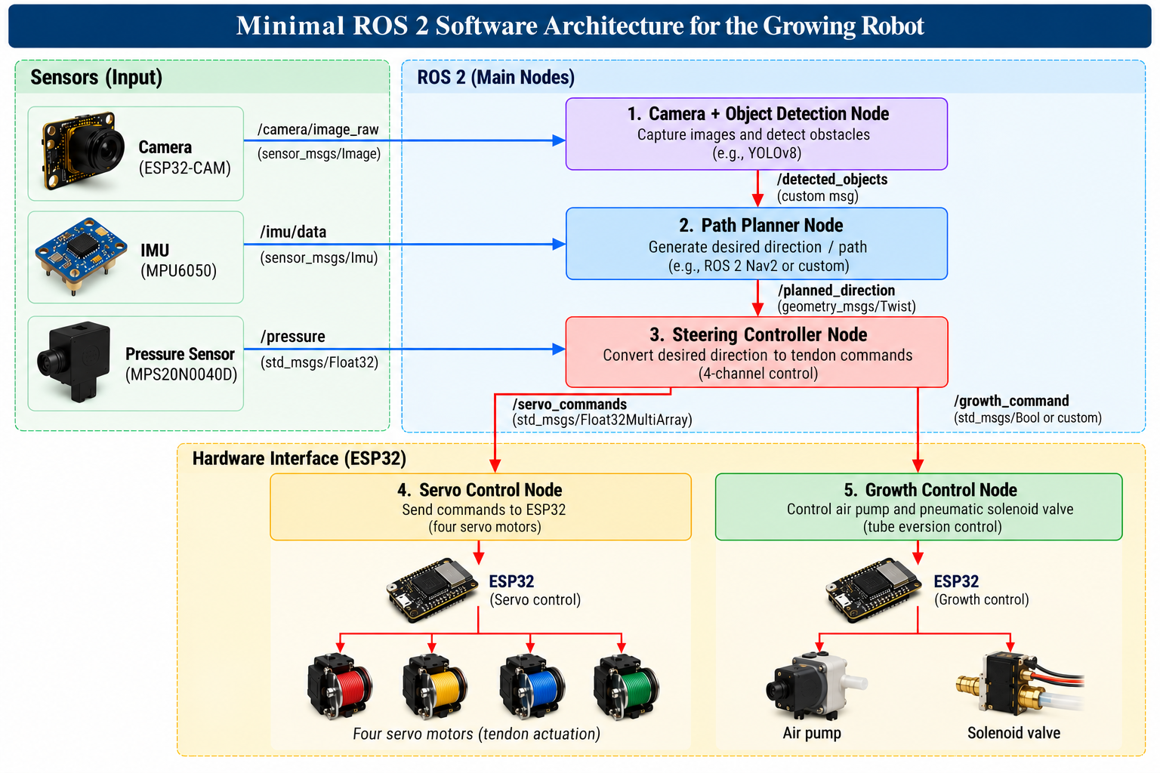
SYSTEM WORKFLOW & SOFTWARE ARCHITECTURE | CHAPTER 05
End-to-End System Workflow & ROS 2 Framework
Modular software nodes communicating across perception, path planning, and embedded actuation.
INTEGRATED SYSTEM WORKFLOW LOOP
1. Initialization: ROS 2 nodes, camera stream, ESP32 UART, & pneumatic manifold initialize.
2. Pneumatic Growth: Regulated air enters chamber; tubular membrane begins tip eversion.
3. Frame Acquisition: Tip camera captures visual frames ahead of advancing robot.
4. YOLO Inference: OpenCV resizes/letterboxes frames; YOLO outputs bounding boxes.
5. Path Planning: ROS 2 node determines obstacle-free trajectory setpoint.
6. Steering Kinematics: Controller converts target angle into 4 differential tendon lengths.
7. Servo Actuation: ESP32 generates PWM pulses for 4 base-mounted servo motors.
8. Cable Payout: Motorized drums release tendon slack synchronous with tube growth.
9. Pressure & Safety: Pressure transducer ensures line pressure stays within safe thresholds.
Figure 5.1: ROS 2 Software Architecture & Hardware Interface
Robo-Root: Plant-Root-Inspired Pneumatic Tip-Growing Robot | CUSAT Major Project 2026
Slide 5 of 10

Slide 6
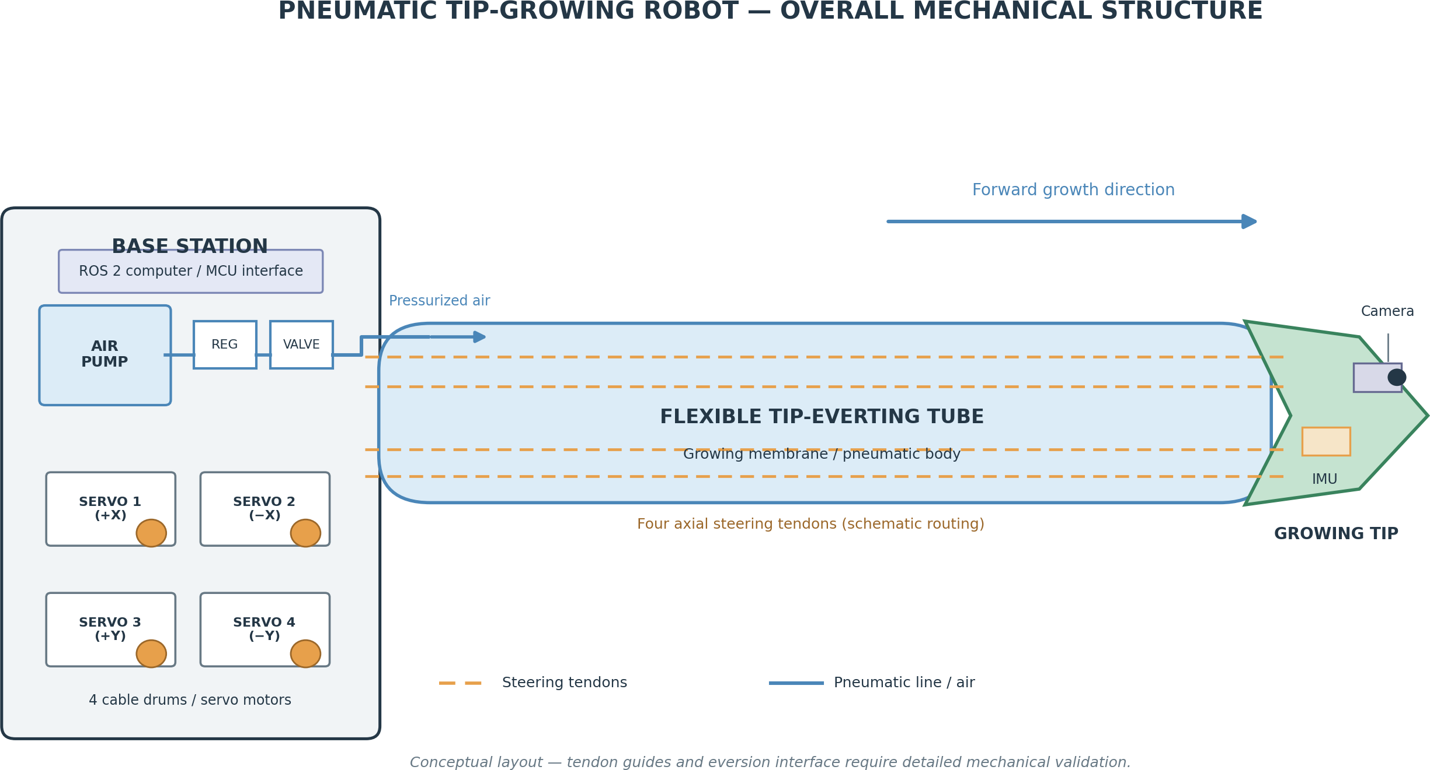
MODULAR STRUCTURE: MECHANICAL | CHAPTER 06
Mechanical Design & Tip-Eversion Mechanism
Pneumatic inversion dynamics, base-station structural layout, and internal lumen routing.
MECHANICAL DESIGN PRINCIPLES
• Tip Eversion Dynamics: The robot body consists of a flexible, airtight membrane folded inwards upon itself. Pneumatic pressure applied internally forces new material to unfold exclusively at the tip, pushing the robot forward without sliding friction.
• Base Station Assembly: Houses the primary structural weight: the air supply connection, pressure regulator, four servo actuators, cable payout drums, and control electronics. Isolates delicate parts from hazardous environments.
• Growing Tip Head Assembly: A lightweight, rigid circular ring mounted at the inversion point. Acts as the anchor for the 4 steering tendons, mounts the micro-camera module, and ensures circular aperture maintenance.
• Internal Working Lumen: The hollow central core forms a protected conduit that carries tendon cables, camera wiring, and pneumatic hoses without exposing them to exterior dirt, sand, or debris.
Figure 6.1: Overall Mechanical Structure of the Pneumatic Tip-Growing Robot
Robo-Root: Plant-Root-Inspired Pneumatic Tip-Growing Robot | CUSAT Major Project 2026
Slide 6 of 10

Slide 7
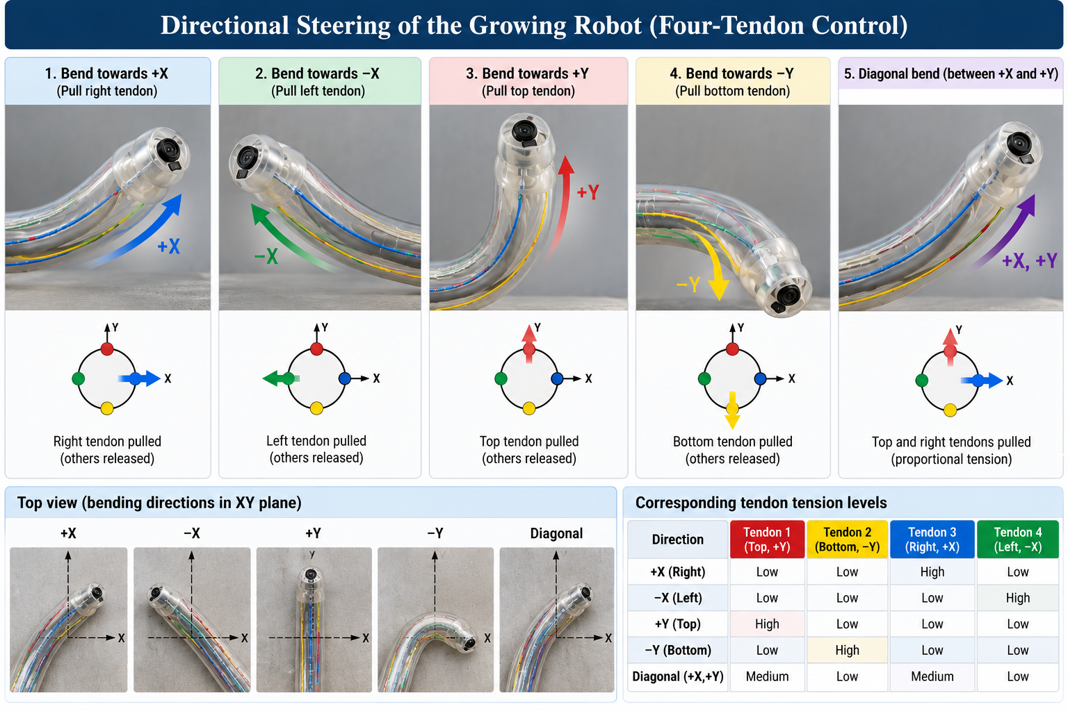
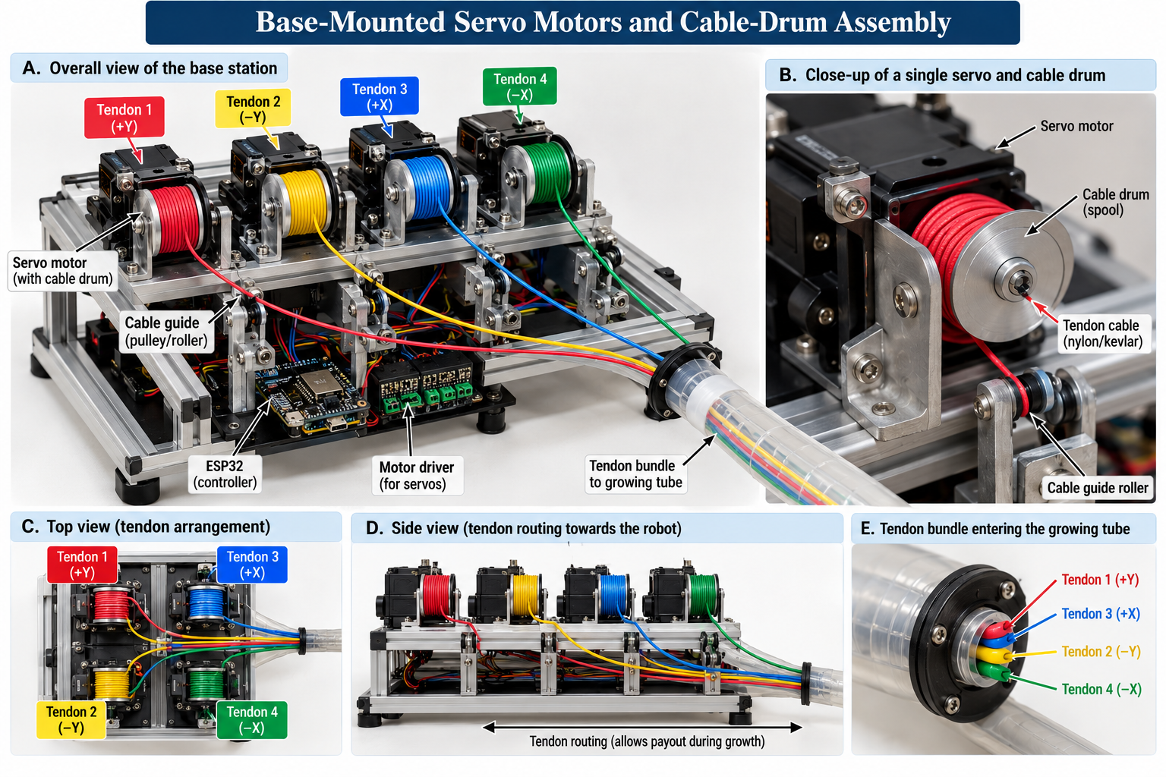
MODULAR STRUCTURE: STEERING & ACTUATION | CHAPTER 06
Four-Tendon Steering & Base-Mounted Servo Mechanism
Decoupling actuation weight from the tip through base-mounted antagonistic cable spools.
DIRECTIONAL STEERING & ACTUATION
• Four-Tendon Orthogonal Arrangement: Four axial cables are routed circumferentially at 90° intervals (North, East, South, West). Antagonistic tensioning allows omnidirectional 2D bending in the X-Y plane.
• Differential Bending Moments: Pulling tendon X+ while releasing tendon X- creates a bending curvature in the +X direction without altering overall growth speed or internal pressure.
• Base-Mounted Actuator Spools: Mounting the four high-torque servo motors at the stationary base keeps tip inertia at zero, preventing front-heavy tipping and allowing high steering agility.
• Dynamic Cable Payout Mechanics: Each servo drives a precision cable drum with guide channels. As the robot grows, tendons pay out in lockstep with the advancing membrane, maintaining consistent tension and avoiding tangling.
Figure 6.2: Directional Steering via Four-Tendon Control
Figure 6.3: Base-Mounted Servo Motors & Cable-Drum Assembly
Robo-Root: Plant-Root-Inspired Pneumatic Tip-Growing Robot | CUSAT Major Project 2026
Slide 7 of 10

Slide 8
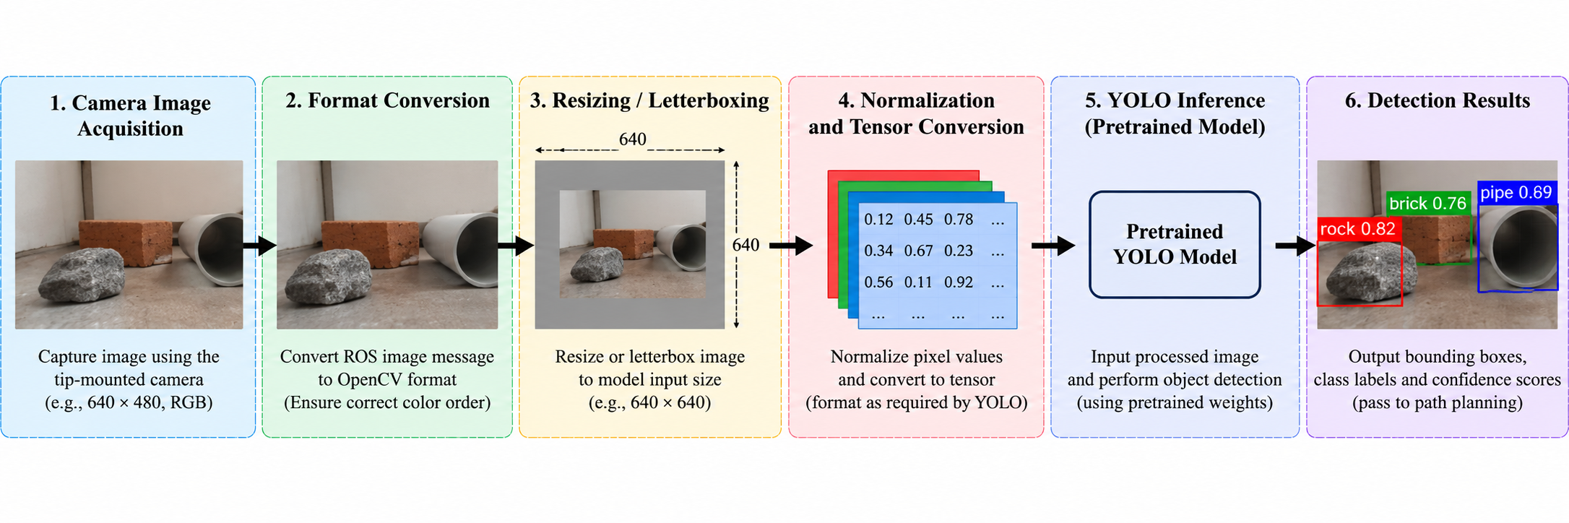
PERCEPTION SYSTEM: YOLO PIPELINE | CHAPTER 04
Tip-Mounted Computer Vision & YOLO Inference Pipeline
From raw camera capture to real-time object classification, bounding boxes, and path planner inputs.
1. CAMERA ACQUISITION & CONVERSION
• Micro-Camera Tip Capture: High-framerate video captures terrain ahead of growing apex.
• ROS 2 Transport & CvBridge: Converts raw sensor buffers into standard OpenCV BGR arrays.
2. PREPROCESSING & LETTERBOXING
• Aspect-Preserving Letterboxing: Resizes frames to 640x640 with symmetric padding.
• Pixel Normalization: Scales RGB values [0, 255] -> [0.0, 1.0] for model tensor batching.
3. YOLO INFERENCE & INTEGRATION
• Pretrained Neural Inference: Multi-scale convolutional feature extraction & class prediction.
• NMS & Trajectory Node: Non-Maximum Suppression sends obstacle coordinates to ROS 2.
Figure 4.1: End-to-End Image Processing & Pretrained YOLO Object Detection Pipeline
Robo-Root: Plant-Root-Inspired Pneumatic Tip-Growing Robot | CUSAT Major Project 2026
Slide 8 of 10

Slide 9
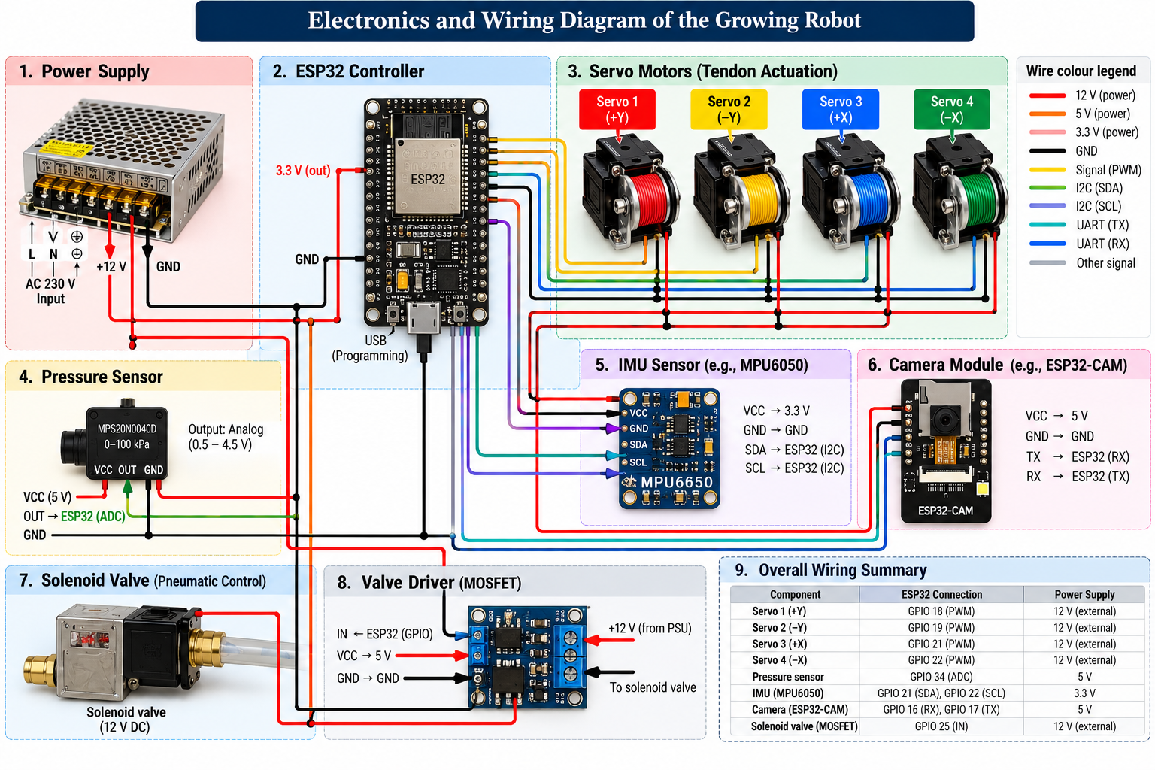
EMBEDDED HARDWARE: ELECTRONICS | CHAPTERS 06 & 07
Electronics, Power Distribution & Interfacing
ESP32 embedded microcontroller bridging high-level ROS 2 commands with physical actuators and sensors.
HARDWARE & ELECTRICAL INTEGRATION
• ESP32 Dual-Core Microcontroller: Manages low-latency real-time actuator control. Receives high-level trajectory commands from host PC via USB/UART and generates high-resolution PWM signals.
• Dedicated High-Current Servo Bus: Steering requires significant torque; four servos are powered by an isolated 5V/6V high-amperage power supply with common ground isolation to prevent logic brownouts.
• Pneumatic Solenoid Valve Driver: Transistor/MOSFET switching circuit controls the air flow solenoid valve, modulating pneumatic growth rate and emergency shutoff.
• Sensory & Safety Interfacing: Integrated pressure sensor continuously transmits pneumatic line pressure to prevent tube over-inflation; supports optional tip IMU sensor for orientation.
Figure 6.4: Electronics and Wiring Diagram of the Growing Robot
Robo-Root: Plant-Root-Inspired Pneumatic Tip-Growing Robot | CUSAT Major Project 2026
Slide 9 of 10

Slide 10
CONCLUSION & FUTURE WORK | CHAPTER 08
Project Summary, Evaluation Benchmarks & Future Scope
Synthesizing key design achievements and outlining empirical test plans for the prototype.
PROJECT DESIGN ACHIEVEMENTS
• Integrated Soft-Growing Architecture: Successfully established a complete design paradigm combining pneumatic tip eversion with 4-tendon steering.
• Actuator Weight Decoupling: Positioned high-torque servos at the base station, eliminating moving tip mass and maximizing navigation agility.
• Vision-Integrated Control: Formulated an end-to-end perception pipeline leveraging pretrained YOLO for real-time obstacle detection.
• Modular ROS 2 Architecture: Created a decoupled framework where mechanical, pneumatic, electronic, and software components can be tested independently.
PLANNED EVALUATION BENCHMARKS
• Pneumatic Growth Rate: Measure deployment velocity (cm/s) as a function of air pressure (kPa) and tube material friction.
• Steering Precision & Deflection: Quantify maximum angular deflection range (0°–90°), hysteresis, and repeatable steering accuracy.
• Perception Latency: Benchmark YOLO frame rate (FPS), detection mAP, and classification confidence under dim lighting.
• Deployment & Retrieval Cycles: Test complete forward growth and tendon-assisted retraction without entanglement or membrane rupture.
FUTURE ENHANCEMENTS
• Closed-Loop Visual Servoing: Incorporate stereoscopic / depth camera sensing for exact metric 3D obstacle distance measurement.
• Tension Feedback Control: Integrate inline miniature load cells on cable drums for closed-loop tension regulation.
• Granular Media Burrowing: Evaluate penetration capabilities in noncohesive dry granular media (sand, loose gravel).
• Autonomous Path Replanning: Implement dynamic obstacle avoidance and SLAM in GPS-denied confined cavities.
Robo-Root: Plant-Root-Inspired Pneumatic Tip-Growing Robot | CUSAT Major Project 2026
Slide 10 of 10

