Slide 1
CAPSTONE : Overview of the directed study

Slide 2
PART I : Understanding the contexts and the data

Slide 3
Task : Importation of useful libraries
Solution :
import pandas as pd : importation of the pandas library
import seaborn as sns : importation of the seaborn library
import matplotlib.pyplot as plt : importation of matplotlib library
import math : importation of mathematics library

Slide 4
PART II : Exploring Fandango's displayed scores compared to actual user ratings

Slide 5
Task : Read the file fandango_scrape.csv
Solution :
Url = 'https://raw.githubusercontent.com/moncoachdata/MasterClass_DS_ML/main/fandango_scrape.csv'
fandango = pd.read_csv(url)
The codes above allow to read fandango_scrape.csv file in the fandango dataframe

Slide 6
Task : Create scatter plot between RATING and VOTES
Solution :
sns.scatterplot(x = 'RATING', y = 'VOTES', data = fandango)
plt.show()

Slide 7

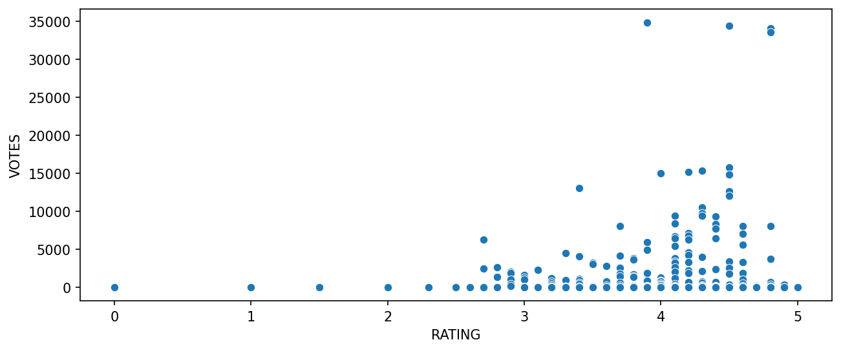

Slide 8
The x-axis represents the columns ‘RATING’, and the y-axis represents the columns ‘VOTES’.
Most of data are clustered between 2 and 5 on the x-axis, but there are few outliers.
There appears to be a positive correlation between RATING and VOTES, as higher values of RATING are associated with higher values of VOTES.
Although, the correlation is positive, it appears to be minimal

Slide 9
Task : Create new columns ‘YEAR’
Solution :
fandango['YEAR'] = fandango['FILM'].str.split('(').str[-1]
The codes above allow to add new columns named ‘YEAR’ in the dataframe of fandango

Slide 10
Task : Visualize the number of film par year with a graphic
Solution :
sns.countplot(x = 'YEAR', data = fandango, palette = 'tab10')
plt.show()

Slide 11
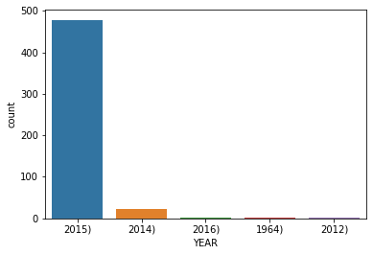

Slide 12
The x-axis represents the columns ‘YEAR’, and the y-axis represents the number of film.
We can see that most of the film in the dataframe fandango was released on 2015

Slide 13
Task : Create KDE diagram between ‘STARS’ and ‘RATING’
Solution :
sns.kdeplot(data = fandango, x = 'RATING', fill = True, clip = (0, 5), label = 'Note réelle')
sns.kdeplot(data = fandango, x = 'STARS', fill = True, clip = (0, 5), label = "Nombre d'étoiles affichées")
plt.legend()
plt.xlim(0, 5.5)
plt.show()

Slide 14
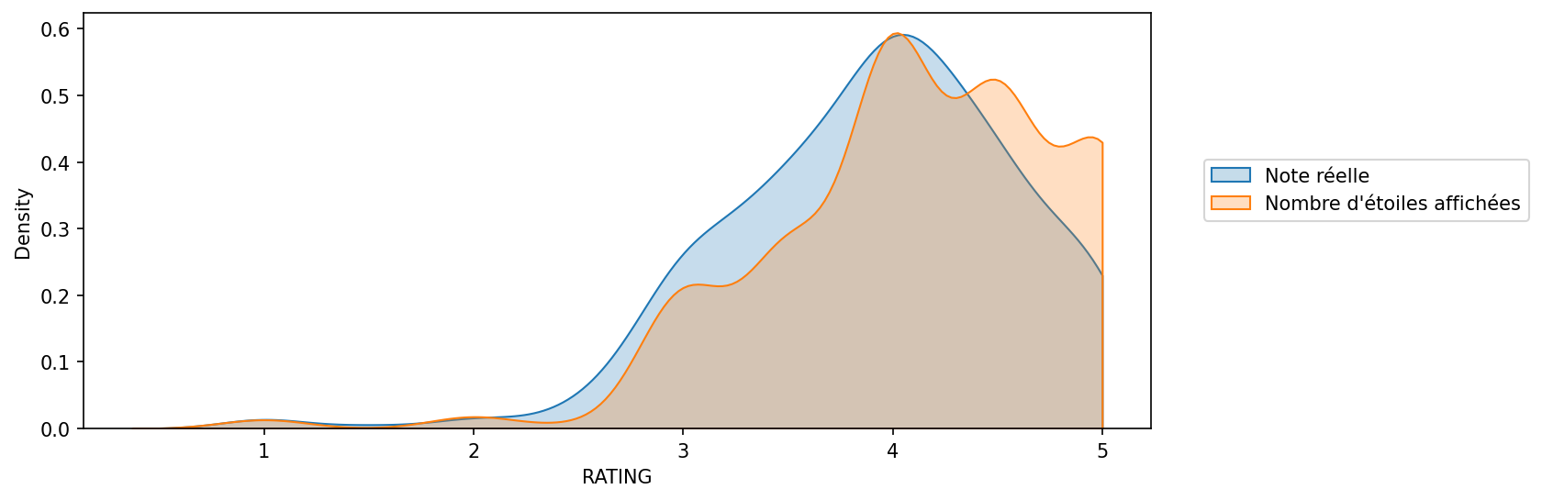

Slide 15
The x-axis represents the columns ‘RATING’ and ‘STARS’, and the y-axis represents the density of both.
The distribution of both is left-skewed with a peak around 0.6

Slide 16
Task : Create count plot to display the number of difference between ‘STARS’ and ‘RATING’
Solution :
fandango['STARS_DIFF'] = round(fandango['STARS'] - fandango['RATING'], 1)
sns.countplot(data = fandango, x = 'STARS_DIFF', palette = 'magma')
plt.show()

Slide 17
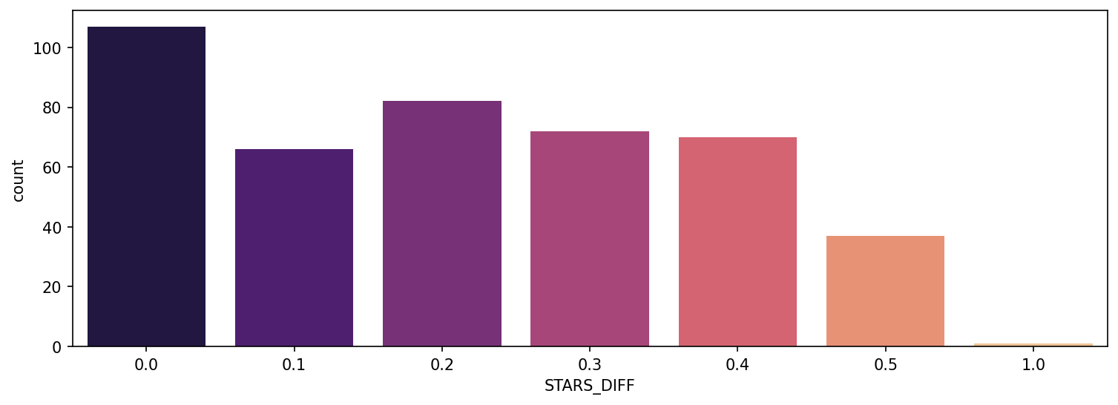

Slide 18
The x-axis represents the columns ‘STAR_DIFF’ which is the difference between ‘STARS’ and ‘RATING’ , and the y-axis represents the number of times of each differences .
Although, the difference with high count is STAR_DIFF = 0.0, we can see that there’s difference with STAR_DIFF = 1.0

Slide 19
PART III : Comparison of Fandango ratings with other platforms

Slide 20
Task : Read All_sites_scores.csv
Solution :
url = 'https://raw.githubusercontent.com/moncoachdata/MasterClass_DS_ML/main/all_sites_scores.csv'
all_sites = pd.read_csv(url)
The codes above allow to read the all_sites_scores.csv dataframe

Slide 21
Task : Create scatter plot between ‘RottenTomatoes’ and ‘RottenTomatoes_User’
Solution :
sns.scatterplot(x = 'RottenTomatoes', y = 'RottenTomatoes_User', data = all_sites)
plt.xlim(0, 100)
plt.show()

Slide 22
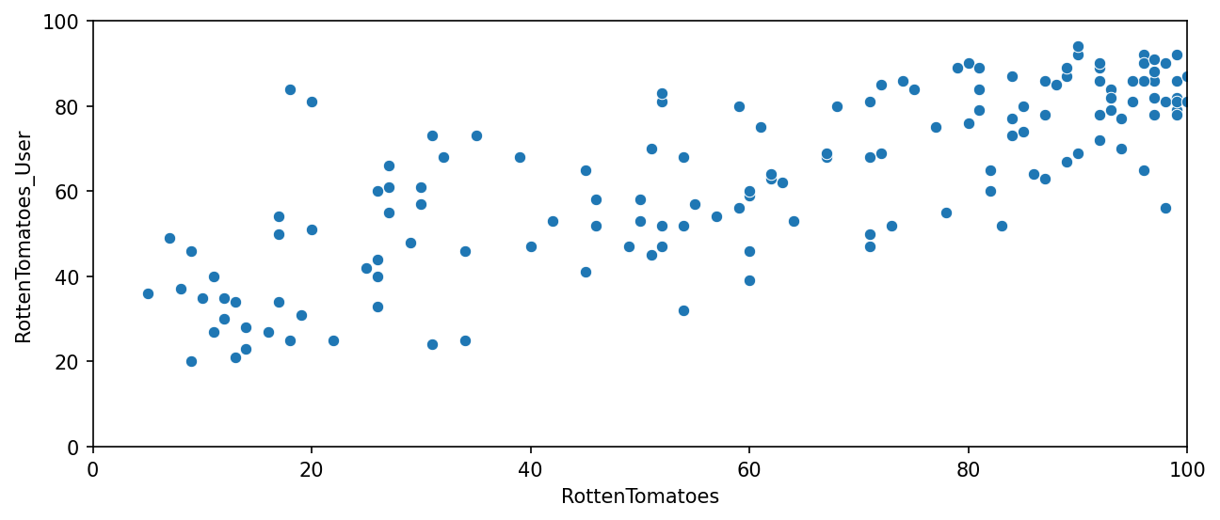

Slide 23
The x-axis represents the columns ‘RottenTomatoes’ , and the y-axis represents the columns ‘RottenTomatoes_User’ .
There appears to be a positive correlation between RottenTomatoes and RottenTomatoes_User

Slide 24
Task : Display the differences distribution between ‘RottenTomatoes’ ‘and RottenTomatoes_User’
Solution :
all_sites['Rotten_Diff'] = all_sites['RottenTomatoes'] – all_sites['RottenTomatoes_User']
sns.displot(x = 'Rotten_Diff', data = all_sites, kde = True, bins = 25)
plt.title('Distribution des notes RT - RT_User')
plt.ylim(0,20.5)
plt.show()

Slide 25
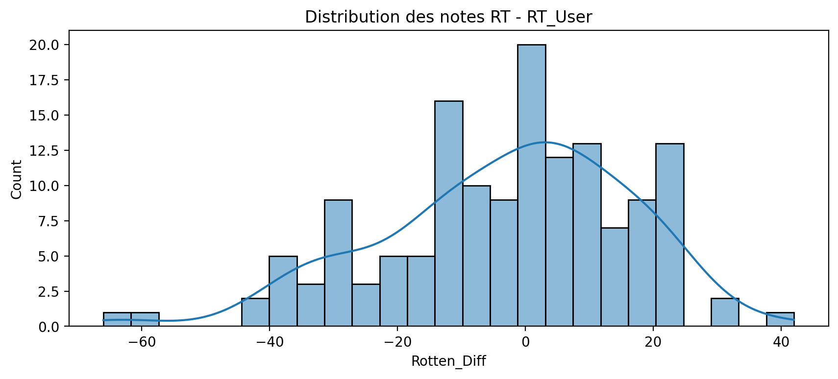

Slide 26
The x-axis represents the columns ‘Rotten_Diff’ which is the difference between ‘RottenTomatoes’ and ‘RottenTomatoes_User’ of the all_sites dataframe , and the y-axis represents the number of each differences.
The diagram is unimodal with a peak ~ 20 in Rotten_Diff = 0
The spread is fairly narrow, with the majority of Rotten_Diff between -40 and 25
We can also see some outliers in the diagram

Slide 27
Task : Display absolute values of ‘Rotten_Diff’
Solution :
rotten_Diff_abs = all_sites['Rotten_Diff'].abs()
sns.displot(x = rotten_Diff_abs, kde = True, bins = 25)
plt.title('Différence absolue entre les notes des critiques RT et les notes des utilisateurs de RT')
plt.show()

Slide 28
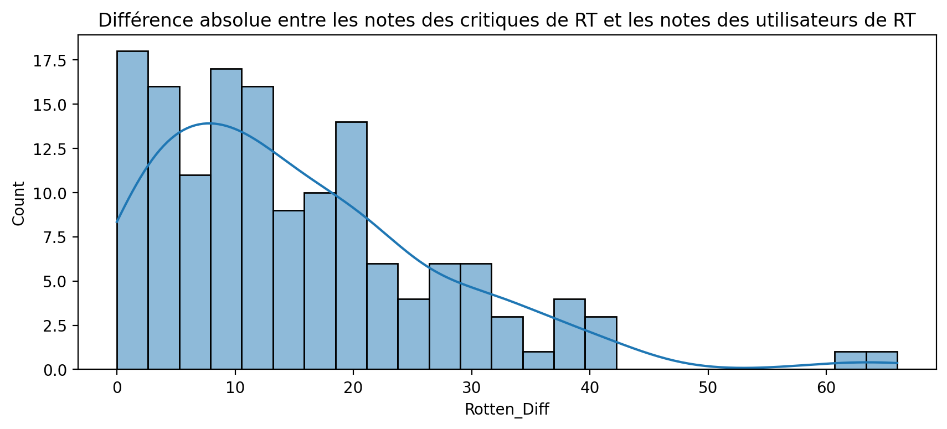

Slide 29
The x-axis represents absolute values of the columns ‘Rotten_Diff’ , and the y-axis represents the number of each differences.
The diagram is right-skewed with a peak ~ 17.5 in Rotten_Diff = 0
The spread is fairly narrow, with the majority of Rotten_Diff between 0 and 40
We can also see outliers in the diagram with Rotten_Diff > 60

Slide 30
Task : Create scatter plot between ‘Metacritic’ and ‘Metacritic_User’
Solution :
sns.scatterplot(data = all_sites, x = 'Metacritic', y = 'Metacritic_User')
plt.xlim(0, 100)
plt.ylim(0, 10)
plt.show()

Slide 31
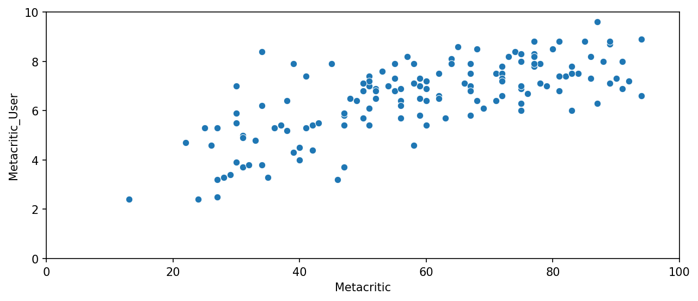

Slide 32
The x-axis represents the columns ‘Metacritic’ , and the y-axis represents the columns ‘Metacritic_User’ .
There appears to be a positive correlation between Metacritic and Metacritic_User
Datas are mostly clustered between 20 and 100 on the x-axis, but there is outlier on 0 < Metacritic < 20 .

Slide 33
Task : Create scatter plot between ‘Metacritic_user_vote_count’ and ‘IMDB_user_vote_count’
Solution :
sns.scatterplot(data = all_sites, x = 'Metacritic_user_vote_count', y = 'IMDB_user_vote_count')
plt.show()

Slide 34
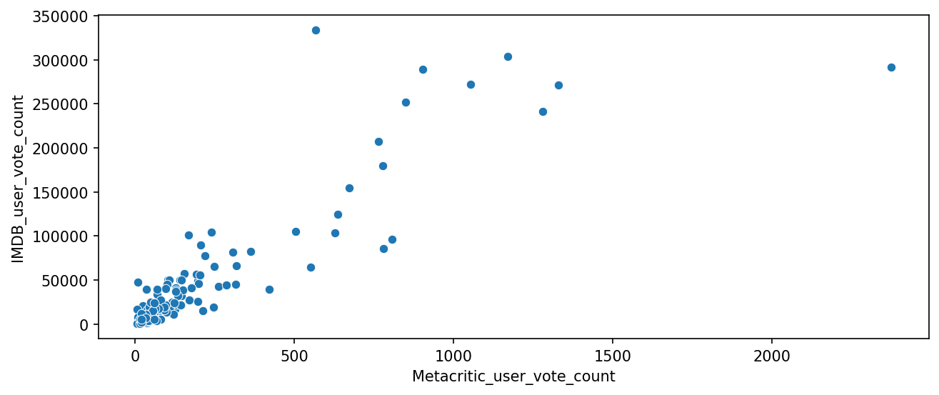

Slide 35
The x-axis represents the columns ‘Metacritic_user_vote_count’ , and the y-axis represents the columns ‘IMDB_user_vote_count’ .
There appears to be a positive correlation between Metacritic and Metacritic_User
Datas are mostly clustered between 0 and 400 on the x-axis, but there are few outliers like on Metacritic_user_vote_count > 2000 or on 300000<IMDB_user_vote_count <350000 .

Slide 36
Task : Create diagram of comparison between scores
Solution :
norm_scores = fusion[['STARS', 'RATING', 'RT_Norm', 'RTU_Norm', 'Meta_Norm', 'Meta_U_Norm', 'IMDB_Norm']]
sns.kdeplot(data = norm_scores, fill = True, clip = (0, 5))
plt.xlim(-0.5, 5.5)
plt.show()

Slide 37
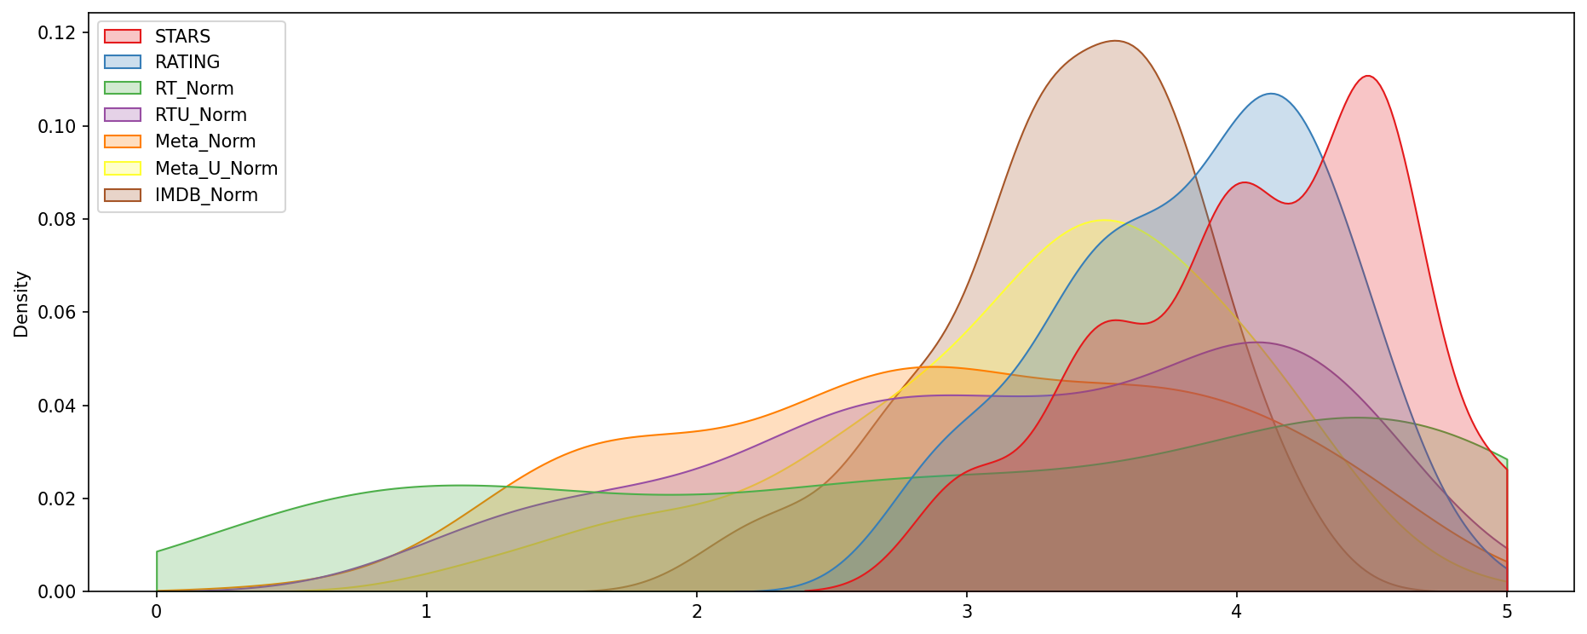

Slide 38
We can see that the distribution of fandango is the most unequal
However, the distribution of RottenTomatoes is the most uniform

Slide 39
Task : Display the comparison of RottenTomatoes and fandango
Solution :
sns.kdeplot(data = norm_scores[['RT_Norm', 'STARS']], fill = True, clip = (0, 5))
plt.xlim(-0.5, 5.5)
plt.show()

Slide 40
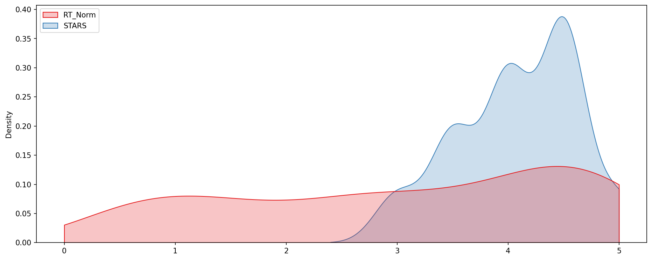

Slide 41
We can see that there’s big difference between the uniformity of RottenTomatoes and fandango scores
The density peak of RottenTomatoes is around 0.15 and for fandango is around 0.40

Slide 42
Task : Create comparison histogram of every normalized scores
Solution :
sns.histplot(data = norm_scores, palette = 'tab20', bins = 50)
plt.xlim(-0.5, 5.5)
plt.show()

Slide 43
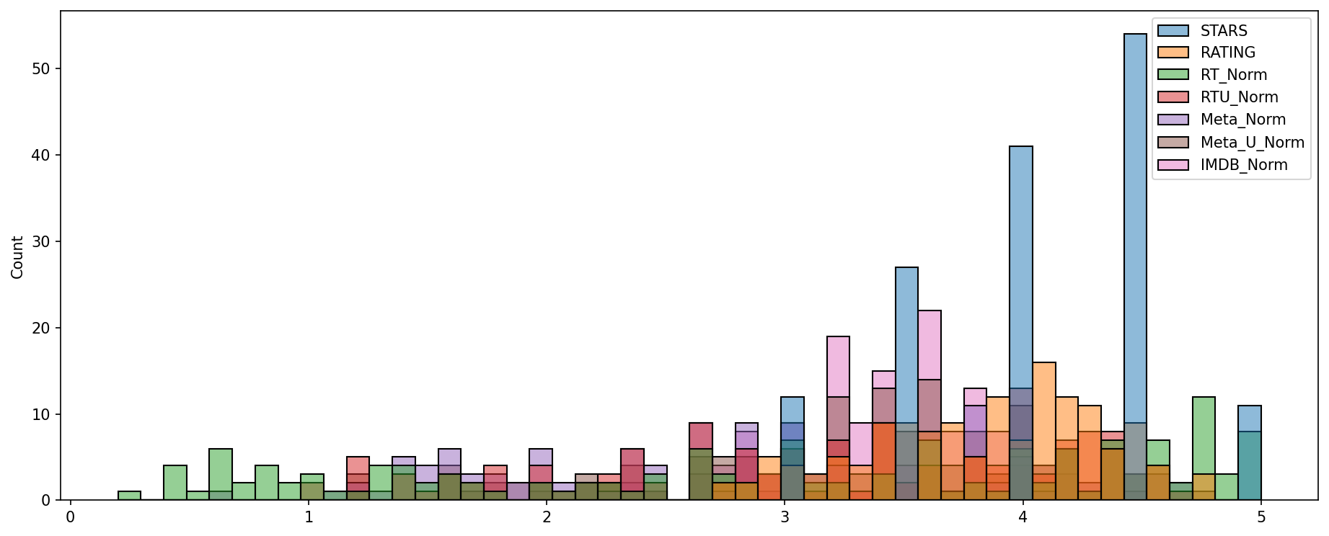

Slide 44
The diagram is left-skewed with a peak around 55 and it is fandango scores

Slide 45
Task : Create clustermap of normalized scores
Solution :
sns.clustermap(norm_scores)
plt.show()

Slide 46
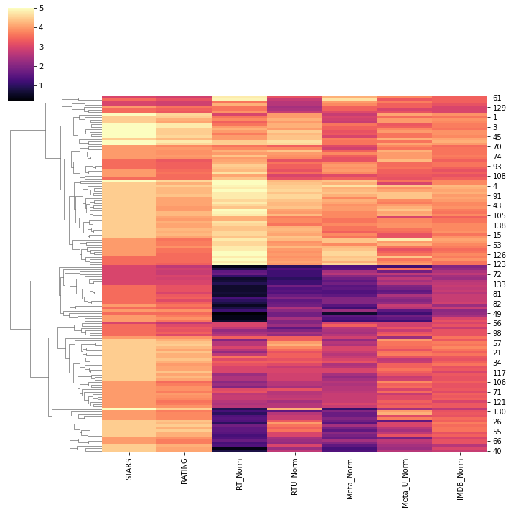

Slide 47
We can see that Fandango rates movies much more generously than other platforms in the clustermap.

Slide 48
Task : Visualize notes distribution of top 10 worst films in function of RottenTomatoes scores
Solution :
norm_scores['FILM'] = fusion['FILM']
RT_rates = norm_scores.sort_values(by = 'RT_Norm', ascending = True).head(10)
sns.kdeplot(data = RT_rates, fill = True, clip = (0, 5))
plt.show()

Slide 49
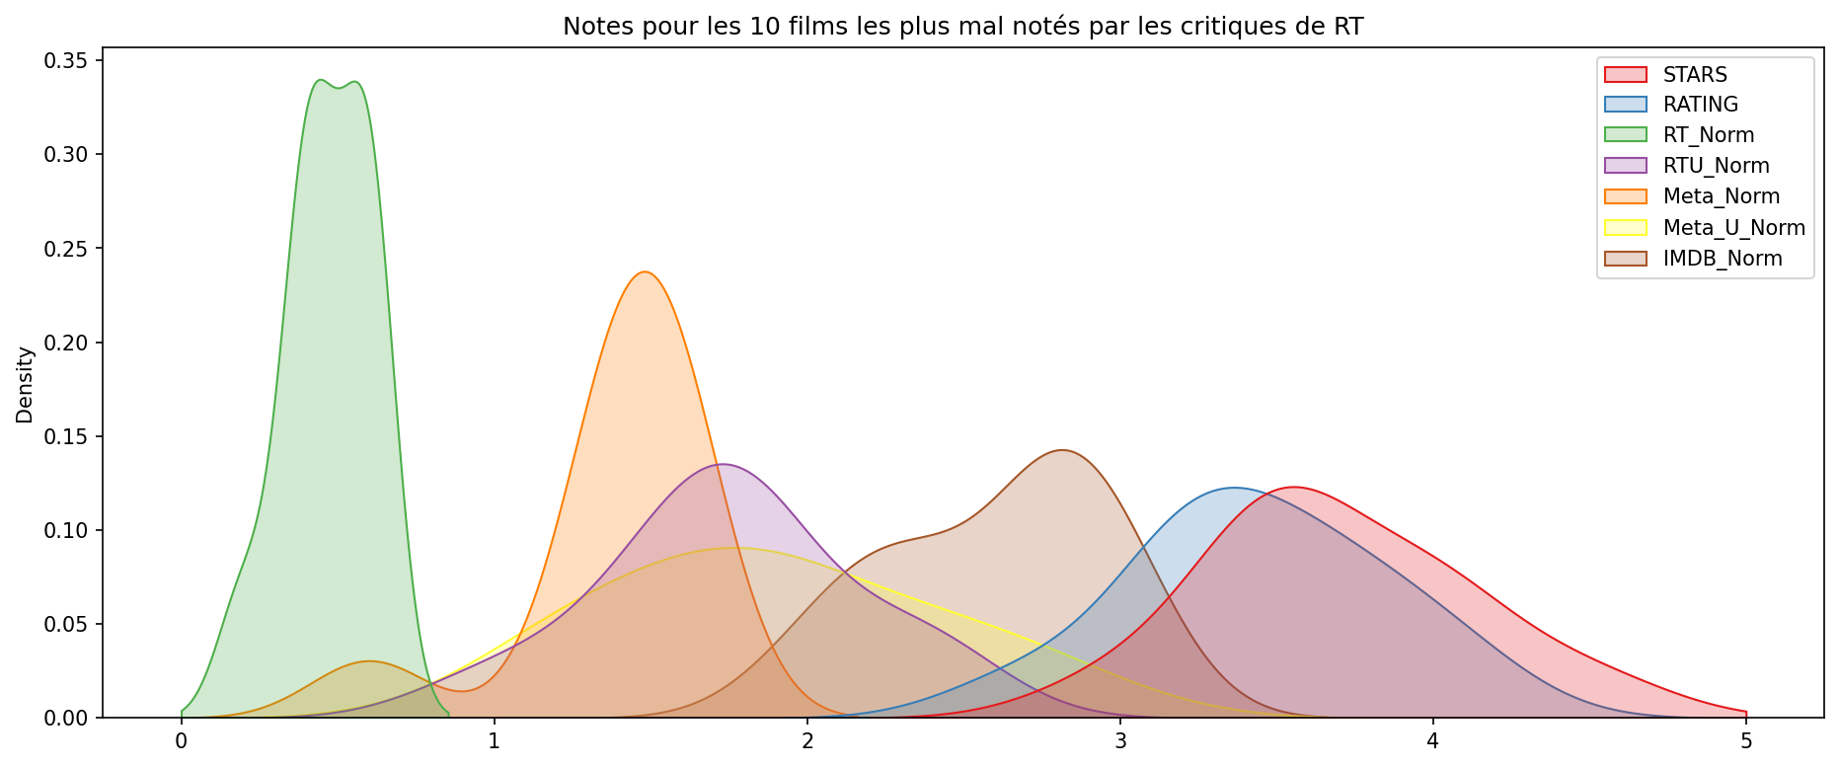

Slide 50
Since that the distribution is in function of RottenTomatoes scores, we can see that the most high density is RT_norm which is situate between 0 and 0.9 in x-axis
Fandango has the most good score for the top 10 worst films which situate between 2.5 and 5 in x-axis

Slide 51
CONCLUSION :
Fandango gives very good score for many bad films
Example : Taken 3. Fandango gave 4.5 stars for a film which has average rating of 1.86 in the others platforms

