Slide 1


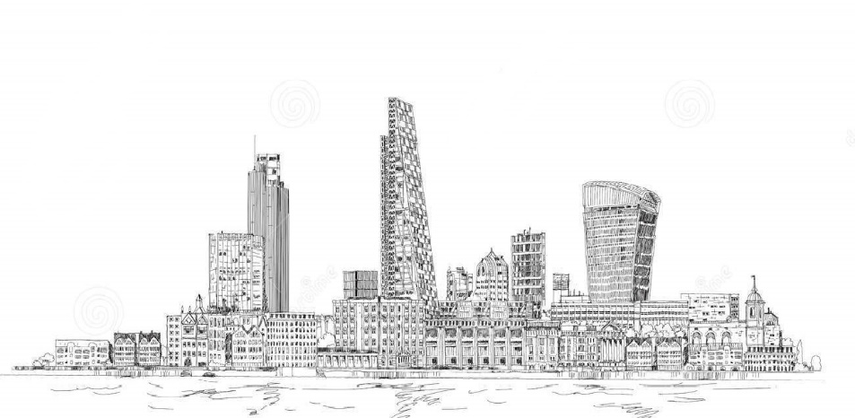
http://ourcity.azurewebsites.net/
…making people aware

Slide 2
Aapli City (Our City)
Making people aware of businesses and services around them.
Designed specifically for my city (Dhule).
Before buying from a particular shop, the citizens can browse the
website and see whether it is available in some other shops
A very simple design interface so the website will load
quickly even on 2G internet.
No complex animations or styles so the website is very
user friendly.

Slide 3
Upcoming Updates…
Utilizing Office 365 for giving the customers their own email ID’s
Merging their existing ID’s and social network credentials to the Office 365 ID’s “ Social Integration “
Responsive design (Bootstrap)
Google Location and Navigation Facility
Registration of the businesses on Google Bussiness
Apps for Windows, Android, iOS, etc.
Include multi-language options for ease of the common public.

