Slide 1
Restaurant Review System
Advanced Database Management System Mini-Project

Slide 2
FUNCTIONALITIES
1. Review Submission:
Enable users to submit reviews for restaurants they have visited.
Allow users to provide ratings, write text reviews, and include photos if desired.
2. Rating Calculation:
Automatically calculate and update restaurant ratings based on user reviews and ratings (using triggers) .
3. Look up Ratings:
User can look up ratings of most rated or most review restaurants.
4. Better Visualization:
Graphs and charts based on ratings provided by users are generating for comparison and are accessible to all users.
5. Interactive User Interface:
Intuitive and user-friendly interface that encourages user engagement.

Slide 3
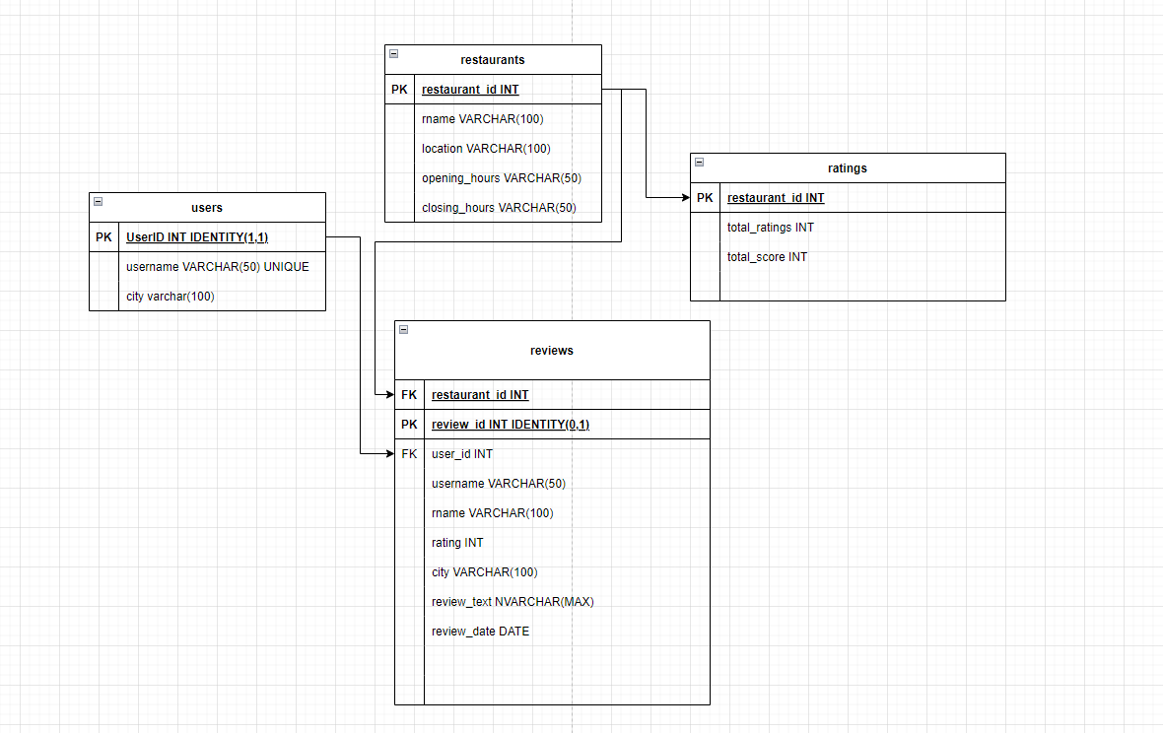
DATABASE SCHEMA

Slide 4
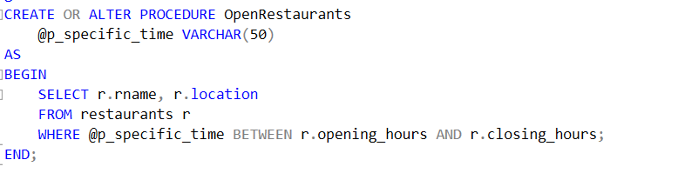

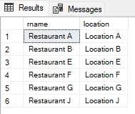
SQL QUERIES
1. Find Restaurants opened at specific time

Slide 5
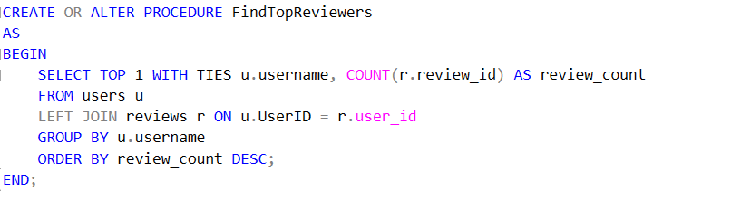


SQL QUERIES
1. PL/SQL Procedure to Find Users with the Most Reviews

Slide 6
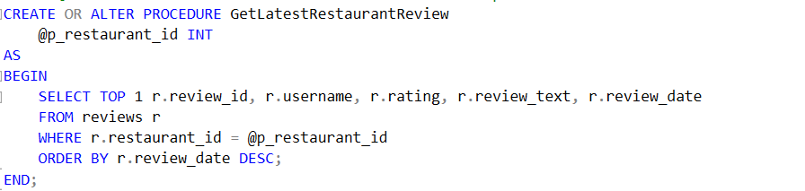


SQL QUERIES
1. PL/SQL Procedure to Retrieve the Latest Review for a Specific Restaurant

Slide 7
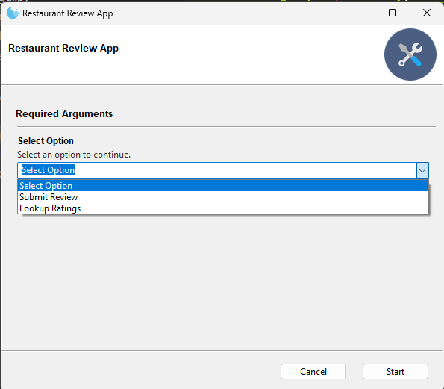
GUI
Menu.py

Slide 8
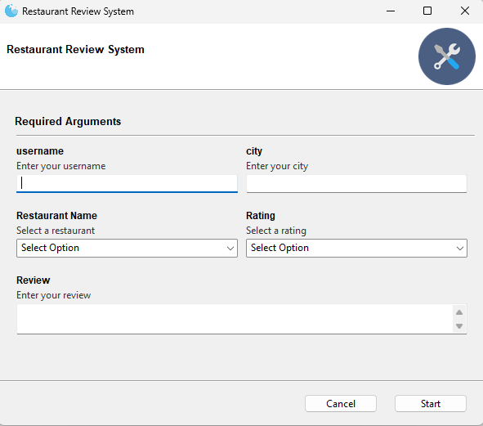
Submit_review.py

Slide 9
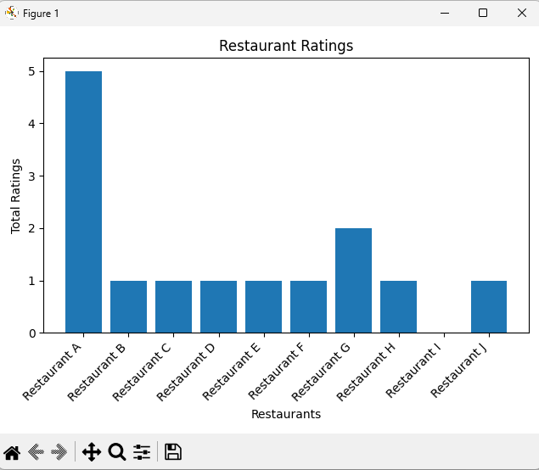
Lookup_ratings.py

Slide 10
Thank YOU

