Slide 1
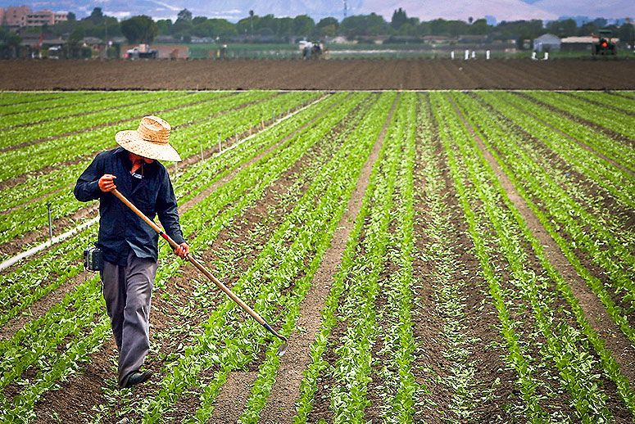
(SOFTWARE ENGINEERING) ECSE205L
FarmOcon
Done by
MIHIR SIRPAUL E19CSE217
VIVAN SINGH CHAUHAN E19CSE249
DAKSH JAIN E19CSE
SIDDARTH MITTAL E19CSE

Slide 2
Contents
Introduction
Problem
Solution
Tech utilized
Feedback
Acknowledgement

Slide 3


Slide 4
In the current scenario, fruits and vegetables reach the market through manual calling system or through agents.
Farmers grow it in the field and then sell in market through agents. Transportation helps them to reach market.
We are planning to make an android app as well as website, where a farmer can connect to cold storage people, cold storage can connect to adat people and adat people can connect to local fruit/vegetable market.
According to the demand of the city, the adat people can order cold storage people and ask them to deliver.
We aim to made an interlinkable link of all the people who made this process succesful from Farmers to consumers through an app.

Slide 5

Problem that our project solves

Slide 6
Problem Statement
In the existing system, residents buy fruits & vegetables either from retailers or through online preexisting startups like Big basket. As the farmers are not able to contact cold storage people very easily without hiring any agents, this results in the spoilage of fruits & vegetables. According to the research we have done, in most of the current startups, residents receive fruits & vegetables directly from farmers. As many of the residents go to their local market to buy the best quality of fruits & vegetables, they don't prefer to deliver at their homes too.

Slide 7


Slide 8
Solution
So, according the proposed system we have to create more and more job opportunities, we aim to make an android application as well as website which connects all the people from farmers to residents. We aim to democratize the jobs rather than cutting them. So,farmer,coldstorage,warehouse,wholesaler,retailer can connect with everyone on one platform. According to the demand of the market, each one of them can order without wasting any sort of time.

Slide 9






TECH UTILIZED

Slide 10
FEEDBACK
Akarshit Jain- akijain02@gmail.com SDE at EagleView Bangalore, Ex-Bitsian. He believes that this project has the potential as it will not only help the residents but also to the retailers, wholesalers, cold storage people, and farmers. He recommended some additional features through which a buyer can easily purchase fruits and vegetables.

Slide 11
Acknowledgement
We would like to thank our mentors Dr. Tapas Badal and Dr. Hiren (Department of computer sci. engineering) for helping us with the project and guiding us through our obstacles in making the project a success.

Slide 12


