Slide 1
Food Delivery Time Prediction
Author: Meet Patel, Mihir Chitre
Institution: Khoury College of Computer Science Northeastern University, Boston.
Professor: Ahmad Uzair
Course: Machine Learning - CS 6140

Slide 2
Introduction
Our project aims to leverage machine learning classifier models for practical applications.
We focused on predicting food delivery times, considering factors such as delivery personnel info, order details, weather, and traffic.
Accurate predictions hold potential for enhancing operational efficiency and customer satisfaction in the food delivery industry.

Slide 3
Problem Statement
Objective: Predicting Food Delivery Time
Challenge: Estimating accurate food delivery times
Goal: Develop accurate predictive Machine Learning models that consider various influential variables to estimate delivery times effectively.

Slide 4
Understanding Dataset
Categorical Features: Weather Condition, Road Traffic, Type of order, Type of vehicle, Festival, City.
Numerical Features: Delivery Person Age, Delivery Person Ratings, restaurant and delivery location latitude-longitude, Vehicle condition, Multiple deliveries.
Other Features: ID, Delivery Person ID, Order Date, Time Ordered, Time Order Picked
Target Feature: Time taken(min)
Source:https://www.kaggle.com/datasets/gauravmalik26/food-delivery-dataset?select=train.csv

Slide 5
Exploratory Data Analysis

Slide 6
Data Cleaning
Handling missing values from the features
Removing (min) suffix from the target variable
Handling incorrect restaurant latitude and longitude
Converting the data types.

Slide 7
Feature Engineering
Extracted City Code from Person ID
Calculate the distance between restaurant location and delivery location
Calculate the Order Preparation Time
Create new features using Order day such as whether it was the start of the month or not, weekdays versus weekends, and the influence of order day, month, and week on the food delivery time.

Slide 8
Data Preprocessing
Perform label encoding on categorical variables
Splitting the dataset into training set, validation set and test set
Performed feature scaling

Slide 9
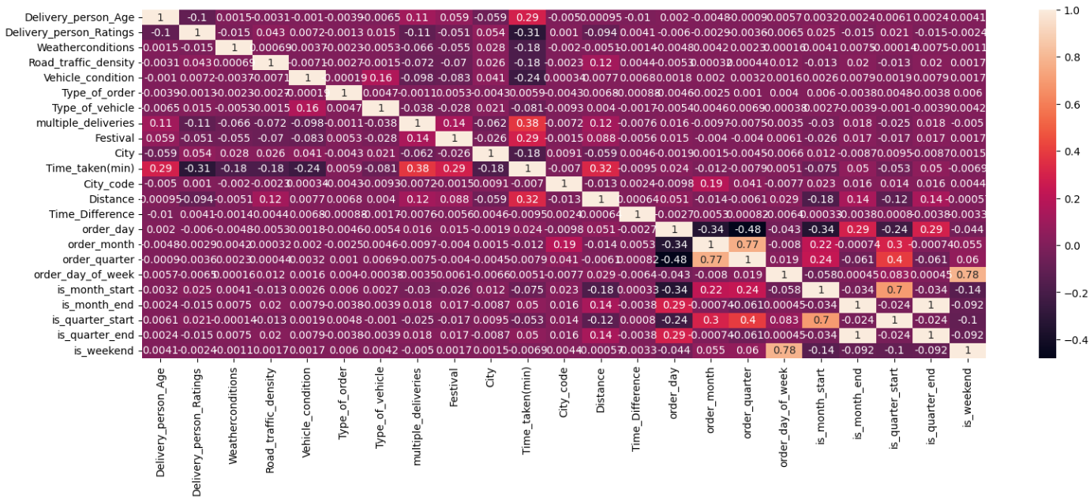
Feature Selection

Slide 10
Implementation
Scratch Model Implementation
Linear Regression
Ridge Regression
Decision Tree Regression
Built-in Library Implementation
Lasso Regression
Random Forest Regression
Support Vector Regression
XGBoost Regression
AdaBoost Regression

Slide 11
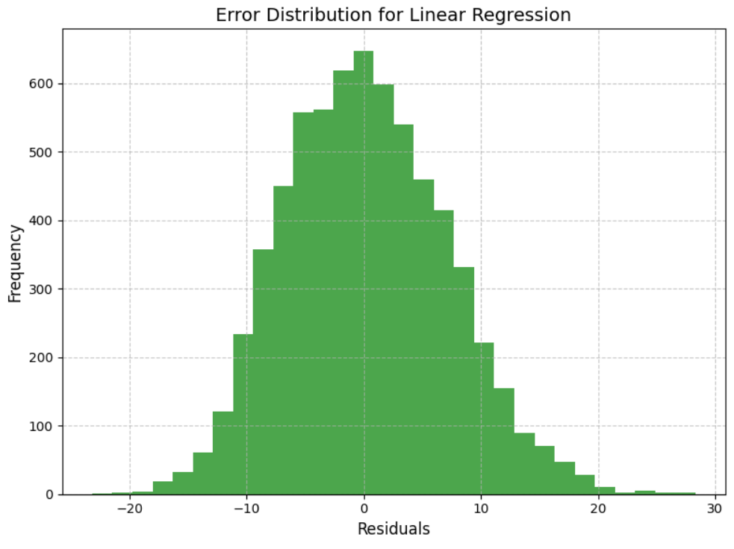
Linear Regression

Slide 12
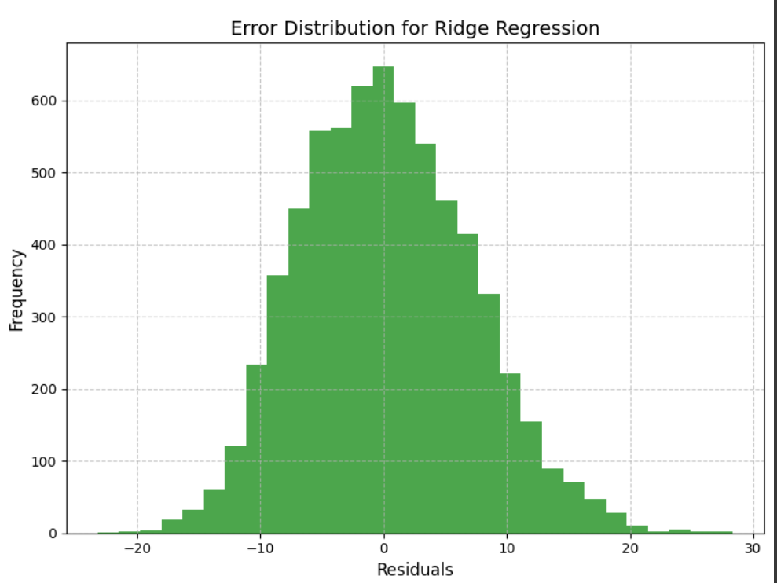
Ridge Regression

Slide 13
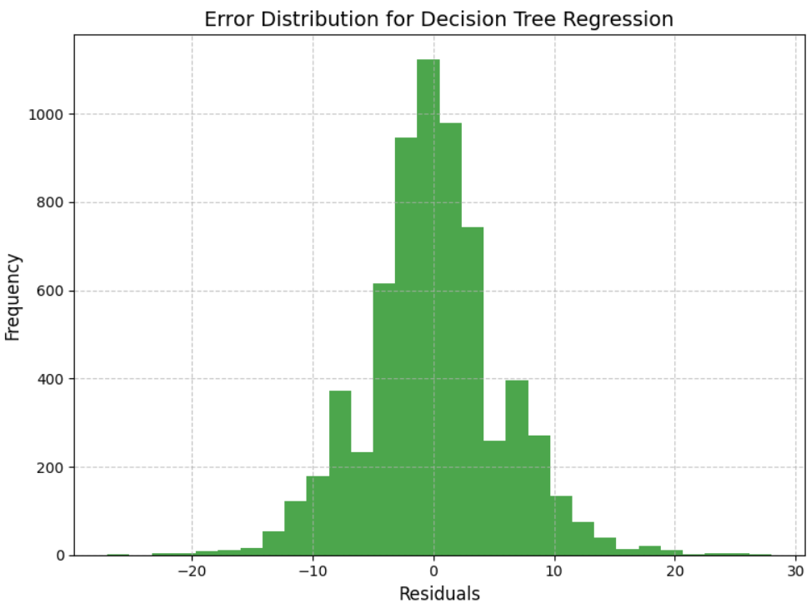
Decision Tree Regression

Slide 14
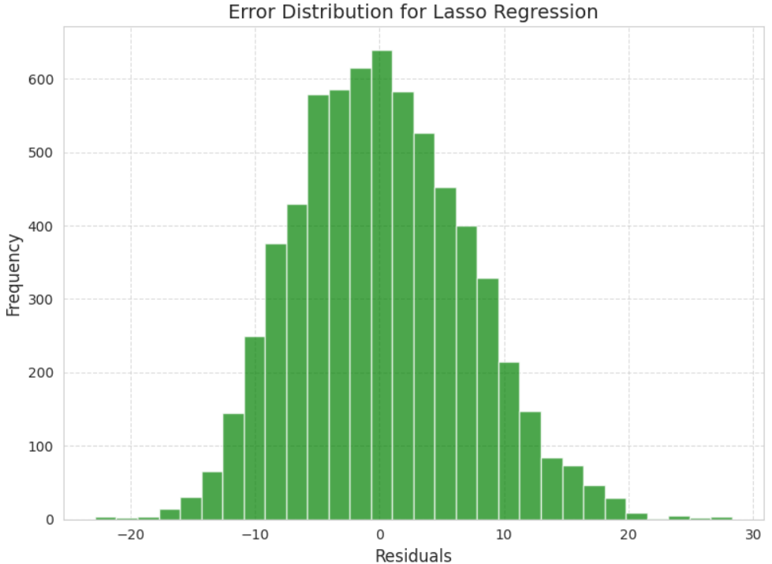
Lasso Regression

Slide 15
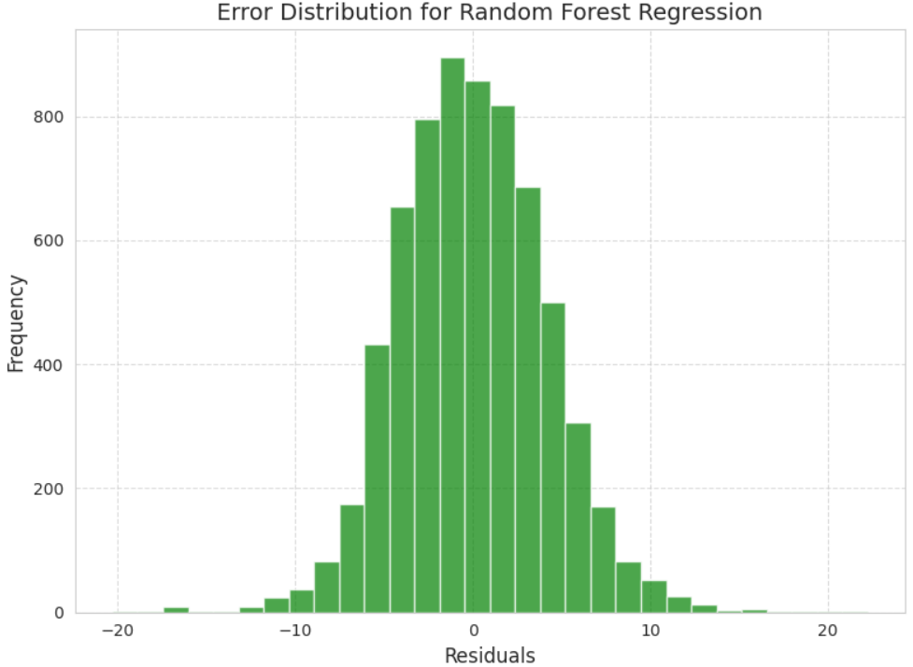
Random Forest Regression

Slide 16
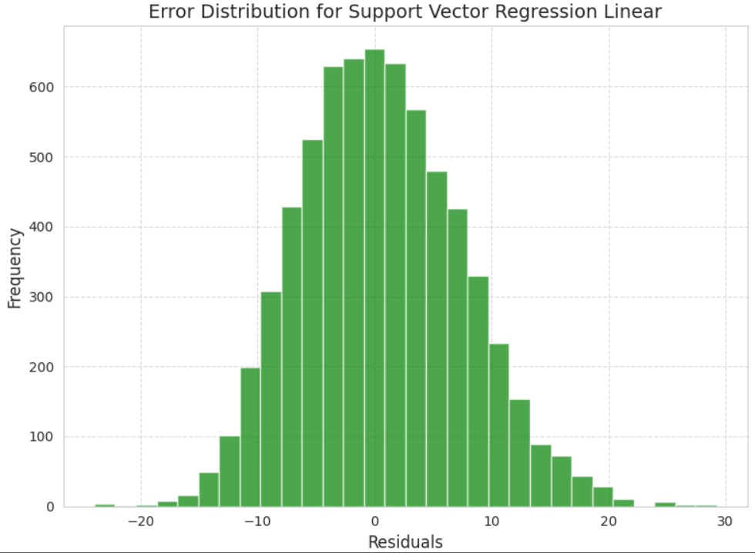
Support Vector Regression Linear

Slide 17
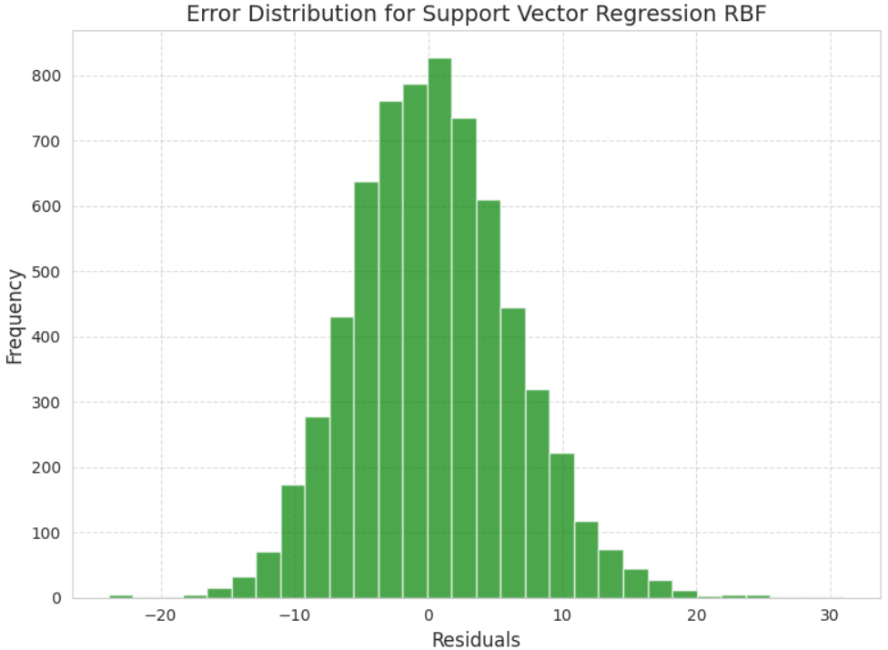
Support Vector Regression RBF

Slide 18
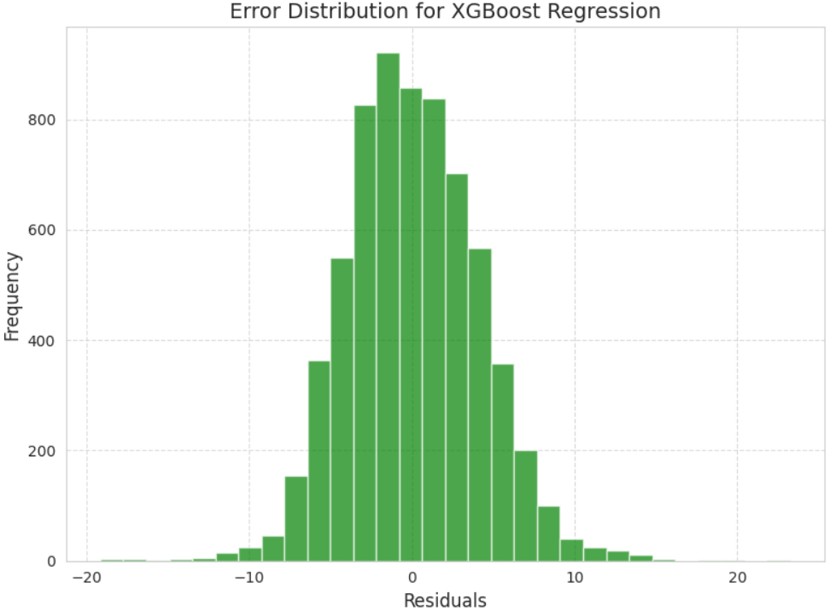
XGBoost Regression

Slide 19
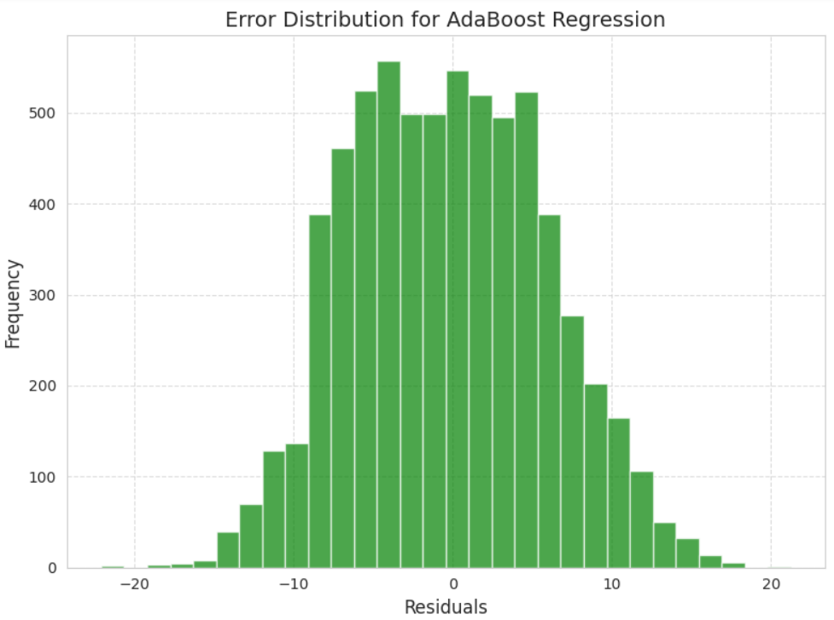
AdaBoost Regression

Slide 20
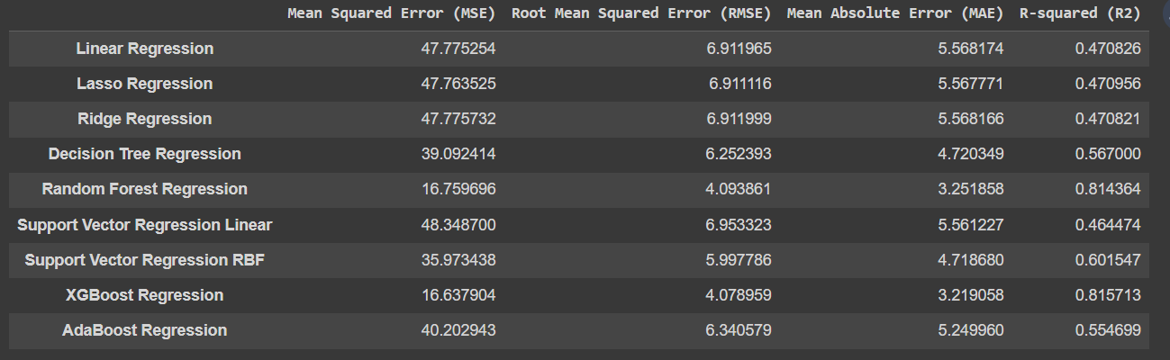
Results before hyperparameter tuning

Slide 21
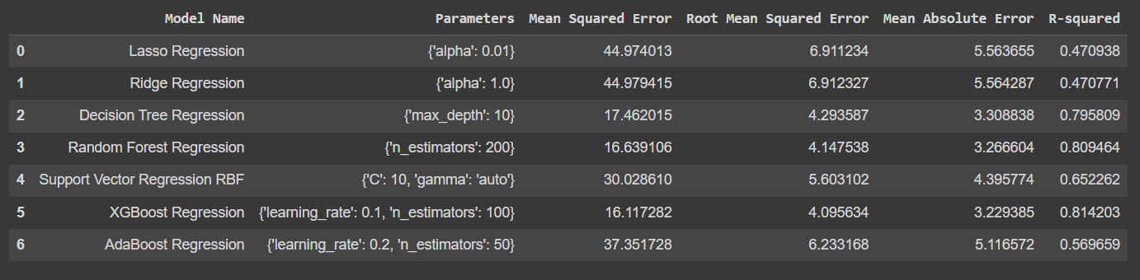
Results after hyperparameter tuning

Slide 22
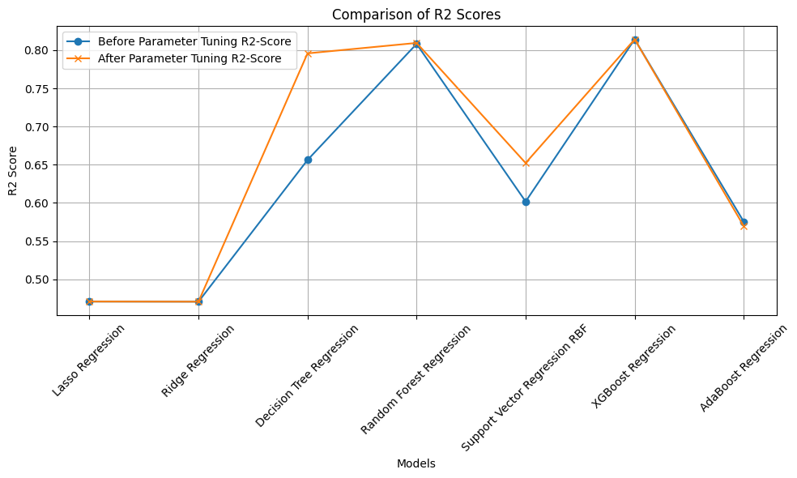
Results

Slide 23
ANN Model Architecture
Input Layer: Input layer has 19 neurons, number of feature variables.
Hidden Layers: Different configurations were tested ranging from 1 to 5 layers with the units of 64, 128, 256 per layer.
Output Layer: Single neuron responsible for predicting food delivery time.
Model Compilation: Adam Optimizer and MSE loss function
Early Stopping: patience of 5 epochs

Slide 24
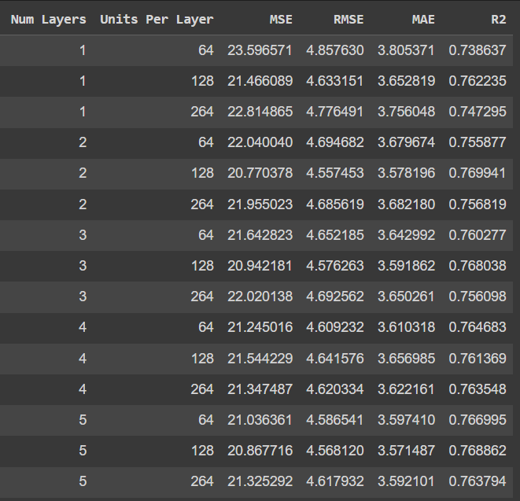
ANN Results

Slide 25
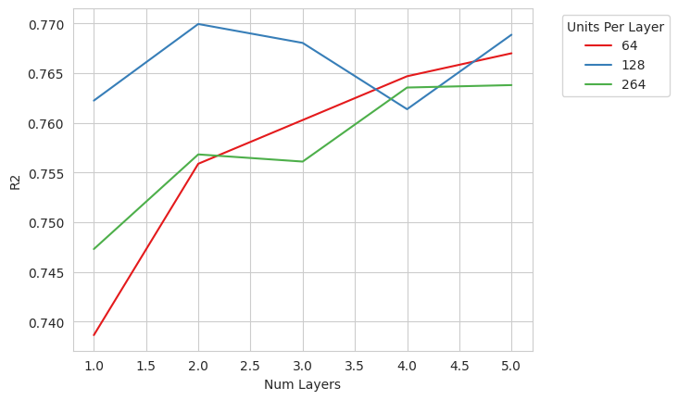
ANN Results

Slide 26
Conclusion
In our food delivery time prediction study, XGBoost emerges as the top performer with an impressive R2 score of 0.81, showcasing its ability to capture target variance effectively.
Linear, ridge, and lasso regression models exhibit similar performance with an R2 score of 0.47. Surprisingly, regularization (lasso and ridge) has minimal impact on these models.
Random forest regression excels, achieving an R2 score of 0.8, indicating its strong capability to capture intricate data relationships.
Notes:
Summary:
While Decision tree regressor, Support Vector Regression (SVR), and AdaBoost models deliver satisfactory R2 scores, SVR with radial basis function kernel (SVR rbf) surpasses linear SVR, excelling in capturing complex nonlinear patterns.
Custom linear regression, ridge regression, and decision tree models perform on par with standard libraries, confirming their reliability.
Optimal Artificial Neural Network (ANN) configuration includes 2 hidden layers with 128 neurons, yielding the highest R2 score among tested ANN models.
Grid Search CV significantly enhances Decision tree regressor and Support vector regression, while limited improvement is observed in other models. This study provides insights into model strengths and guides effective food delivery time prediction.

Slide 27
Conclusion
While Decision tree regressor, Support Vector Regression (SVR), and AdaBoost models deliver satisfactory R2 scores, SVR with radial basis function kernel (SVR rbf) surpasses linear SVR, excelling in capturing complex nonlinear patterns.
Custom linear regression, ridge regression, and decision tree models perform on par with standard libraries, confirming their reliability.
Optimal Artificial Neural Network (ANN) configuration includes 2 hidden layers with 128 neurons, yielding the highest R2 score among tested ANN models.
Grid Search CV significantly enhances Decision tree regressor and Support vector regression, while limited improvement is observed in other models. This study provides insights into model strengths and guides effective food delivery time prediction.

