Slide 1
PRICE · SAMPLES · WORD OF MOUTH
Can a smaller giveaway
make a better product launch?
An agent-based decision experiment
for a hypothetical campus bottle seller
300
60
36
individual customers
campaign periods
tested policy cells
Mihir Jagdish Vasave · Vaibhav Mathur
IE305 Simulation Lab · Group 9
Scope: MODEL_SPEC.md; 36 cells include the exploratory three-sample extension.
IE305 · Group 9 · All customer inputs synthetic · Mihir · 35s
1

Slide 2
SCOPE AND OBJECTIVES
The seller chooses the launch. Customers decide to buy.
CHOOSE
SIMULATE
EVALUATE
Price: Rs 400 / 500 / 600
Free bottles: 3 or 12
Who receives them?
Customers talk to contacts
Opinions and awareness change
Eligible individuals buy once
Paid buyers, not free owners
Revenue and all bottle costs
Profit and uncertainty
Discussion-contact policy is an additional scenario: random or similar-opinion replacements.
Boundary: one product; one purchase/customer; no inventory shortage or fixed overhead. MODEL_SPEC.md
IE305 · Group 9 · All customer inputs synthetic · Mihir · 45s
2

Slide 3
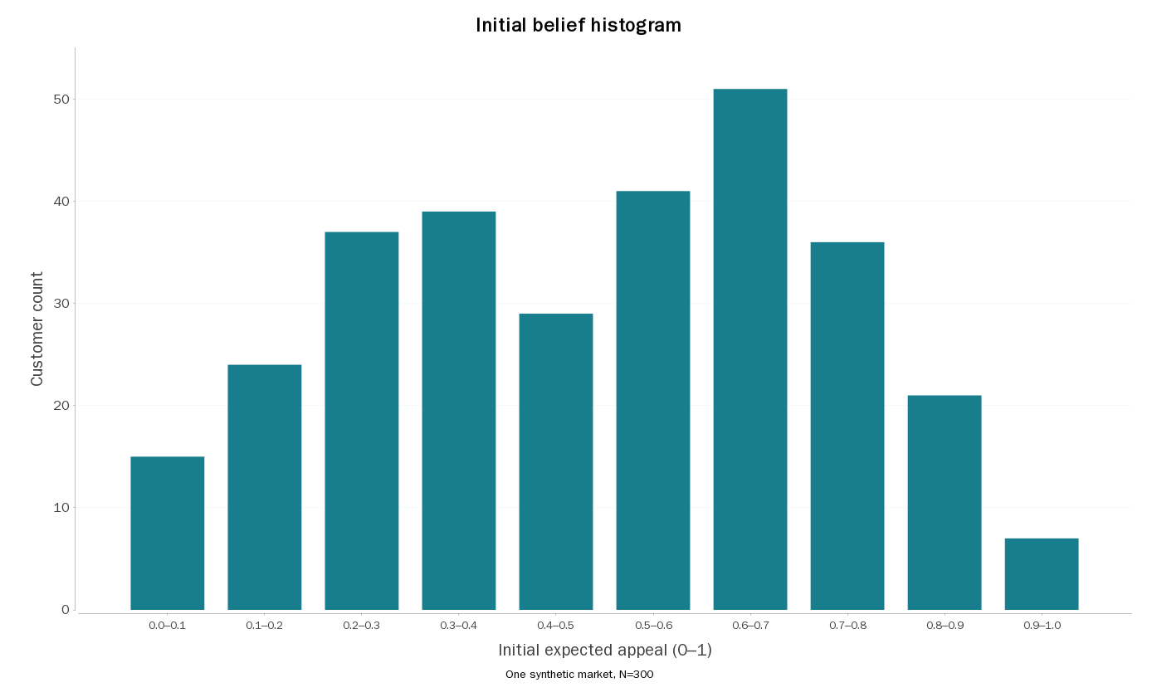
DATA AND INPUT ANALYSIS
Synthetic inputs are specified, not fitted to campus data.
300 people, 1,200 ties
Three known groups; stronger initial preference for within-group contacts.
Budgets and value
Belief Beta(2,2)
Value scale Rs 500–1,000
Affordability Rs 400–1,000
Example market, rep 1000
Belief mean 0.490; SD 0.235.
Budget mean Rs 710.93.
data/customers_rep1000.csv; sim/analysis/input_statistics.csv. Histogram is one synthetic market.
IE305 · Group 9 · All customer inputs synthetic · Mihir · 60s
3

Slide 4
AGENT RULES
A conversation changes beliefs. A purchase needs value AND budget.
1 INFORM
An aware contact shares launch news with probability 0.25.
2 DISCUSS
Close beliefs compromise: 0.40 and 0.50 become 0.43 and 0.47.
3 BUY ONCE
Aware + can afford + perceived value ≥ price. Purchases at period end.
4 EXPERIENCE
New owners receive personal feedback. Beliefs and later conversations can change.
Rules: MODEL_SPEC.md. d=0.2; mu=0.3; phi=0.05. Worked opinion example is illustrative.
IE305 · Group 9 · All customer inputs synthetic · Mihir · 80s
4

Slide 5
LITERATURE AND VERIFICATION
Established mechanisms; explicit new assumptions; checked code.
LITERATURE
OUR ASSUMPTIONS
EVIDENCE
Bounded confidence and adaptive ties
Promotional seeding and diffusion
No claim to invent these mechanisms
Price/value/budget threshold
Experience resets and cost accounting
Synthetic graph and attributes
16 product checks passed
First AnyLogic default matches Java
Revised code: actual API compile passes
Deffuant et al. 2000; Kozma & Barrat 2008; Delre et al. 2007/2010; Kempe et al. 2003. See LITERATURE_NOTES.md and VALIDATION_REPORT.md.
IE305 · Group 9 · All customer inputs synthetic · Mihir · 60s
5

Slide 6
EXPERIMENTAL DESIGN
Compare policies on the same market; confirm on fresh markets.
PILOT
MAIN + FOLLOW-UP
CONFIRMATION
30 separate markets
18 policies
Choose a provisional policy
100 main markets
18 + 18 policies
3,600 evaluations, paired
100 fresh markets
4 fixed comparisons
No search for a new winner
95% intervals: 10,000 bootstrap resamples of markets.
Customers, periods and reused policies are not independent replications.
sim/results/*manifest.json; sim/analysis/confirmation_paired.csv. Exploratory follow-up explicitly distinguished from initial design.
IE305 · Group 9 · All customer inputs synthetic · Mihir · 60s
6

Slide 7
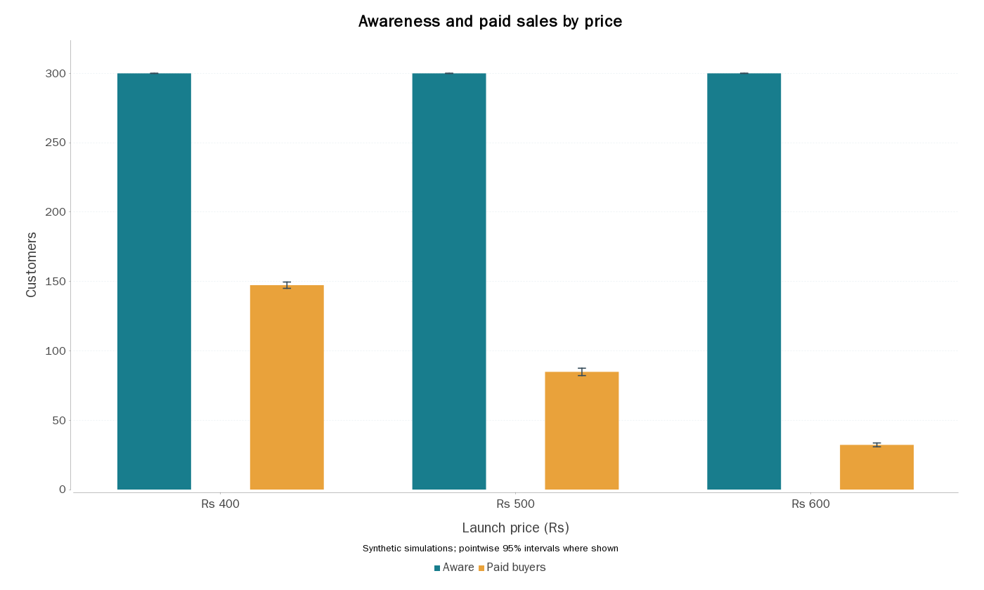
RESULT 1 · PRICE
Almost everyone hears. Far fewer buy at the high price.
News is not conversion
At Rs 600, awareness is nearly 300; mean paid buyers are 32.21.
Margin is not profit
Profit means: Rs 19,100 / 18,213 / 8,274 at the three prices.
Same campaign setup
12 samples; degree targeting; random contact replacement.
sim/analysis/policy_summary.csv; 100 main markets/cell; error bars are pointwise 95% intervals for means.
IE305 · Group 9 · All customer inputs synthetic · Vaibhav · 55s
7

Slide 8
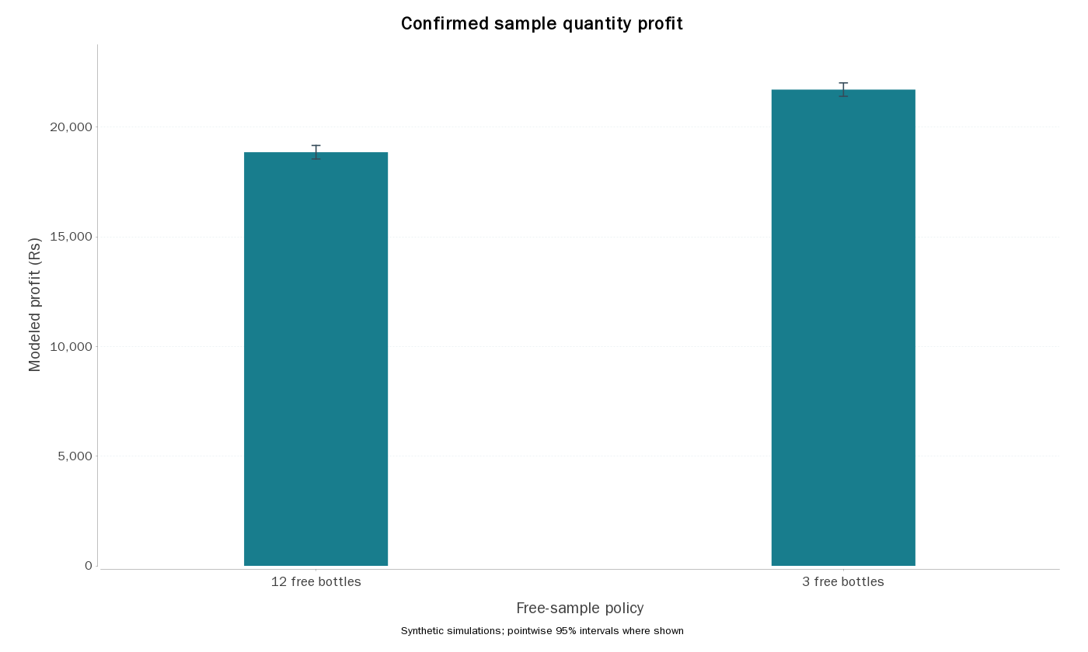
RESULT 2 · SAMPLE QUANTITY
Nine fewer free bottles can increase profit while reducing total owners.
+ Rs 2,854.50
Fresh-market paired profit gain
95% CI: Rs 2,698.50–3,006
Why it happens
Rs 2,250 less sample cost,
plus margin on about 4 extra sales.
Different objectives differ
Paid sales rise; total owners fall.
Three vs twelve is not a global quantity optimum.
sim/analysis/confirmation_summary.csv and confirmation_paired.csv; 100 fresh paired markets; price Rs 400, degree, h=0.
IE305 · Group 9 · All customer inputs synthetic · Vaibhav · 65s
8

Slide 9
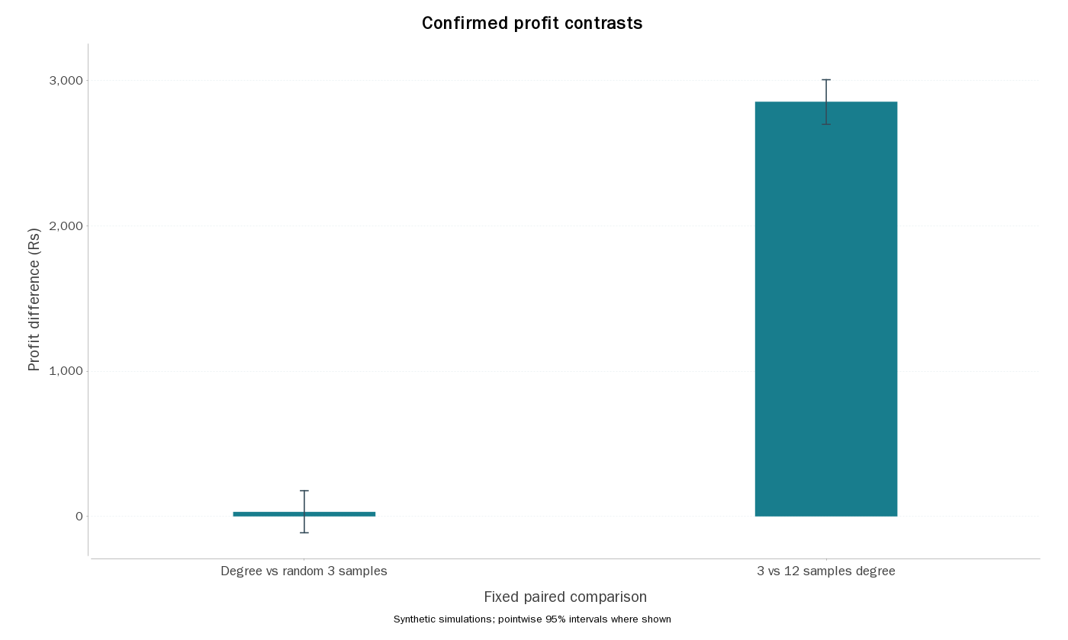
RESULT 3 · TARGETING
The sample saving is clear. The influencer premium is uncertain.
Degree over random
+ Rs 31.50
95% CI: −112.50 to +177
Avoid expensive targeting
We have not established a large final-profit benefit from degree information.
Timing can still matter
Strong-group stress: distributed seeding helps early coverage, not clearly final profit.
confirmation_paired.csv; stress_paired.csv. Pointwise intervals; lack of a clear difference is not equivalence.
IE305 · Group 9 · All customer inputs synthetic · Vaibhav · 50s
9

Slide 10
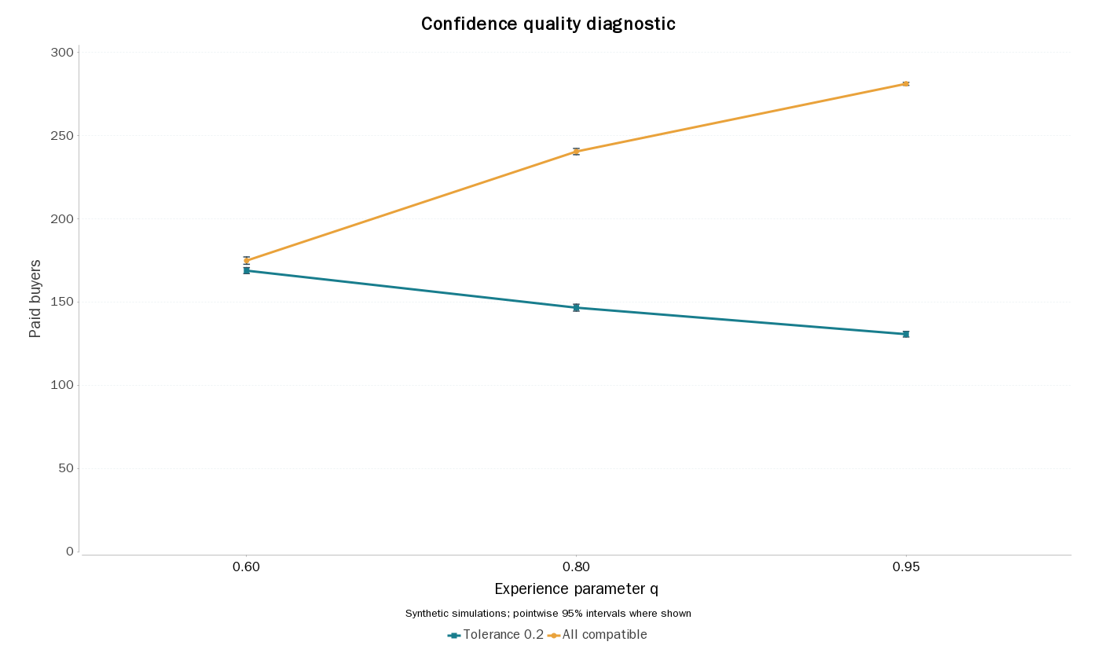
MECHANISM DIAGNOSTIC
A surprise exposes a risky assumption: very positive opinions can be ignored.
At narrow confidence
Higher experience mean can reduce simulated sales.
Remove the gate
With all opinions compatible, the quality effect becomes positive.
Interpretation
Validate or soften the attention rule. Do not recommend worse products.
quality_diagnostic_summary.csv; quality_paired.csv. Exploratory 100 paired markets/setting; fixed graph, Rs 400, 12 samples, degree.
IE305 · Group 9 · All customer inputs synthetic · Vaibhav · 65s
10

Slide 11
ANYLOGIC DEMONSTRATION
Live: follow one conversation, then check the campaign accounts.
WATCH
EXPLAIN
CHECK
Agent colors: awareness and ownership
Selected link: a recent meeting
Opinions: values and distribution
Close opinions move together
Distant opinions may change contacts
Buying requires budget and value
Default: 148 paid + 12 free
Revenue Rs 59,200 − cost Rs 40,000
Profit Rs 19,200
Run the engine-tested model. Defaults: policyIndex=6, rep=1000. Keep the grid model as fallback.
Approved grid default has real screenshot/CSV evidence. LiveNetwork API/wiring pass; its actual engine run is tracked separately.
IE305 · Group 9 · All customer inputs synthetic · Vaibhav · 90s
11

Slide 12
CONDITIONAL RECOMMENDATION
Start small. Revisit price with cost. Validate the behavior before deployment.
01
Baseline candidate: Rs 400, three samples. Random targeting remains a practical alternative.
02
Budget is a ceiling, not a spending target. Cost changes can change the preferred price.
03
Synthetic assumptions drive outcomes. The quality reversal is a warning to validate behavior.
Best among tested candidates; no claim of a global optimum or actual-campus sales forecast.
confirmation_paired.csv; all_cost_revaluation.csv; PROJECT_REPORT.md. AI-assisted research, code and drafting.
IE305 · Group 9 · All customer inputs synthetic · Vaibhav · 70s
12

Slide 13
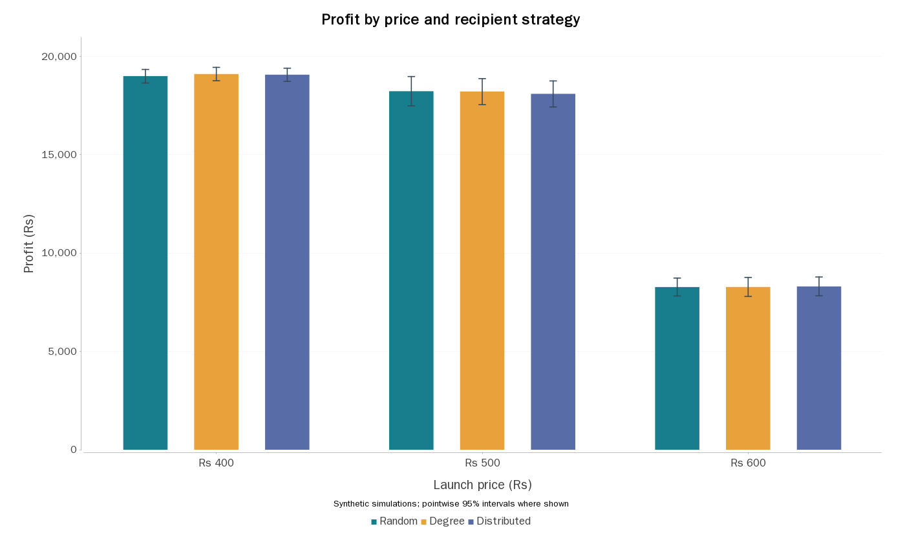
BACKUP · FULL PRICE COMPARISON
Profit versus price under the original equal-sample design.
all_policy_summary.csv. 12 samples, h=0; 100 markets; pointwise mean intervals.
IE305 · Group 9 · All customer inputs synthetic · Backup
13

Slide 14
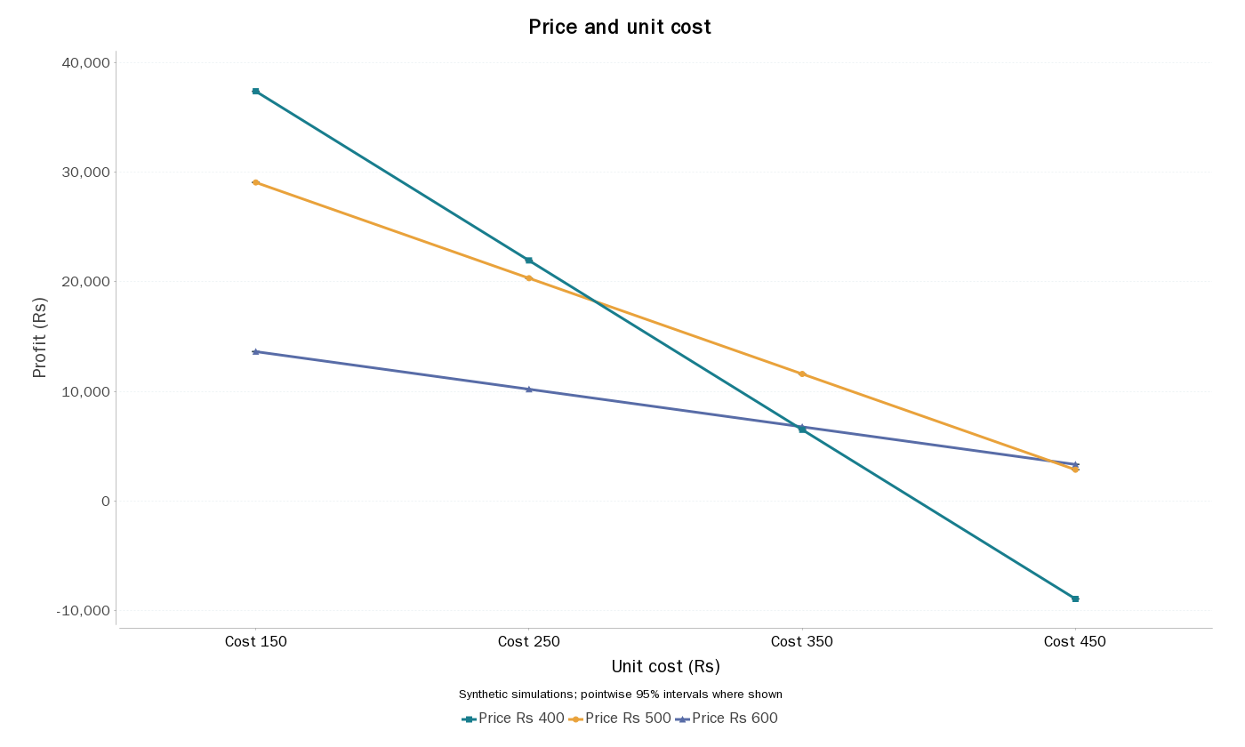
BACKUP · COST REVALUATION
The preferred price depends on unit cost.
all_cost_revaluation.csv. 3 samples, degree, h=0; cost-only re-accounting holds customer behavior fixed.
IE305 · Group 9 · All customer inputs synthetic · Backup
14

Slide 15
BACKUP · LIMITATIONS
What we did not establish.
• No real demand calibration or empirical sales validation.
• No global optimum: only three prices and two sample quantities.
• No costly network-data collection, competition, inventory or fixed overhead.
• Hard confidence, independent attributes and informed-nonbuyer sharing are assumptions.
• Finite campaign outcomes are not equilibrium claims.
• Pointwise intervals do not protect every comparison simultaneously.
• Actual engine evidence must be kept separate from reference and Java runs.
OPEN_ISSUES.md; VALIDATION_REPORT.md; MODEL_SPEC.md.
IE305 · Group 9 · All customer inputs synthetic · Backup
15

Slide 16
BACKUP · LITERATURE
Sources and the boundary of our contribution.
Deffuant et al. (2000), Mixing beliefs among interacting agents.
Kozma & Barrat (2008), PRE 77, 016102. doi:10.1103/PhysRevE.77.016102
Delre et al. (2007), JBR 60, 826–835. doi:10.1016/j.jbusres.2007.02.002
Delre et al. (2010), JPIM 27, 267–282. doi:10.1111/j.1540-5885.2010.00714.x
Kempe, Kleinberg & Tardos (2003), Maximizing the Spread of Influence.
Replication-informed extension; seeding and homophilic rewiring are established.
Full reading limits and claim checks are preserved in LITERATURE_NOTES.md.
Direct source links and remaining extraction limits are in the literature notes; no research-priority claim.
IE305 · Group 9 · All customer inputs synthetic · Backup
16

