Slide 1
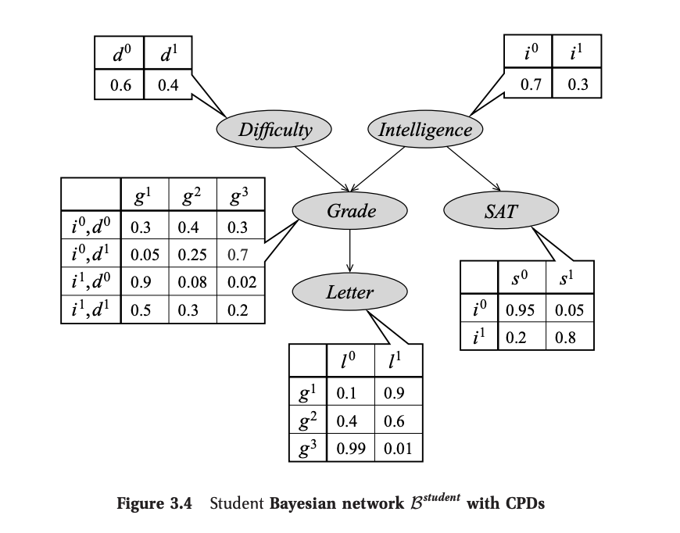
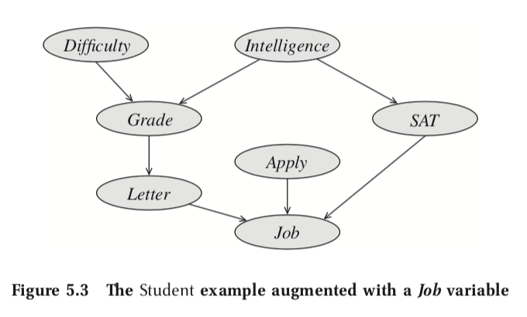
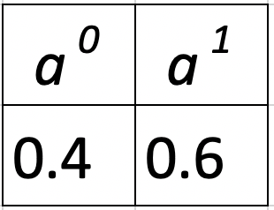
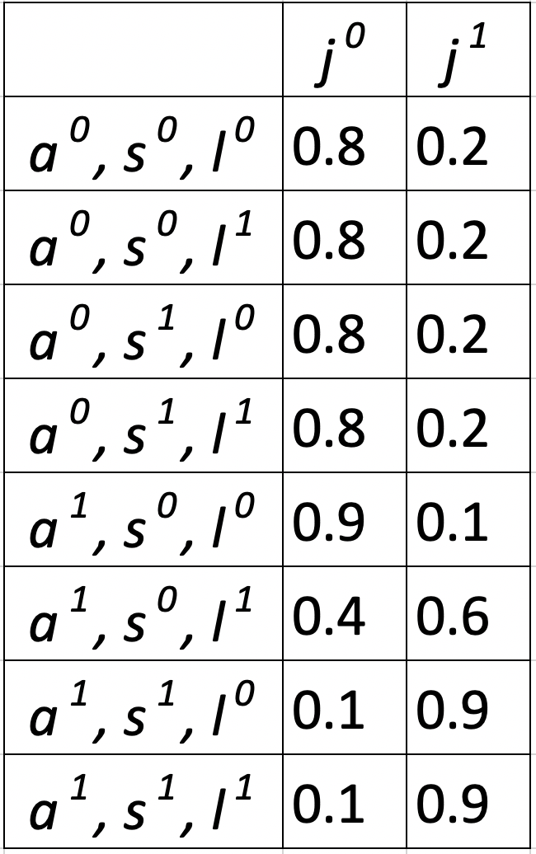
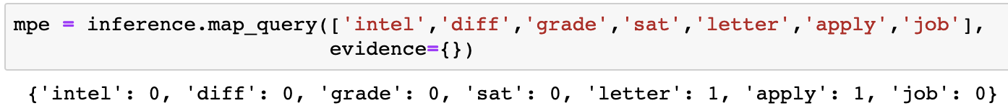
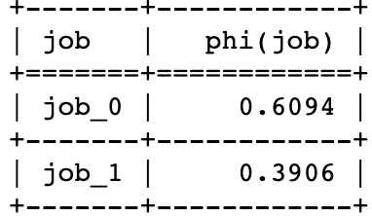
Joint Probability MAP Inference
Explanation:
The most probable setting given all conditional probabilities is:
student is not intelligent;
course is easy;
a weak student gets A grade in an easy class;
a weak student gets a low score on his SAT;
gets a strong letter of recommendation;
student applies for the job;
60.94% chance student does not get the job.
Formula:
PGMPY:
Notes:
Github code: https://github.com/Mihir2/Student_Bayesian_Network/blob/master/PGM-Student.ipynb
P(I,D,G,S,L,A,J) = P(I)P(D)P(G|I,D)P(S|I)P(L|G)P(A)P(J|G,S,L)

Slide 2
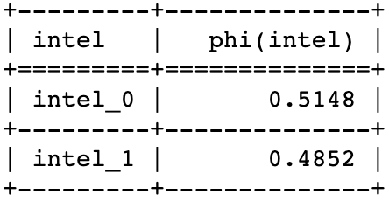
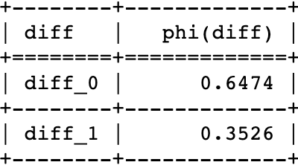
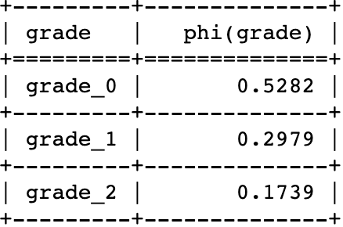
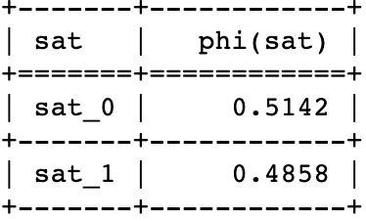
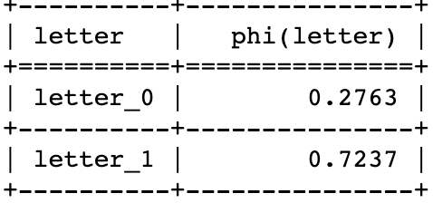
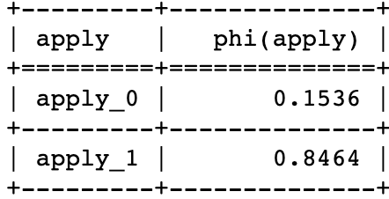
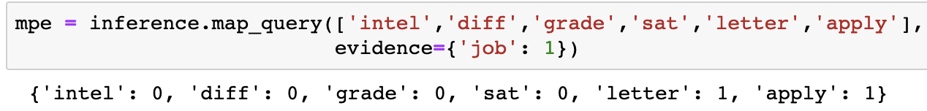
Conditional Probability MAP Inference given Job
Explanation:
Probability of Student Intelligence
Probability of course difficulty
The most probable explanation given student gets job is:
student is not intelligent;
course is easy;
a weak student gets A grade in an easy class;
a weak student gets a low score on his SAT;
gets a strong letter of recommendation;
85% chance that student applied for the job;
Probability of student grade
Probability of student SAT score
Formula:
Probability of professor letter or recommendation
Probability of student applying to the job
PGMPY:
Notes:
Github code: https://github.com/Mihir2/Student_Bayesian_Network/blob/master/PGM-Student.ipynb
P(I,D,G,S,L,A|J=1) = P(I,D,G,S,L,A) / P(J=1)

Slide 3

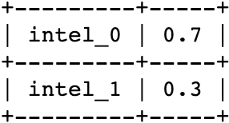
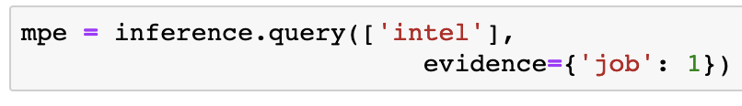
Intelligence Probability MAP Inference given Job
Explanation:
Probability of Student Intelligence
Probability of course difficulty
The most probable explanation given student gets job is:
51% chance that student is not intelligent;
Formula:
Probability of student grade
Probability of student SAT score
P(I): Marginal Probability Distribution
of Student’s Intelligence
Probability of professor letter or recommendation
Probability of student applying to the job
PGMPY:
Notes:
Github code: https://github.com/Mihir2/Student_Bayesian_Network/blob/master/PGM-Student.ipynb
P(I,D,G,S,L,A|J=1) = P(I,D,G,S,L,A) / P(J=1)
P(I,D,G,S,L,A) = P(I)P(D)P(G|I,D)P(S|I)P(L|G)P(A)

Slide 4
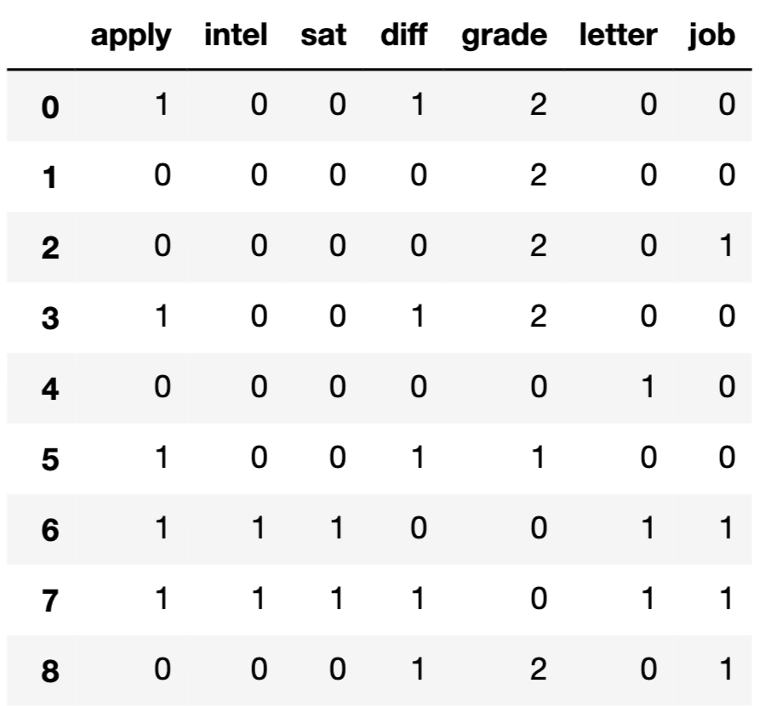
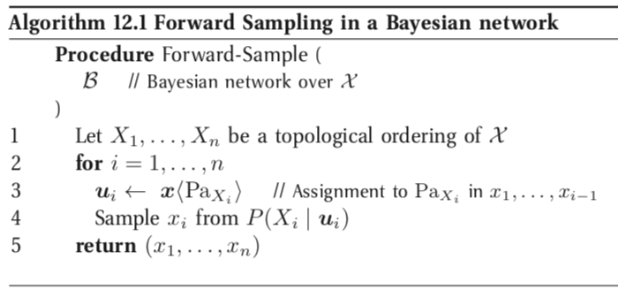
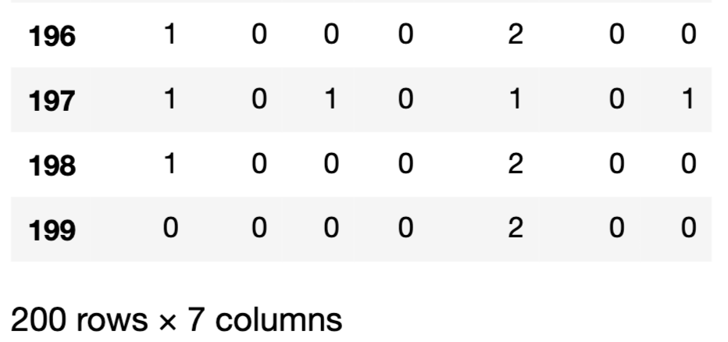
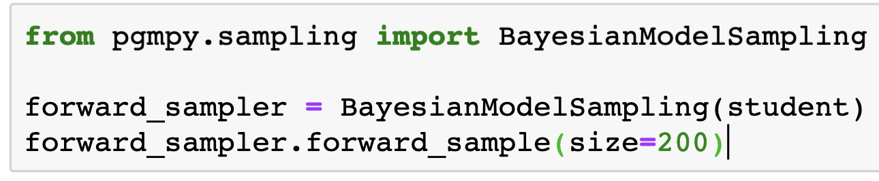
Forward Sampling from Student Bayesian Network
…
…
PGMPY:
Notes:
Github code: https://github.com/Mihir2/Student_Bayesian_Network/blob/master/PGM-Student.ipynb

Slide 5
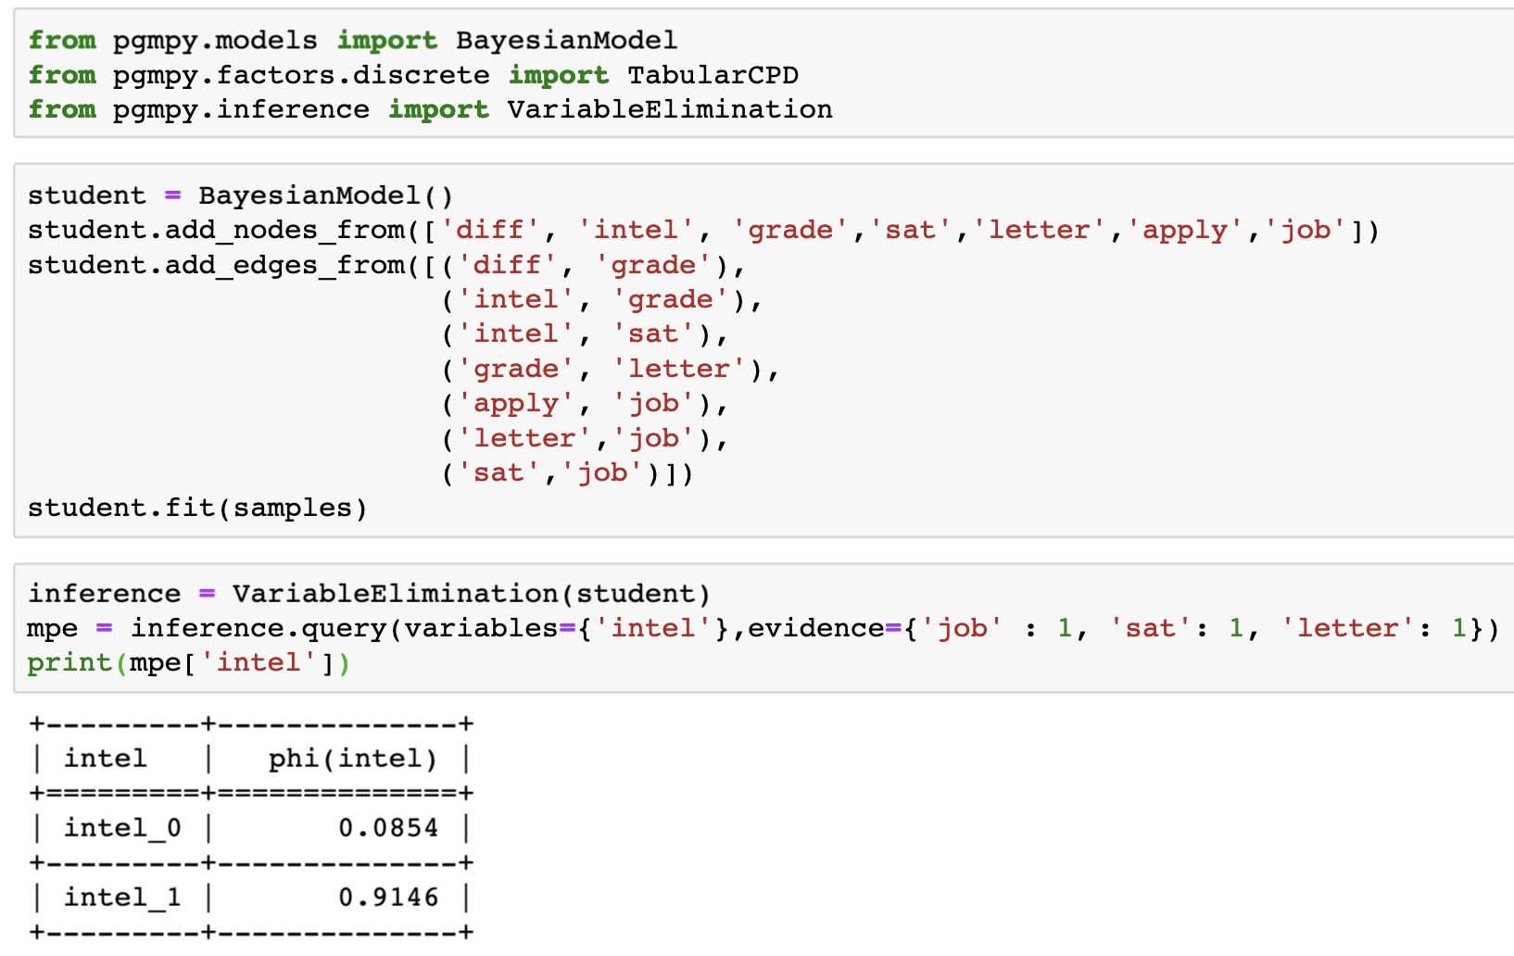
Train BN over samples to compute I from J, S, L
PGMPY:
Explanation:
The most probable explanation given student gets job and scored high on SAT and got a good letter of recommendation is:
91.46% chance that student is intelligent;
Notes:
Github code: https://github.com/Mihir2/Student_Bayesian_Network/blob/master/PGM-Student.ipynb

Slide 6
Appendix

Slide 7

Joint Probability Inference
The probability that the
student is intelligent;
course is easy;
a smart student gets a B in an easy class;
a smart student gets a high score on his SAT;
a student who got a B in the class gets a weak letter.
The total probability of this state is: 0.004608

Slide 8
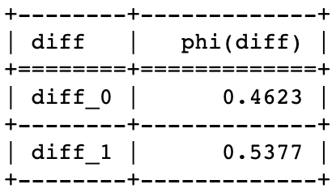
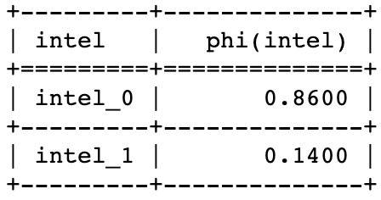
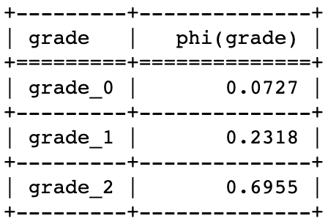
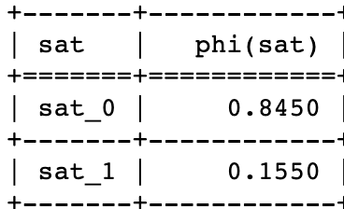
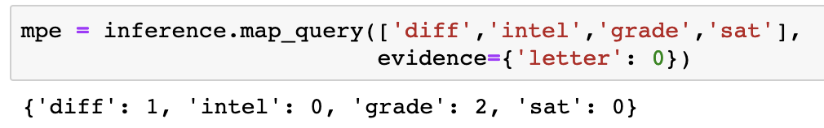
Conditional Probability Inference (MAP Query 1)
Given that professor gives a weak letter, the most probable explanation is that:
student is not intelligent;
course is difficult;
a weak student gets a B grade in a hard class;
a smart student gets a low score on his SAT;
Hence, the student got a weak letter of recommendation
Probability of course Difficulty
Probability of student Intelligence
Probability of student grade
Probability of student SAT score
PGMPY:

Slide 9
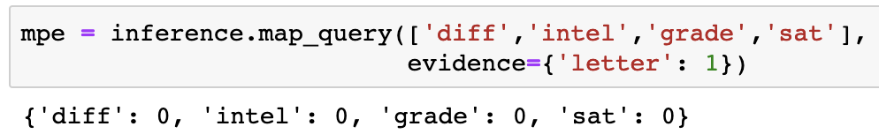
Conditional Probability Inference (MAP Query 2)
Given that professor gives a weak letter, the most probable explanation is that:
student is not intelligent;
course is easy;
a weak student gets a high score in an easy class;
a smart student gets a high score on his SAT;
Hence, the student got a strong letter of recommendation
Probability of course Difficulty
Probability of student Intelligence
Probability of student grade
Probability of student SAT score
PGMPY:

Slide 10
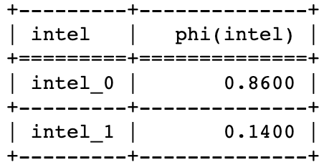
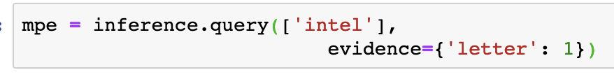
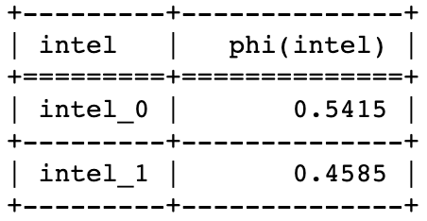
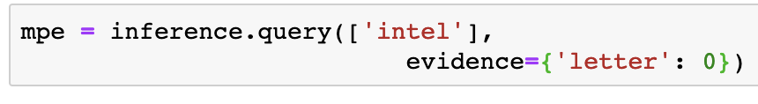
Conditional Probability Inference (MAP Query 3, 4)
Given that professor gives a weak letter or recommendation, the most probable explanation is that:
student is not intelligent;
Probability of student intelligence when recommendation is weak
Given that professor gives a strong letter of recommendation, the most probable explanation is that:
student may or may not be intelligent;
Probability of student intelligence when recommendation is strong

