Slide 1
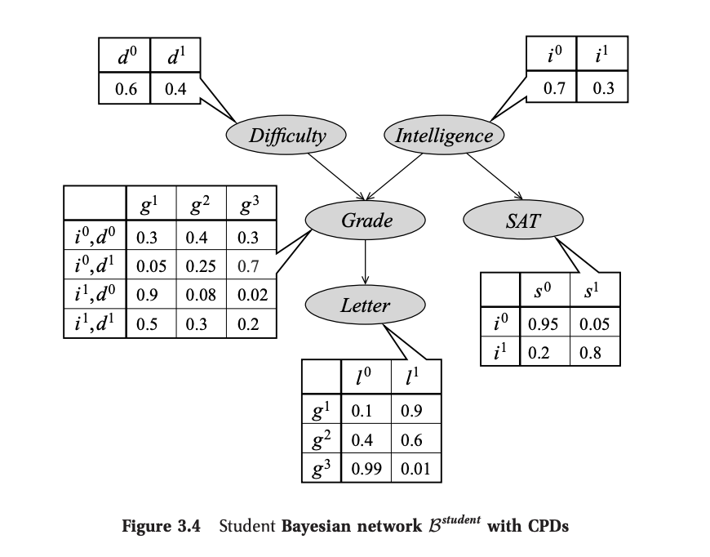
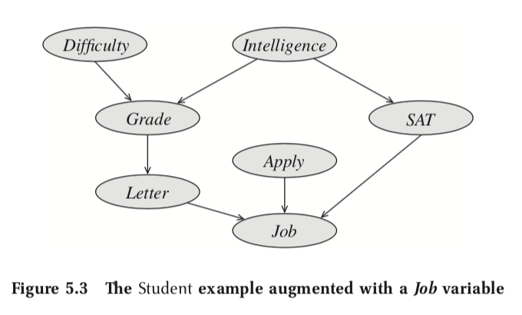
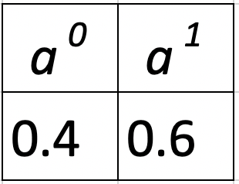
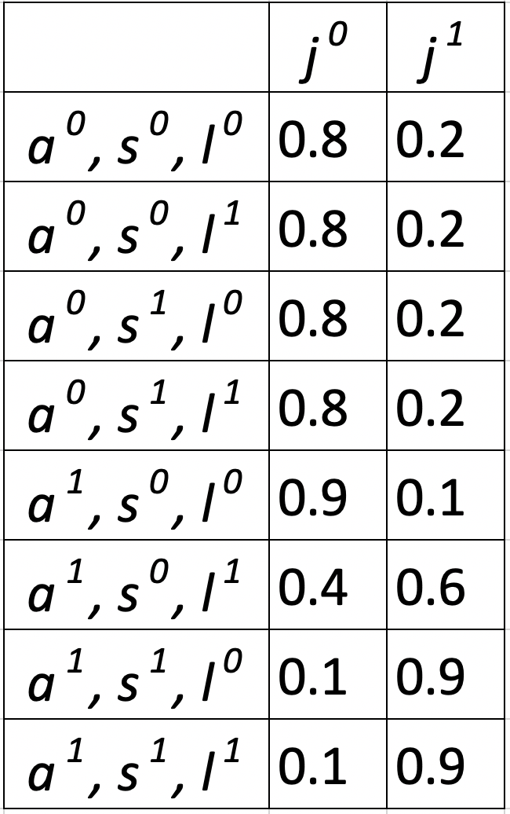
Joint Probability Inference
Explanation:
The most probable setting for all variables is:
student is not intelligent;
course is difficult;
C grade in course;
low score on SAT;
Weak letter of recommendation;
student applies for the job;
student does not get the job.
Formula:
Similarly, we have calculated joint probability for each of 192 combinations of input variables.
Notes:
Github code: https://github.com/Mihir2/Student_Bayesian_Network/blob/master/PGM-Student.ipynb
P(I,D,G,S,L,A,J) = P(I)P(D)P(G|I,D)P(S|I)P(L|G)P(A)P(J|A,S,L)
P(I,D,G,S,L,A,J) = 0.4 * 0.7 * 0.7 * 0.99 * 0.95 * 0.6 * 0.9

Slide 2
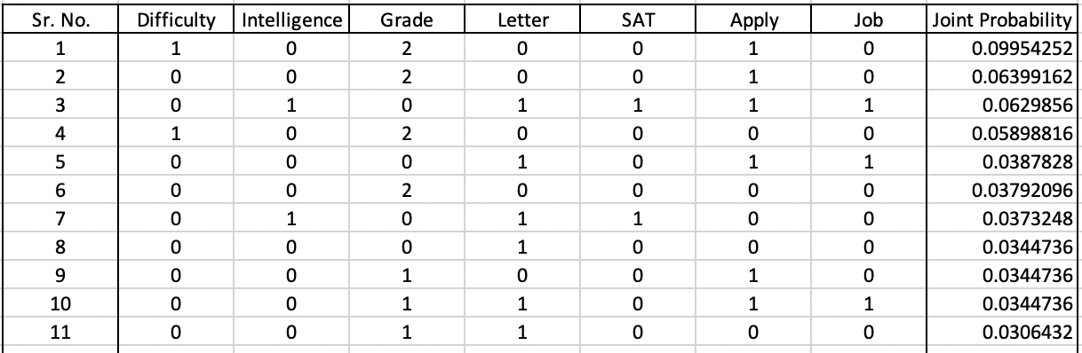
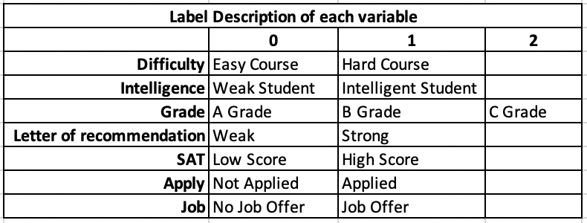
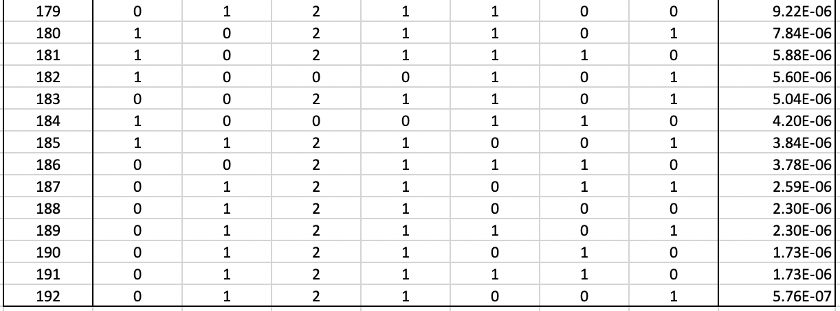
Joint Probability Inference - Combinations
most probable setting
…
…
…
Notes:
Github code: https://github.com/Mihir2/Student_Bayesian_Network/blob/master/PGM-Student.ipynb
P(I,D,G,S,L,A,J) = P(I)P(D)P(G|I,D)P(S|I)P(L|G)P(A)P(J|A,S,L)
P(I,D,G,S,L,A,J) = 0.4 * 0.7 * 0.7 * 0.99 * 0.95 * 0.6 * 0.9

Slide 3
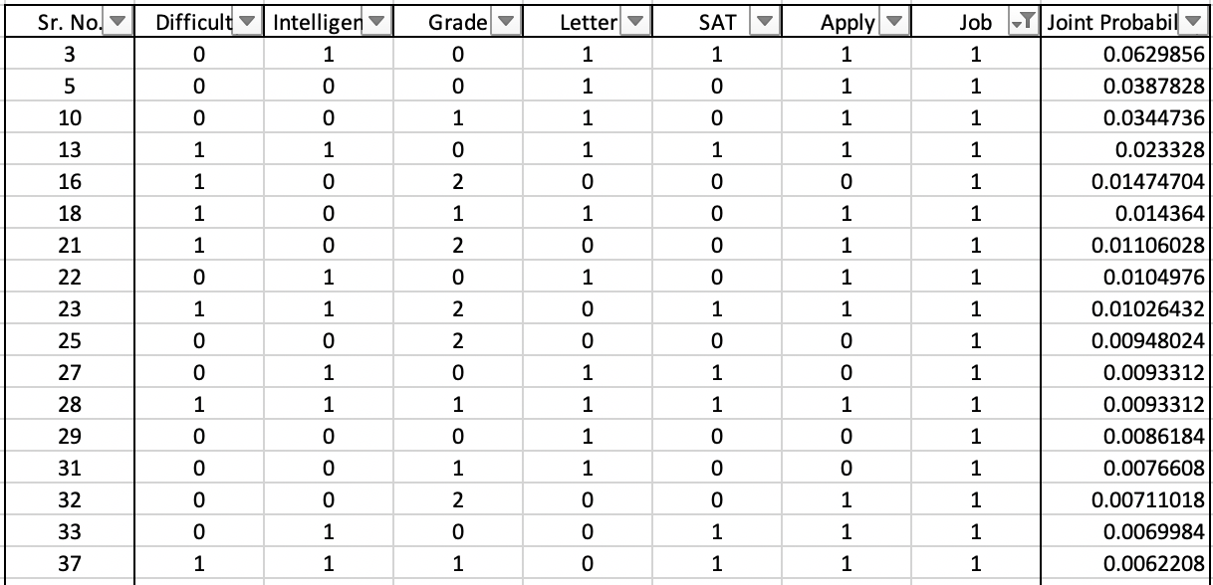
Conditional Probability MAP Inference given Job
Explanation:
The most probable explanation given student gets job is:
student is intelligent;
course is easy;
A grade;
High score on his SAT;
Strong letter of recommendation;
Applied for the job;
Formula:
Given Job is offered, student is most likely to be intelligent
Notes:
Github code: https://github.com/Mihir2/Student_Bayesian_Network/blob/master/PGM-Student.ipynb
P(I,D,G,S,L,A|J=1) = P(I,D,G,S,L,A) / P(J=1)

Slide 4
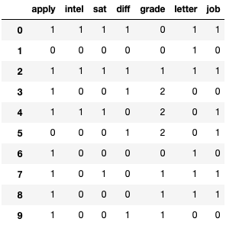
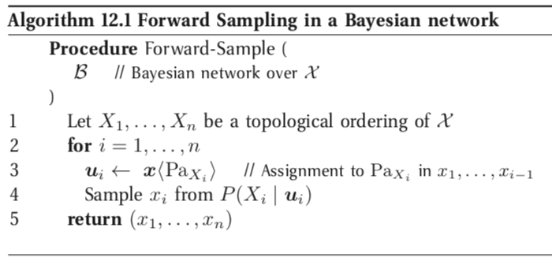
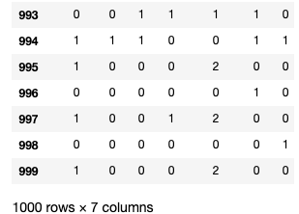
Forward Sampling from Student Bayesian Network
…
…
PGMPY:
Notes:
Github code: https://github.com/Mihir2/Student_Bayesian_Network/blob/master/PGM-Student.ipynb

Slide 5
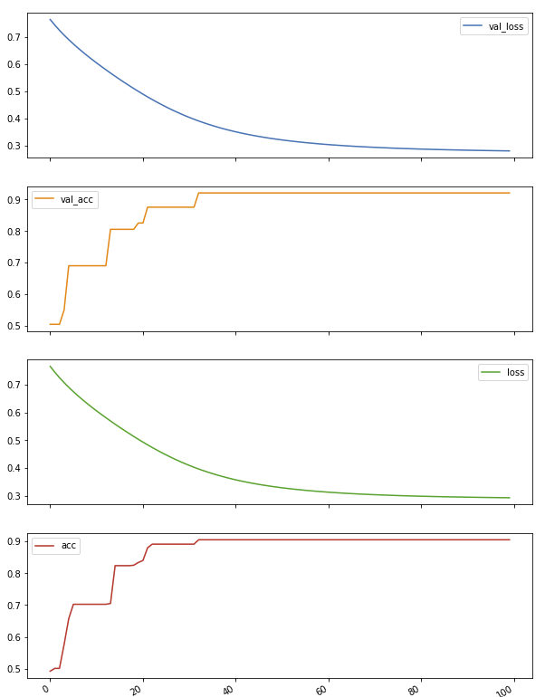
Logistic Regression over 1000 samples
Training Hyperparameters:
Number of Epochs: 100
Batch Size: 100
Number of samples: 1000
Number of Training samples: 800
Number of Validation samples: 200
Results:
Training Accuracy: 90.5%
Training Loss: 0.293
Testing Accuracy: 92%
Testing Loss: 0.2802
Job
Sigmoid
Activation
SAT
Intelligence
Letter
Bias
Notes:
Github code: https://github.com/Mihir2/Student_Bayesian_Network/blob/master/PGM-Student.ipynb

Slide 6
Appendix

Slide 7

Joint Probability Inference
The probability that the
student is intelligent;
course is easy;
a smart student gets a B in an easy class;
a smart student gets a high score on his SAT;
a student who got a B in the class gets a weak letter.
The total probability of this state is: 0.004608

Slide 8
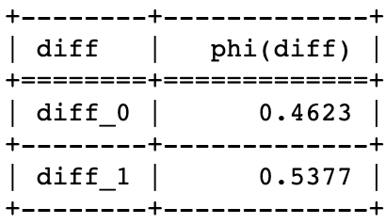
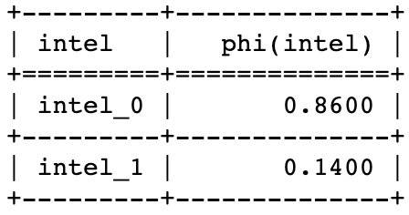
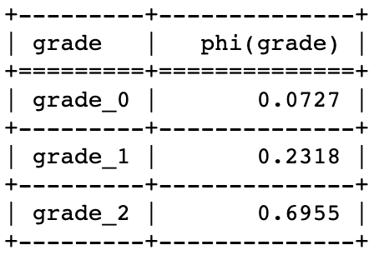
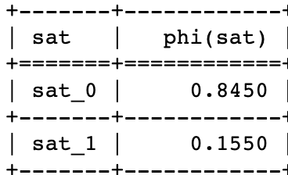
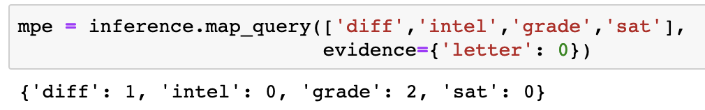
Conditional Probability Inference (MAP Query 1)
Given that professor gives a weak letter, the most probable explanation is that:
student is not intelligent;
course is difficult;
a weak student gets a B grade in a hard class;
a smart student gets a low score on his SAT;
Hence, the student got a weak letter of recommendation
Probability of course Difficulty
Probability of student Intelligence
Probability of student grade
Probability of student SAT score
PGMPY:

Slide 9
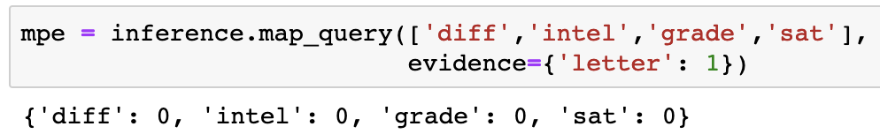
Conditional Probability Inference (MAP Query 2)
Given that professor gives a weak letter, the most probable explanation is that:
student is not intelligent;
course is easy;
a weak student gets a high score in an easy class;
a smart student gets a high score on his SAT;
Hence, the student got a strong letter of recommendation
Probability of course Difficulty
Probability of student Intelligence
Probability of student grade
Probability of student SAT score
PGMPY:

Slide 10
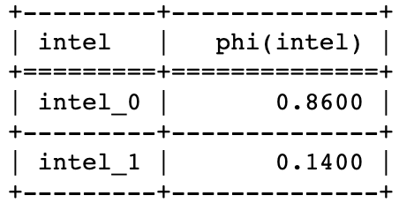
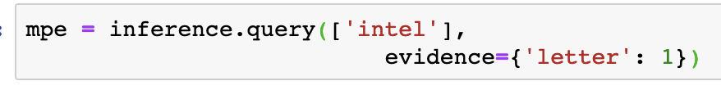
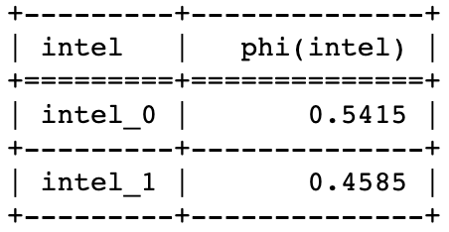
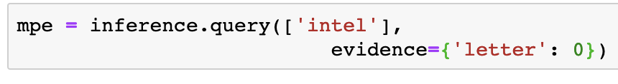
Conditional Probability Inference (MAP Query 3, 4)
Given that professor gives a weak letter or recommendation, the most probable explanation is that:
student is not intelligent;
Probability of student intelligence when recommendation is weak
Given that professor gives a strong letter of recommendation, the most probable explanation is that:
student may or may not be intelligent;
Probability of student intelligence when recommendation is strong

