Slide 1
Telemedicine with real-time image analysis In today's interconnected world, healthcare remains a challenge for many. Our project aims to bridge critical gaps in medical diagnostics, particularly for brain tumors and cancer, through an innovative telemedicine platform.

Slide 2
Introduction
Telehealth is the distribution of health-related services and information via electronic information and telecommunication technologies.
Benefits:
Enhanced Disaster Response
Increased Accessibility
Improved Patient-Doctor Relationships
Reduced Healthcare Costs
Real time image analysis
Real-time image analysis plays a crucial role in telemedicine by enabling remote diagnosis and treatment. It allows doctors to analyze images of symptoms, such as rashes or wounds, during virtual consultations. This technology enhances accuracy, accessibility, and timeliness of healthcare, especially for patients in remote areas.

Slide 3
Tools and Technologies
Javascript
Node.js
React.js
Python
Streamlit
MongoDB Atlas
AuthO

Slide 4
Telemedicine platform
Key components of a telemedicine platform
User interface (web or mobile app)
Video conferencing
Real-time image processing
Medical records management
Payment gateway
Technical considerations for platform development
Scalability
Security
User experience

Slide 5
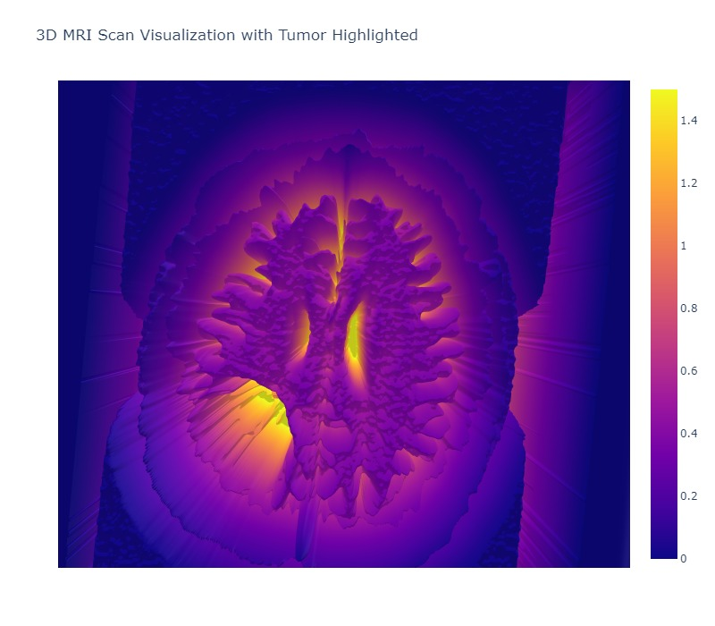
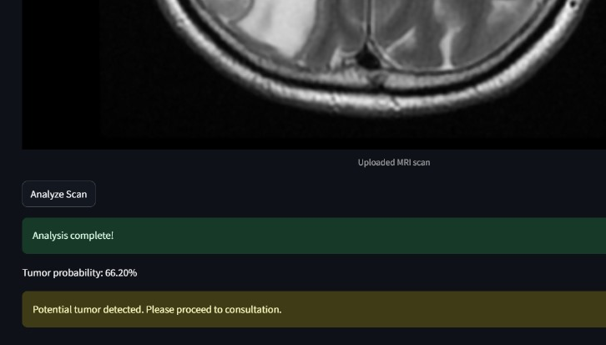
Real – time image analysis using ML
3D image generation
MRI scan analysis

Slide 6
Real – time image analysis and ML integration
Technologies used:
Streamlit
Tensorflow
Pillow
Reportlab
Numpy
Scikit-learn
Scipy
Plotly
Matplotlib
jinja2

Slide 7
MongoDB Atlas: A Powerful Solution for Telemedicine
MongoDB Atlas: A Powerful Solution for Telemedicine
Key Benefits:
Scalability: Easily handle increasing patient data and user loads.
Security: Protect sensitive patient information with robust security features.
Flexibility: Adapt to evolving data structures and requirements.
Performance: Optimize query performance with indexing and sharding.
Integration: Seamlessly integrate with various telemedicine applications.
Use Cases in Telemedicine:
Patient Records: Store and manage comprehensive patient data.
Medical Images: Store and analyze large medical images efficiently.
Real-time Analytics: Process patient data for insights and decision-making.
Integration with AI/ML: Leverage MongoDB Atlas for AI-powered diagnostics.

Slide 8
Case study and future directions:
Remote Diagnosis of diseases
Second Opinion for any disease treatment
Telemedicine for Follow-up Care
Global Collaboration for Diseases and Cancer Research

Slide 9
Conclusion:
System does..
Live video conference for consulting
2D MRI image to 3D graph
Remote access to medical specialists
Disease detection

