Slide 1
Power System Fault Detection and Classification Using machine learning
CAPSTONE PROJECT
Presented By:
1. Mihir Ravat-SIES College of Management Studies–Master of Computer Applications(MCA)

Slide 2
OUTLINE
Problem Statement (Should not include solution)
Proposed System/Solution
System Development Approach (Technology Used)
Algorithm & Deployment
Result (Output Image)
Conclusion
Future Scope
References

Slide 3
Problem Statement
Faults in power distribution systems threaten grid stability and service reliability. This project develops a machine learning model to detect and classify faults using voltage and current phasor data. The model will distinguish between normal and fault conditions—such as LG, LL, and LLL faults—based on time-series analysis. This approach aims to enhance the speed and accuracy of fault diagnosis, improving grid resilience and operational efficiency.

Slide 4
Proposed Solution
Develop a machine learning model that classifies power system faults using the dataset provided. The model will process electrical measurements to identify the type of fault rapidly and accurately.This classification will help automate fault detection and assist in quicker recovery actions, ensuring system reliability.
Key components:
Data Collection: Use the Kaggle dataset on power system faults.
Preprocessing: Clean and normalize the dataset.
Model Training: Train a classification model (e.g., Decision Tree, Random Forest, or SVM).
Evaluation: Assess model performance using metrics such as accuracy, precision, recall, and F1-score.

Slide 5
System Approach
The "System Approach" section outlines the overall strategy and methodology for developing and implementing the power system fault detection and classification model. Here's a suggested structure for this section:
System requirements:
IBM Cloud (mandatory)
IBM Watson Studio for model development and deployment
IBM Cloud Object Storage for dataset handling

Slide 6
Algorithm & Deployment
Algorithm Selection: Random Forest Classifier (or SVM based on performance)
Data Input: Voltage, current, and phasor measurements from the dataset
Training Process: Supervised learning using labeled fault types
Prediction Process: Model deployed on IBM Watson Studio with API endpoint for real-time predictions

Slide 7
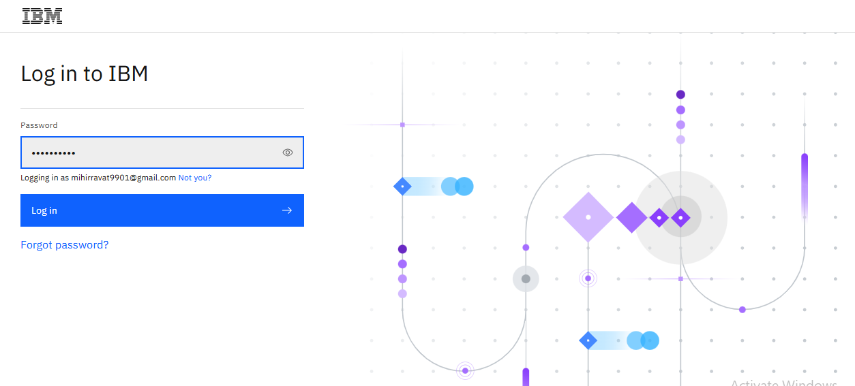
Result
Step1: Open IBM Cloud login page with this link cloud.ibm.com, enter your Gmail and password and click on login
Here’s Step by step process to execute this project

Slide 8
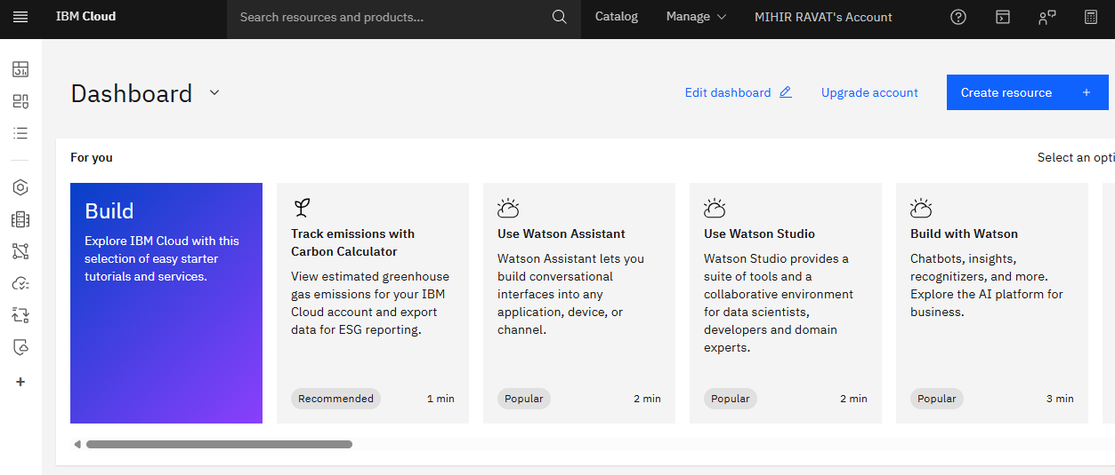
Result
This is IBM cloud dashboard

Slide 9
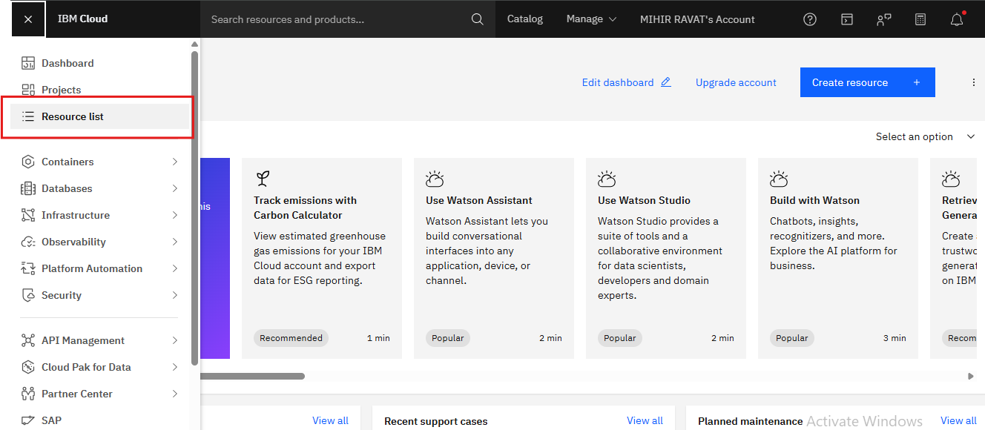
Result
Step2 : Click on Navigation menu, go to Resources list and clear all the resources

Slide 10
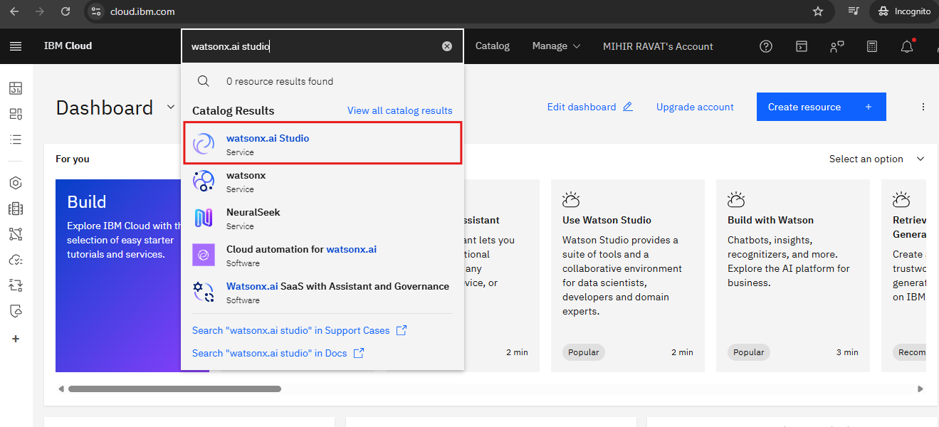
Result
Step 3:Click on search icon and type “Watsonx.ai studio”. Select Watsonx.ai studio(Service).

Slide 11
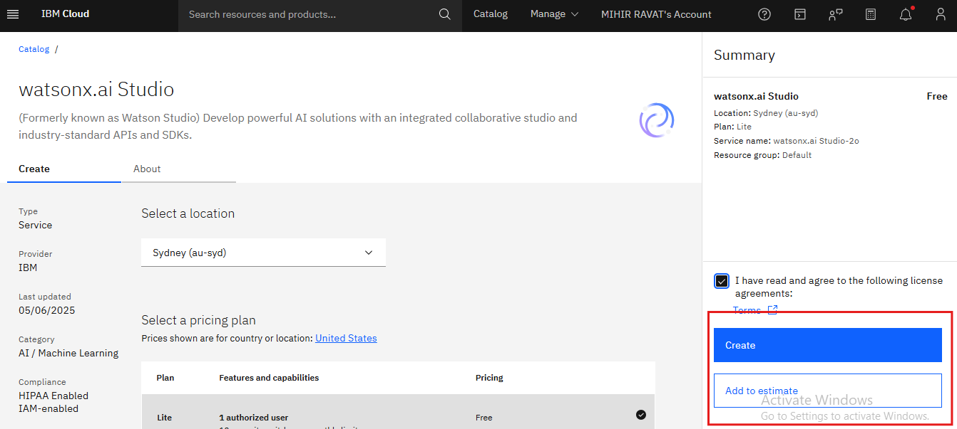
Result
Step 4: Click on the check box and Create

Slide 12
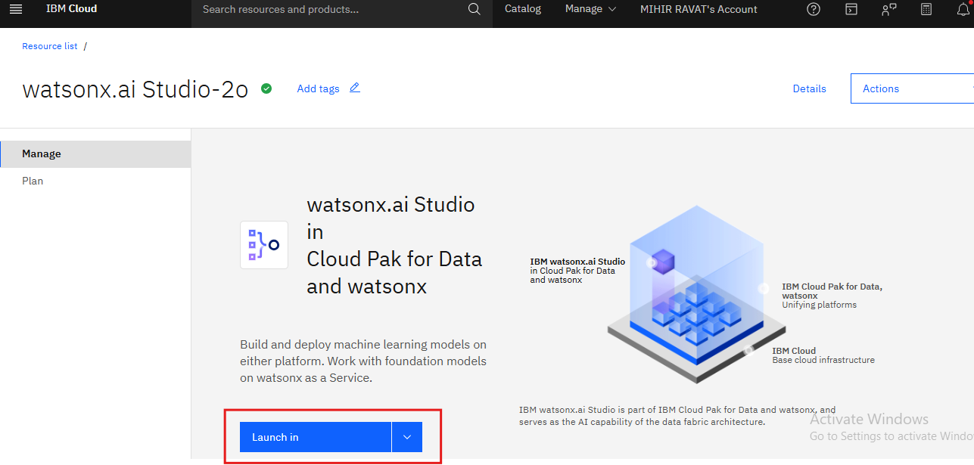
Result
Step 5: Click on the Launch in

Slide 13
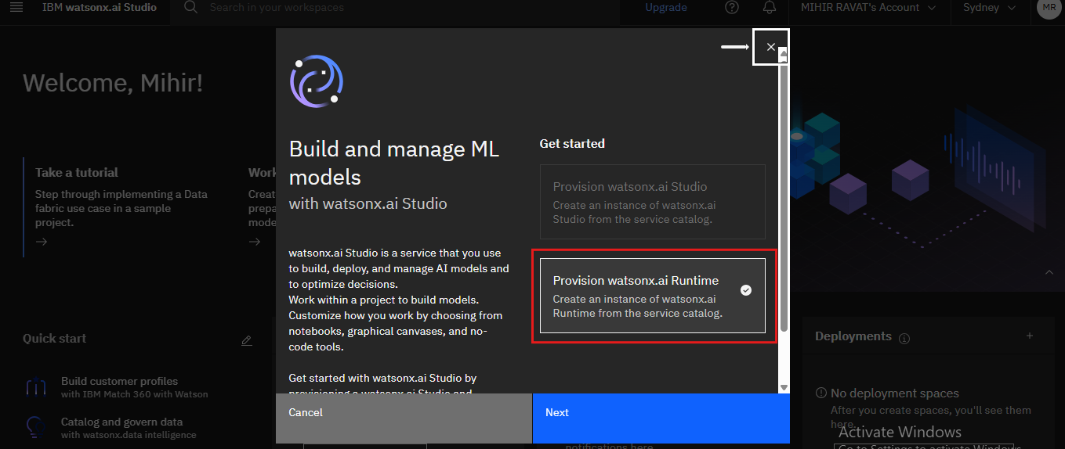
Result
Step 6: Select Provision Watsonx.ai Runtime and click on Next.

Slide 14
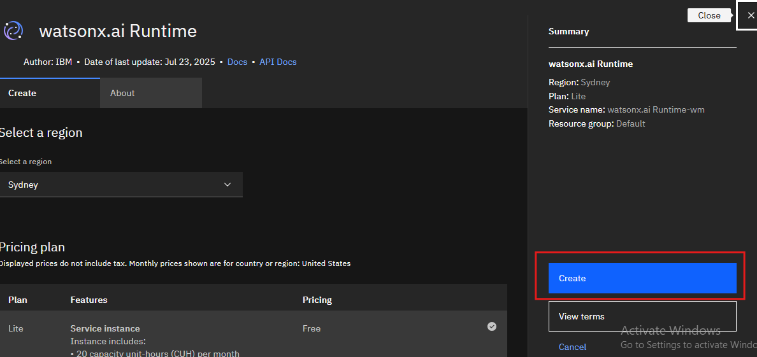
Result
Step 7: Click on create

Slide 15
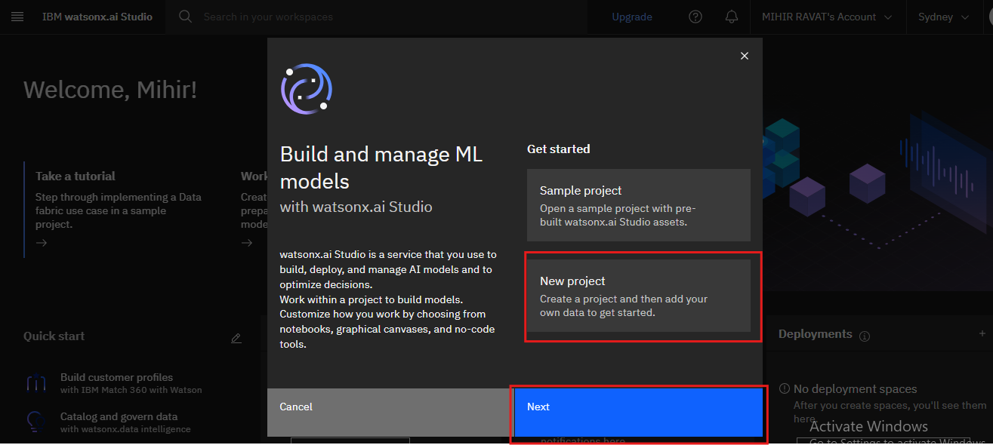
Result
Step 8: Select New project and click on Next

Slide 16
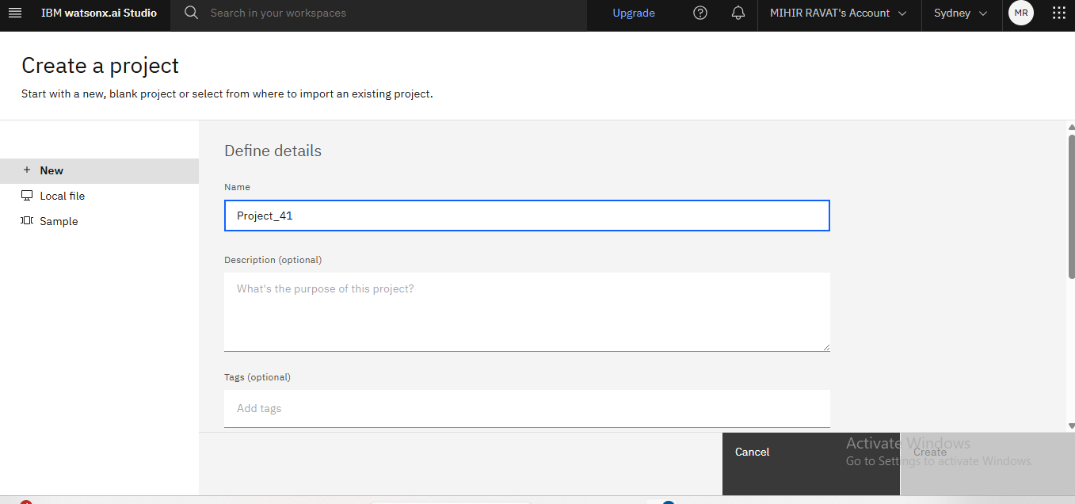
Result
Step 9: Enter project name and scroll a little.

Slide 17
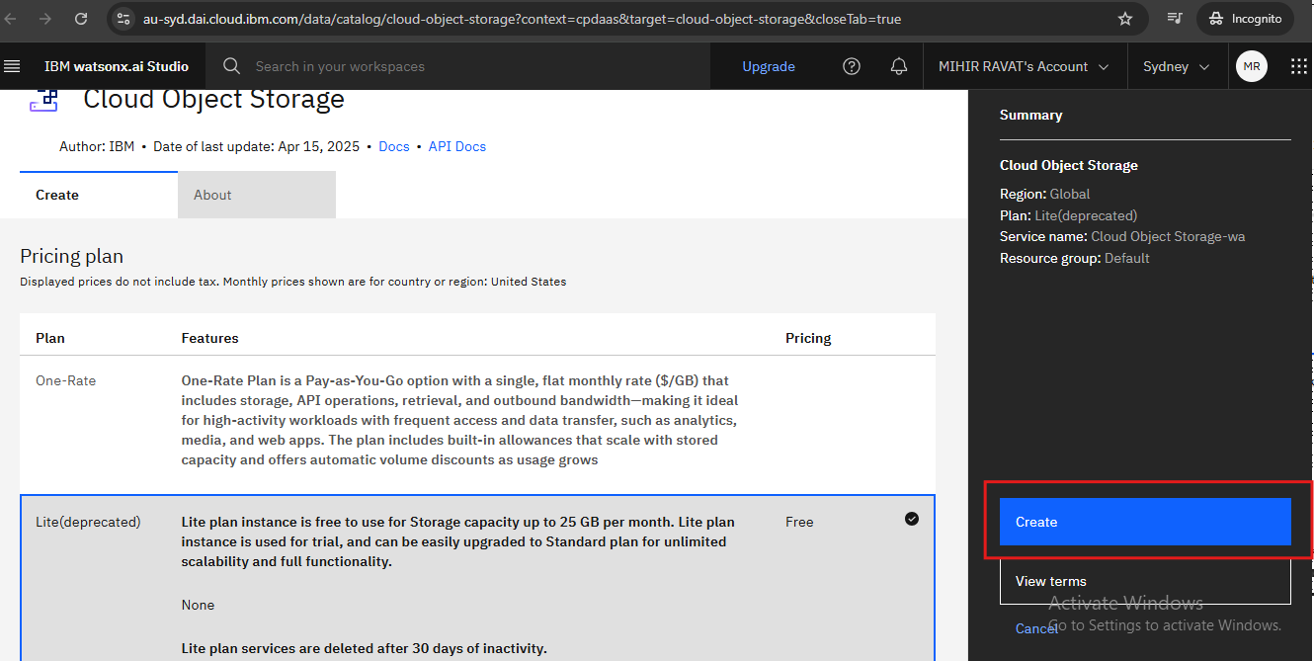
Result
Step10: Select storage service and Click on Add ,then select Free plan and Click on continue

Slide 18
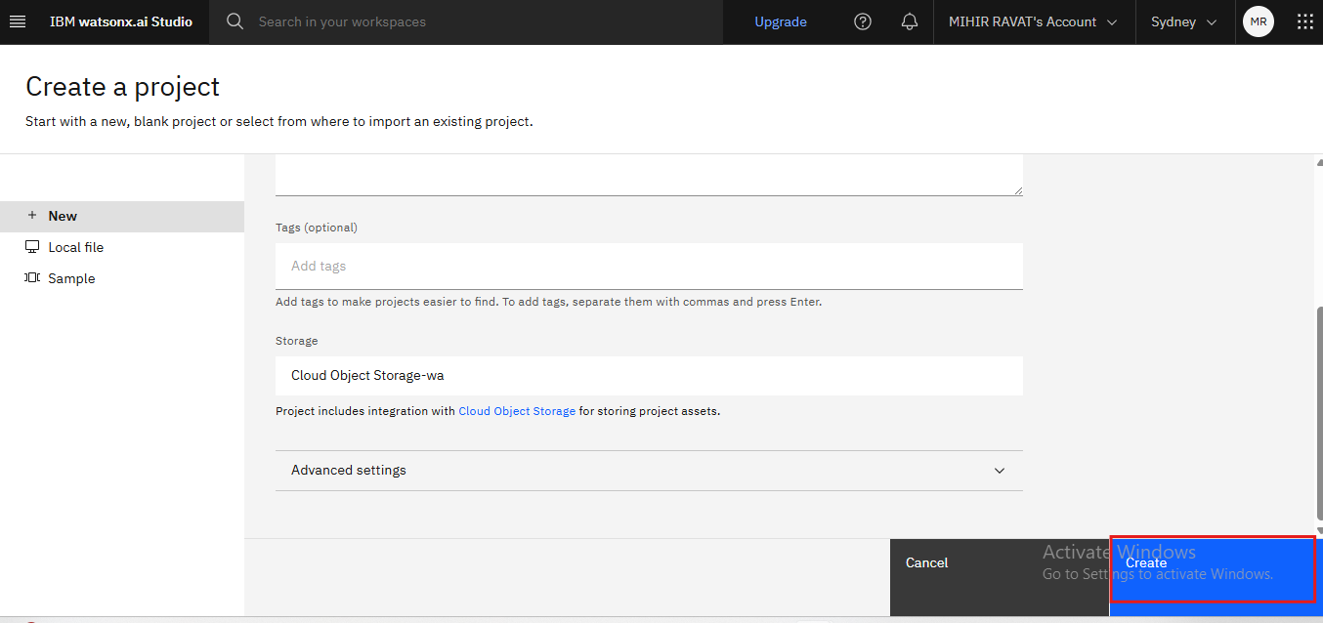
Result
Step 11:Click on refresh then click on Create

Slide 19
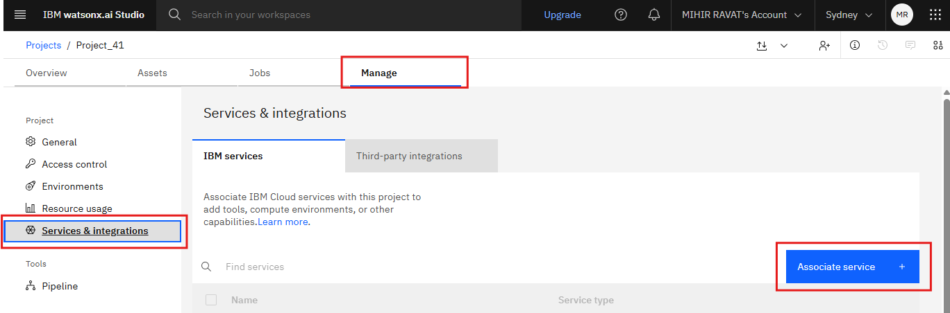
Result
Step 12: Click on the Manage,Under Manage tab click on Services & integrations and click on Associate service.

Slide 20
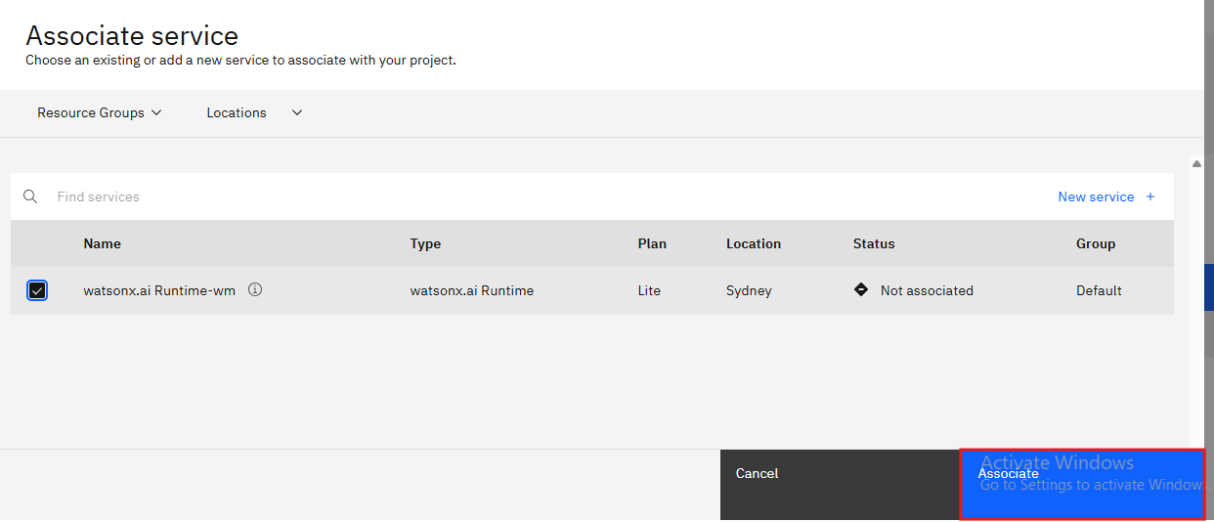
Result
Step 13: Click on the Watsonx.ai Runtime and Associate

Slide 21
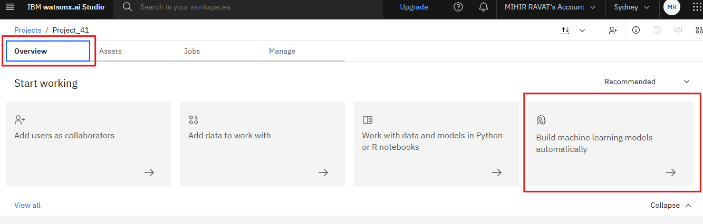
Result
Step 14:Click on Overview and then Click on “Build machine learning models automatically”

Slide 22
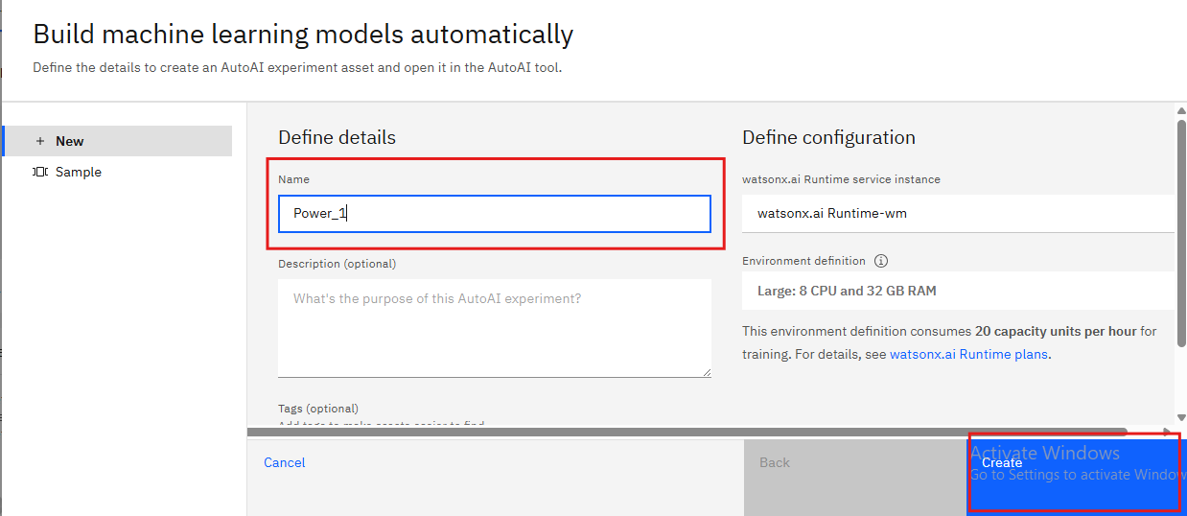
Result
Step 15: Enter experiment name and click on Create

Slide 23
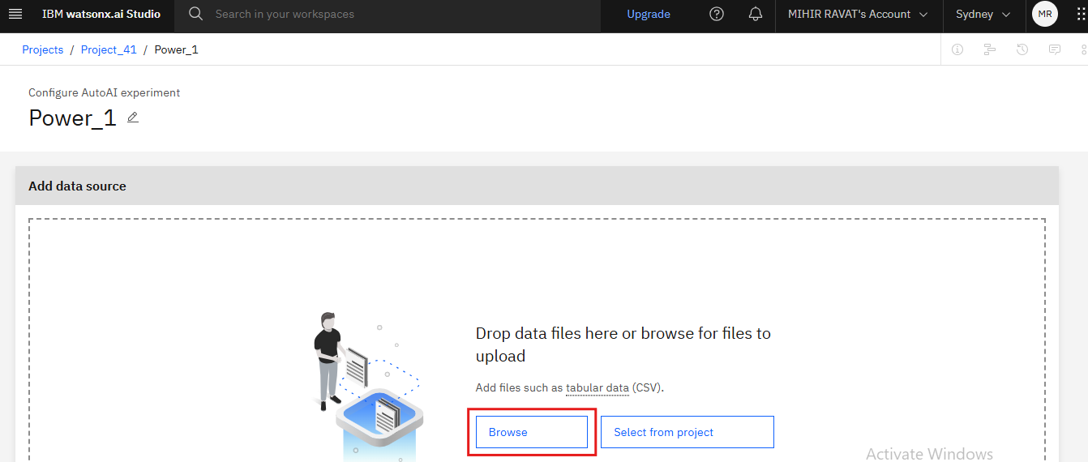
Result
Step 16: Add the downloaded data set (fault_data.csv) with the help of Browse option

Slide 24
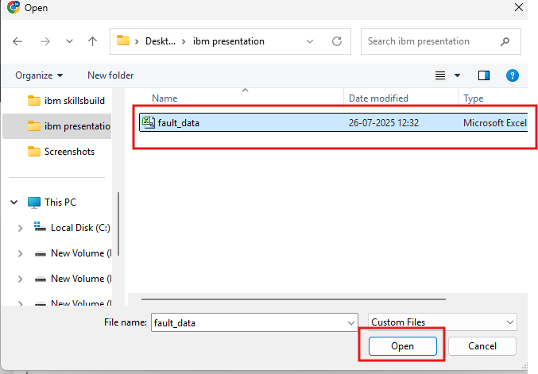
Result
Step 17: Select the data set and click on Open

Slide 25
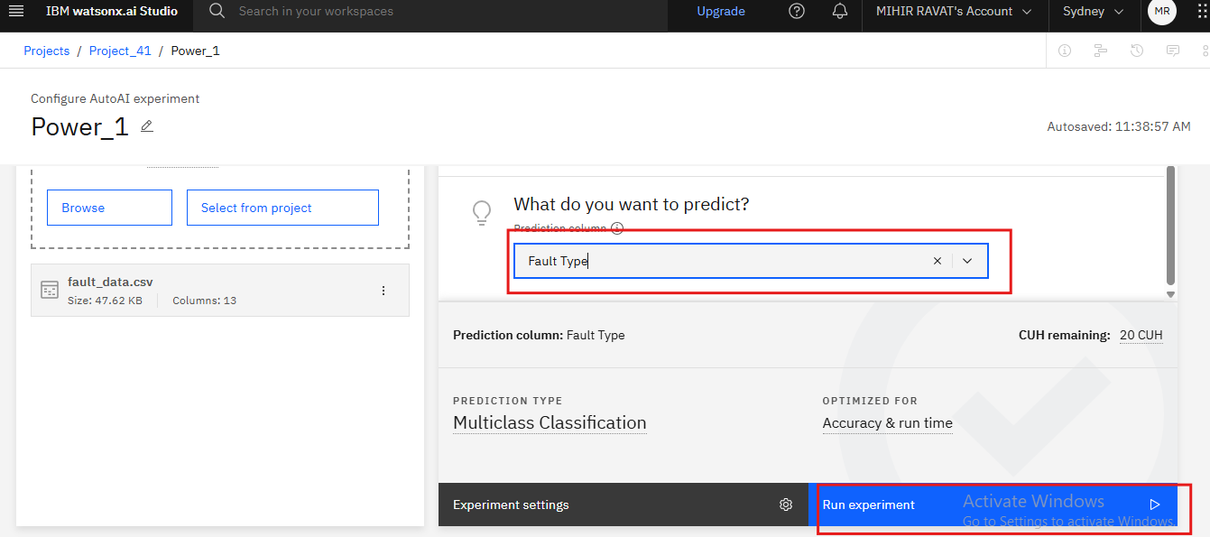
Result
Step 18: Data set is loaded. In create a time series analysis? Choose No option, Choose prediction column.(Fault_Type) and click on run experiment

Slide 26
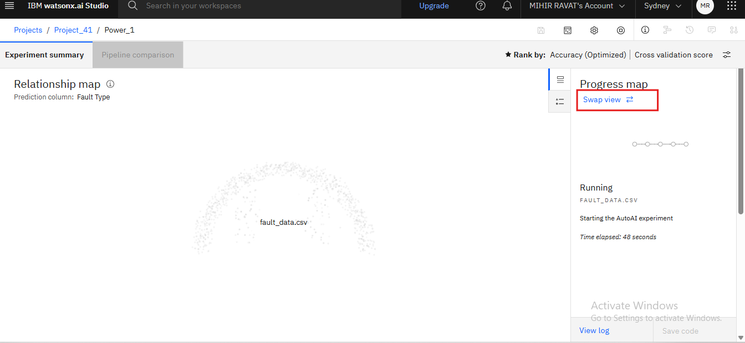
Result
Step 19: Auto AI experiment is running. Now click on swap view

Slide 27
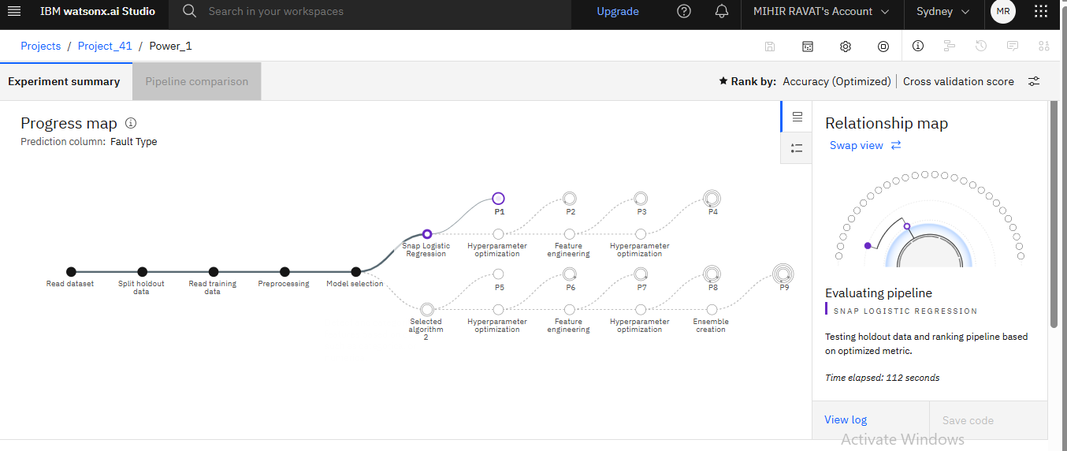
Result
Pipelines are building

Slide 28
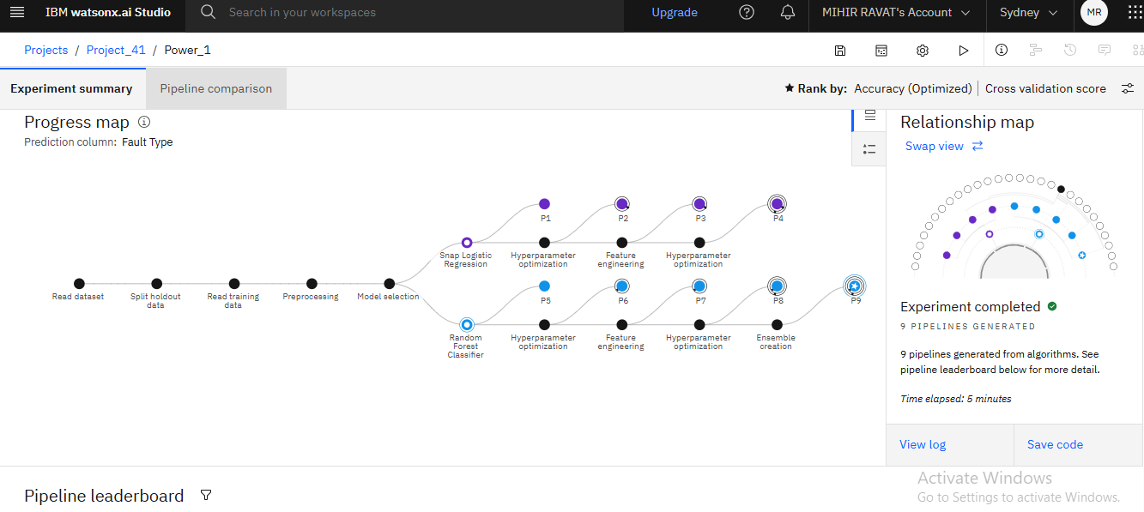
Result
The experiment is completed

Slide 29
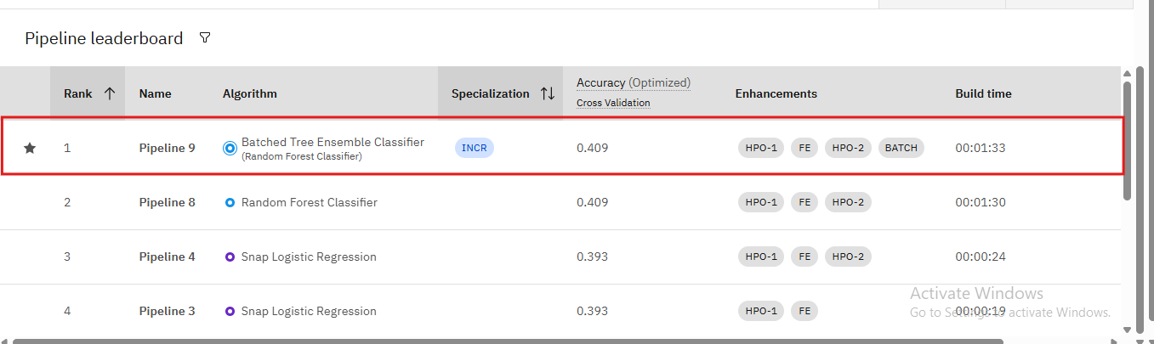
Result
This is the pipeline leader board. In this Pipeline9 is the top performer along with the algorithm name i.e. Batched Tree Ensemble Classifier(Random Forest Classifier).

Slide 30
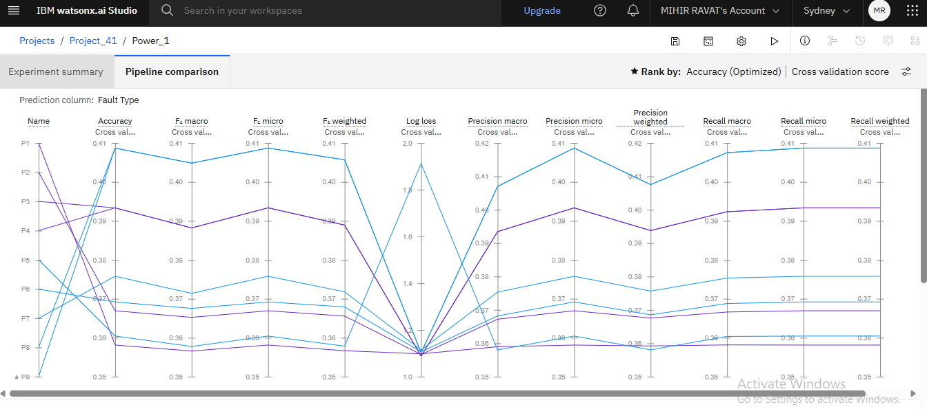
Result
This is pipeline comparison matric chart,it shows the performance of all pipelines along with the parameter i.e Accuracy,Log-loss ,etc

Slide 31
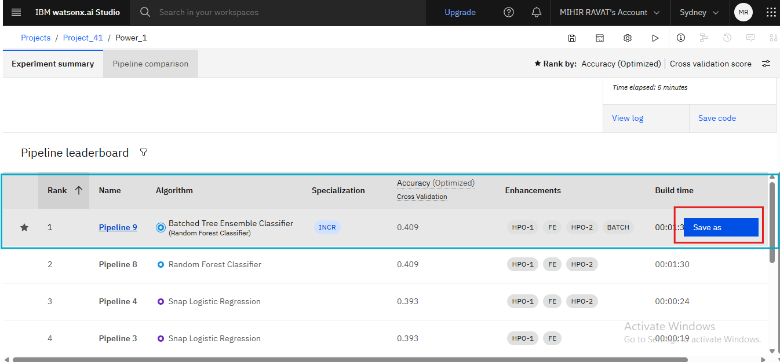
Result
Step 20: Select the best pipeline i.e Pipeline9 and click on save as

Slide 32
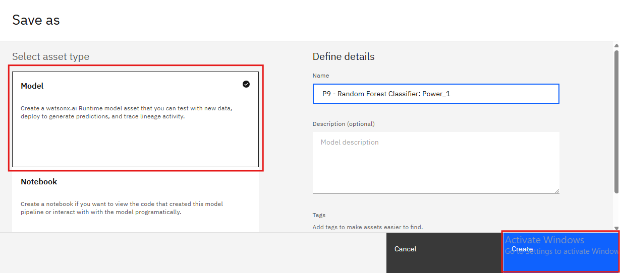
Result
Step 21: Choose Model asset and click on Create

Slide 33
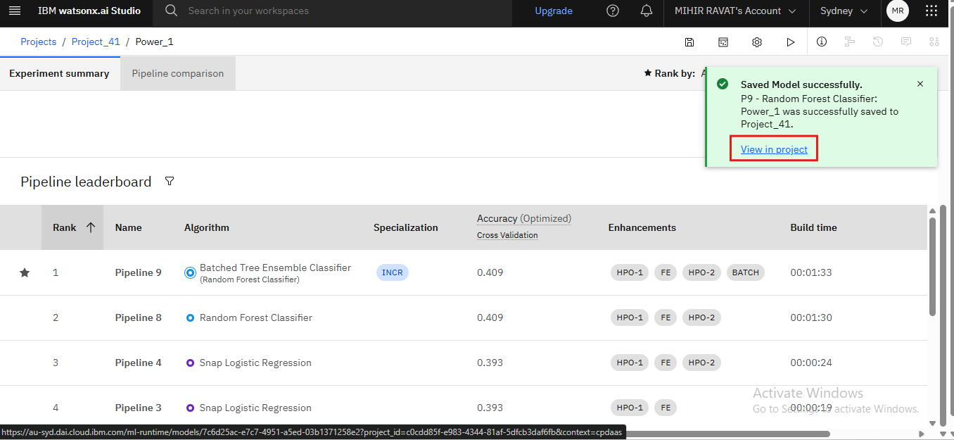
Result
The mode saved successfully and click on view in project

Slide 34
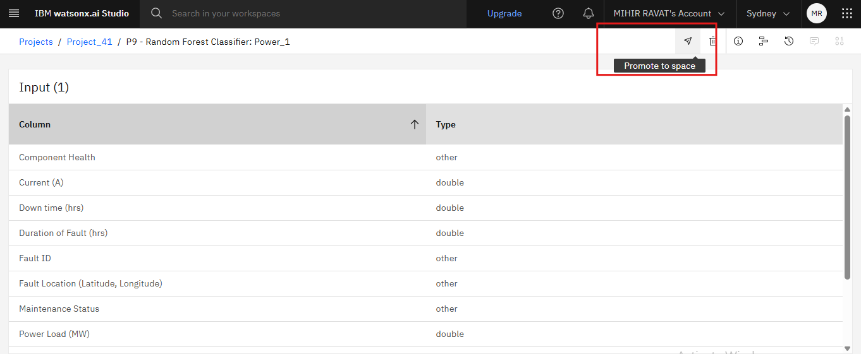
Result
Step 22: Click on promote to space on arrow

Slide 35
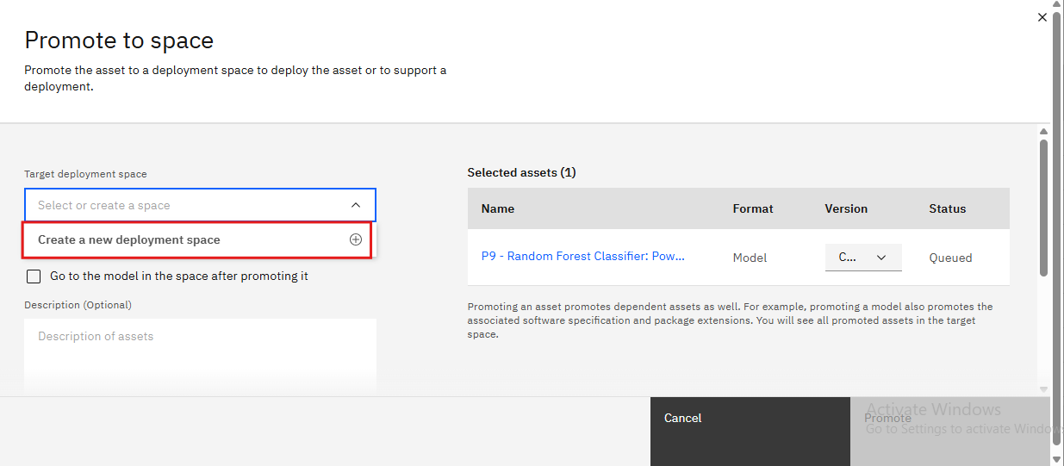
Result
Step 23:Click on Create a new deployement space

Slide 36
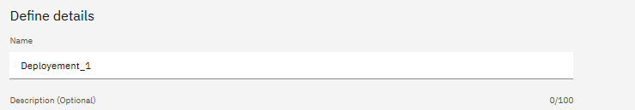

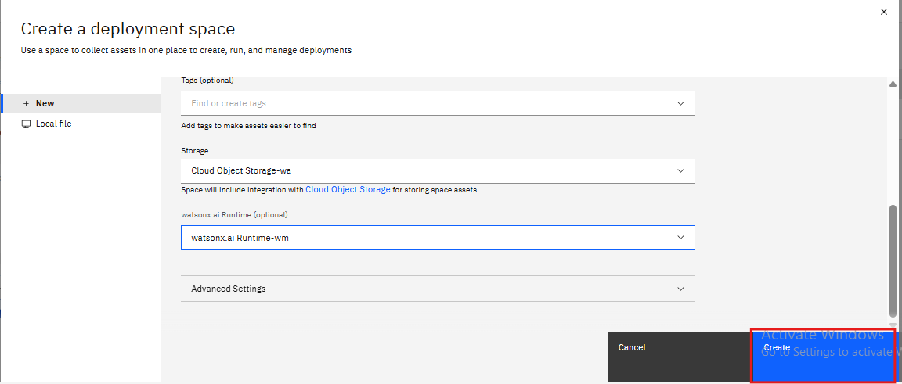
Result
Step 24:Give the deployment space name and select watsonx.ai Runtime service , click on Create

Slide 37
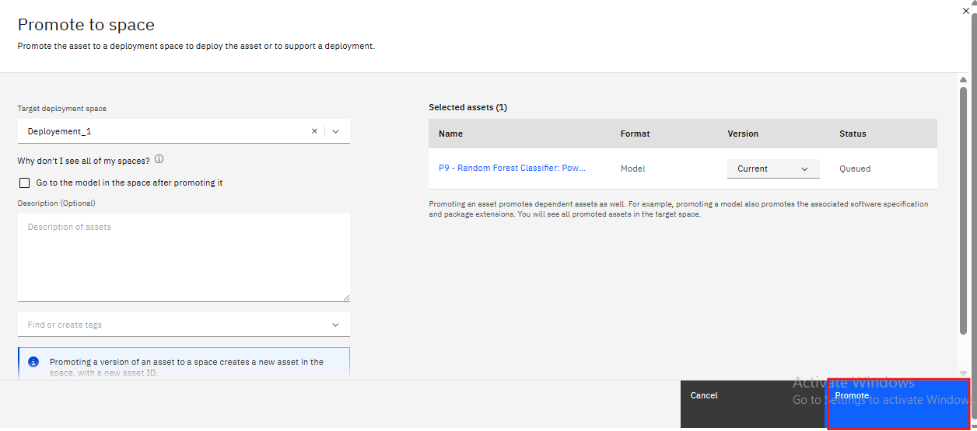
Result
Step 25:Click on Promote

Slide 38
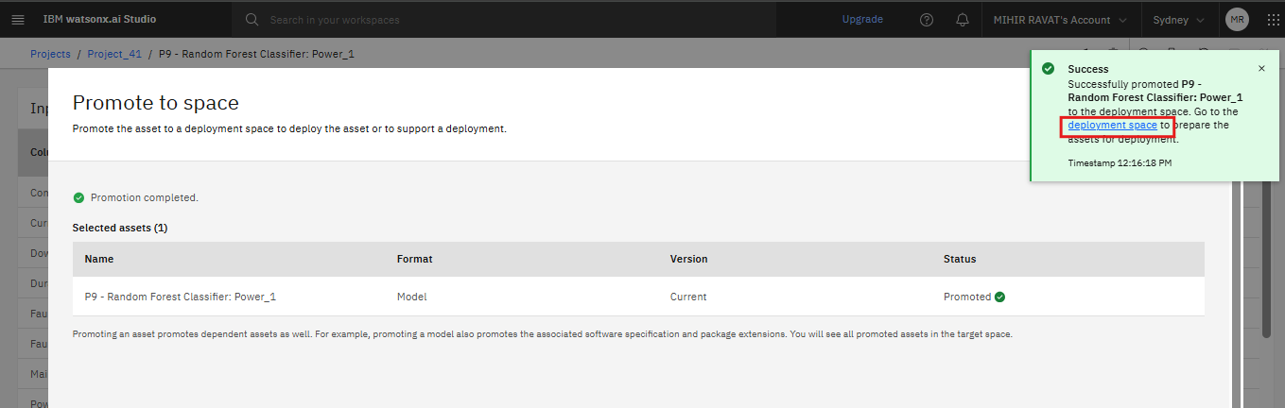
Result
Step 26:It’s Promoted and now click on deployement space

Slide 39
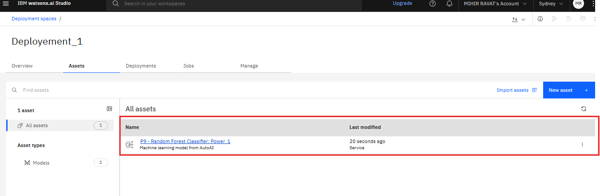
Result
Step 27:Click on the Asset name

Slide 40
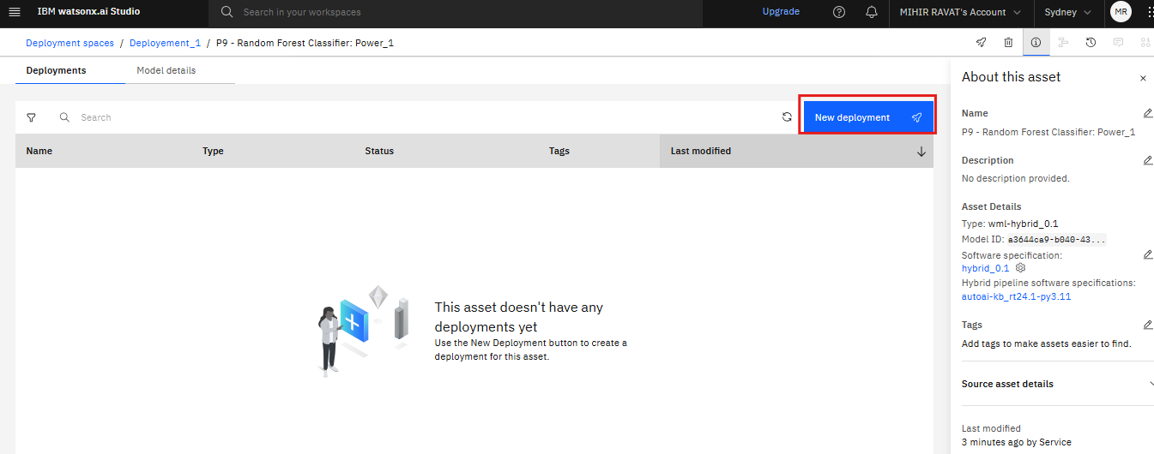
Result
Step 28: Click on new deployment

Slide 41
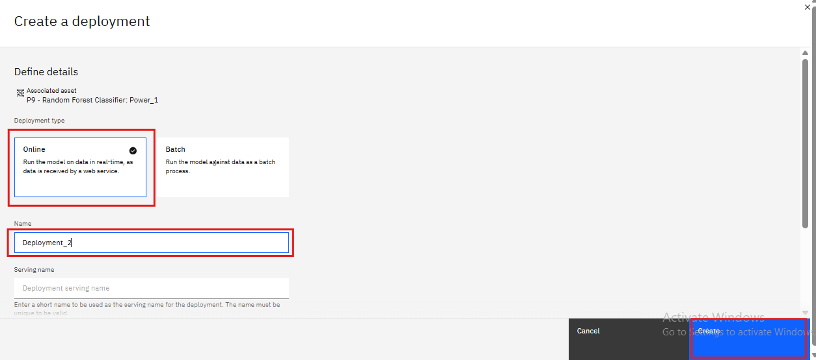
Result
Step 29:Select the deployment type and deployement name and click on Create

Slide 42
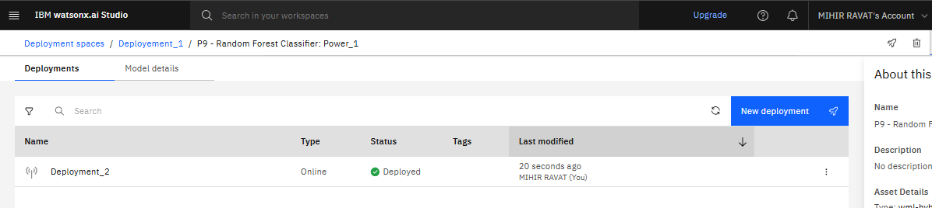
Result
The model is deployed

Slide 43
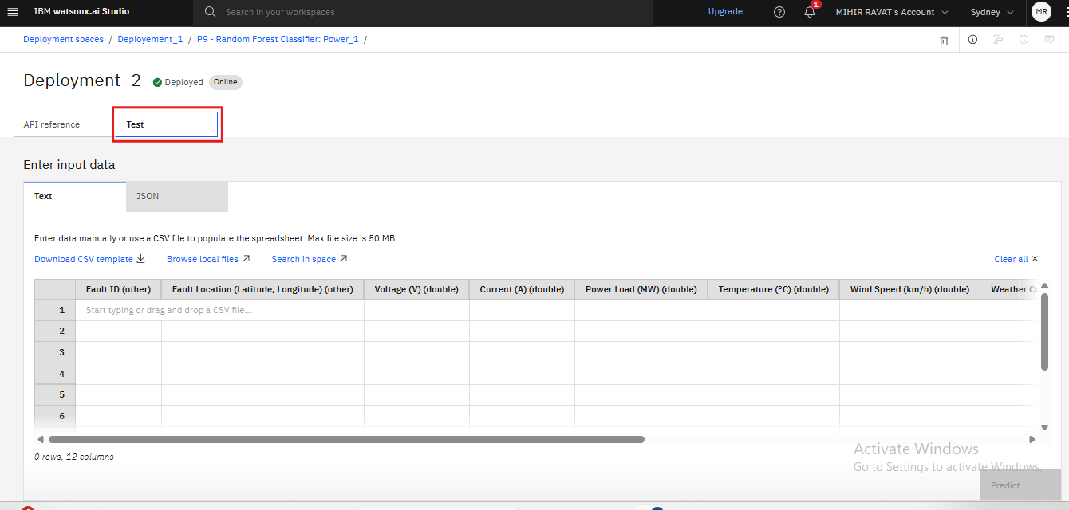
Result
Step 30: Now click on Test to predict with new values.Enter the data required from the fault_data.csv and then click on predict

Slide 44
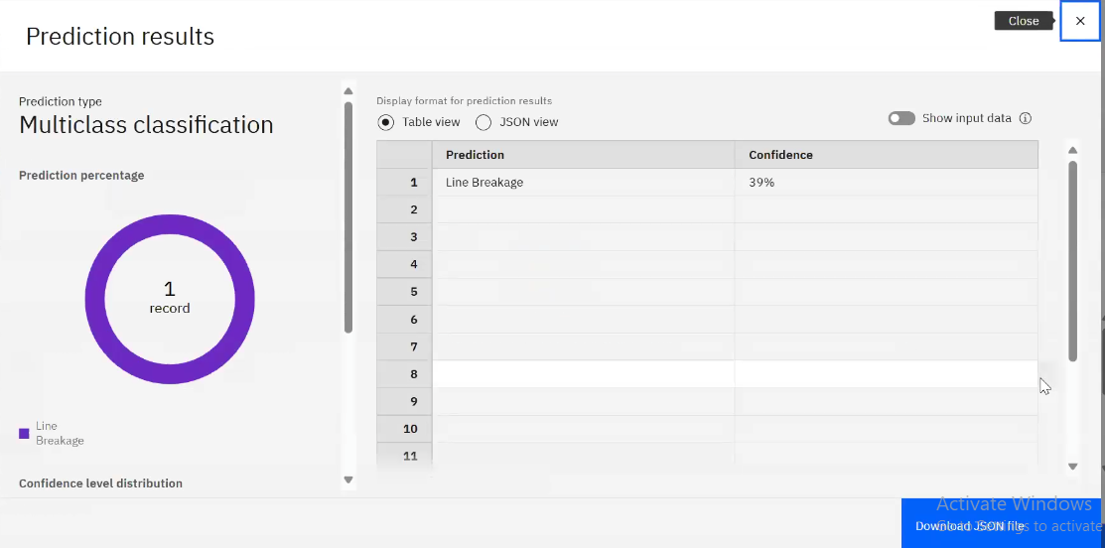
Result
The result is being displayed .It shows that the predicition type is Multiclass classification,in the table views it shows the confidence for the data entered,here the prediction is Line Breakage with a confidence of 39%

Slide 45
Conclusion
The implementation of a machine learning model for power system fault detection and classification demonstrates the potential of data-driven approaches in improving grid reliability and operational efficiency. By analyzing voltage, current, and phasor measurement data, the model effectively distinguishes between normal and faulty conditions, including line-to-ground, line-to-line, and three-phase faults. Deploying the model on platforms like IBM Watson Studio further enables real-time fault diagnosis and faster system recovery. This work highlights the value of integrating AI with smart grid technologies to enable proactive and intelligent grid management.

Slide 46
Future scope
Model Enhancement: Explore deep learning techniques (e.g., LSTM or CNN) for improved accuracy in complex fault scenarios.
Real-Time Data Integration: Integrate streaming data from smart sensors or PMUs (Phasor Measurement Units) for live fault monitoring.
Scalability: Extend the system to cover larger grid segments and more diverse fault types.
Edge Deployment: Investigate deployment on edge devices for faster, localized fault detection in remote substations.
Cybersecurity Considerations: Explore secure AI models to prevent tampering and ensure trustworthy grid operation.

Slide 47
References
IBM Cloud Documentation – https://cloud.ibm.com/docs
Kaggle Dataset: Power System Fault Classification https://www.kaggle.com/datasets/ziya07/power-system-faults-dataset

Slide 48
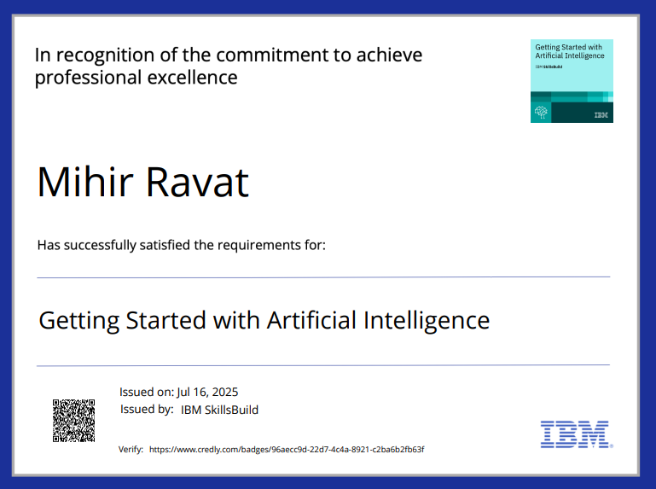
IBM Certifications

Slide 49
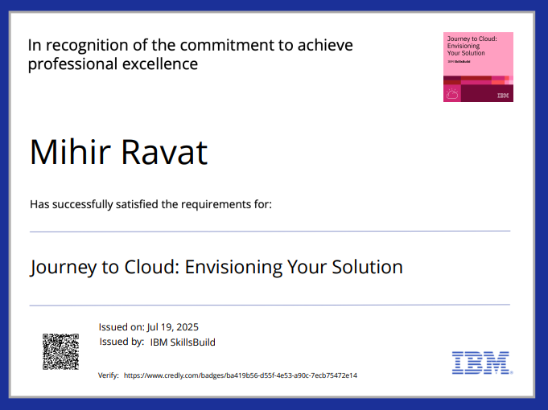
IBM Certifications

Slide 50
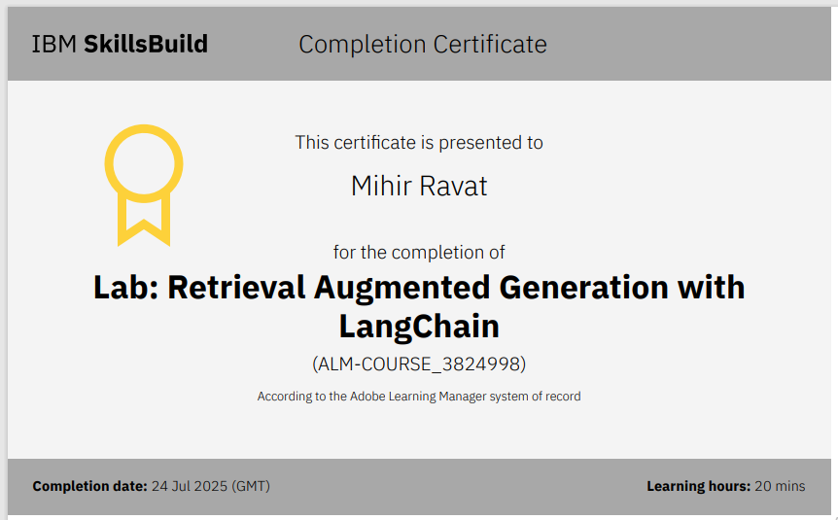
IBM Certifications

Slide 51
THANK YOU

