Slide 1

Preventive Health Copilot
An Open-Source LLM Agent using Multi-Step Reasoning & Tool Calling
By: Mihir Dichwalkar

Slide 2
Project Objective
Goal: Successfully build and evaluate an intelligent agent capable of multi-step reasoning and tool-calling for complex preventive health tasks.
Hypothesis: Iterative prompt engineering, culminating in a "Production-Ready" structured prompt, can significantly improve the reliability and output quality of an open-source LLM (Llama 3.1).
Deliverable: A robust, machine-readable output structure suitable for downstream application integration (e.g., scheduling, logging, and UI display).

Slide 3








System Architecture: The ReAct Agent
1. User Query
2. LangGraph Agent
3. Tool Calling
4. Structured Output
User provides a natural language request, e.g., "Give me stress tips and set a reminder."
Agent invokes necessary tools like get_health_tips("stress") or schedule_reminder(...).
The ReAct agent, guided by a "Production-Ready" prompt, interprets the query and plans steps.
LLM (Llama 3.1) generates a final, structured response with recommendations and plan.

Slide 4
Frameworks & Models Used
Core LLM: Llama 3.1 (8B) running locally via Ollama. Chosen for its strong reasoning and open-source availability.
Agent Framework: LangChain & LangGraph. Used to create a robust, stateful ReAct (Reason-Act) agent.
Tools: Standard Python functions (`get_health_tips`, `schedule_preventive_reminder`) integrated as agent tools.
Evaluation Judge: Google Gemini 2.5 Flash. Used as an impartial LLM to score the quality of different prompt iterations.

Slide 5




Integrated Agent Tools
get_health_tips
schedule_preventive_reminder
A function that returns evidence-aligned lifestyle advice for a specific condition (e.g., "diabetes", "stress"). This provides the core health information for the agent.
A function that (mock) schedules a reminder. It requires a strict ISO 8601 datetime and a message, forcing the LLM to parse user intent and arguments correctly.

Slide 6


Prompt Design Strategy (Iterations 1-2)
Prompt 1: Baseline
Prompt 2: Improved Reasoning
A simple system prompt defining the "Copilot" persona. It provided general advice but had no structure, reasoning, or tool-calling capabilities.
Introduced multi-step reasoning (ReAct-style) and safety guardrails. Mandated a simple Final Output heading for consistency.
Result: Often verbose and unable to handle complex, multi-part requests (like scheduling).
Result: Better at planning, but the output was still just unstructured text and not machine-readable.

Slide 7


Prompt Design Strategy (Iterations 3-4)
Prompt 3: Structured ReAct
Prompt 4: Production-Ready
Defined strict JSON-like schemas for tools (`get_health_tips`). Mandated a *structured* `Final Output` block (recommendation, plan, tools_used).
The final prompt. Added explicit instructional examples (few-shot), argument validation rules, and enforcement of exact function signatures
Result: Achieved maximum reliability and robustness. Output is a single, parseable structure for seamless downstream application integration.
Result: First version to reliably use tools and return parsable output, but sometimes failed on complex inputs.

Slide 8
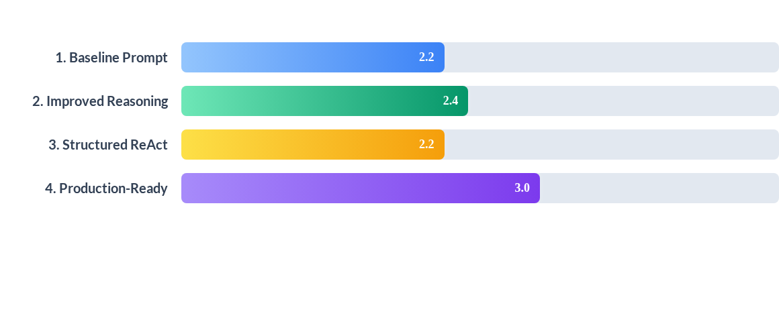
Evaluation Summary & Trade-offs
Key Insight: The "Production-Ready" prompt had the highest Overall Score (3.0).
Trade-off: It scored low on `prompt_adherence` (1.6) because the prompt was so complex, but its `query_relevance` (4.4) was highest, proving it was best at solving the user's actual problem.

Slide 9
Key Findings & Conclusion
Success: The "Production Ready" prompt significantly improved query relevance (4.4/5.0) and achieved the highest overall score (3.0/5.0).
Challenge: "Prompt Adherence" (avg. 1.6/5.0) was the weakest metric. Llama 3.1 struggled to *perfectly* match the strict output format.
Analysis: The low adherence score is likely due to a model mismatch: a strict `Gemini 2.5` (Judge) evaluating a smaller open-source model (`Llama 3.1`).
Conclusion: Iterative prompt engineering is critical for agent reliability. Future work should align the judge model with the generator model for a more "apples-to-apples" evaluation.

Slide 10
Thank You

