Slide 1
Convex Hull in 2D plane
HPC Project
Akshay Miterani - 201401443
Mihir Limbachia - 201401456

Slide 2
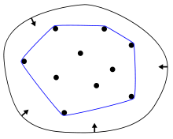
Introduction - What is Convex Hull?
Let S be a set of points in the plane. The convex hull of S is the smallest convex polygon that contains all the points of S.

Slide 3
Applications :
Path finding in robots when there are obstacles along the way. The shortest path for robot is along one of the set of hull points if obstacle is along the way.
Visual Pattern matching- The convex hull of the image is created to make a pattern which is used to identify number or letter. For example license plate.
The problem of finding convex hulls finds its practical applications in pattern recognition, image processing, statistics, geographic information system, game theory, construction of phase diagrams, and static code analysis by abstract interpretation

Slide 4
Serial Algorithm
The algorithm used here is the Jarvis march which is as follows:
The leftmost point is found out which becomes the first hull point.
Select any random candidate-in-run hull point other than the first hull point and traverse through all the points and for each point find orientation previous hull-point->candidate-in-run-hull-point->traverse-point
If counter clockwise :
Change the candidate-in-run hull point to traverse->point
3. If the candidate-in-run hull point is not the first hull point set the previous
hull point to candidate-in-run-hull point and repeat the step 2 after adding
hull point to set of hull points.

Slide 5
Complexity of Algorithm
The main task of the algorithm is to find the hull points until all the other points are enclosed within the formed hull.
So the complexity of algorithm is O(n*h) where n is the number of input points and h is the no of hull points.
The no of hull points can vary between n^⅓ (circle enclosing points)to n^2 (all the points on the hull)
So the worst case complexity is O(n*n) and average case is O(n^4/3).

Slide 6
Parallelization Strategy
The task is to find the next hull point by finding the orientation of the given point with respect to the previous hull point and candidate-in-run hull point.
So the task is data oriented and we use work sharing construct to divide the points among the threads launched on each core. Each core has its set of points and initial hull point (same for each thread initially). Then at each step of finding hull point the suitable hull point for each thread is found out. The hull points obtained locally for each thread are then again checked for orientation with the previous hull point and the candidate-in-run hull point (which is one of these locally obtained hull points) to get the final next hull point.
In next step, this hull point becomes the previous hull point and the same task is repeated.

Slide 7
Parallel Pseudo Code
In the serial algorithm
Initialize next Hull Point as any point for all threads.
For all threads check orientation of all other points and previous hull point against that thread’s next Hull point.
Find the winner of all the thread points according the orientation
Add the winner as the last hull point

Slide 8
Improving Cache Performance
In the given algorithm we can use two arrays to hold x and y coordinates respectively.
Scope of improvement in performance
We can see that x and y value of a particular points are always accessed together. Hence instead of defining two different arrays we can use a 2D array to store x and y coordinates as int point[num_points][2]
Hence we will improve the cache performance of our code by reducing the memory access time.

Slide 9
Example
Input:
Number of points on plane = 7
{0, 3}
{2, 2}
{1, 1}
{2, 1}
{3, 0}
{0, 0}
{3, 3}
Output:
Number of points in Polygon = 4
(0, 3)
(0, 0)
(3, 0)
(3, 3)

Slide 10
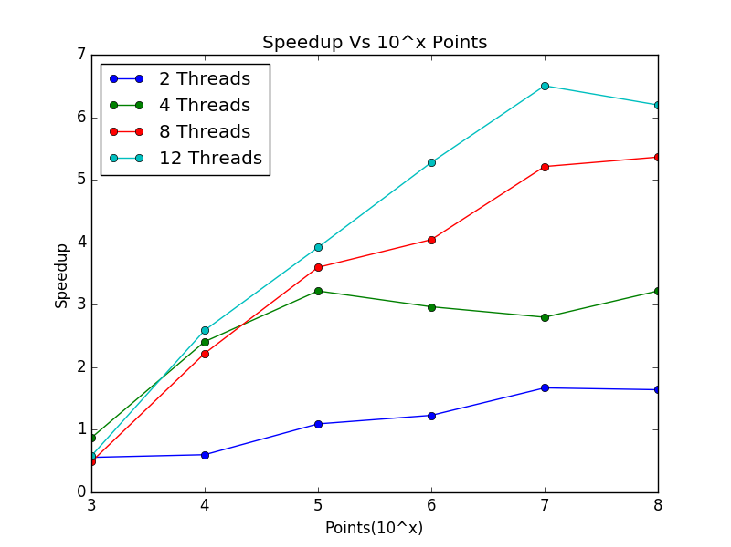
Speed Up
The speed up for small problem-size is lesser than 10^5 owing to the synchronization overheads.
Parallel slowdown is happening in this case where the benefit due to parallelization is lesser than the overheads involved.

Slide 11
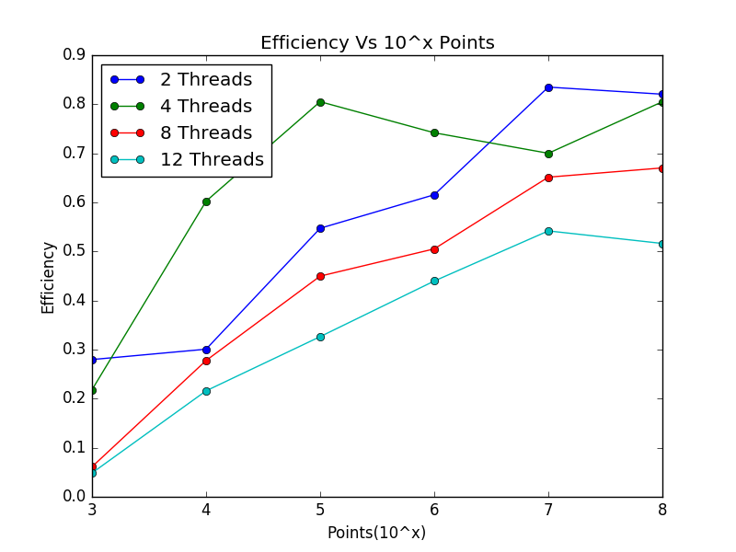
Efficiency
The Efficiency increases as problem size increases as problem size increases. This is obvious from the Gustafson’s law which says that as problem size increases the speedup increases because the time for which code runs serially decreases which leads to increase in efficiency for fixed no of processors.

Slide 12
Observation
We observe that as problem size increases the speed up increases. This is because in our algorithm the expected ideal speed up is O(h*n/p) and as p increases considerably against the number of points we get a good speed up.
However, after a limit, the problem becomes difficult to run on more number of processors and hence speed up stops increasing considerably.

Slide 13
Future Scope
As a future scope, we can divide the plane in p parts and then combine it using different algorithm.
This will give a more speed up than our current algorithm.
As even further extension, we can change the algorithm to Graham Scan Algorithm, which is more time-optimized algorithm, and then parallelize the code,
References: http://www.cse.buffalo.edu/faculty/miller/Courses/CSE633/Vertlieb-Fall-2012-CSE633.pdf

