Slide 1
DSA-MINIPROJECT
PHONE-BOOK IMPLEMENTATION
Mihir Malani
SY-COMP DIV1
111903046

Slide 2
DATA STRUCTURE
Data structure used to implement phonebook in c language is trie trees.
A trie is also called digital tree and sometimes radix tree or prefix tree ( as they can be searched by prefixes), its key is usually a string.
Each node consist of a max 26 children and edges connect each parent to its children, these are nothing but pointers foe each of the 26 letters of English alphabet

Slide 3
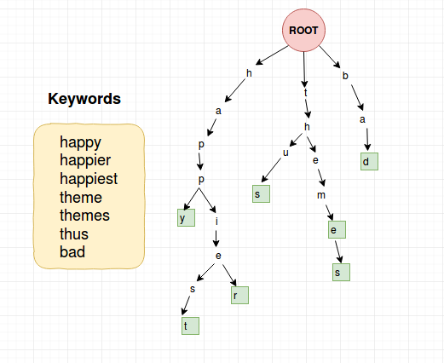

Slide 4
ADVANTAGES OVER BST
A trie tree provides an alphabetical ordering of each character of string by key, moreover there are no collisions of different keys in a trie tree
TIME COMPLEXITY
Using trie search complexities can be brought to a optimal limit , in a BST the time required will be proportional to M*logN whereas in trie we can search the key in O(M) where M is maximum length of string and N is number of keys is the tree .

Slide 5
LIST OF FUNCTIONS
Insert
Contains a profile which includes .
Name, Phone Number(at max 2) and Description of the contact.
Search
Search a given contact by his name and display all his details.
Delete
To delete a specific contact.
Display
To display all the contacts saved in the phonebook.

Slide 6
DATA HANDLING
Creating a text file storage.txt where all the input content of the phonebook will be recorded according to their structure.
Data updation and searching of contacts from this file to be performed .
Backup of the data can also be preserved .

