Slide 1
BRIEF OUTLINE AND PROBLEM STATEMENT

Slide 2
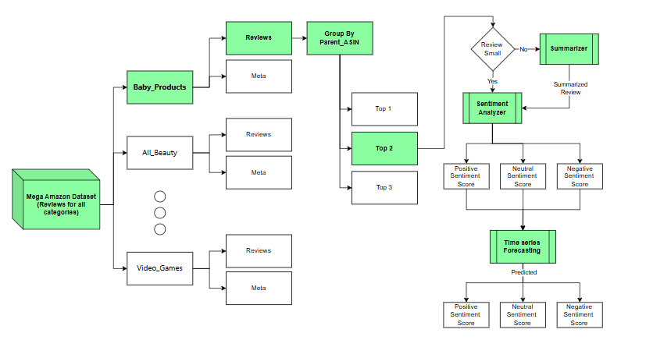
END-TO-END SOLUTION PIPELINE

Slide 3
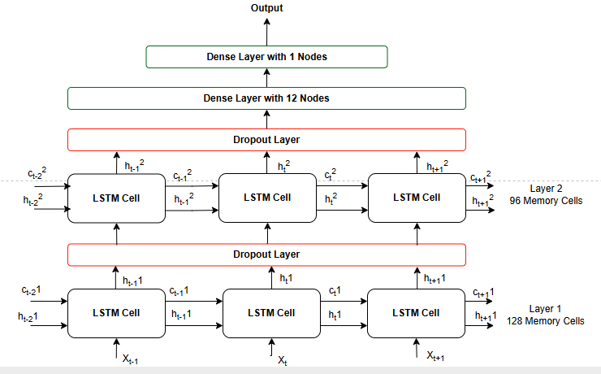
MODEL ARCHITECTURE DIAGRAM

Slide 4
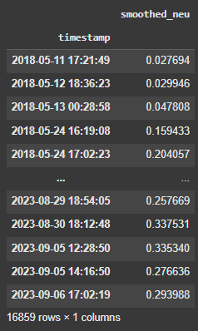
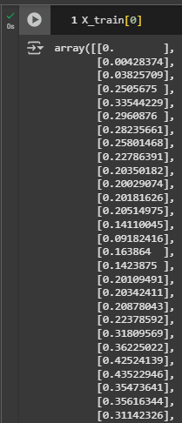

TRAINING DATA

Slide 5


TEST DATA

Slide 6



LEADERBOARD TABLE

Slide 7
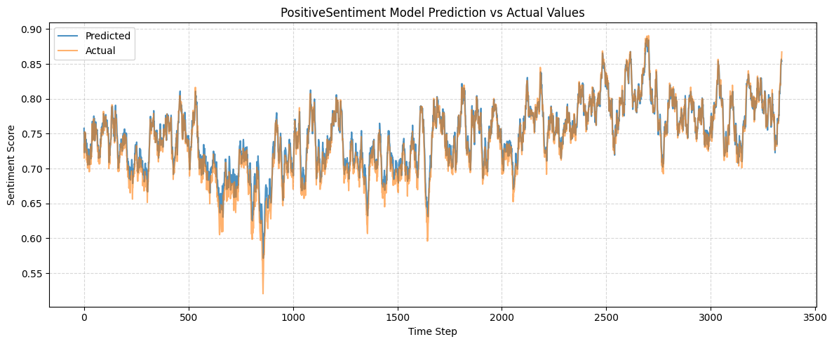
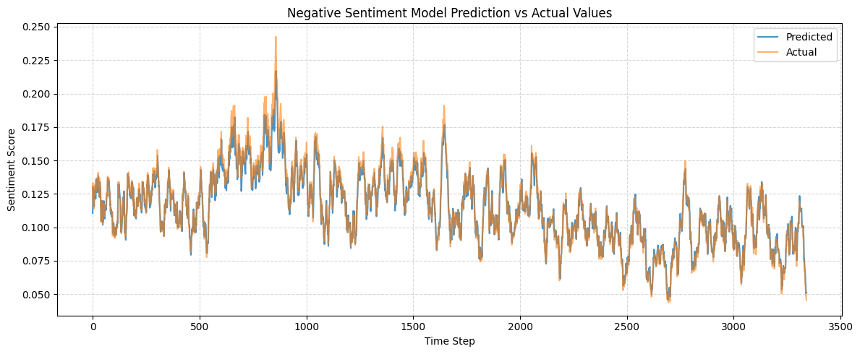
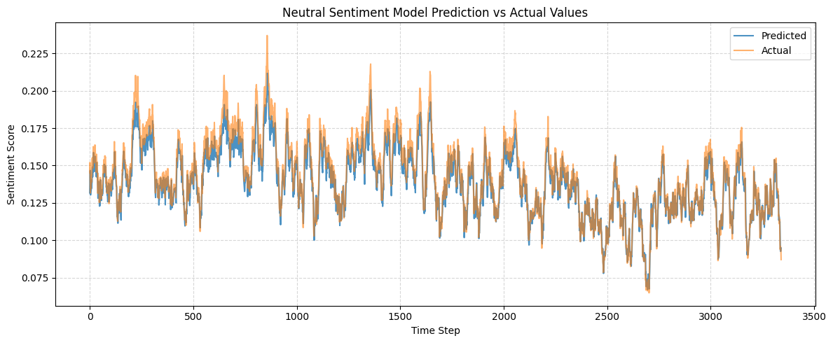
ADDITIONAL RESULT ANALYSIS

