Slide 1
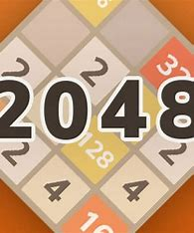
2048 Game
Name: Patel Mihir
Enrollment No: 22002171310088
Roll No :- 33
Div :- C1
Branch:- C.S.T
Ma

Slide 2
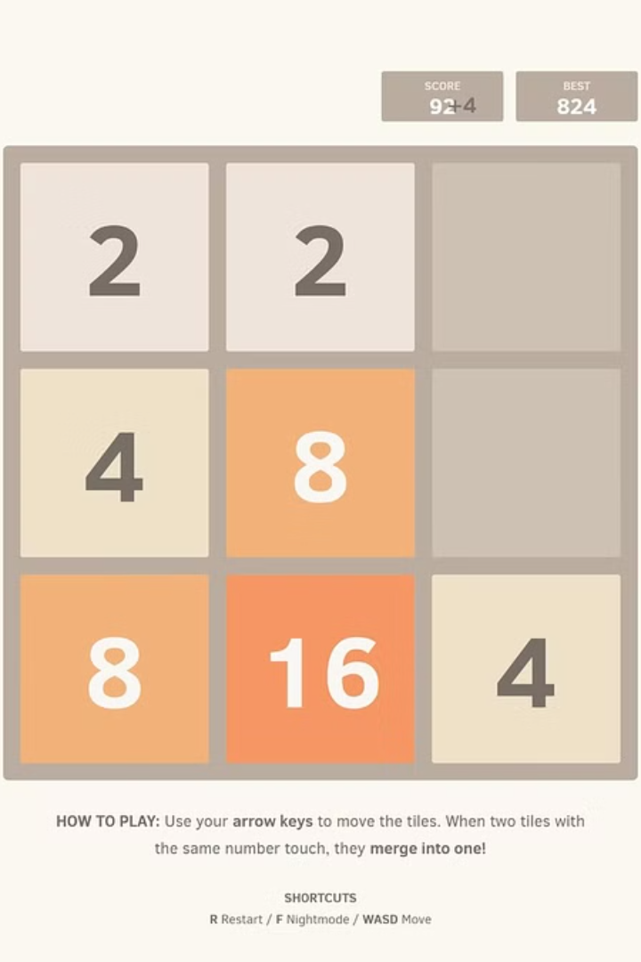
Exploring the 2048 Game
2048 is a captivating single-player puzzle game where players combine numbered tiles on a 4x4 grid to create the elusive 2048 tile. This deceptively simple but addictive game challenges players to strategize, think critically, and test their problem-solving skills.

Slide 3
Building the 2048 Game with Python
Game Logic
Game Board
User Input
The core of the 2048 game is implemented using Python, data structures and algorithms to handle the game mechanics, including tile movements, merging, and score tracking.
Python is used to create and manage the 4x4 game board, tracking the state of each tile and updating the board as the player makes moves.
Python's input handling capabilities are utilized to capture the player's moves, such as swiping the tiles in various directions.

Slide 4
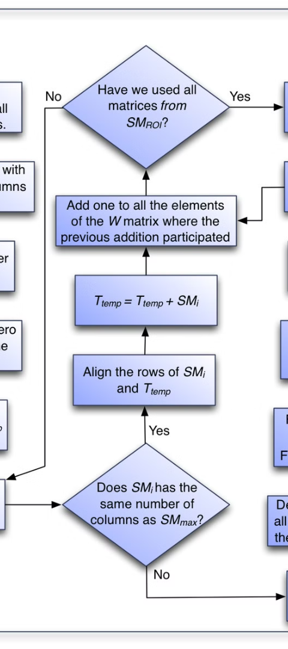
Implementing the Game Logic
1
Tile Movement
Implement the logic to move tiles in each direction, merging tiles with the same value and shifting the remaining tiles accordingly.
2
Tile Spawning
Automatically spawn new tiles with a value of 2 or 4 in empty spaces on the board after each player move.
3
Score Tracking
Keep track of the player's score by updating it as tiles are merged, and display the current score to the user.

Slide 5

Designing the 2048 User Interface with Tkinter
Game Board
Control Buttons
Utilize Tkinter's canvas and grid layout to create the visually appealing 4x4 game board, with each tile represented as a graphical element.
Incorporate buttons or key bindings to allow the player to swipe the tiles in the four cardinal directions and start a new game.

Slide 6



Enhancing the 2048 Game
High Scores
Time Tracking
Online Leaderboard
Implement a high score feature to keep track of the player's best performances and motivate them to improve.
Add a timer to the game interface, allowing players to see how long they have been playing and challenge themselves to beat their own records.
Integrate an online leaderboard, where players can compare their scores with others and compete for the top spots.

