Slide 1
5. Constructor & Destructor

Slide 2
Mr. M.R. Solanki
Sr. Lecturer, Information Technology,
manish_ratilal2002@yahoo.com
SBMP

Slide 3
Learning Outcomes
Students will be able to:
Initialize class objects with default values using constructors.
Create replica of an object using copy constructor.
Observe the invocation of destructors.

Slide 4
Constructor

Slide 5
Constructor
A constructor is a “special” member function which initializes an objects of its class.
It’s name is same as class name but no return type.( not even void)
It is invoked whenever an object of its class is created.
As it constructs the values of data members of a class , it is called as constructor.

Slide 6
Default Constructor
A constructor that accepts no parameters is called the default constructor.
The default constructor for class A is A::A().
lf no such constructor is defined, then the compiler supplies
a default constructor.
Therefore the below statement
A a;
invokes the default constructor of the compiler to create the object a.
Note: The default constructor is automatically provided by C++ and it initializes object data members with garbage values.

Slide 7
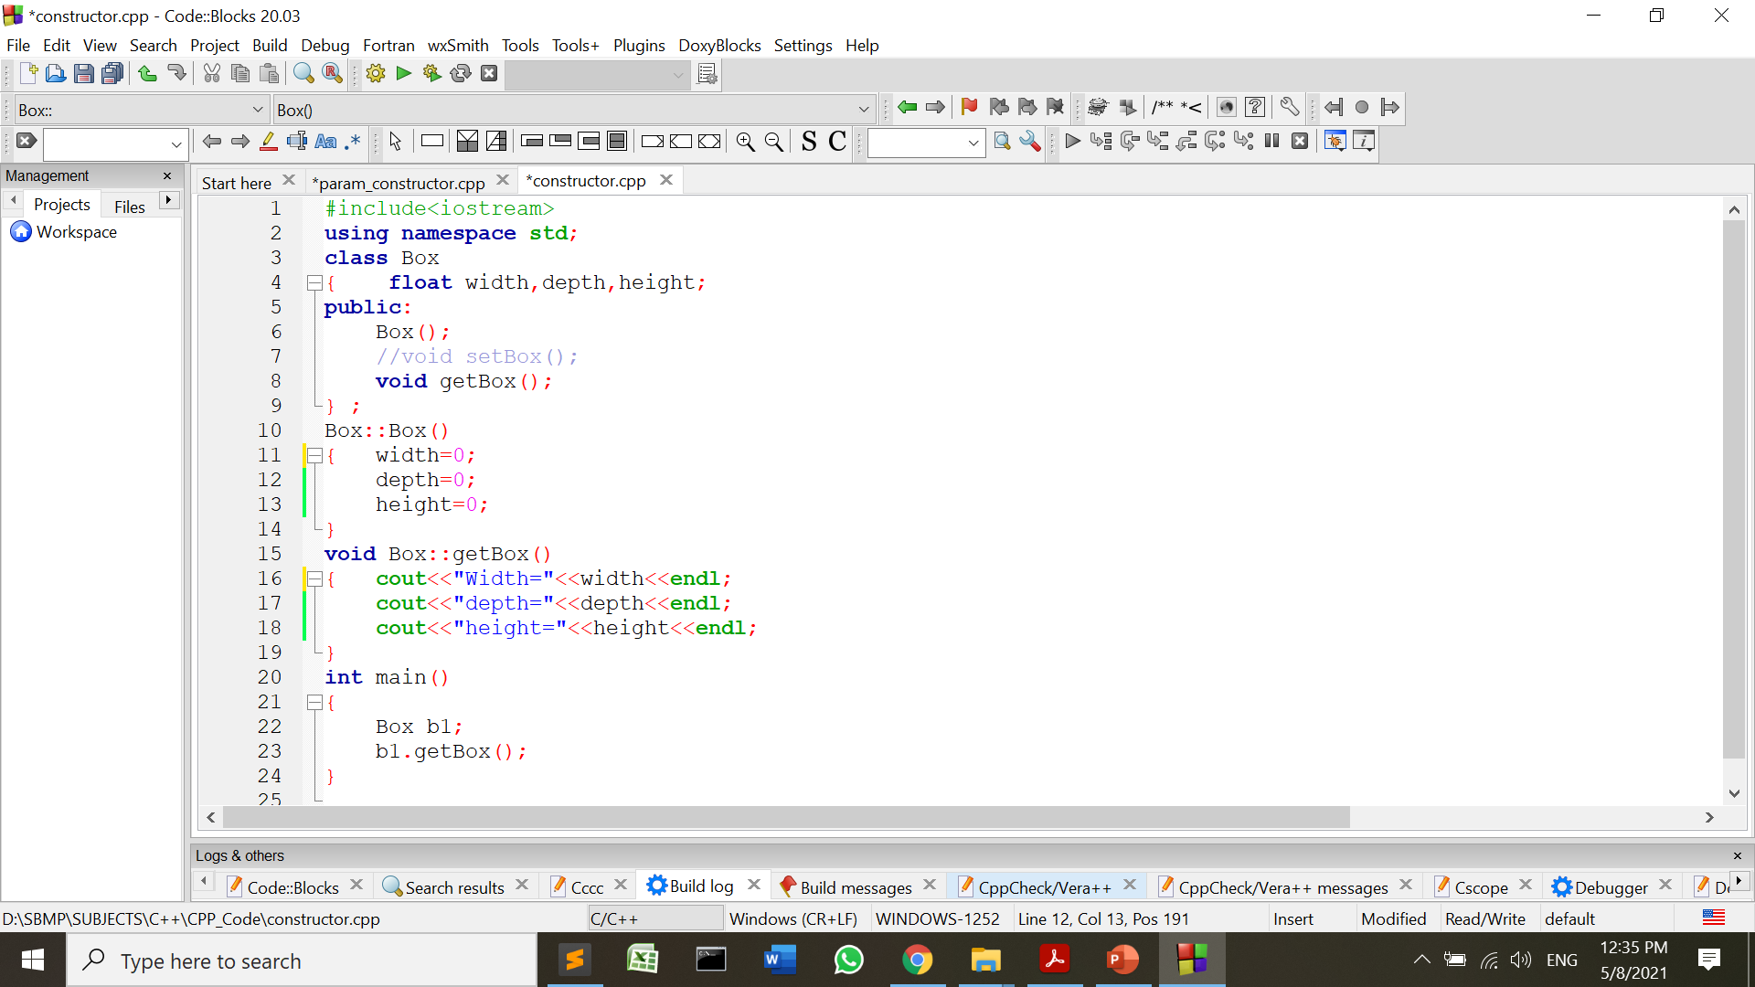
User Defined Constructor
User can provide the body of constructor as shown below:
Width=0
depth=0
height=0

Slide 8
Characteristics of Constructors
Declared in public section.
Invoked automatically when the object is getting created.
Do not have return types ( Not even void)
Like other C++ functions, they can have default arguments.
Constructors cannot be virtual.

Slide 9
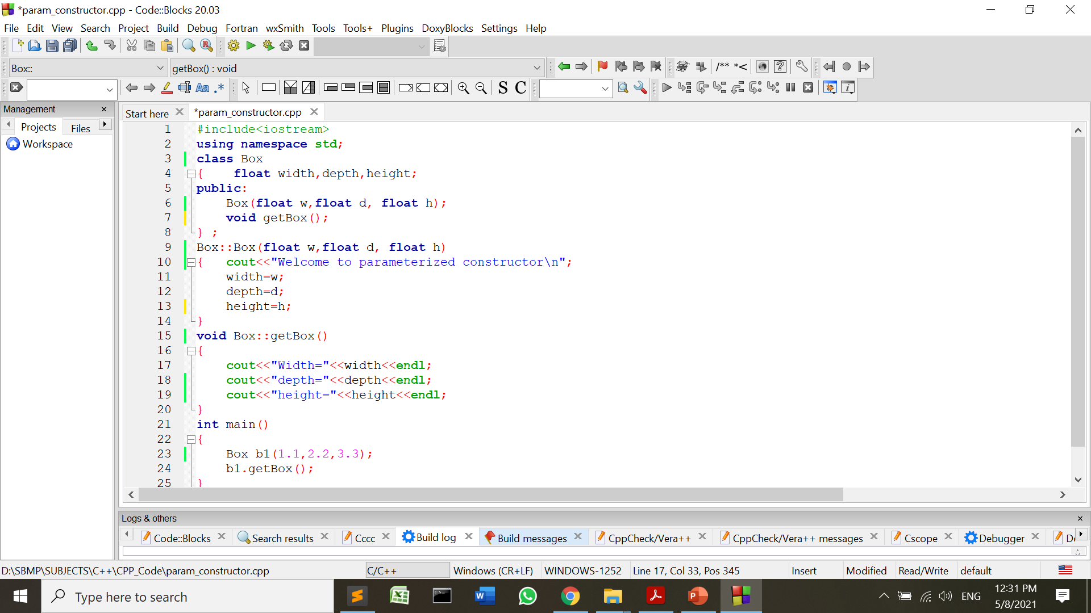
Parameterized Constructor
We can pass parameters to the constructors to initialize objects with desired values.
Such constructors are called as parameterized constructors.

Slide 10
We can invoke parameterized constructor by 2 ways:
Explicit Call:
Box b1=Box(1.1,2.2,3.3);
Implicit Call:
Box b1(1.1,2.2,3.3);

Slide 11
# If a programmer provides any constructor (without parameter or parameterized), then C++ does not provide default constructor. So it would be responsibility of the programmer to supply the default constructor.

Slide 12
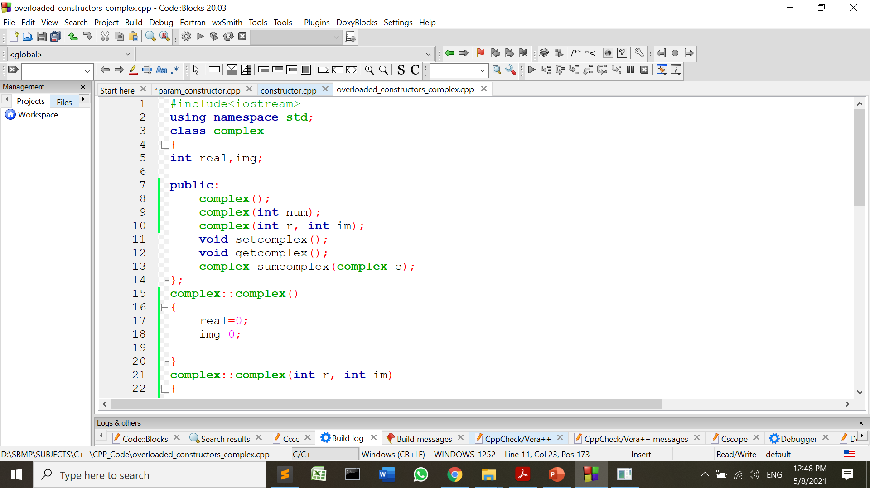
Multiple Constructors
We can have more than one constructors in a class but with different parameter lists.
Such constructors are called as “overloaded constructors”.

Slide 13
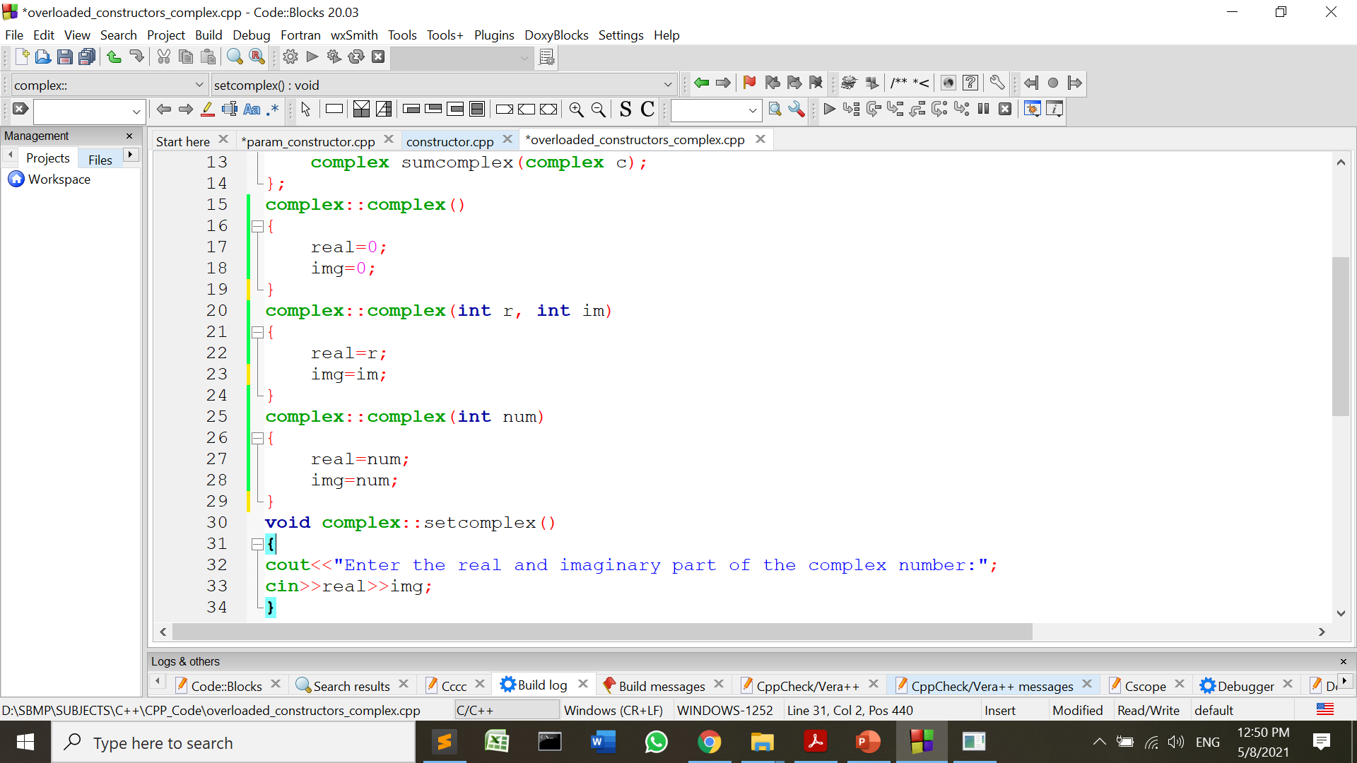
Multiple Constructors

Slide 14
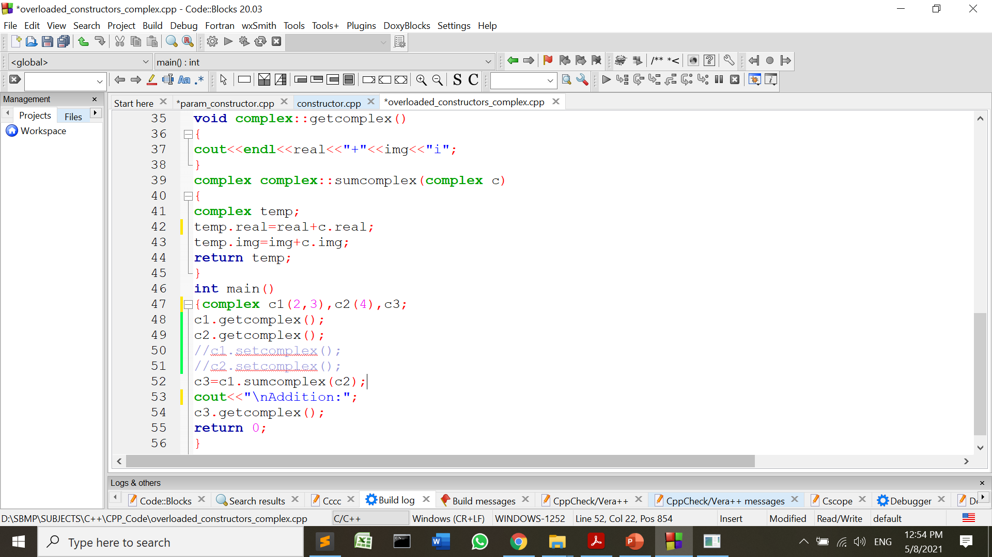
Multiple Constructors
2+3i
4+4i
Addition:
6+7i

Slide 15
#We can use default arguments with Constructors.(like functions with default arguments)
# If a programmer provides any constructor, in that case C++ does not provide default constructor. So it would be responsibility of programmer to supply the default constructor.

Slide 16
Copy Constructor
A constructor can accept a reference to its own class as a parameter, such constructor is called as copy constructor.
A copy constructor is used to declare and initialize an object from another object.
Syntax: copy constructor body
class_name(class_name &ob)
{
// initialization logic
}
call to copy constructor
complex c2(c1);
OR
complex c2=c1;

Slide 17
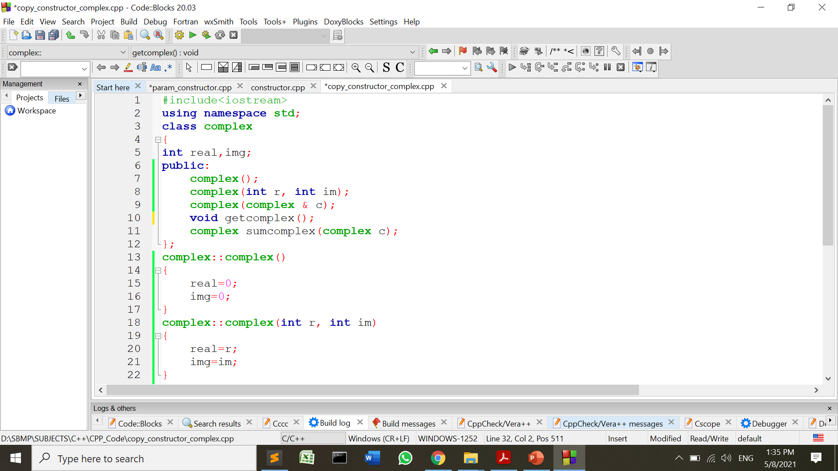
Copy Constructor

Slide 18
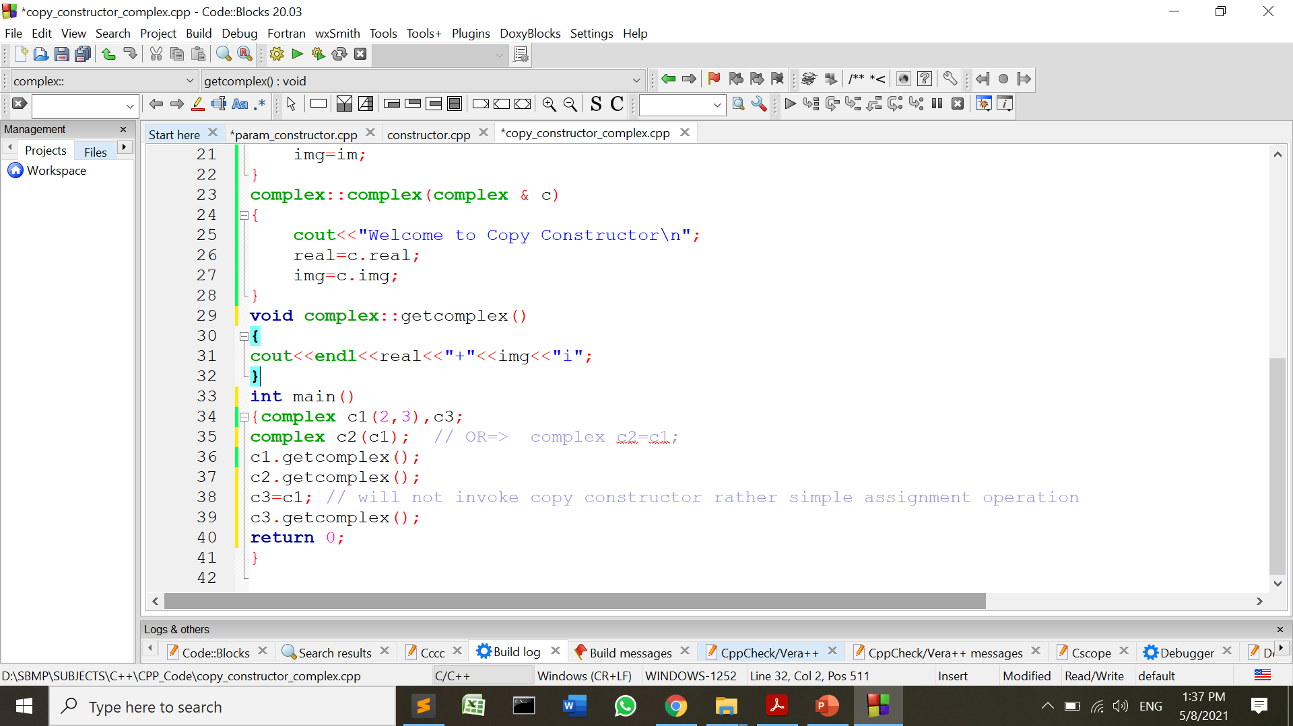
Copy Constructor
Welcome to Copy Constructor
2+3i
2+3i
2+3i

Slide 19
#If we don’t define our own copy constructor, the C++ compiler creates a default copy constructor for each class which does a member-wise copy between objects.
#We need to define our own copy constructor only if an object has pointers.

Slide 20
Destructor
A destructor is used to destroy the object that has been created by a constructor.
Like a constructor, the destructor is a member function of a class and its name is same as the class name but is preceded by a tilde.
Syntax: ~class_name() { }
A destructor never takes any argument nor does it return any value.
It is invoked implicitly by the compiler upon exit from the program (or block or function as the case may be) to clean up storage allocated to objects.
It is good practice to declare destructors in a program since it releases memory space for future use.

Slide 21
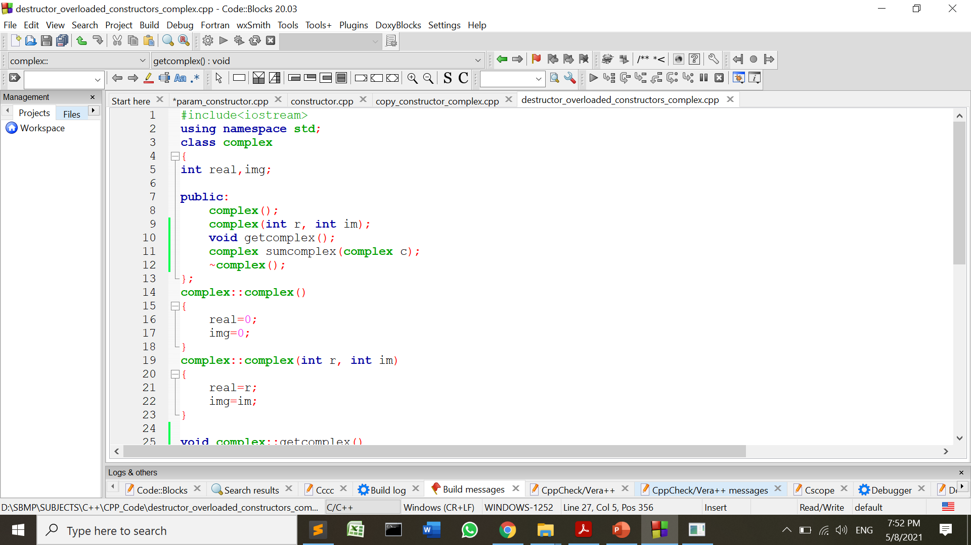
Destructor

Slide 22
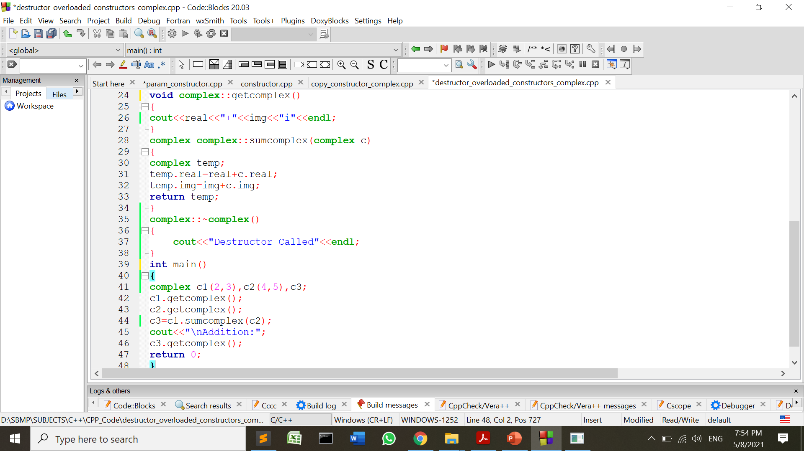
Destructor

Slide 23
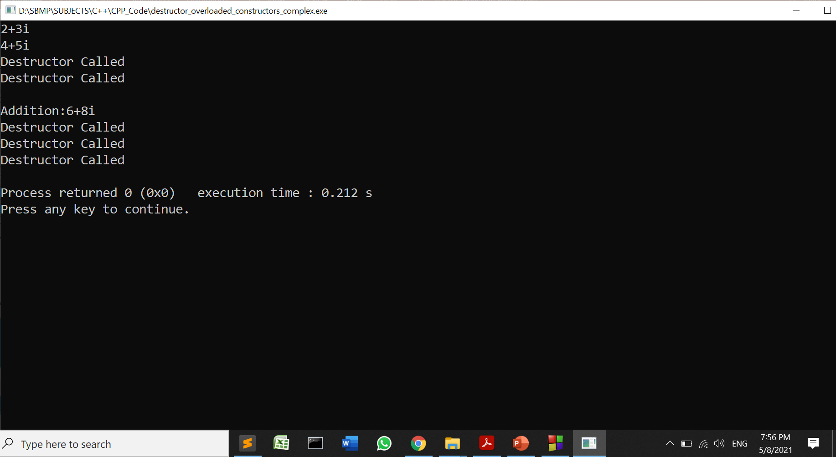
Destructor

Slide 24
Exercise Questions

Slide 25
Practice Questions
Every class can have constructor as well as destructor.
So, we should provide both functions in our programs.

Slide 26
Thanks!
Any questions?
You can find me at:
manish_ratilal2002@yahoo.com

Slide 27
Credits
Object Oriented Programming with C++, E Balagurusamy, TMH

