Slide 1
6. Operator Overloading

Slide 2
Mr. M.R. Solanki
Sr. Lecturer, Information Technology,
manish_ratilal2002@yahoo.com
SBMP

Slide 3
Learning Outcomes
Students will be able to:
Describe Operator Overloading concept.
Write programs for unary operator overloading
Write programs for binary operator overloading

Slide 4
User Defined Data Type: enum

Slide 5
Data Types: User Defined:ENUM
Allows us to attach names to numbers to increase comprehensibility.
The enum keyword automatically enumerates a list of words by assigning them values from 0,1,2,…
Syntax: enum tagname { val1, val2, ….., valn};
Example: enum direction {east, west, north, south};
enum colour{ red, green, blue, yellow};
enum switch_position {off, on};
Tag name becomes a new data type
Syntax: tagname var_name;
Example: colour bgcolor;
bgcolor =red;

Slide 6
Data Types: User Defined:ENUM
Example Program:
#include <iostream>
using namespace std;
enum direction {east, west, north, south};
int main()
{
direction dir;
dir = south;
cout<<dir;
return 0;
}

Slide 7
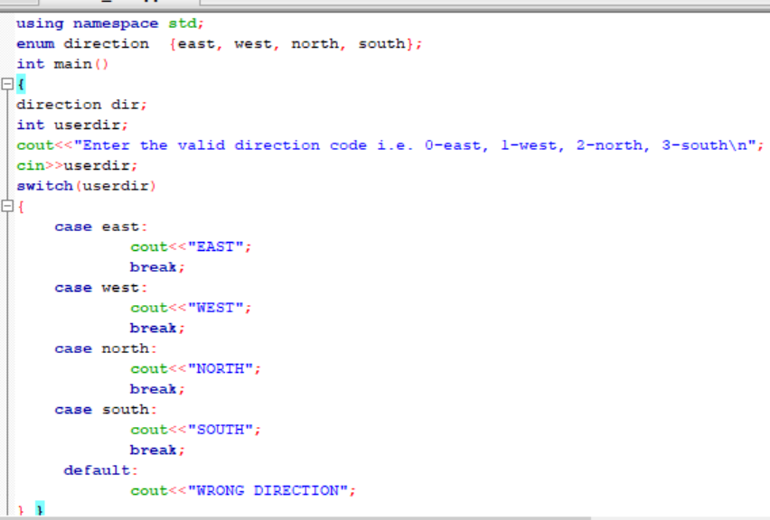
Data Types: User Defined:ENUM

Slide 8
Operator Overloading

Slide 9
Definition
The mechanism of providing a special meaning to the operator for the user defined data type is called operator overloading.
C++ provides addition of two primary data types
c=a+b; but we can not write the same for the user defined data types i.e. for objects i.e. ob3 = ob1 + ob2;
To apply the same mechanism for the objects, we have to use operator overloading.
User defined data type can behave same as built-in types using operator overloading.

Slide 10
Definition
In operator overloading although we change the semantic (meaning) of operators, we can not change the syntax.
i.e. No. of operands, precedence and associativity remains same.
The same + operator can be used for adding two integers, two arrays and two strings.

Slide 11
Syntax
Overloading is achieved through an operator function:
ret_type class_name:: operator op(arg-list)
{
//function body
}
Here, operator is a keyword
op = operator i.e. +,-,*, / , etc.

Slide 12
Operator function can be either a member function (non-static) or a friend function.

Slide 13
Steps to perform operator overloading
Write a class having data members on which operator is to be applied.
Declare an operator function
i.e. ret_type operator op(arg-list);
inside the public section of the class
3. Define the body of operator function outside the class.

Slide 14
Unary Operator Overloading

Slide 15
Unary Operator Overloading
The expression requires only one operand.
i.e. unary minus will negate all the data members of the class.
Syntax: -ob_name;

Slide 16
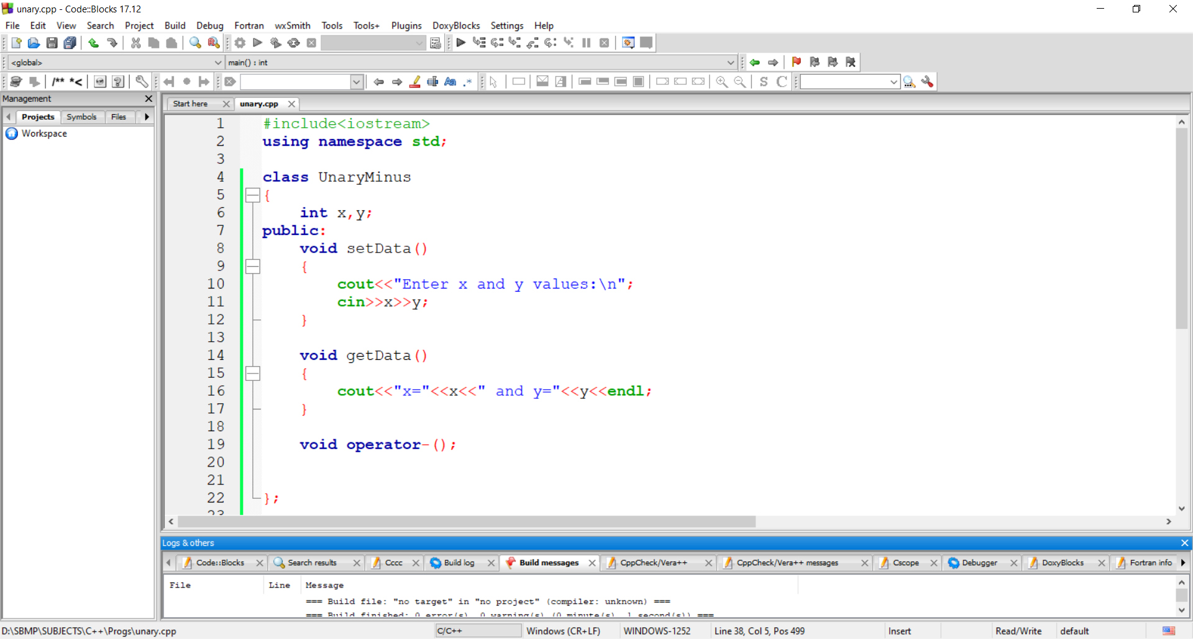
Unary Operator Overloading

Slide 17
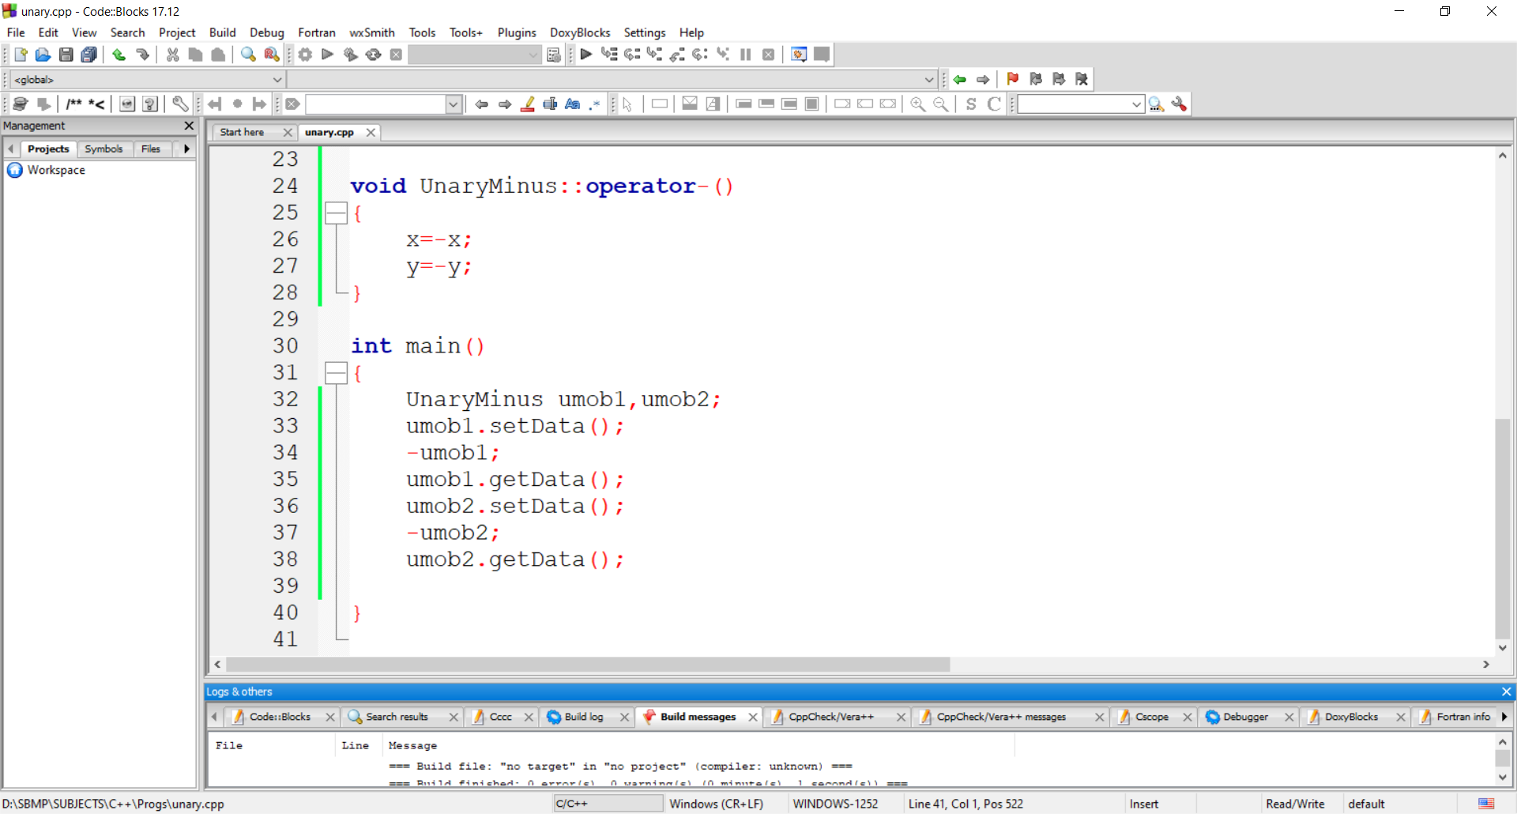
Unary Operator Overloading

Slide 18
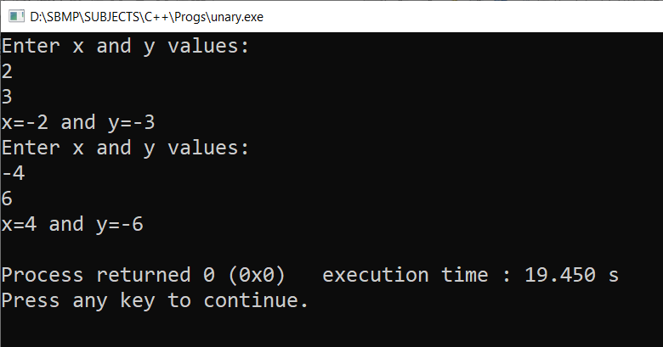
Unary Operator Overloading

Slide 19
Exercise
Write a C++ program to overload ++/-- operator for an object of a class.
Hint: For post fix operator overloading,use
operator++(int)

Slide 20
Binary Operator Overloading

Slide 21
Binary Operator Overloading
The expression requires two operands.
i.e. addition of two complex numbers will be written as follows:
Syntax: ob3= ob1+ob2;
c3 = c1+ c2;

Slide 22
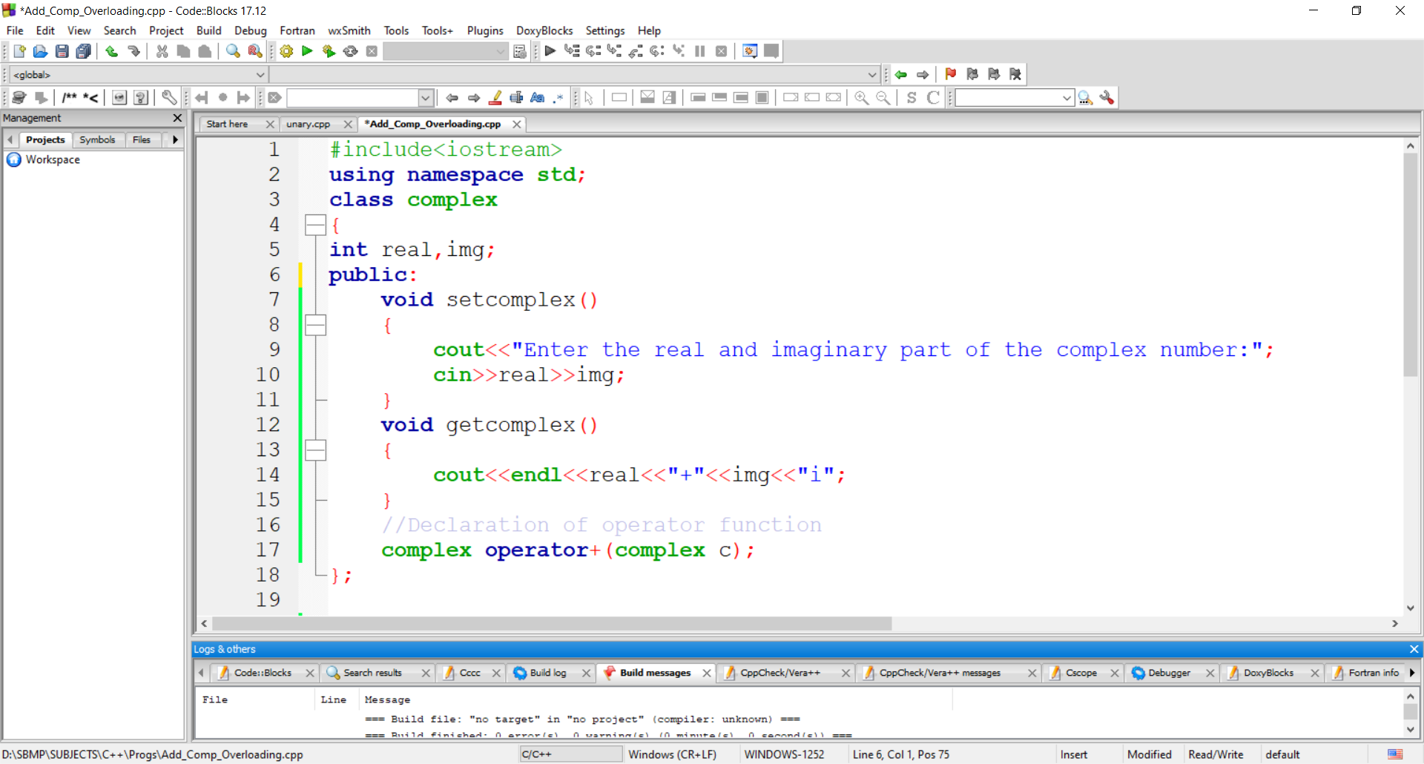
Binary Operator Overloading

Slide 23
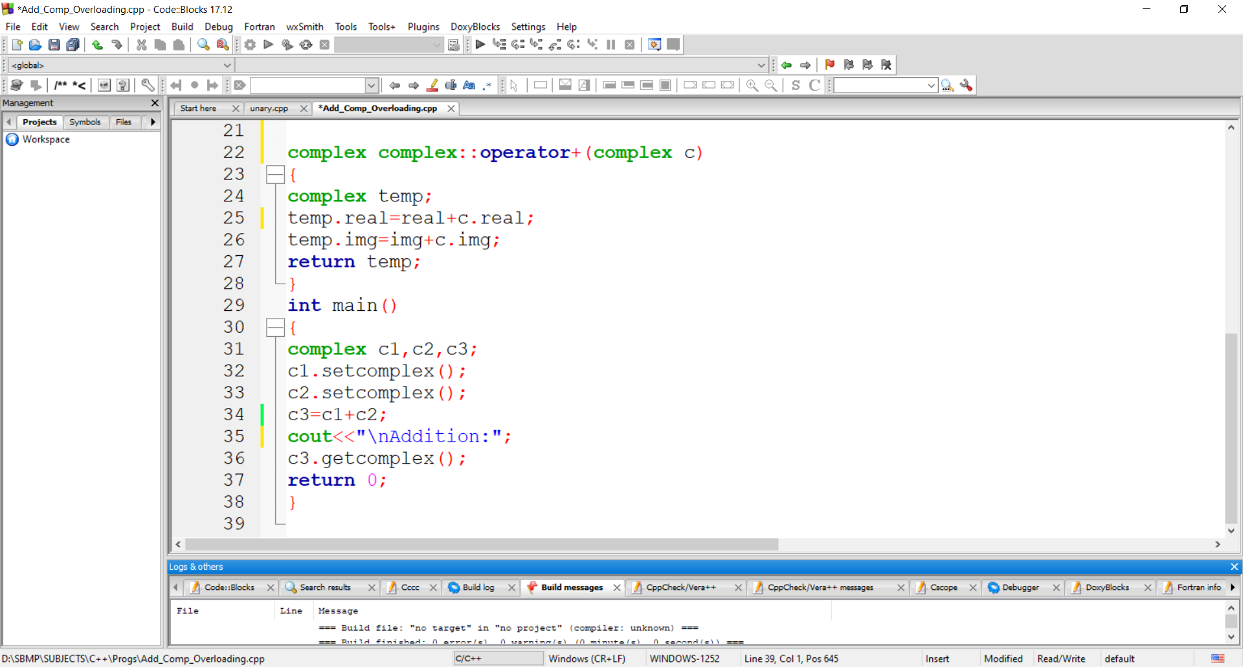
Binary Operator Overloading

Slide 24
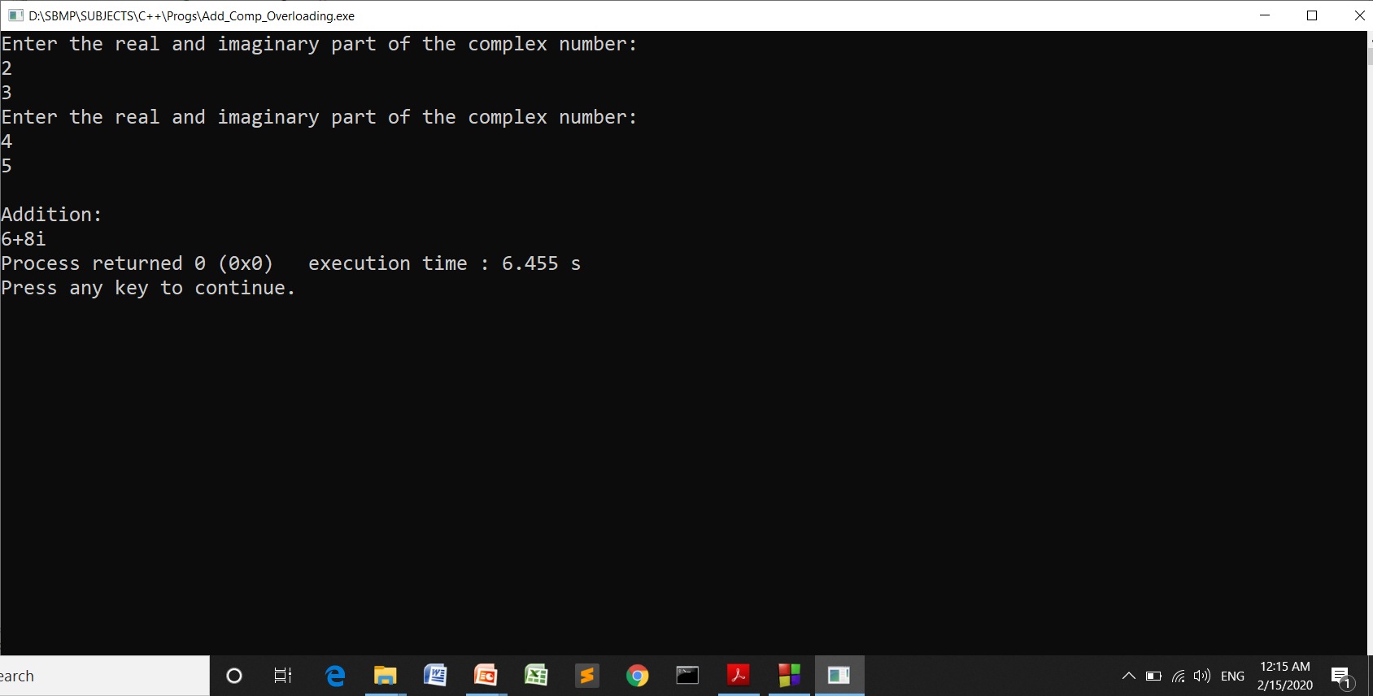
Binary Operator Overloading

Slide 25
Binary Operator Overloading
In the statement, c3 = c1+ c2; object c1 invokes the operator() and object c2 is passed as an argument.

Slide 26
Exercise
Q:1 Write a C++ program to overload relational == operator to compare 2 objects of a class.
Q:2 Write a C++ program to add two strings using + operator

Slide 27
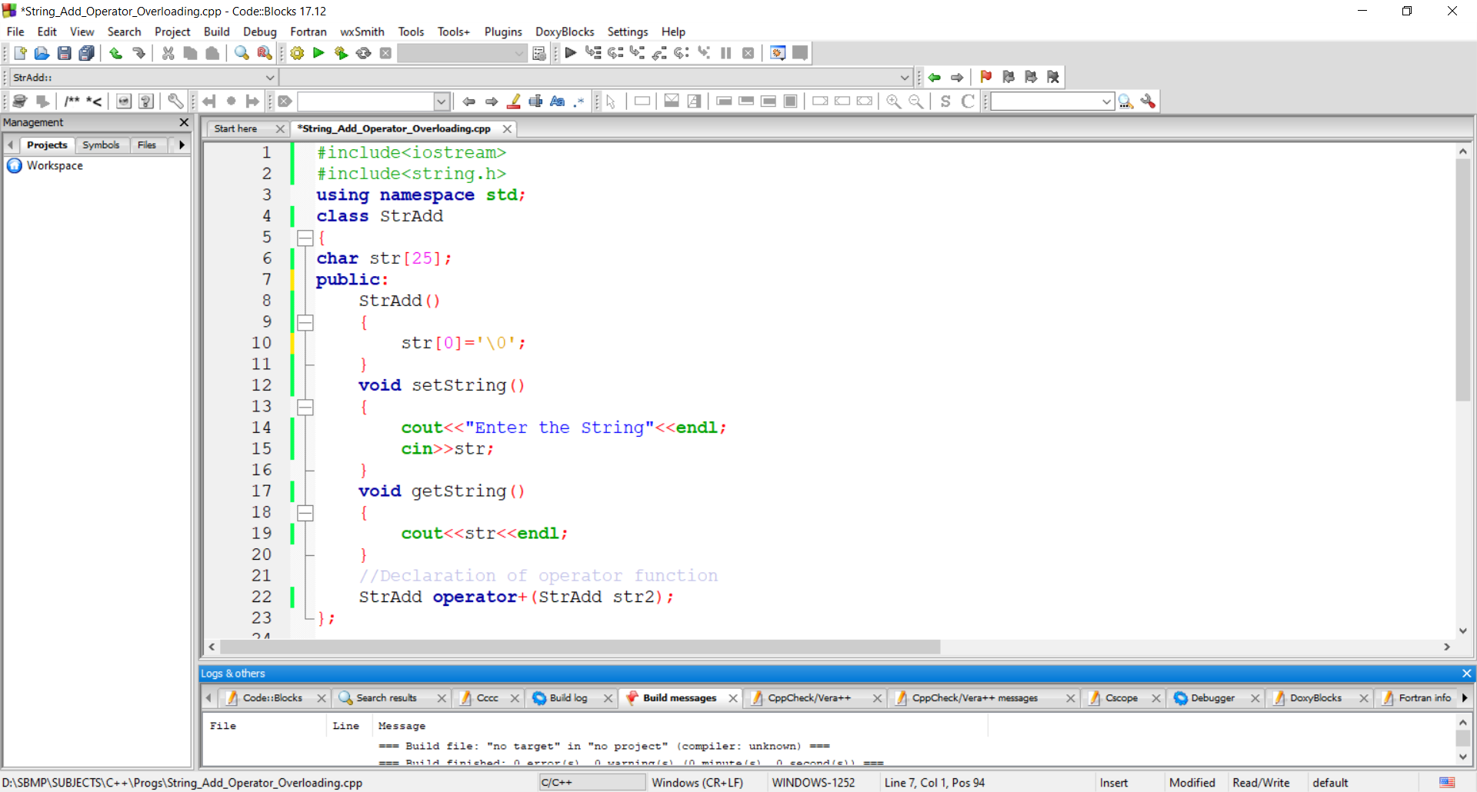
Adding Two Strings

Slide 28
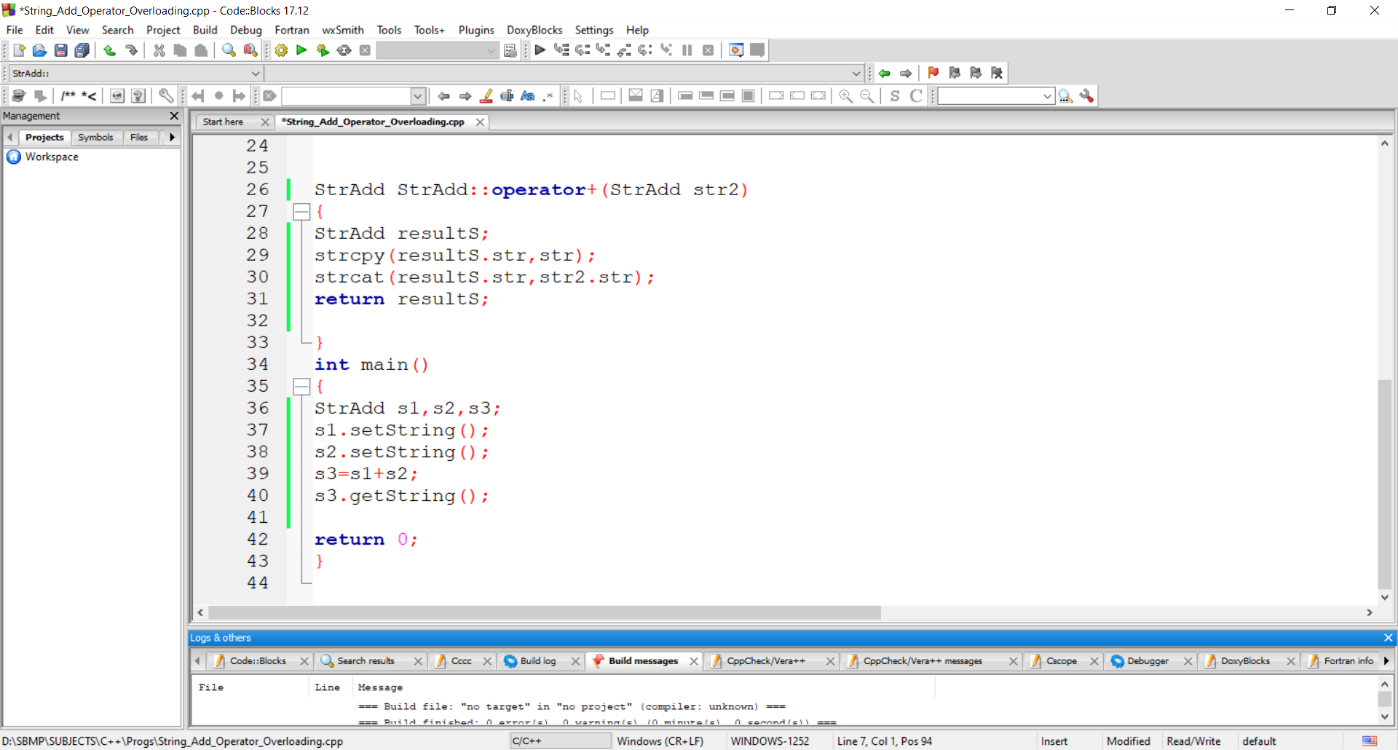
Adding Two Strings

Slide 29
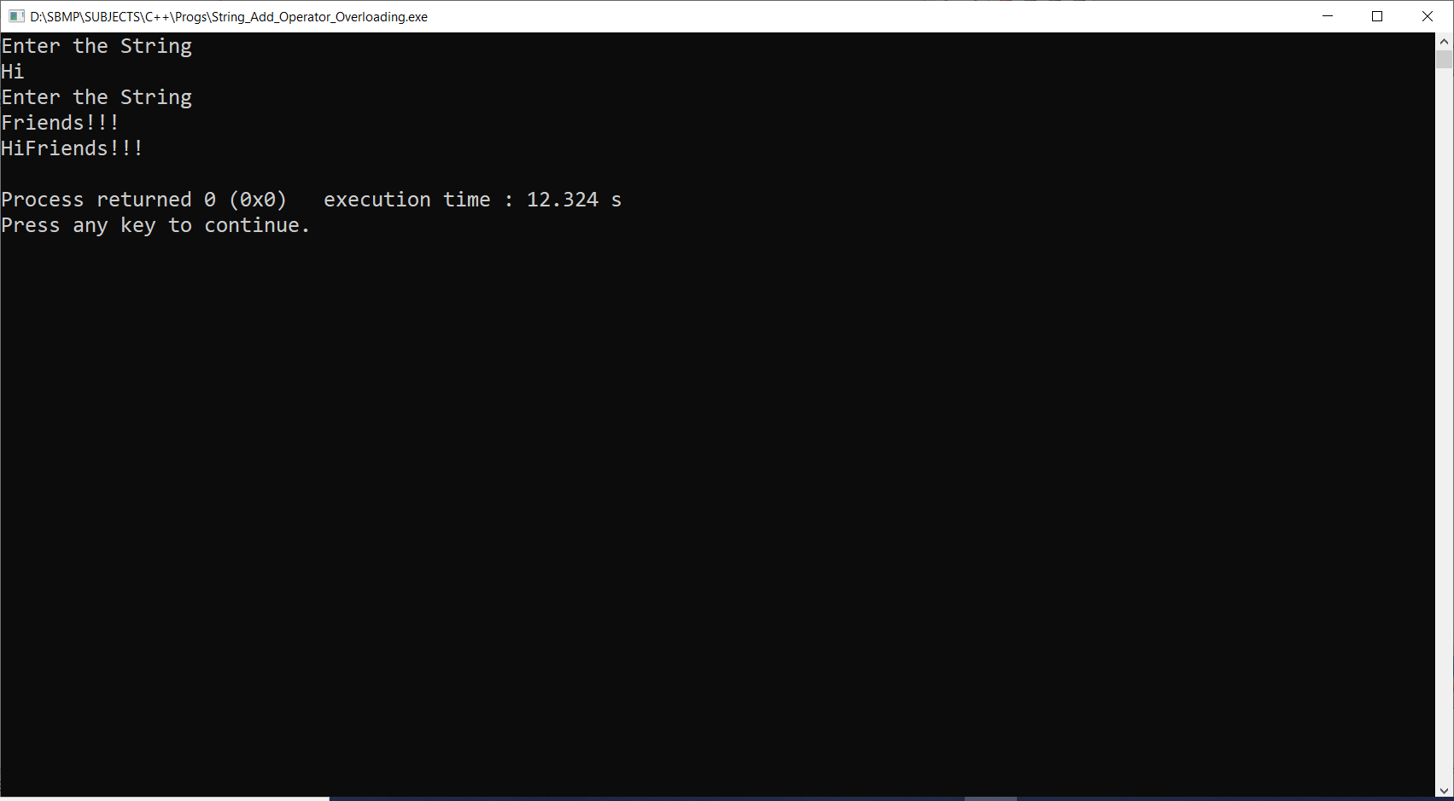
Adding Two Strings

Slide 30
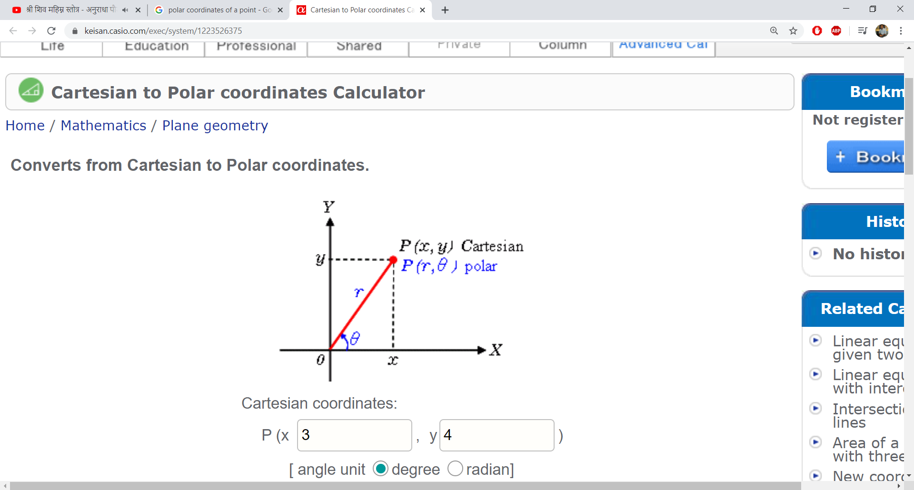
Design a class Polar which describes a point in the plane using polar coordinates radius and angle. A point in polar
coordinates is shown in the Fig. 7.3.

Slide 31
Use the overloaded + Operator to add two objects of Polar.
Note that we cannot add polar values of two points directly. This requires conversion of points into rectangular Co-ordinates, then adding the corresponding rectangular co-ordinates and finally converting the result back into polar co-ordinates. You need to use the following trigonometric formulae:
x=r * cos(theta);
y= r * sin(theta);
theta= atan(y/x); // arc tangent – tan inverse
r = sqrt(x*x + y*y);

Slide 32
Operators can not be overloaded
Class member access operators i.e.( . and .* )
Scope Resolution operator ( ::)
sizeof operator
Conditional operator (?:)

Slide 33
Polymorphism

Slide 34
Polymorphism
It is a Greek term, means the ability to take more than one form
An operation may exhibit different behaviors in different
Instances.
The behavior depends upon the types of data used in the operation. For example, consider the operation of addition. For two numbers, the operation will generate a sum. If the operands are strings. then the operation would produce a third string by concatenation.
The process of making an operator to exhibit different behaviors in different instances is known as operator overloading [Compile Time Polymorphism]

Slide 35
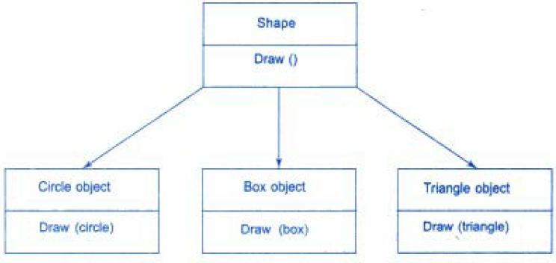
Polymorphism
A single function name can be used to handle different number
and different types of arguments. (i.e. a particular word having several different meanings depending on the context)
Using a single function name to perform different types or tasks is known as function overloading

Slide 37
Thanks!
Any questions?
You can find me at:
manish_ratilal2002@yahoo.com

Slide 38
Credits
Object Oriented Programming with C++, E Balagurusamy, TMH

