Slide 1
Security and Surveillance Drone
Team : Mihir Panchal – t118
prinkal doshi – t107
tanay desai – t137
sarid Qureshi – t154
arshkumar Sakaria – t127
Project guide : mr. abhijeet Dongaonkar

Slide 2
Problem statement
Finding Lost Individual in Mass Public Gathering​
Analysing Depth and effects of Calamity occurred to save as many lives as possible

Slide 3
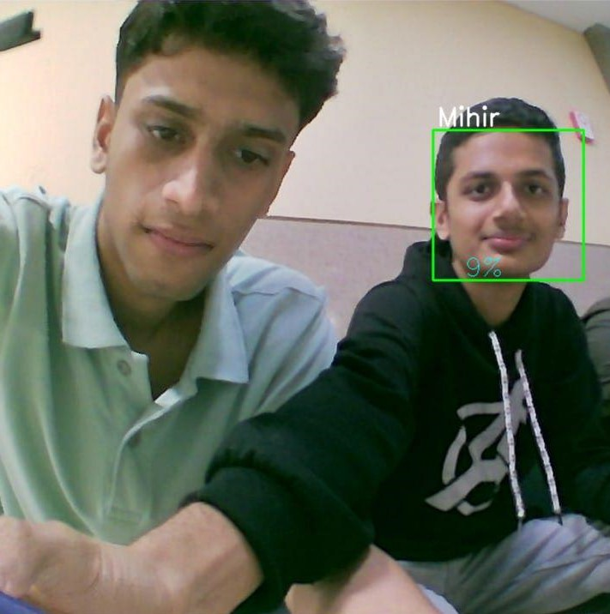
Lost Individual Detection
One of the primary goals of this project is to develop a drone that can help locate lost individuals in a crowd.
The drone will be equipped with facial recognition technology that can quickly scan a large group of people and identify any missing persons.​
Additionally, the drone will be able to track the movements of the individual once they have been located, making it easier for security personnel to reach them and provide assistance.

Slide 4
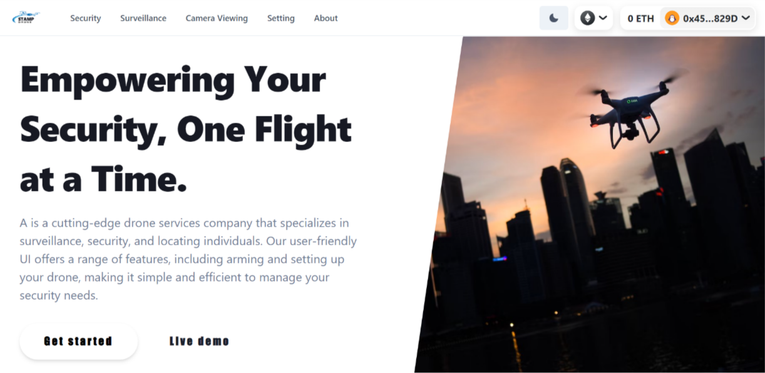
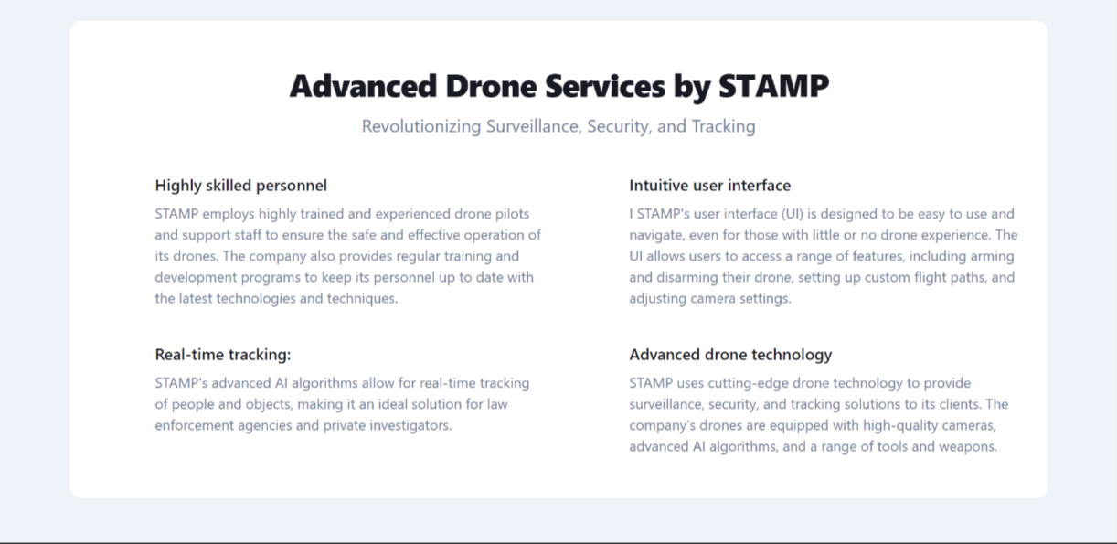
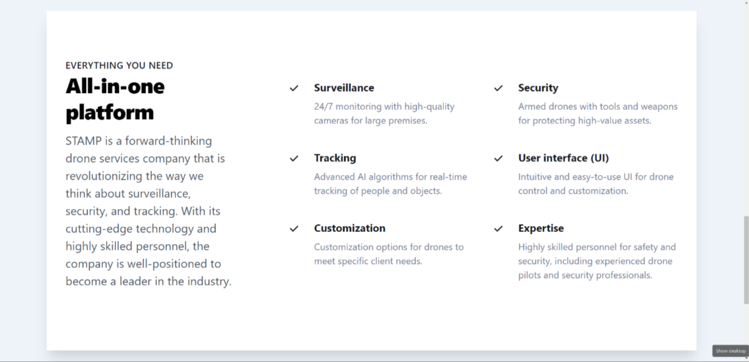
WeB Application - Homepage

Slide 5
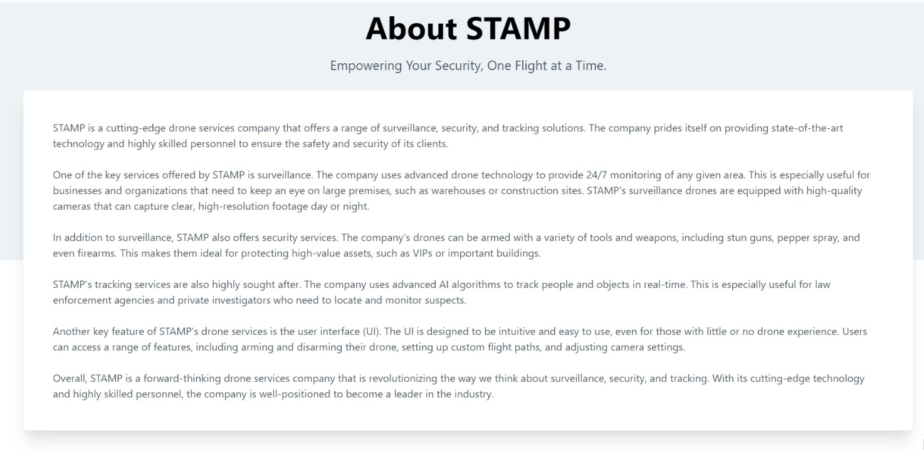
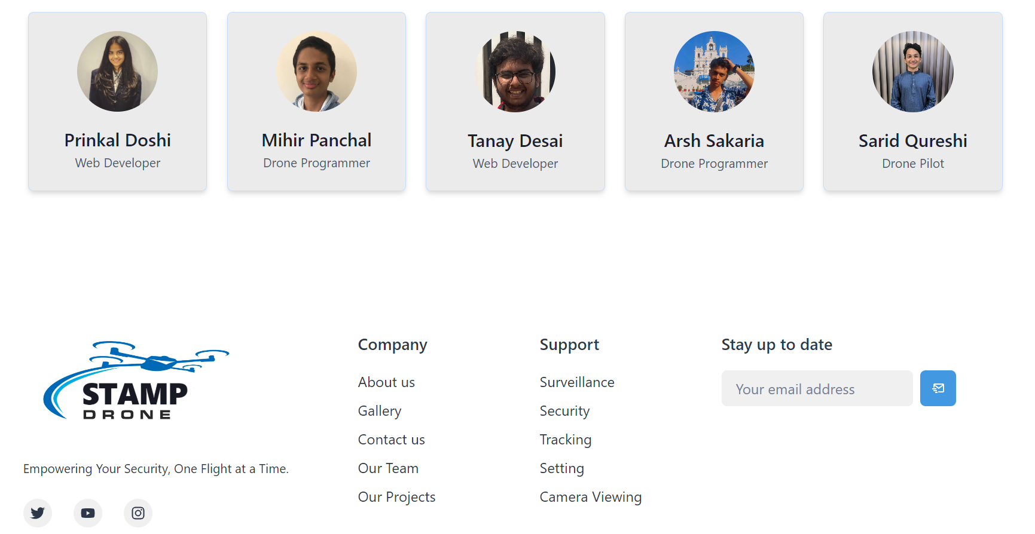
WeB Application – aBout Us

Slide 6

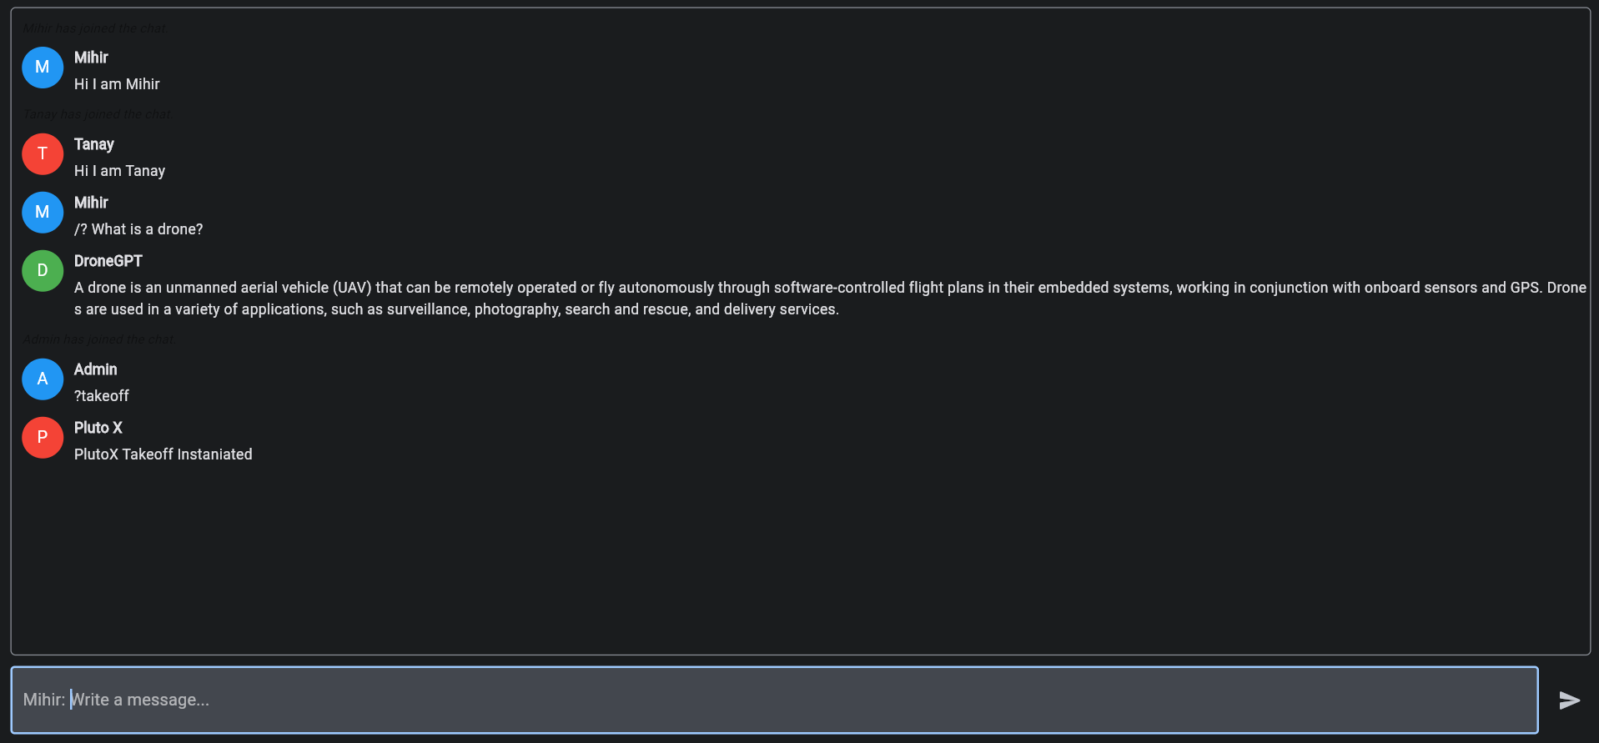
DRONEGPT

Slide 7
WORK DONE
Lost Individual Detection (Haar cascade)
Established communication channel between drone and device through MSP protocol
Drone Web Application (Frontend)
Metamask Integration with WebApp
DroneGPT
Object Detection of COCO Dataset (Yolo)

Slide 8
WORK Pending
Drone Web Application (Backend)
PlutoX API (Takeoff)

Slide 9
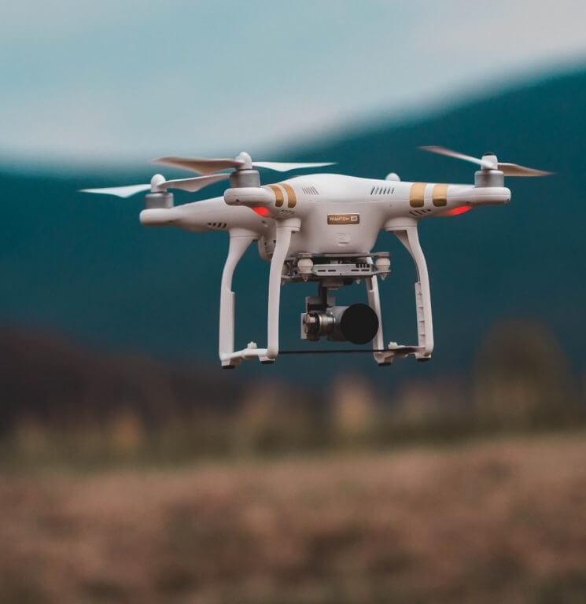
CONCLUSION
The benefits of using Security and Surveillance Drones include quick response time, cost-effectiveness, accuracy, and flexibility.
With quick deployment times and advanced technologies, drones can cover large areas quickly and efficiently, reducing the need for extensive ground-based search efforts or traditional surveying methods.
This can help reduce the overall cost of the search and rescue operation or disaster response effort, while also improving accuracy and flexibility.

Slide 10
Thank you

