Slide 1

Drone Application
Surveillance, Security and Rescue Operation

Slide 2
TEAM INFO
Project Guide : Abhijit Dongaonkar
Project Team Name : STAMP
Mihir Panchal (Team Leader) (IT) – T118
Tanay Desai (IT) – T137
Sarid Qureshi (IT) – T154
Prinkal Doshi (IT) – T107
Arshkumar Sakaria (IT) – T127

Slide 3
Basic Features of Drone
Capture video feed of environment
Live display of collected feed on controlling device
Follow a certain object, person or target

Slide 4
TECHNOLOGIES USED
Drone
Blockchain
Cloud
Machine Learning
Deep Learning
IOT
AI
Web Application

Slide 5
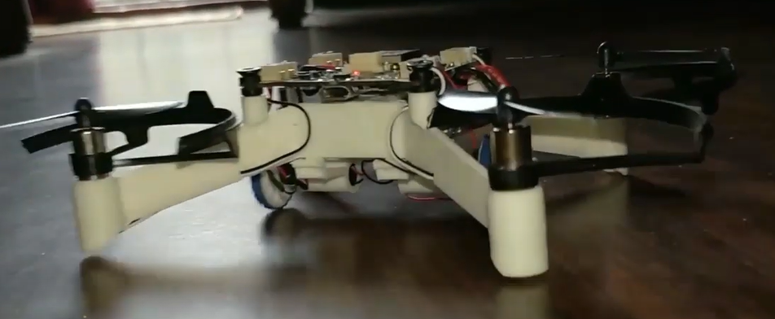
PLUTO – X Tinkerer kit
Kit Accessories
Pluto X Drone
Camera Module
X – Breakout
X - Hybrid Addon
X – Ranging Addon
2 X Laser Sensors
2 X Motors
1 set of Propellers
Propeller Remover Tool
Software Copy of Project book of experiments
Rookie Pilot Badge
https://www.dronaaviation.com/product/plutox tinkerer-kit/

Slide 6
Modes in DRONE
1st Mode – Surveillance : Drone can drive or fly at specific height along a specific color line path
2nd Mode – Security : Drone follows and specific man or object
3rd Mode - Search Operation : Auto Mode fly yourself

Slide 7
Target audience for product
Mode 1 : Surveillance
Police department
For bank vault safe
Museum / Airports / Shopping Malls
Mode 2 : Security
Following particular person (PM / Famous Personality)
Selfie / Bloggers
Mode 3 : Search Operation
Disaster management or Rescue Teams
Search Operation

Slide 8
Features enabled by software processing
Get Direction measurements on web Application
Video Display with Cloud Integration
Speaker and Mic on Drone
Blockchain integration with rewarding pilots with ethcoins
Convert Video file to VR and cloud integration

Slide 9
Other Features
Multiple Drone Controllers using PC and Phone
Achievements Tab for Drone Pilots
Dashboard for Flight time , Battery status , Drone health
AI assistant on Drone (Siri)
Multipurpose Drone with multiple modes

Slide 10
prototype

Slide 11
BUDGET
Accessories | Price
Pluto X Tinkerer Kit | 21,499
Additional Sensors | *500
Backup – (Part Repair) | *500
Total | 21499 - 22,499

Slide 12
Any question?

