Slide 1
Drone idea (4)
IT DRONE TEAM

Slide 2
DOMAIN - surveillance
Traffic lights are sometimes pretty useless in some countries like India, Africa. It can be due to many vehicles in a small road, absence of officers in roads or due to rash drivers.
By using drones for this, many traffic violations and breaches can be detected that were missed by the officers.

Slide 3
Traffic breach detection
With the help of drones, we can use 360 cameras to view any traffic breaches on red light.
We can inform the local traffic police if any breach is detected.
The drone can follow the suspect and gives real time positioning to police officer (if possible)
It can also capture the proof of the traffic violation for instance: running on a red light for evidence.
It can also capture the name plate of the breaching person.

Slide 4
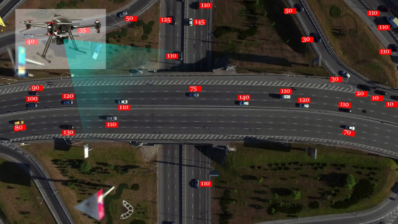
Drone Monitoring vehicles

Slide 5
DRONE Features
Drone will have a 360 camera so as to detect traffic violation from all sides.
The drone can also be used to detect potholes in the road which may be causing the traffic to occur in the first place.
The ML algorithm can detect vehicles breaching the traffic lights and click images of the name plate or vehicle automatically which the officers usually try to do and fail most of the time due to the traffic.

Slide 6
ASSOCIATE IT SOLUTION
A web application to display the traffic violators along with the time and date of the violation.
Collecting the various violators according to the different categories for e.g: breaking the signal, speeding, etc.
The website could also be made public (hosted) for other people to view the violators.
Also provide an option to the violator to claim if there was a mistake in identifying the vehicle.

Slide 7
Perspective of selling point
Drone can be used in places where there is scarcity of police officers.
An extra help will be available to the officers in case of high traffics.
The violations not noticed by the officers can also be detected.
It will help the officers for more detection of traffic violations and result in less difficulties in traffic.

Slide 8
Any question?

