Slide 1
Applets

Slide 2
Mr. M.R. Solanki
Sr. Lecturer, Information Technology,
manish_ratilal2002@yahoo.com
SBMP

Slide 3
Learning Outcomes
Students will be able to:
Define and write features of an applet
Demonstrate the life cycle of an applet
Pass parameters to an applet

Slide 4
Definition and Features of an Applet

Slide 5
Applet
applets are small applications that are accessed on an
Internet server, transported over the Internet, automatically installed, and run as part of a web
Document
After an applet arrives on the client, it has limited access to resources so that it can produce a graphical user interface and run complex computations without introducing the risk of viruses or breaching data integrity.

Slide 6
Features of an Applet
An applet is a Java class that extends the java.applet.Applet class
An applet class can not define main()
Applets are designed to be embedded within an HTML page.
When a user views an HTML page that contains an applet, the code for the applet is downloaded to the user's machine.
A JVM is required to view an applet. The JVM can be either a plug-in of the Web browser or a separate runtime environment.

Slide 7
Features of an Applet
The JVM on the user's machine creates an instance of the applet class and invokes various methods during the applet's lifetime.
Applets have strict security rules that are enforced by the Web browser. Applets can not access the local file system of client (digitally signed applets can do this)

Slide 8
Applet Life Cycle

Slide 9
Applet Life Cycle
init( )
The first method to be called. This is where you should initialize variables.
Called only once during the run time of your applet
2. start( )
Called after init( ). Also called to restart an applet after it has been stopped.
Called each time an applet’s HTML document is displayed onscreen. So, if a user leaves a web page
and comes back, the applet resumes execution at start( )

Slide 10
Applet Life Cycle
paint( )
Called each time your applet’s output must be redrawn.
This situation can occur for several reasons i.e., the window in which the applet is running may be overwritten by another window and then uncovered. Or the applet window may be minimized and then restored
Also called when the applet begins execution.
whenever the applet must redraw its output, paint( ) is called.
The paint( ) method has one parameter of type Graphics. This parameter will contain the graphics context, which describes the graphics environment in which the applet is running. This context is used whenever output to the applet is required.

Slide 11
Applet Life Cycle
4. stop( )
Called when a web browser leaves the HTML document containing the applet—when it goes to another page, for example.
When stop( ) is called, the applet is probably running.
You should use stop( ) to suspend threads that don’t need to run when the applet is not visible.
You can restart them when start( ) is called if the user returns to the page.

Slide 12
Applet Life Cycle
5. destroy( )
Called when the environment determines that your applet needs to be removed completely from memory.
At this point, you should free up any resources the applet may be using.
The stop( ) method is always called before destroy( ).

Slide 13
Sample Applet
import java.awt.*;
import java.applet.*;
public class SimpleApplet extends Applet
{
public void paint(Graphics g)
{
g.drawString("A Simple Applet", 20, 20);
}
}

Slide 14
Compiling and Running Sample Applet
Applet program is saved as .java file
Applet is compiled through javac command
Applet can be executed by two ways:
Using appletviewer command
Using a web browser
We have to write the following tag in a html file:
<applet code=“class_name” width=width height=height >
</applet>
Here, width and height are integer parameters which specifies size of an applet
<applet code=“SampleApplet” width=350 height=200 >
</applet>

Slide 15
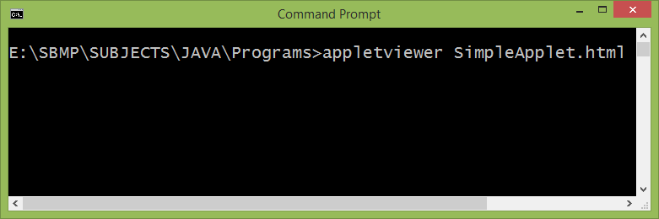
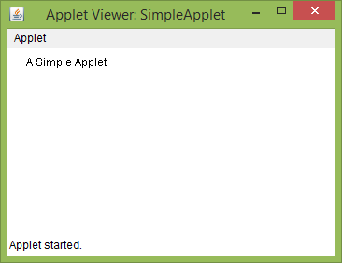
Running Sample Applet

Slide 16
Demonstartion of Applet Life Cycle
import java.awt.*;
import java.applet.*;
public class LifeCycleApplet extends Applet{
String msg;
// set the foreground and background colors.
public void init() {
//Color c1=new Color(120,255,240);
setBackground(Color.cyan);
setForeground(Color.red);
msg = "Inside init( ) --";
}
public void start() {
msg += " Inside start( ) --";
}

Slide 17
Demonstartion of Applet Life Cycle
public void stop() {
msg += " Inside stop( ) --";
System.out.println("Applet Stopped");
}
public void destroy() {
System.out.println("Applet Destroyed");
}
// Display msg in applet window.
public void paint(Graphics g) {
g.setColor(Color.red);
msg += " Inside paint( ).";
g.drawString(msg, 10, 30);
}
} //end of class

Slide 18
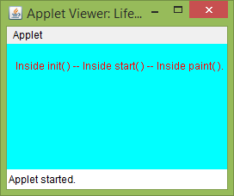
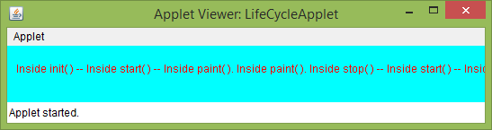
Demonstartion of Applet Life Cycle
Applet Loaded
Applet minimized and maximized

Slide 19
Passing Parameters to Applet

Slide 20
Passing Parameters to Applet
import java.awt.*;
import java.applet.*;
public class ParamAddApplet extends Applet{
int num1,num2,result;
public void start() {
num1= Integer.parseInt(getParameter("num1"));
num2= Integer.parseInt(getParameter("num2"));
result = num1+num2;
}
public void paint(Graphics g) {
g.drawString("Num1: " + num1, 0, 10);
g.drawString("Num2: " + num2, 0, 26);
g.drawString("Addition : " + result, 0, 42);
}
}

Slide 21
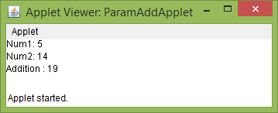
Passing Parameters to Applet
<applet code="ParamAddApplet" width=300 height=80>
<param name=num1 value=5>
<param name=num2 value=14>
</applet>

Slide 22
Thanks!
Any questions?
You can find me at:
manish_ratilal2002@yahoo.com

Slide 23
Credits
My Degree classmate Mr. Vimal Parakhiya (served as a scientist at BARC, Mumbai) who taught me C++ concepts
My degree Professor Mr. D.G. Thakor who taught me Java
Java The Complete Reference
Tutorials and Forums available on Internet
https://www.tutorialspoint.com/java/java_applet_basics.htm

