Slide 1
PACKAGES

Slide 2
Mr. M.R.Solanki
Sr. Lecturer, Infrormation Technology,
manish_ratilal2002@yahoo.com
SBMP

Slide 3
Learning Outcomes
Students will be able to:
Apply packages as naming control tool for classes
Apply packages as visibility control tool
Set CLASSPATH environment variable
Import available or created packages in other classes

Slide 4
Package
A Java class is to be given a unique name because all programs we write are stored in the same container(directory), a default name space.
If a team of programmers working on a project and two programmers choose the same class name while working independently then what will happen?

Slide 5
Package
Java provides a mechanism for partitioning the class name space into more manageable chunks. This mechanism is the package.
The package is both a naming and a visibility control mechanism

Slide 6
1.
Package as Naming Control Mechanism

Slide 7
Defining a Package
To create a package, simply include a package command as the first statement as shown below:
Syntax: package pkg;
Example: package MyPackage;
The package statement defines a name space in which classes are stored.
If you omit the package statement, the class names are put into the default package, which has no name.

Slide 8
Defining a Package
Java uses file system directories to store packages. For example, the .class files for any classes you declare to be part of MyPackage must be stored in a directory called MyPackage.
Remember that the directory name must match the package name exactly. (Case Sensitive)
The package statement simply specifies to which package the classes defined in a file belong.

Slide 9
Defining a Package
To create a hierarchy of packages, simply separate each package name from the one above it by use of a period as shown below:
package pkg1[.pkg2[.pkg3]];
A package hierarchy must be reflected in the file system. For example, a package declared as
package java.awt.image;
needs to be stored in java\awt\image in a Windows environment

Slide 10
A Package Example
// A simple package
package MyPack;
class Balance {
String name;
double bal;
Balance(String n, double b) {
name = n;
bal = b;
}
void show() {
if(bal<0)
System.out.print("--> ");
System.out.println(name + ": $" + bal);
}
}

Slide 11
A Package Example
class AccountBalance {
public static void main(String args[]) {
Balance current[] = new Balance[3];
current[0] = new Balance("K. J. Fielding", 123.23);
current[1] = new Balance("Will Tell", 157.02);
current[2] = new Balance("Tom Jackson", -12.33);
for(int i=0; i<3; i++) current[i].show();
}
}

Slide 12
Setting a CLASSPATH variable
In order for a program to find MyPack, one of three things must be true.
The program can be executed from a directory immediately above MyPack
The CLASSPATH must be set to include the path to MyPack
The -classpath option must specify the path to MyPack when the program is run via Java.

Slide 13
Setting a CLASSPATH variable
For example, in a Windows environment, if the path to MyPack is
C:\MyPrograms\Java\MyPack
Then the class path to MyPack is
C:\MyPrograms\Java

Slide 14
Executing the Program
Compile AccountBalance.java as usual. Make sure that the resulting .class file is also in the MyPack
directory.
Then, try executing the AccountBalance class, using the following command line:
java MyPack.AccountBalance
Remember, you will need to be in the directory above MyPack when you execute this command. (option 1)

Slide 15
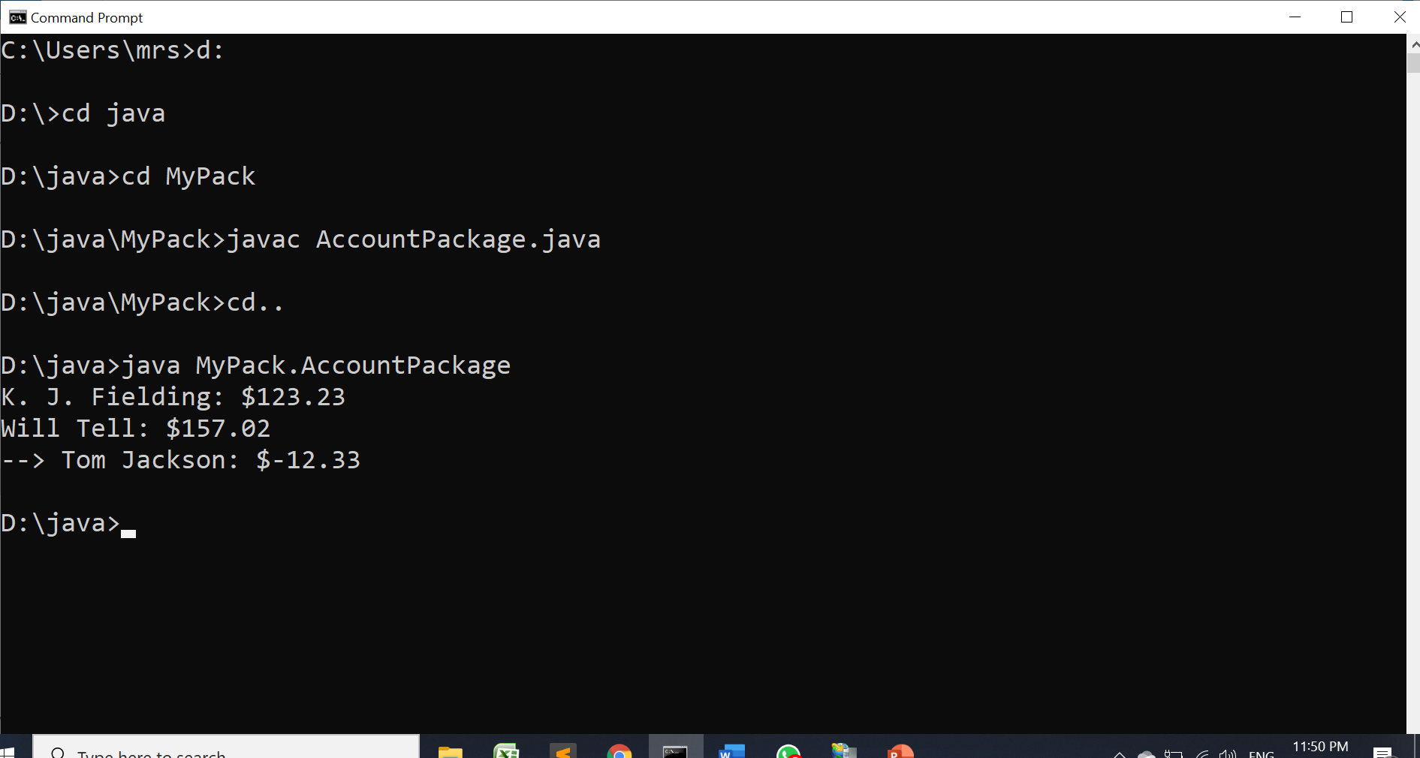
Executing the Program

Slide 16
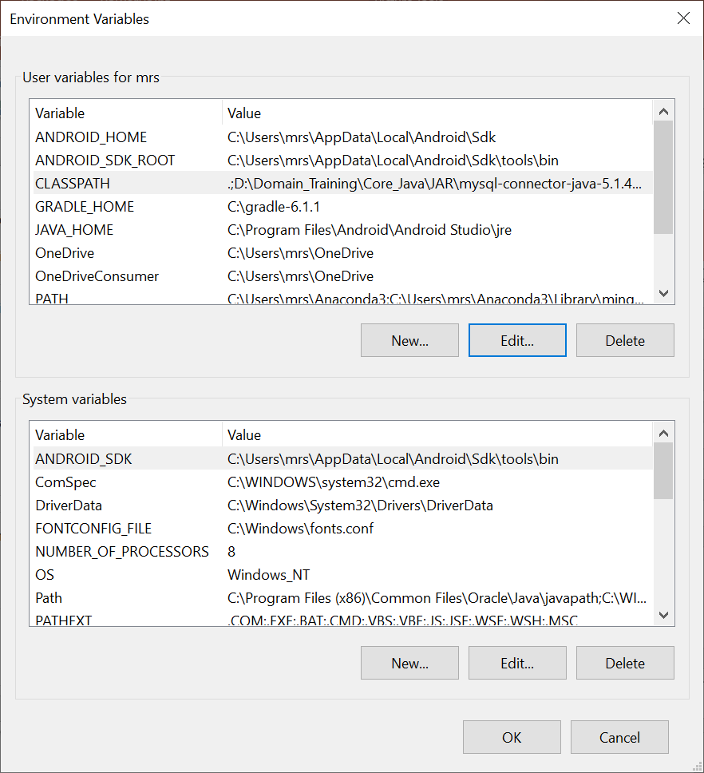
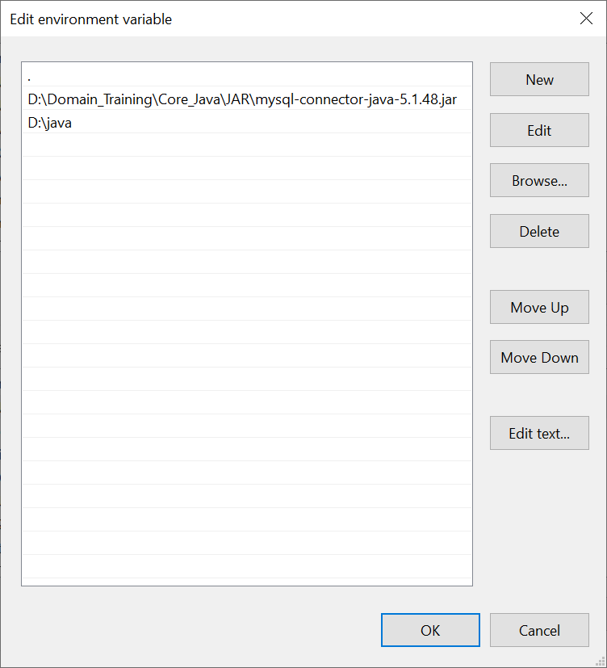
Setting the CLASSPATH

Slide 17
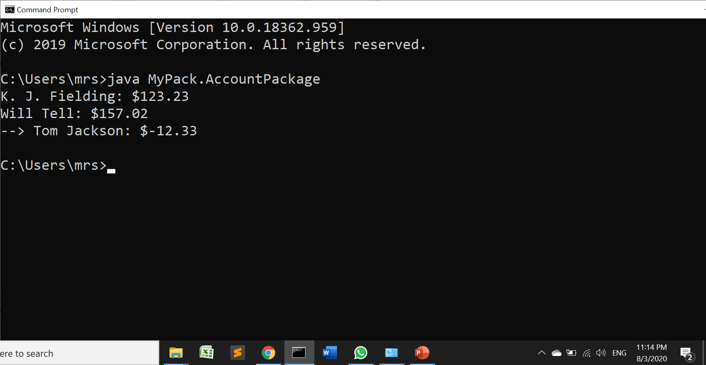
Executing the Program
Setting CLASSPATH variable

Slide 18
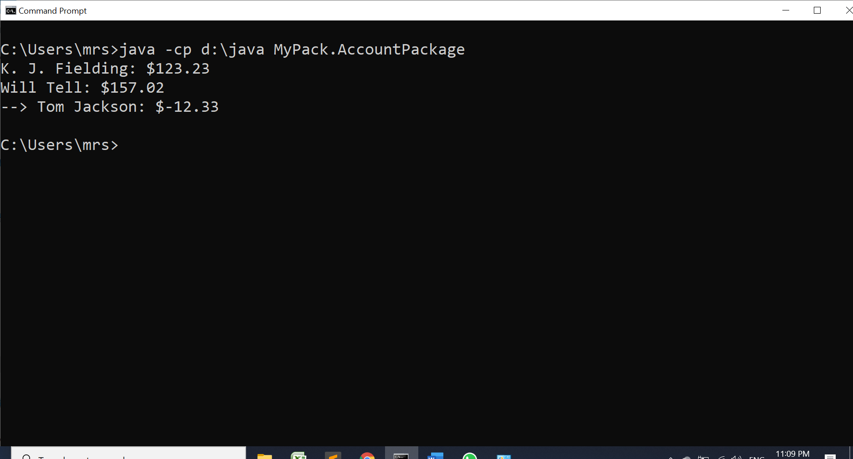
Executing the Program
With –cp option

Slide 19
2.
Package as Visibility Control Mechanism

Slide 20
Java Access Specifiers
Anything declared private cannot be seen outside of its class.
Anything declared public can be accessed from anywhere.
If an element to be seen outside the current package, but only to direct subclasses, then declare that element protected.
When no access specifier is given(default), it is visible to subclasses as well as to other classes in the same package.

Slide 21
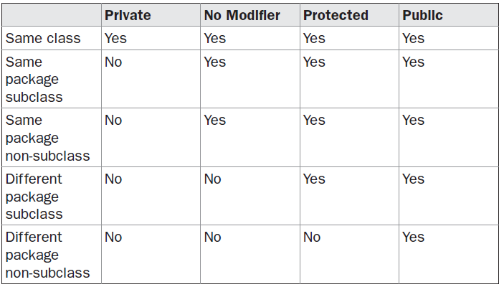
And tables to compare data
Visibility Control Table

Slide 22
Example (Same Class)
package p1;
public class Protection {
int n = 1;
private int n_pri = 2;
protected int n_pro = 3;
public int n_pub = 4;
public Protection() {
System.out.println("base constructor");
System.out.println("n = " + n);
System.out.println("n_pri = " + n_pri);
System.out.println("n_pro = " + n_pro);
System.out.println("n_pub = " + n_pub);
}
}

Slide 23
Example(Subclass)
package p1;
class Derived extends Protection {
Derived() {
System.out.println("derived constructor");
System.out.println("n = " + n);
// class only
// System.out.println("n_pri = "4 + n_pri);
System.out.println("n_pro = " + n_pro);
System.out.println("n_pub = " + n_pub);
}
}

Slide 24
Example(Same Package)
package p1;
class SamePackage {
SamePackage() {
Protection p = new Protection();
System.out.println("same package constructor");
System.out.println("n = " + p.n);
// class only
// System.out.println("n_pri = " + p.n_pri);
System.out.println("n_pro = " + p.n_pro);
System.out.println("n_pub = " + p.n_pub);
}
}

Slide 25
Example(Testing for same package)
// Demo package p1.
package p1;
// Instantiate the various classes in p1.
public class Demo {
public static void main(String args[]) {
Protection ob1 = new Protection();
Derived ob2 = new Derived();
SamePackage ob3 = new SamePackage();
}
}

Slide 26
Example(different package subclass)
package p2;
class Protection2 extends p1.Protection {
Protection2() {
System.out.println("derived other package constructor");
// class or package only
// System.out.println("n = " + n);
// class only
// System.out.println("n_pri = " + n_pri);
System.out.println("n_pro = " + n_pro);
System.out.println("n_pub = " + n_pub);
}
}

Slide 27
Example(different package nonsubclass)
package p2;
class OtherPackage {
OtherPackage() {
p1.Protection p = new p1.Protection();
System.out.println("other package constructor");
// class or package only
// System.out.println("n = " + p.n);
// class only
// System.out.println("n_pri = " + p.n_pri);
// class, subclass or package only
// System.out.println("n_pro = " + p.n_pro);
System.out.println("n_pub = " + p.n_pub);
}
}

Slide 28
Example(different package Test)
// Demo package p2.
package p2;
// Instantiate the various classes in p2.
public class Demo {
public static void main(String args[]) {
Protection2 ob1 = new Protection2();
OtherPackage ob2 = new OtherPackage();
}
}

Slide 29
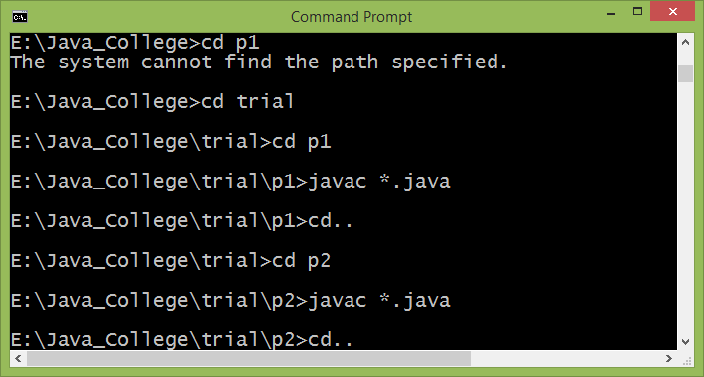
Compilation & Execution

Slide 30
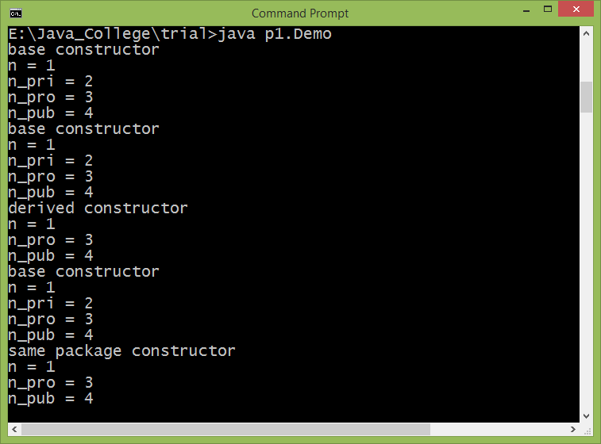
Compilation & Execution

Slide 31
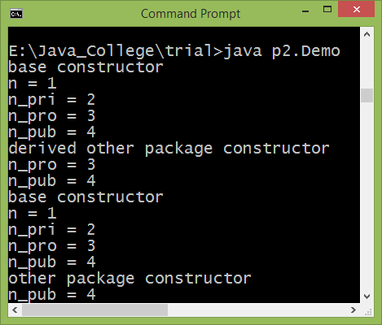
Compilation & Execution

Slide 32
Importing packages
All of the built-in Java classes are stored in packages.
There are no core Java classes in the unnamed default package
It is tedious to type in the long dot-separated package path name for every class we want to use
For this reason, Java includes the import statement to bring certain classes, or entire packages, into visibility.
Once imported, a class can be referred to directly, using only its name

Slide 33
Importing packages
In a Java source file, import statements occur immediately following the package statement (if it exists) and before any class definitions.
Format:
import pkg1[.pkg2].(classname | *);
Example:
import java.util.Date;
import java.io.*;

Slide 34
Importing packages
The basic language functions are stored in a package inside of the java package called “java.lang”
It is implicitly imported by the compiler for all programs import java.lang.*;
If we don’t want to use import statement then we have to use fully qualified name of class
import java.util.*;
class MyDate extends Date { }
The same example without the import statement looks like this:
class MyDate extends java.util.Date { }

Slide 35
Importing package Example
package MyPack;
public class Balance {
String name;
double bal;
public Balance(String n, double b) {
name = n;
bal = b;
}
public void show() {
if(bal<0)
System.out.print("--> ");
System.out.println(name + ": $" + bal);
}
}

Slide 36
Importing package Example
import MyPack.*;
class TestBalance {
public static void main(String args[]) {
/* Because Balance is public, you may use Balance class and call its constructor. */
Balance test = new Balance("J. J. Jaspers“,99.88);
test.show(); // you may also call show()
}
}

Slide 37
Compilation & Execution
Consider the package path as follows:
E:\Java_College\trial\MyPack
Consider the another directory structure where TestBalance.java file is residing
E:\Java_College
To compile and execute the TestBalance.java do the following:
set CLASSPATH=.;E:\Java_College\trial

Slide 38
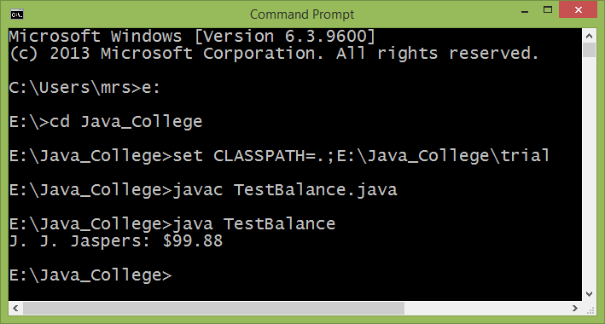
Compilation & Execution

Slide 39
Thanks!
Any questions?
You can find me at manish_ratilal2002@yahoo.com

Slide 40
Credits
Java The Complete Reference, TMH

