Slide 1

Fundamentals of AI and Generative AI
Shri Bhagubhai Mafatlal Polytechnic

Slide 2
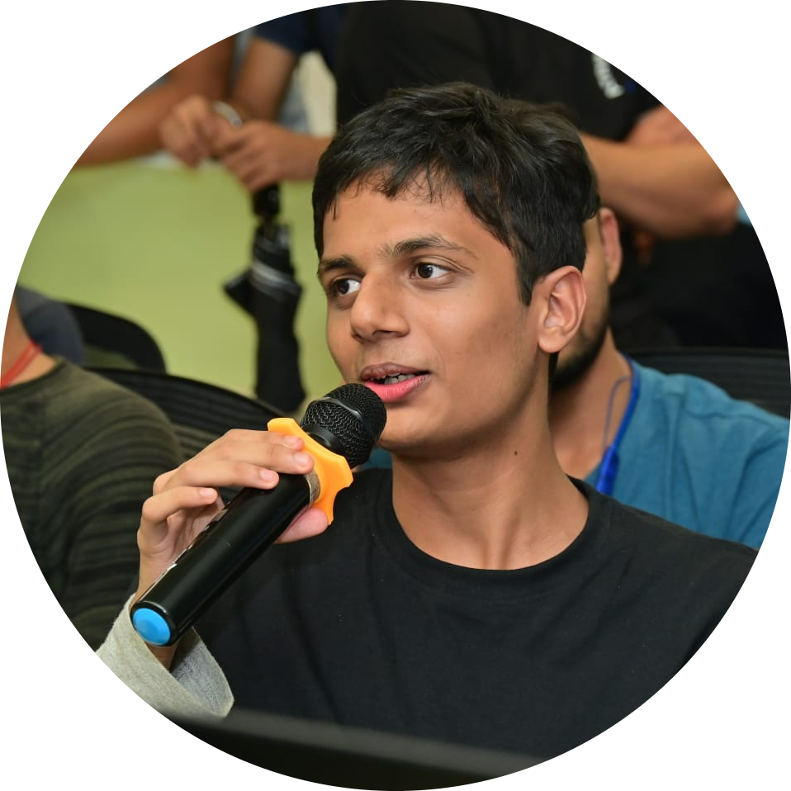
About Myself
Research Assistant at NUS, Georgia Tech, KCL, IIT Patna, Mandi, Dhanbad, Jodhpur, DRDO
Research Head at DJSACM
Researcher in Natural Language Processing and AI
Full Stack Developer
6x Professional Speaker now 7x :)
Final Year Student at DJ Sanghvi College of Engineering

Slide 3
Lets just say you want to bunk a lecture You need to give some sort of excuse

Slide 4
Emergency
I am hungry
Feeling Unwell
Need to study for Term Test
Train Miss ho jayegi ☹
Family Function or Event you need to attend
Decision to Bunk the lecture
Yes/No
Threshold >= 2

Slide 5
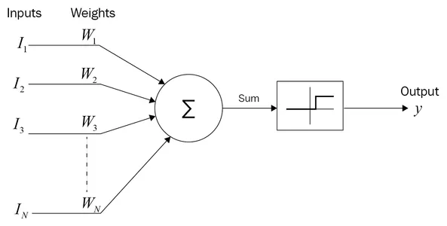
Basics of AI – McCulloch Pitts Neuron
Threshold Function >= 2
Summation = I1 * W1 + I2 * W2 + I3 * W3

Slide 6
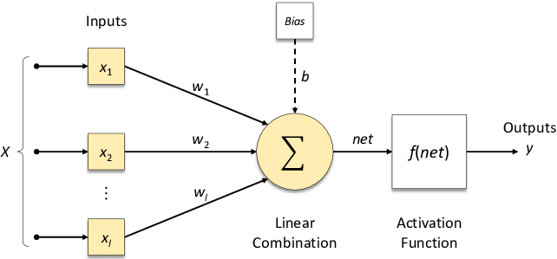
Basics of AI – Perceptron

Slide 7
Difference
Mc Culloch Pitts Neuron
Perceptron
Weak and Logic Only
Input are binary
Inputs are not weighted
First neuron model
There can be some sort of learning involved
Inputs can be real valued
Inputs are weighted
First learning model

Slide 8
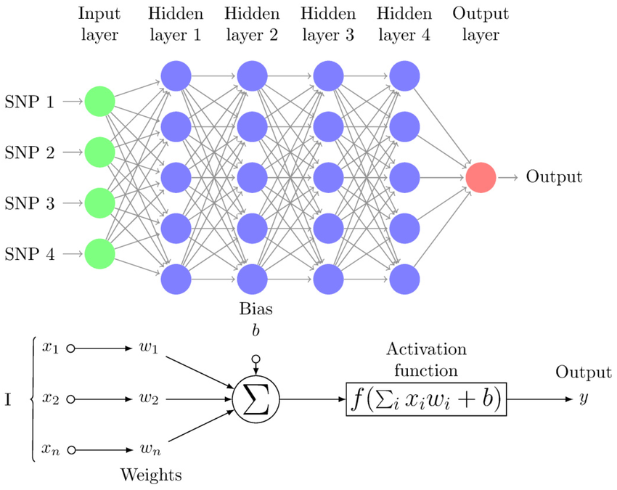
Multi Layer Perceptron
Test Cricket Example

Slide 9
Computer understands which Language?

Slide 10
Lets Play a game!! Antonyms : King = Man =

Slide 11
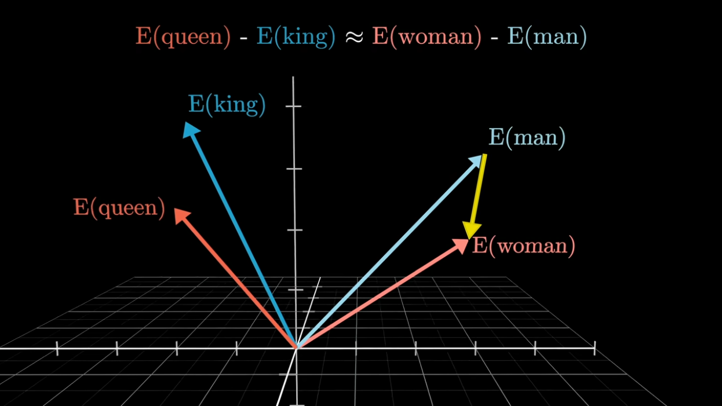

Slide 12
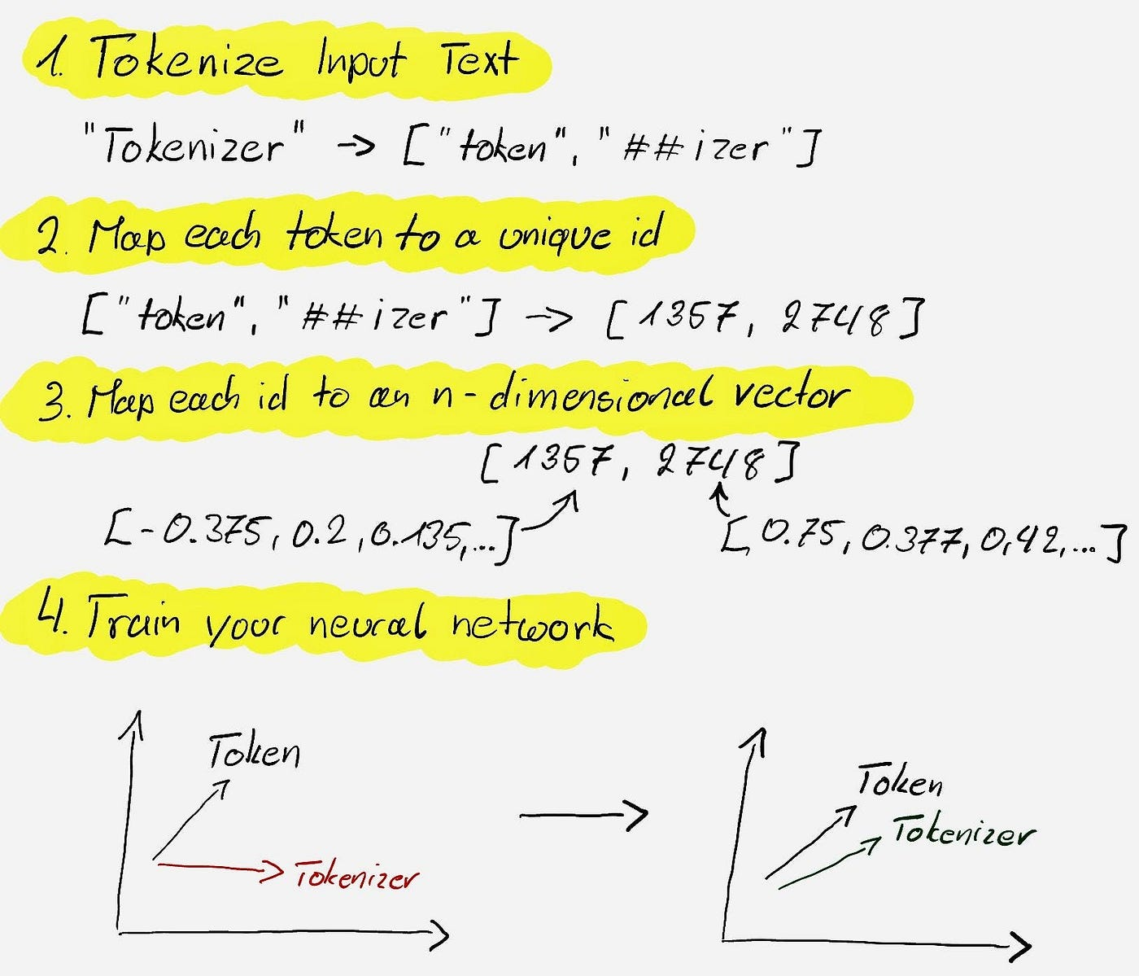
https://platform.openai.com/tokenizer

Slide 13
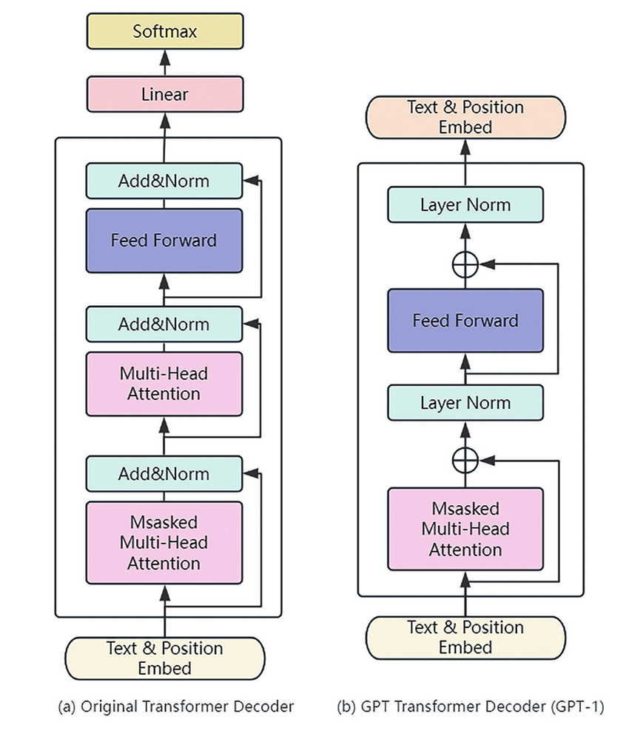
Attention
Feed Forward Neural Network
Add Normalization
Linear
Softmax

Slide 14
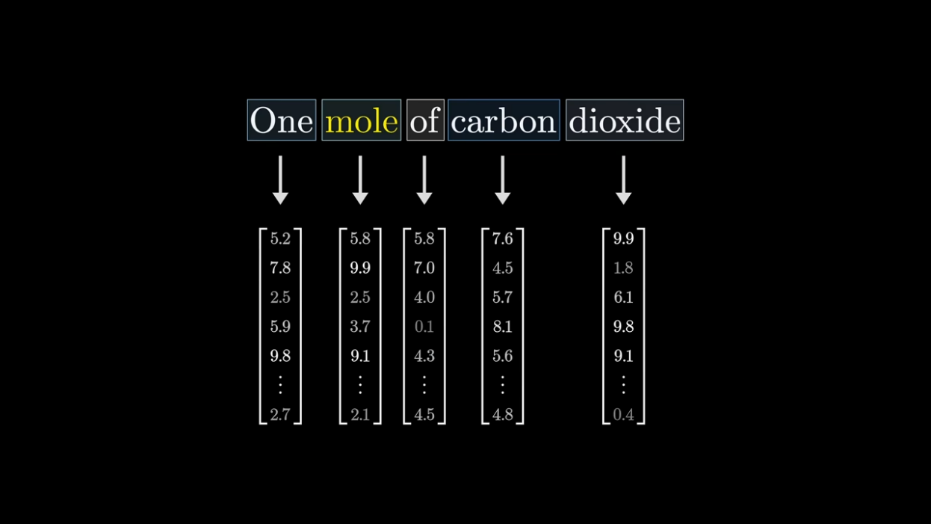
Input

Slide 15
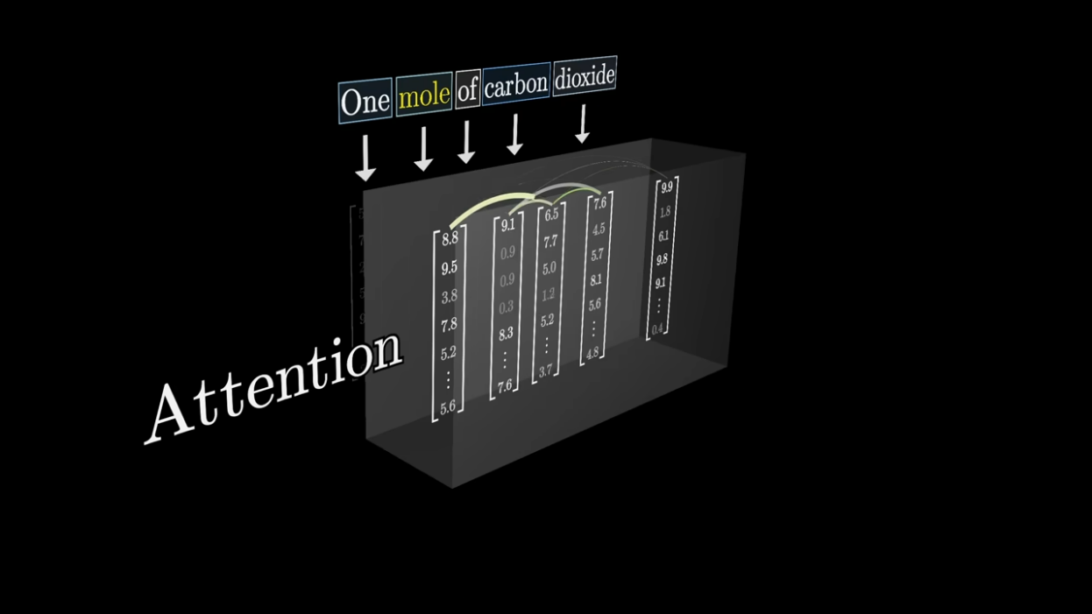
Attention

Slide 16
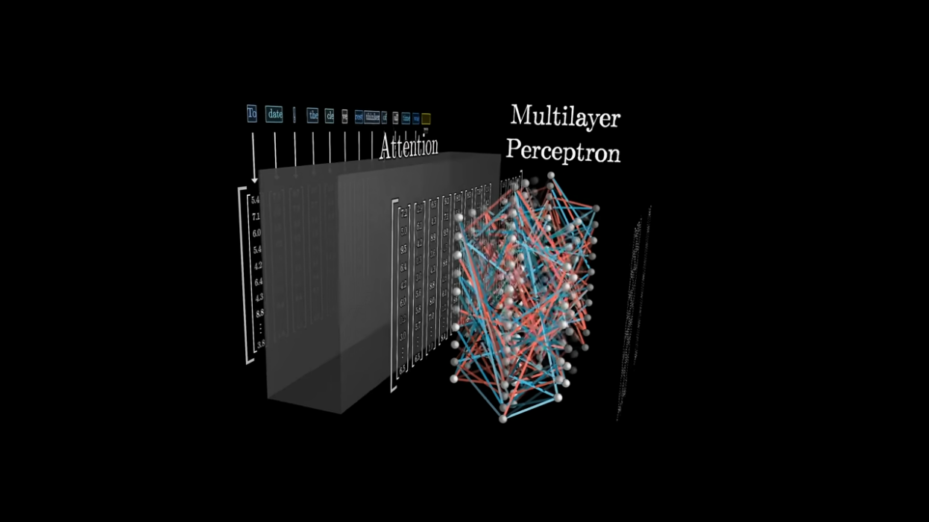
Multilayer Perceptron

Slide 17
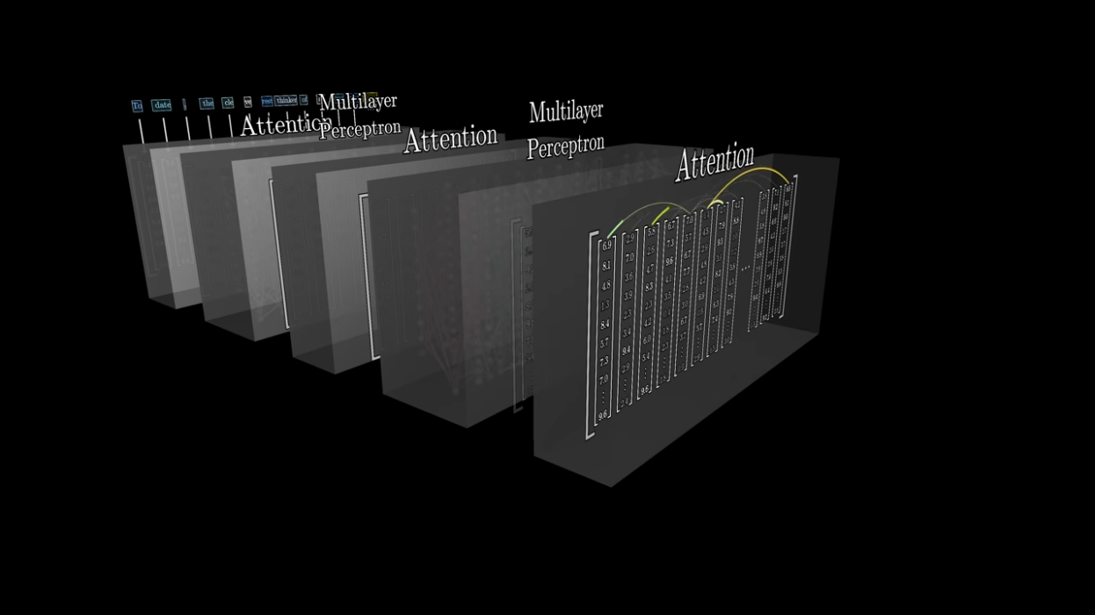
Multiple Rounds

Slide 18
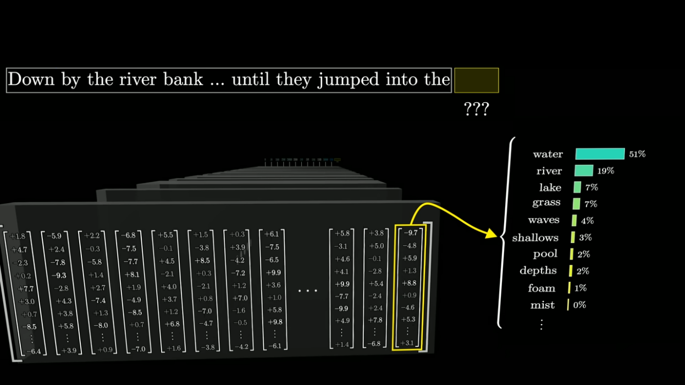
Output

Slide 19
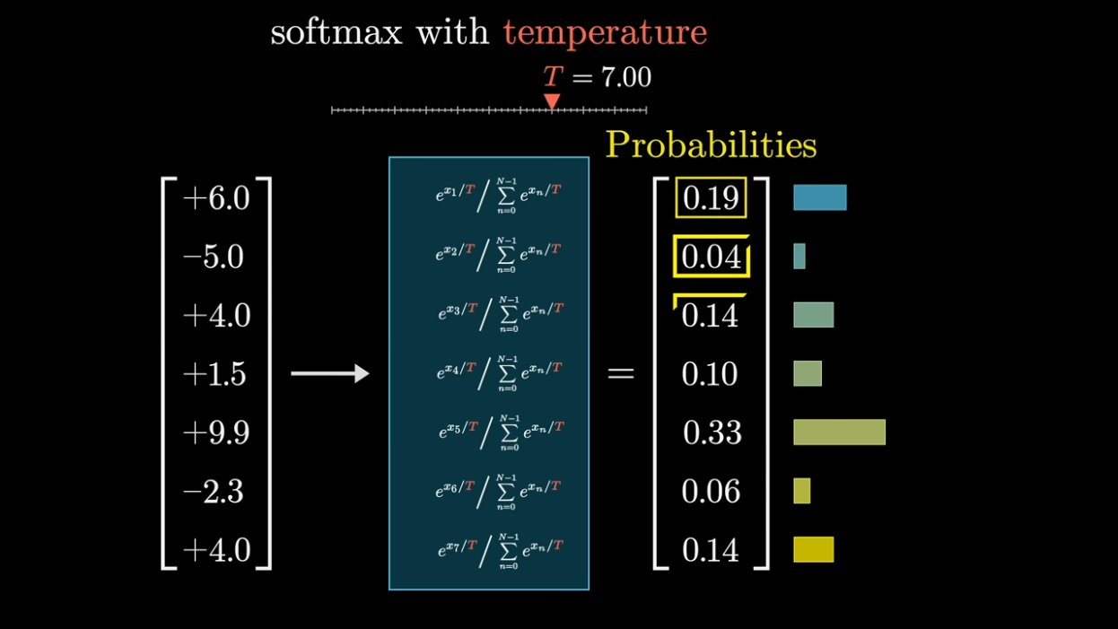
Softmax and
Temperature

Slide 20
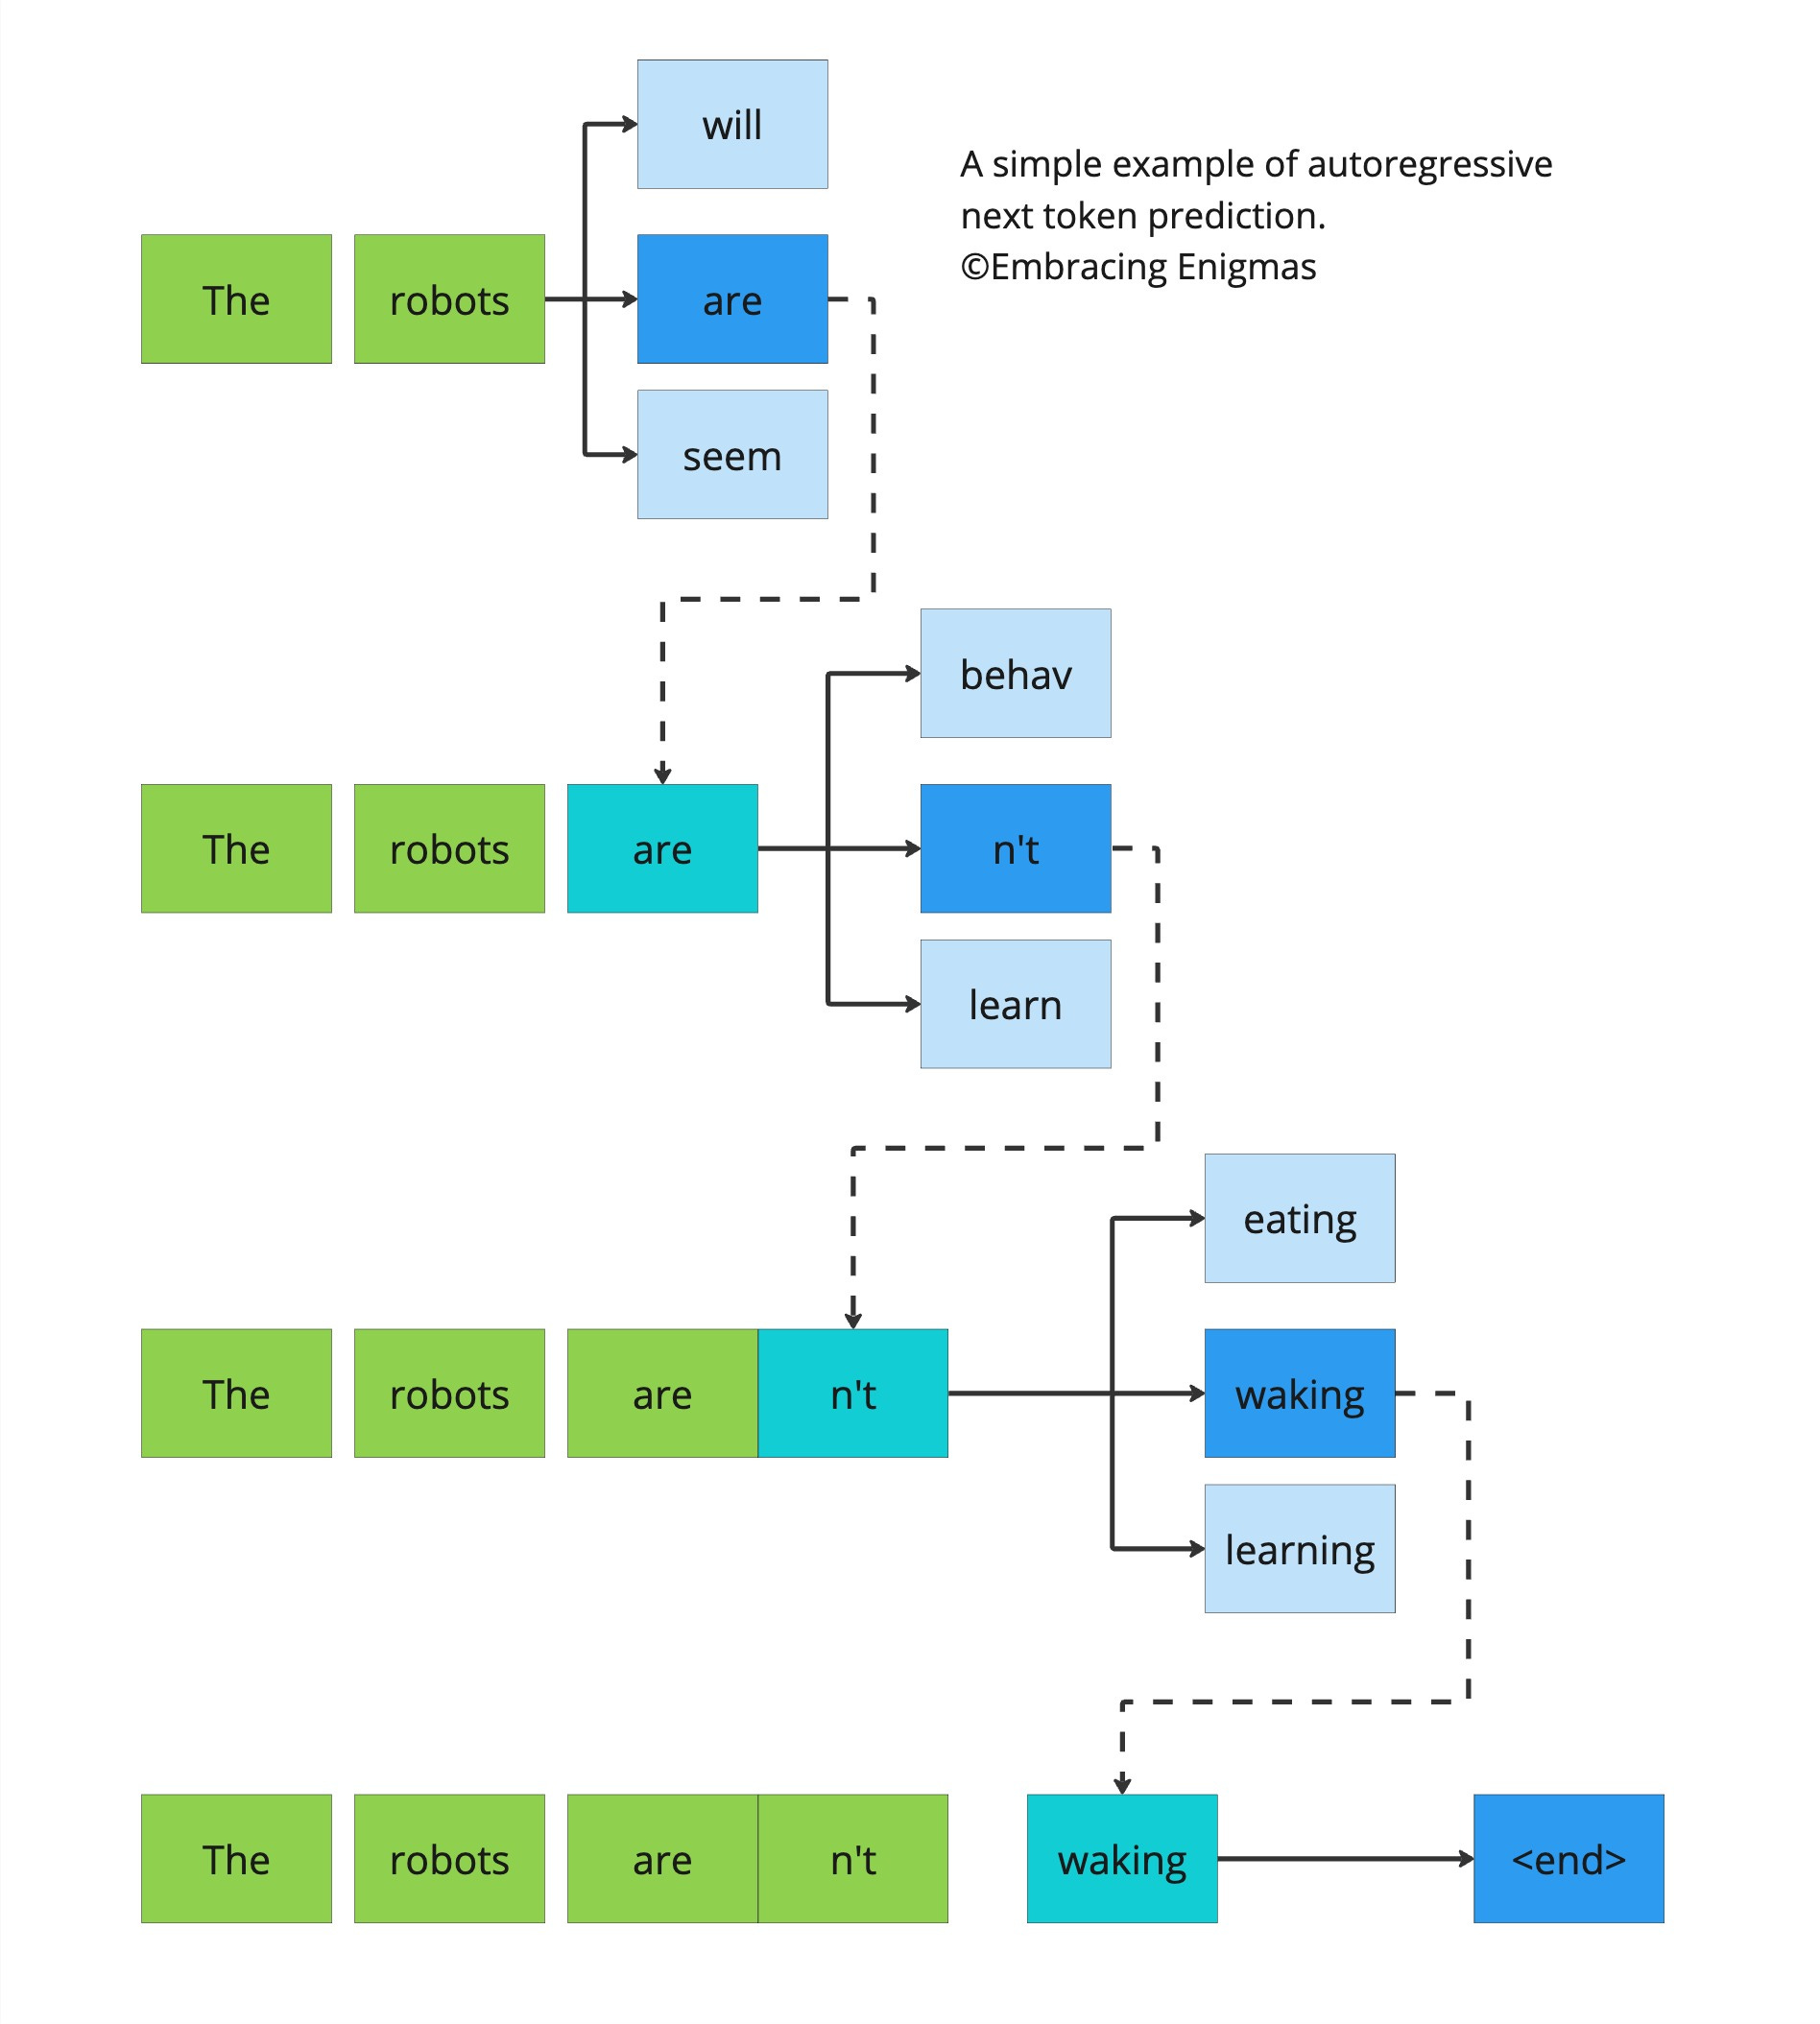
Next Token Predictions

Slide 21

Connect me on
mihirpanchal.tech
Portfolio

