Slide 1

Python – ZERO TO HERO
By – Mihir Panchal

Slide 2
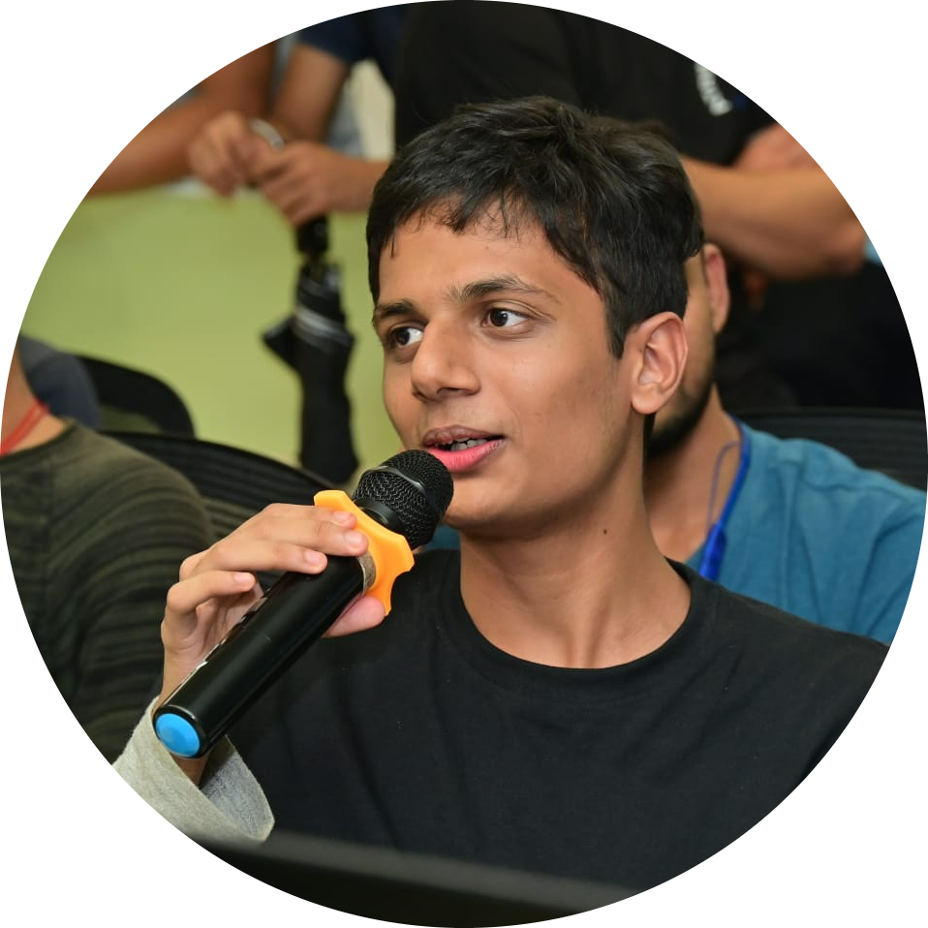
Introduction – MIHIR PANCHAL
Research Intern at IIT Patna
Research Head at DJSACM
Ex-Full Stack AI Intern at Infiheal
Ex-Data Analyst Intern at Illinois Institute of Technology
Open Source Contributor
8x Hackathon Finalist
4x Professional Speaker now 5x :)
Student at DJ Sanghvi College of Engineering

Slide 3
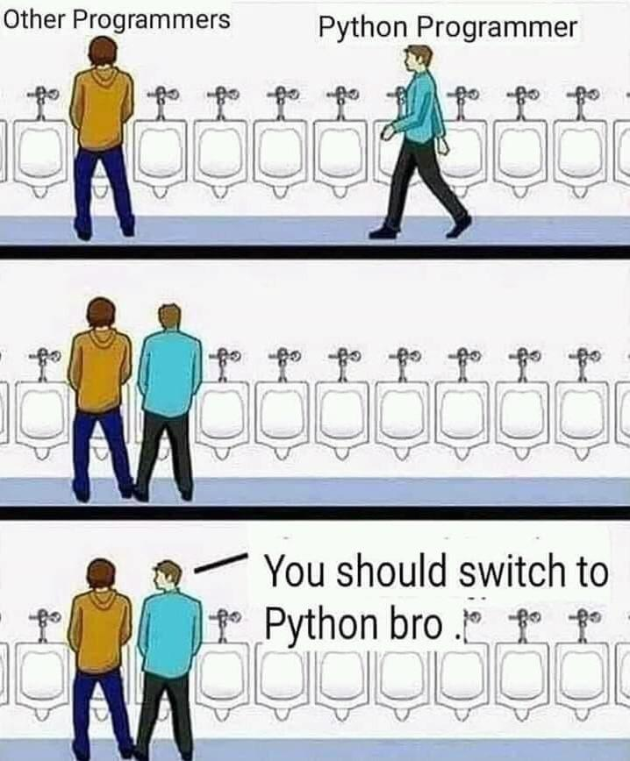
PYTHON – programming language
General Purpose
Object Oriented
Dynamix typing
Interpreted
Open Source
Cross Platform
Library Supporting (PIP)

Slide 4
TABLE OF CONTENTS
Table of contents
Variables
Types of Operators
Data Structures
Conditional and Iterative Statements
Functional Programming
OOP
Exception Handling
API and Backend
FASTAPI

Slide 5
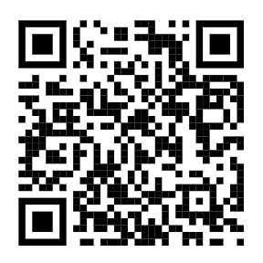

Connect me on
PORTFOLIO
LINKTREE

