Slide 1

From Code to Community: Publishing PyPI Packages in the Open Source World
FOSS MEETUP MUMBAI JUNE 2024

Slide 2
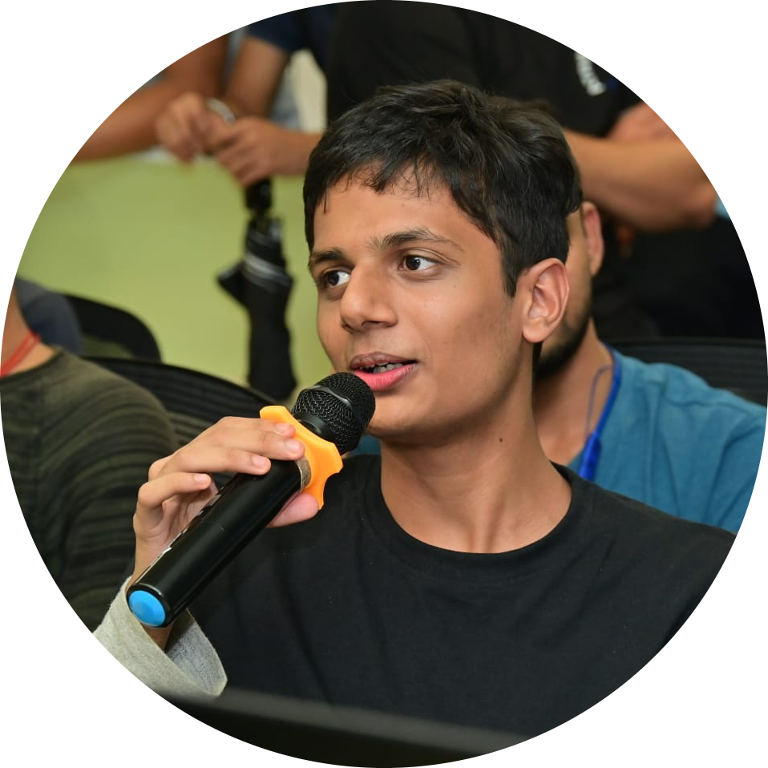
About Myself
Full Stack AI Intern at Infiheal
Research Intern at IIT Patna
Ex- Data Analyst Research Intern Illinois Institute of Technology
ML and Tech Developer at Synapse
Open Source Contributor
Streamlit Student Ambassador
8x Hackathon Finalist
Student at DJ Sanghvi College of Engineering

Slide 3
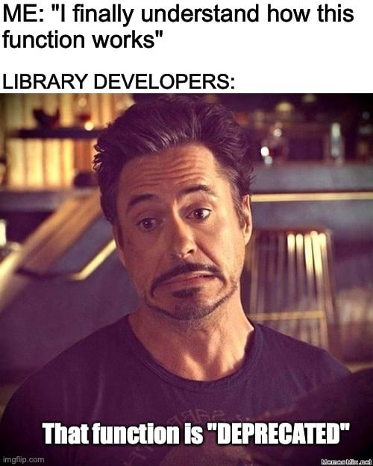
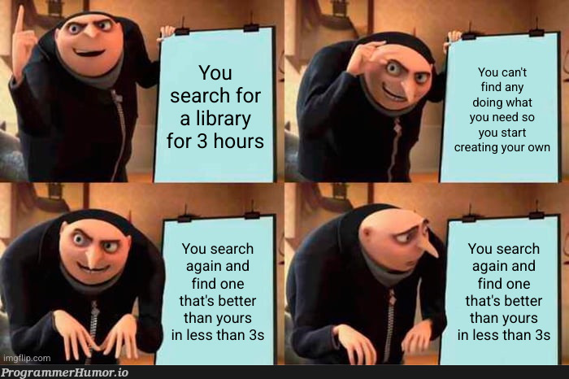
Why am I giving this talk?

Slide 4
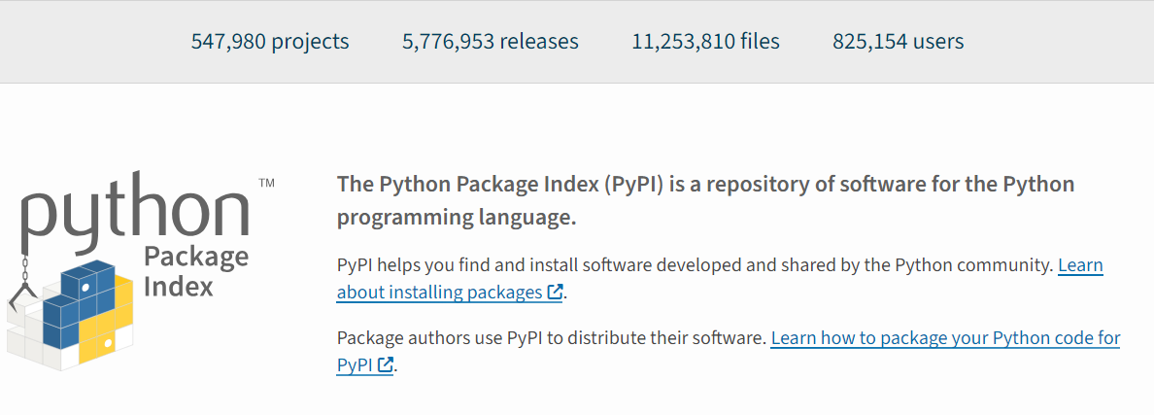
What is PyPI?
Find, install and publish Python packages with the Python Package Index :)

Slide 5
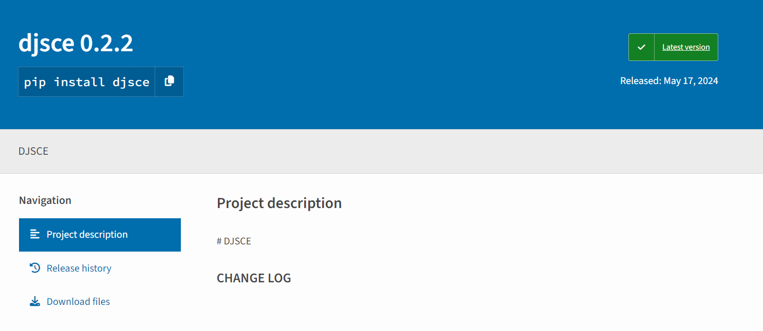

Slide 6
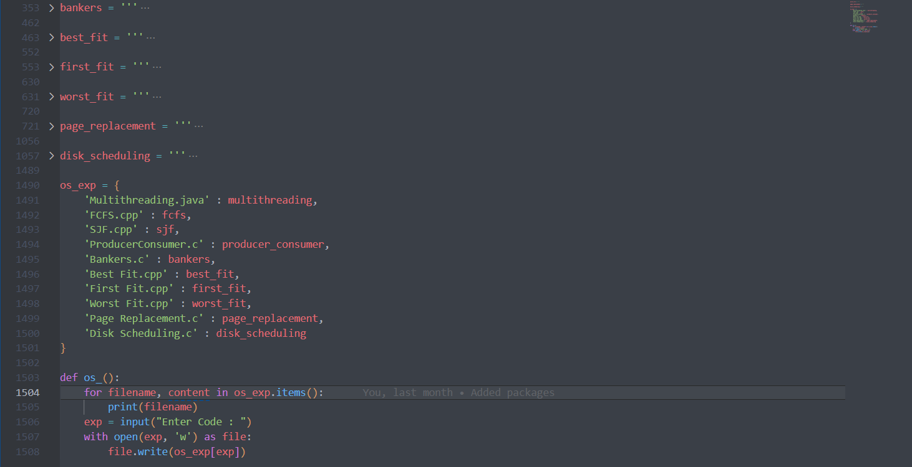

Slide 7
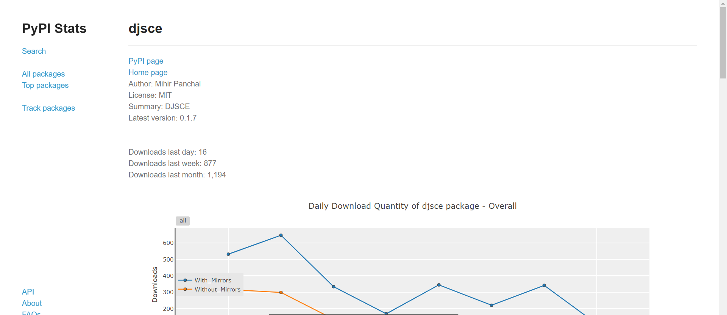
Why create Python Packages?

Slide 8
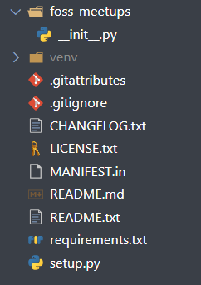
Lets Dive into creating one yourself
Create a GitHub Repository for your python package (Example : pip-install-djsce)
Create an account on pypi (https://pypi.org)
Follow this Folder structure
Create a python virtualenv (python –m venv venv)
https://github.com/MihirRajeshPanchal/pypi-foss

Slide 9
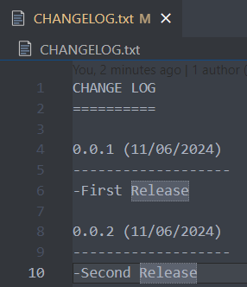
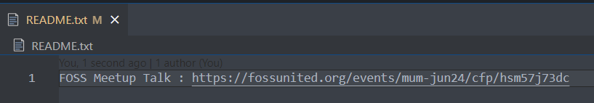
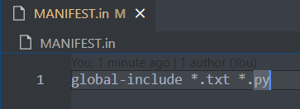
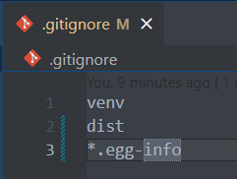
Edit these files
CHANGELOG.txt
README.txt
MANIFEST.in
.gitignore

Slide 10
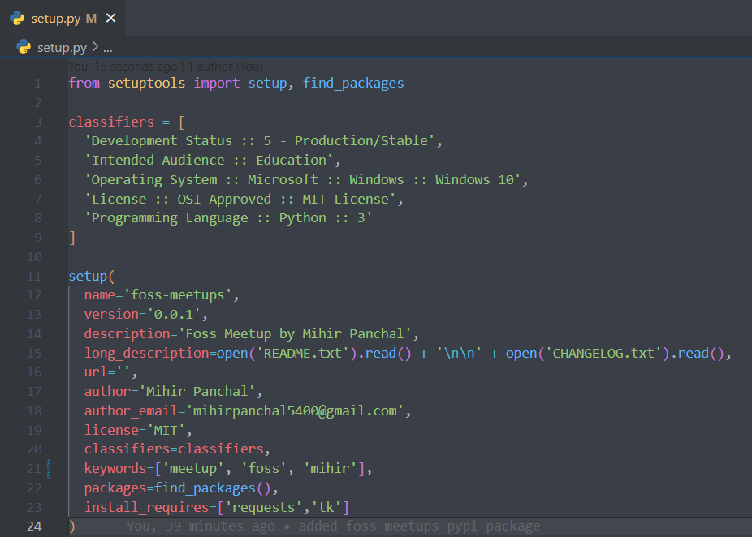
Setup.py

Slide 11
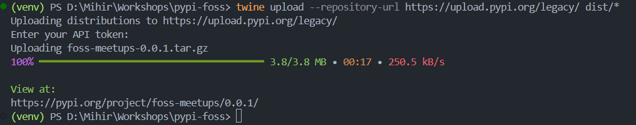
Commands
pip install setuptools twine
python setup.py sdist
twine upload --repository-url https://upload.pypi.org/legacy/ dist/*
It will ask for username password or api token

Slide 12


Congratulations
https://pypistats.org/

Slide 13
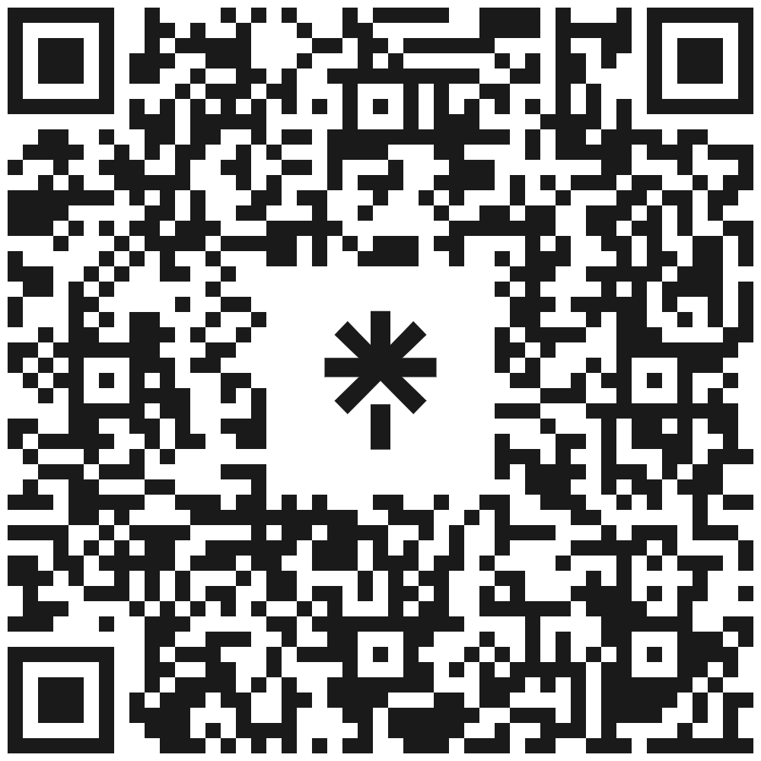
CONNECT ME ON

