Slide 1
Strings In Java
Please refer the .md file

Slide 2
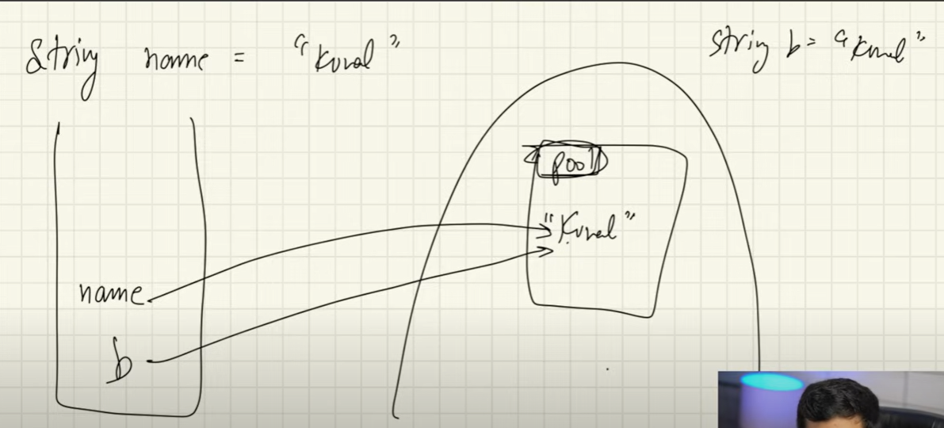
String pool a part of heap

Slide 3
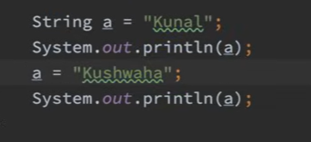
Kushwaha is a new object that gets created, a is a reference variable that changes what its pointing to. The object itself has not been changed. Strings are immutable in java

