Slide 1
Dispatch - Autonomous Traffic & Emergency Response Simulation
AI for Visual Computing · CS 549
Group: Rapid Route
Mihir Shinde (mk1353)
Ananya Das Hullumane Neelameghashyam (ah1895)
Notes:
[Ananya · 0:00–0:15]
Hi, we are Group Rapid Route: Ananya and Mihir. Our project is Dispatch, a traffic and emergency response simulation in a 3D city in the browser.

Slide 2
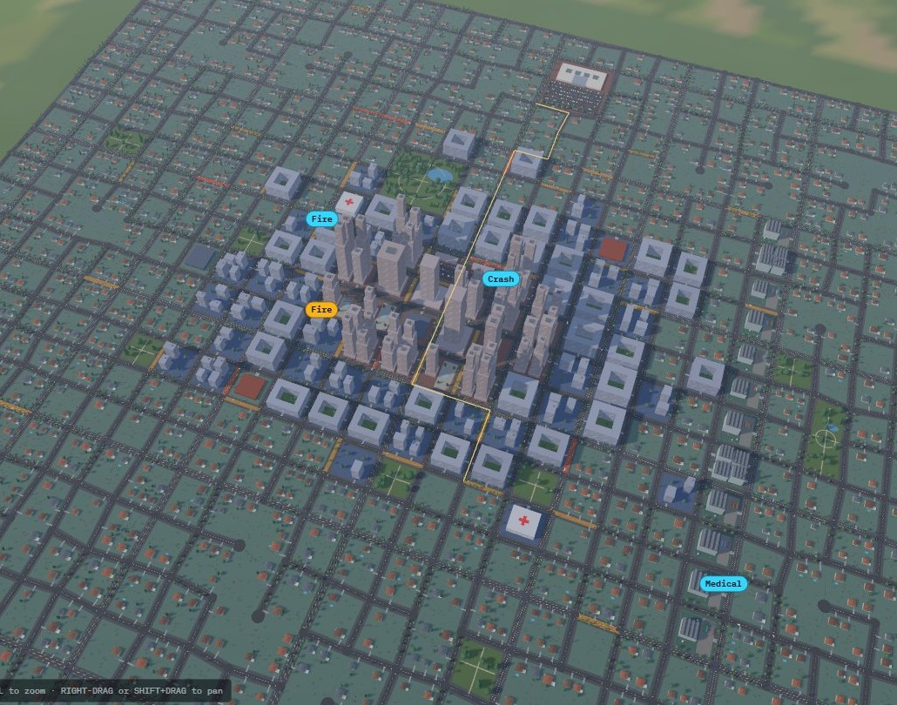
Project Overview
Goal
A browser-based 3D city where about 700 cars drive door to door on generated demand, and emergency units answer calls through that same traffic. You play the dispatcher: take calls, send units, beat the response target.
Pillars
Pathfinding and Navigation: A* on live travel times, unit ETAs, rerouting around incidents, coverage map.
Swarm and Boids Modeling: car following, junction behaviour, and traffic that makes way for sirens.
Today: two challenges
1. Routing and dispatch while road costs keep changing
2. Getting one-lane traffic to yield to an emergency unit
The city at the PM rush: stations, live calls and a unit route (yellow).
Live build: mihirshinde-29.github.io/rapid_route
Notes:
[Ananya · 0:15–0:50]
About 700 cars drive door to door, and emergency units answer calls through that same traffic. You play the dispatcher: pick a unit and it drives there through real traffic.
Our pillars are Pathfinding and Navigation, and Swarm and Boids Modeling.
Today we go deep on two problems: routing in changing traffic, and getting traffic to yield to a unit.

Slide 3
Challenge 1: Dynamic Routing and Emergency Dispatch
The shortest route is not always the fastest. Congestion, accidents and closures change the cost of each road while the simulation runs.
Why this is difficult
A* searches a graph, but road costs change dynamically.
The closest emergency unit may not have the lowest ETA.
A graph route must become continuous vehicle movement.
Dispatch state and vehicle state must stay in sync.
Rerouting must help without making vehicles unstable.
Our approach
A* with live travel-time costs; distance vs time routes compared.
New trips plan on current costs; incidents reroute cars.
Filter units by type and availability; send the best ETA.
Track each call: created, assigned, en route, resolved.
What the results show
1.7×
too high: the plain live-traffic ETA for a unit with its siren on, because it assumed the unit waits in traffic like a car.
1.00
median actual / predicted arrival after giving units their own cost model (morning peak; 10th–90th percentile 0.93–1.16).
Tradeoff: we do not replan every car every frame, which would make cars flip between routes. New trips use current costs and incidents trigger rerouting: stable, but simpler than a real navigation app.
Notes:
[Ananya · 0:50–2:30]
The shortest route is not always the fastest: congestion, accidents and closures change road costs while the simulation runs.
That is hard because A* assumes fixed edge costs, the closest unit is not always the fastest, and the route has to become smooth vehicle movement that matches the call's state.
Our approach: A* on live travel times. New trips plan on current costs, incidents reroute cars, and a call gets the available unit with the best ETA.
The result: our first ETA was about 1.7 times too high for units with sirens, because cars make way for them. With their own cost model, units now arrive in a median of 1.00 of their ETA.
Tradeoff: we don't replan every car every frame; it is stable but simpler than a real navigation app.
Mihir will take the second challenge.

Slide 4
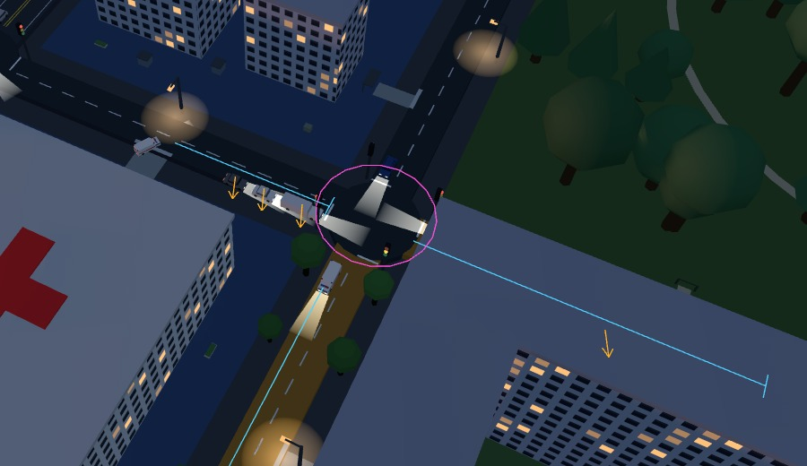
Challenge 2: Making Traffic Yield to Emergency Units
Why this is difficult
One lane each way: there is no free lane to pass in.
Car following (IDM) only looks at the car ahead; yielding needs cars to react to a unit behind them.
A car can only pull over where there is room: not in a junction, a queue or past an accident.
Local rules can deadlock: a stress run found 3 cases.
Our approach
Yield reach: cars up to 120 m ahead on the unit's route pull 2 m onto the shoulder and stop (separation).
Pass, then merge back: the unit passes only cars that have pulled over; they rejoin once it is 20 m ahead (cohesion).
Junction pre-emption: a junction within 100 m of the unit is held, so cross traffic waits.
Deadlock rules: the yield chain stops at a car that cannot pull over; a held junction still lets the unit's own approach in.
Boids debug view (B): an ambulance on its route (cyan). Orange arrows mark cars told to pull over; the pink ring is a junction held for it.
Notes:
[Mihir · 2:30–3:50]
How do cars make way for a unit when there is one lane each way? Our car-following model only looks ahead, but yielding means reacting to something behind.
Our approach is boids-style. Cars up to 120 metres ahead pull 2 metres onto the shoulder and stop: separation. The unit passes only cars that have pulled over, and they merge back once it is 20 metres ahead: cohesion. Junctions ahead are held so cross traffic waits.
The hard part was deadlock: a stress run found three cases, fixed with simple rules, like stopping the yield chain at a car that cannot pull over.
The screenshot is our debug view: route in cyan, orange arrows on cars pulling over, pink ring on a held junction.

Slide 5
Challenge 2: Results and Tradeoffs
Tradeoffs and limits
Shoulder, not a second lane. Pulling over is a 2 m sideways move; a unit never squeezes past a car that has not moved.
Blocked lanes are slow. At an accident or lane closure cars pass one side at a time: about 650–700 cars an hour, so queues build at the peak.
A safety net stays. A car stopped for 3 minutes is removed. It never fired in the tests, but we keep it.
Turning round is crude. A unit re-sent while driving back turns at its next junction, so it can go the wrong way first.
0
3 → 0
0.45 ms
cars removed by the gridlock guard: tests plus 5 scenarios with 24 units each
deadlocks found by the stress run, all fixed
per 0.1 s sim step at the peak (0.55 ms with 12 units and incidents)
Live build: mihirshinde-29.github.io/rapid_route
Notes:
[Mihir · 3:50–5:00]
With yielding, the unit crosses the test route in 120 seconds instead of 265.
It doesn't break the city: no cars removed by the gridlock guard in any test, and a sim step stays under half a millisecond.
Tradeoffs: pulling over is a 2 metre move, not a real second lane; blocked lanes pass one side at a time, so queues build at rush hour; and a re-sent unit can start off the wrong way.
The live build is at the link. Thank you, happy to take questions.

