Slide 1
Building an AI Pipeline for Image Segmentation and Object Analysis
Presented by
Mihir Walvekar

Slide 2
Objective:
Develop a pipeline using transformers or deep learning models that processes an input image
to segment, identify, and analyze objects within the image, and outputs a summary table with
mapped data for each object.
Tools and Technologies:
PyTorch,
TensorFlow,
CLIP,
Mask R-CNN,
OpenCV,
Tesseract OCR

Slide 3
Step-by-Step Workflow :
SR no. | Step
Step 1: | Image Segmentation
Step 2: | Object Extraction and Storage
Step 3: | Object Identification
Step 4: | Text/Data Extraction from Objects
Step 5: | Summarize Object Attributes
Step 6: | Data Mapping
Step 7: | Output Generation

Slide 4
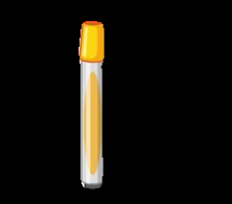


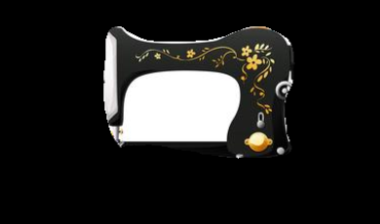


Image extraction

Slide 5
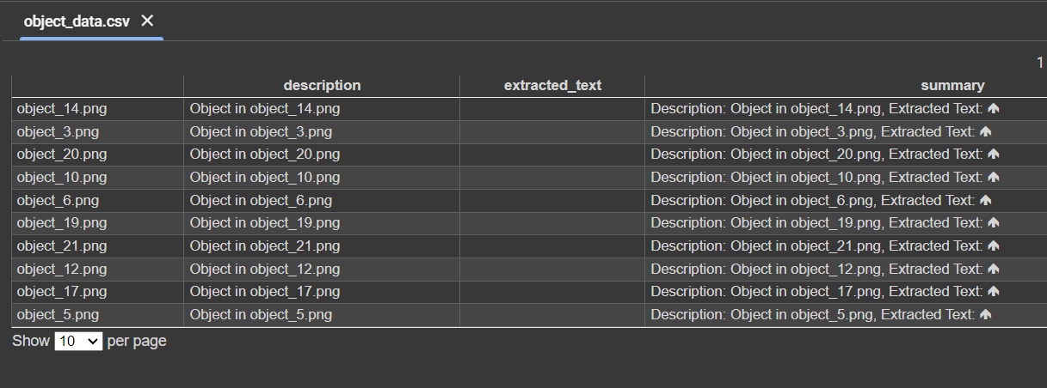
Output Table :

Slide 6
Thank you

