Slide 1
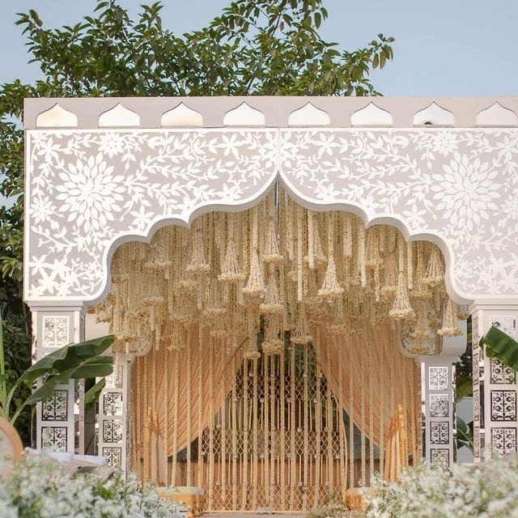

J.VARDHAN
LUXE WEDDINGS & EVENTS
Your wedding.
Every detail,
together.
From Mandap Ropan to the final farewell.
A checklist for your client consultation.
ENGLISH EDITION
Notes:
Editable meeting worksheet. This is not a completed client plan. Website answers are not automatically linked to this PowerPoint. Use the website for live selection and progress tracking.

Slide 2
01 / YOUR CELEBRATION
1 / 3
Mandap Ropan
A meaningful beginning, shaped around your family traditions.
NEED CONFIRM
YOUR REQUIREMENTS
Priest / ritual officiant
Bajoth / low ritual stool
Earthen pots / matki
Chaak vadhavani ritual *
Puja materials
Date: __________
Time: __________
Guests: ________
Ritual plates, bowls & spoons
Ganesh sthapana & family-deity puja
Notes / quantities / responsibility:
* Discuss the exact requirement together.
J.VARDHAN / CLIENT MEETING
02
Notes:
Rituals & puja / Priest / ritual officiant
PDF items: 41
Rituals & puja / Bajoth / low ritual stool
PDF items: 46
Rituals & puja / Earthen pots / matki
PDF items: 47
Rituals & puja / Chaak vadhavani ritual
PDF items: 52
Clarify: Source also says “chaakol”; confirm the local name and materials with the family.
Rituals & puja / Puja materials
PDF items: 53
Rituals & puja / Ritual plates, bowls & spoons
PDF items: 54
Rituals & puja / Ganesh sthapana & family-deity puja
PDF items: Added suggestion
Tick slots: in PowerPoint edit view, select a blank text box inside a square and type a check mark (✓). The first column means requested; the second means arrangement confirmed. Use website for interactive ticking in a client meeting.

Slide 3
01 / YOUR CELEBRATION
2 / 3
Mandap Ropan
A meaningful beginning, shaped around your family traditions.
NEED CONFIRM
YOUR REQUIREMENTS
Confirm the auspicious time & ritual sequence
Ritual platforms / stages *
Mandap backdrop
Floor mattresses, padded platforms & cushions
Chairs
Date: __________
Time: __________
Guests: ________
Sofas
DJ / music setup
Notes / quantities / responsibility:
* Discuss the exact requirement together.
J.VARDHAN / CLIENT MEETING
03
Notes:
Rituals & puja / Confirm the auspicious time & ritual sequence
PDF items: Added suggestion
Setting & seating / Ritual platforms / stages
PDF items: 42
Clarify: The source specifies two stages; confirm the quantity needed.
Setting & seating / Mandap backdrop
PDF items: 43
Setting & seating / Floor mattresses, padded platforms & cushions
PDF items: 45, 48
Setting & seating / Chairs
PDF items: 49
Setting & seating / Sofas
PDF items: 50
Setting & seating / DJ / music setup
PDF items: 44
Tick slots: in PowerPoint edit view, select a blank text box inside a square and type a check mark (✓). The first column means requested; the second means arrangement confirmed. Use website for interactive ticking in a client meeting.

Slide 4
01 / YOUR CELEBRATION
3 / 3
Mandap Ropan
A meaningful beginning, shaped around your family traditions.
NEED CONFIRM
YOUR REQUIREMENTS
Tea & water counter
Toran & floral decoration
Date: __________
Time: __________
Guests: ________
Notes / quantities / responsibility:
Choose → discuss → confirm
J.VARDHAN / CLIENT MEETING
04
Notes:
Setting & seating / Tea & water counter
PDF items: 51
Setting & seating / Toran & floral decoration
PDF items: Added suggestion
Tick slots: in PowerPoint edit view, select a blank text box inside a square and type a check mark (✓). The first column means requested; the second means arrangement confirmed. Use website for interactive ticking in a client meeting.

Slide 5
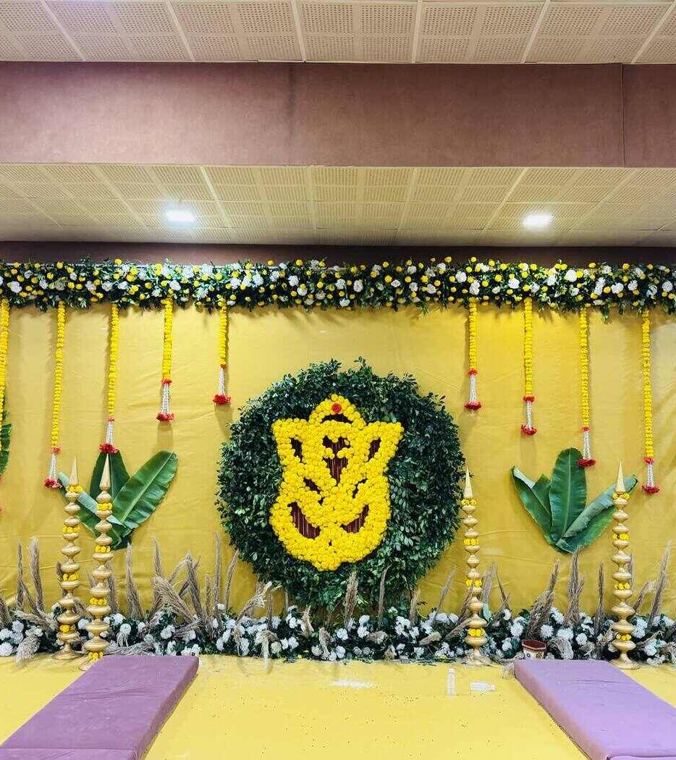
02 / YOUR CELEBRATION
1 / 2
Mameru
A warm family welcome and a thoughtful setting for gifts.
NEED CONFIRM
YOUR REQUIREMENTS
Tables to display Mameru gifts
Welcome stoles / khes
Sofas & family seating
Gift labels & inventory
Family photo area
Date: __________
Time: __________
Guests: ________
DJ
Dhol players
Notes / quantities / responsibility:
Choose → discuss → confirm
J.VARDHAN / CLIENT MEETING
05
Notes:
Welcome & arrangement / Tables to display Mameru gifts
PDF items: 55
Welcome & arrangement / Welcome stoles / khes
PDF items: 56
Welcome & arrangement / Sofas & family seating
PDF items: 60
Welcome & arrangement / Gift labels & inventory
PDF items: Added suggestion
Welcome & arrangement / Family photo area
PDF items: Added suggestion
Music & hospitality / DJ
PDF items: 57
Music & hospitality / Dhol players
PDF items: 58
Tick slots: in PowerPoint edit view, select a blank text box inside a square and type a check mark (✓). The first column means requested; the second means arrangement confirmed. Use website for interactive ticking in a client meeting.

Slide 6
02 / YOUR CELEBRATION
2 / 2
Mameru
A warm family welcome and a thoughtful setting for gifts.
NEED CONFIRM
YOUR REQUIREMENTS
Live band
Tea, water & soft-drink counter
Date: __________
Time: __________
Guests: ________
Notes / quantities / responsibility:
Choose → discuss → confirm
J.VARDHAN / CLIENT MEETING
06
Notes:
Music & hospitality / Live band
PDF items: 59
Music & hospitality / Tea, water & soft-drink counter
PDF items: 61
Tick slots: in PowerPoint edit view, select a blank text box inside a square and type a check mark (✓). The first column means requested; the second means arrangement confirmed. Use website for interactive ticking in a client meeting.

Slide 7
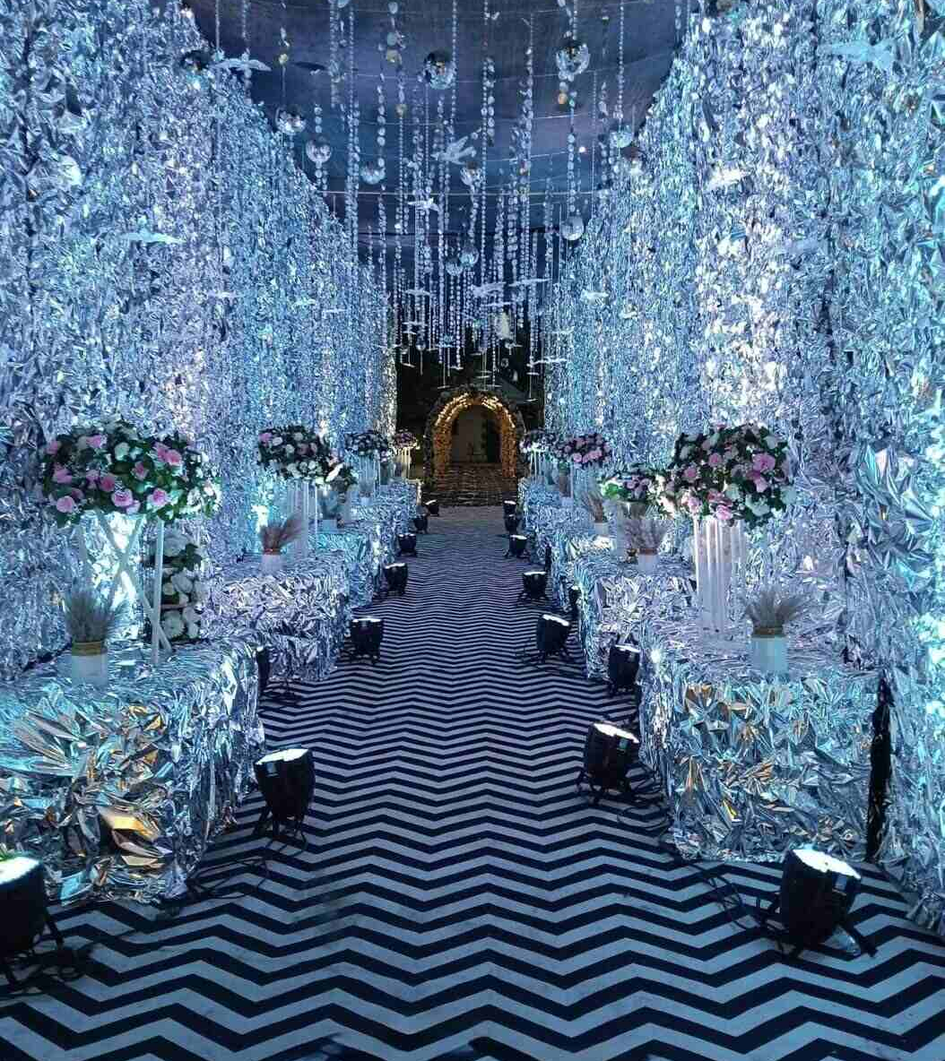
03 / YOUR CELEBRATION
1 / 4
Sangeet & Garba
Music, movement and a celebration that brings everyone together.
NEED CONFIRM
YOUR REQUIREMENTS
Entrance decoration
Couple’s stage & backdrop
Performance stage & backdrop
Bollywood-themed stage *
Lighting truss / box *
Date: __________
Time: __________
Guests: ________
Chairs & sofas
Round tables & chairs
Notes / quantities / responsibility:
* Discuss the exact requirement together.
J.VARDHAN / CLIENT MEETING
07
Notes:
Stage & styling / Entrance decoration
PDF items: 62
Stage & styling / Couple’s stage & backdrop
PDF items: 63, 64
Stage & styling / Performance stage & backdrop
PDF items: 65, 66
Stage & styling / Bollywood-themed stage
PDF items: 67
Clarify: Source wording is unclear; confirm whether “Bollywood night” was intended.
Stage & styling / Lighting truss / box
PDF items: 68, 69
Clarify: Source lists 60 × 60 and 80 × 80 without units; confirm dimensions and design.
Stage & styling / Chairs & sofas
PDF items: 70, 71
Stage & styling / Round tables & chairs
PDF items: 72, 73
Tick slots: in PowerPoint edit view, select a blank text box inside a square and type a check mark (✓). The first column means requested; the second means arrangement confirmed. Use website for interactive ticking in a client meeting.

Slide 8
03 / YOUR CELEBRATION
2 / 4
Sangeet & Garba
Music, movement and a celebration that brings everyone together.
NEED CONFIRM
YOUR REQUIREMENTS
Performance platform
LED screen backdrop
Illuminated dance floor
Couple’s entrance concept
Cold-spark effects
Date: __________
Time: __________
Guests: ________
Dry-ice effects
Balloon styling
Notes / quantities / responsibility:
Choose → discuss → confirm
J.VARDHAN / CLIENT MEETING
08
Notes:
Stage & styling / Performance platform
PDF items: 77
Stage & styling / LED screen backdrop
PDF items: 83
Stage & styling / Illuminated dance floor
PDF items: 86
Programme & entrance / Couple’s entrance concept
PDF items: 76
Programme & entrance / Cold-spark effects
PDF items: 78
Programme & entrance / Dry-ice effects
PDF items: 79
Programme & entrance / Balloon styling
PDF items: 80
Tick slots: in PowerPoint edit view, select a blank text box inside a square and type a check mark (✓). The first column means requested; the second means arrangement confirmed. Use website for interactive ticking in a client meeting.

Slide 9
03 / YOUR CELEBRATION
3 / 4
Sangeet & Garba
Music, movement and a celebration that brings everyone together.
NEED CONFIRM
YOUR REQUIREMENTS
Vintage-car entrance
Emcee / host
Sound system & microphones *
Smoke machine
Garba / dandiya & live music
Date: __________
Time: __________
Guests: ________
Choreographer & rehearsals
Playlist, performance order & sound check
Notes / quantities / responsibility:
* Discuss the exact requirement together.
J.VARDHAN / CLIENT MEETING
09
Notes:
Programme & entrance / Vintage-car entrance
PDF items: 81
Programme & entrance / Emcee / host
PDF items: 82
Programme & entrance / Sound system & microphones
PDF items: 84
Clarify: Specify capacity for the venue; the source’s “volts” is not an appropriate sound-output specification.
Programme & entrance / Smoke machine
PDF items: 85
Programme & entrance / Garba / dandiya & live music
PDF items: Added suggestion
Programme & entrance / Choreographer & rehearsals
PDF items: Added suggestion
Programme & entrance / Playlist, performance order & sound check
PDF items: Added suggestion
Tick slots: in PowerPoint edit view, select a blank text box inside a square and type a check mark (✓). The first column means requested; the second means arrangement confirmed. Use website for interactive ticking in a client meeting.

Slide 10
03 / YOUR CELEBRATION
4 / 4
Sangeet & Garba
Music, movement and a celebration that brings everyone together.
NEED CONFIRM
YOUR REQUIREMENTS
Tea, water & soft-drink counter
Snack service counter
Date: __________
Time: __________
Guests: ________
Notes / quantities / responsibility:
Choose → discuss → confirm
J.VARDHAN / CLIENT MEETING
10
Notes:
Refreshments / Tea, water & soft-drink counter
PDF items: 74
Refreshments / Snack service counter
PDF items: 75
Tick slots: in PowerPoint edit view, select a blank text box inside a square and type a check mark (✓). The first column means requested; the second means arrangement confirmed. Use website for interactive ticking in a client meeting.

Slide 11
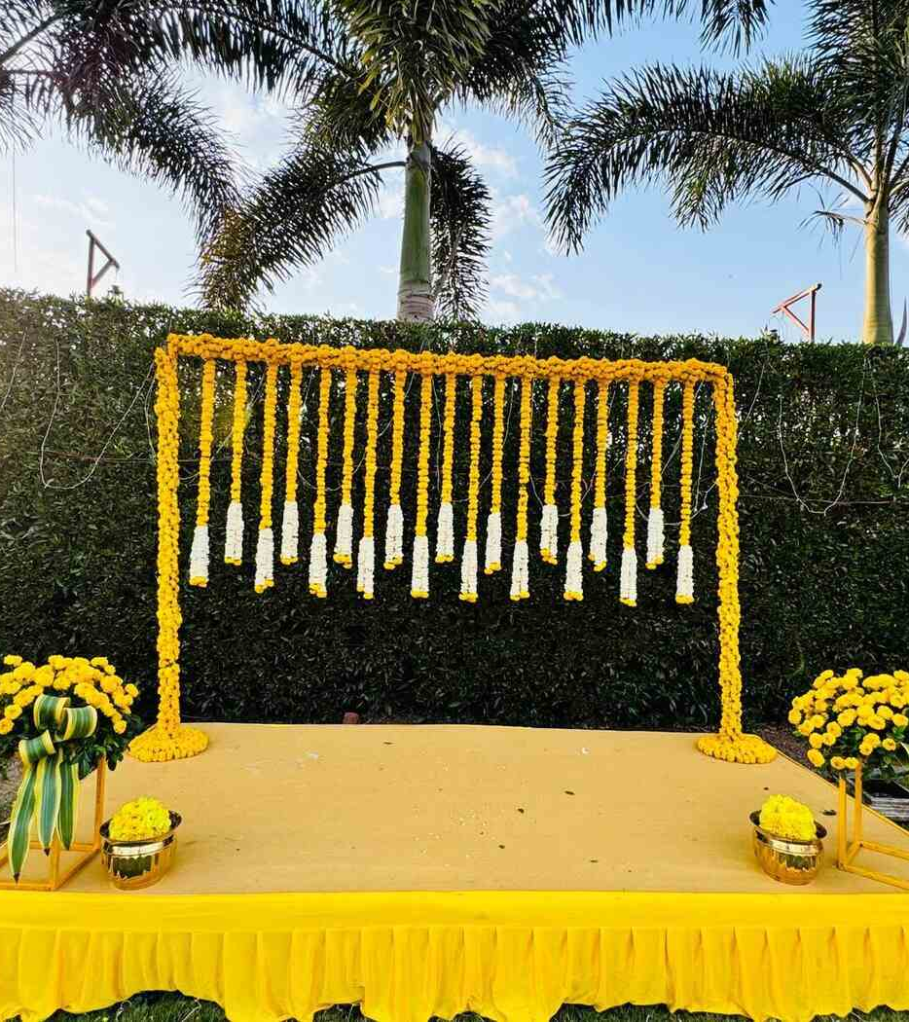
04 / YOUR CELEBRATION
1 / 2
Pithi / Haldi
A joyful morning filled with turmeric, flowers and family.
NEED CONFIRM
YOUR REQUIREMENTS
Haldi stage & backdrop
Chairs & padded floor seating
Haldi tub
Flowers & petals
Bajoth / low stool
Date: __________
Time: __________
Guests: ________
Safa / turbans
Haldi paste, bowls & application brushes
Notes / quantities / responsibility:
Choose → discuss → confirm
J.VARDHAN / CLIENT MEETING
11
Notes:
Setting & materials / Haldi stage & backdrop
PDF items: 87, 88
Setting & materials / Chairs & padded floor seating
PDF items: 89, 90
Setting & materials / Haldi tub
PDF items: 91
Setting & materials / Flowers & petals
PDF items: 92
Setting & materials / Bajoth / low stool
PDF items: 93
Setting & materials / Safa / turbans
PDF items: 96
Setting & materials / Haldi paste, bowls & application brushes
PDF items: Added suggestion
Tick slots: in PowerPoint edit view, select a blank text box inside a square and type a check mark (✓). The first column means requested; the second means arrangement confirmed. Use website for interactive ticking in a client meeting.

Slide 12
04 / YOUR CELEBRATION
2 / 2
Pithi / Haldi
A joyful morning filled with turmeric, flowers and family.
NEED CONFIRM
YOUR REQUIREMENTS
Towels, changing area & cleanup
DJ
Nashik dhol ensemble
Emcee / host *
Special Haldi entrance *
Date: __________
Time: __________
Guests: ________
Snack service tables
Tea, water & soft-drink counter
Notes / quantities / responsibility:
* Discuss the exact requirement together.
J.VARDHAN / CLIENT MEETING
12
Notes:
Setting & materials / Towels, changing area & cleanup
PDF items: Added suggestion
Celebration & hospitality / DJ
PDF items: 94
Celebration & hospitality / Nashik dhol ensemble
PDF items: 95
Celebration & hospitality / Emcee / host
PDF items: 97
Clarify: Source says “ank”, an incomplete word; confirm that a host is intended.
Celebration & hospitality / Special Haldi entrance
PDF items: 98
Clarify: Source says “dagla vali”; confirm the intended entrance or performer type.
Celebration & hospitality / Snack service tables
PDF items: 99
Celebration & hospitality / Tea, water & soft-drink counter
PDF items: 100
Tick slots: in PowerPoint edit view, select a blank text box inside a square and type a check mark (✓). The first column means requested; the second means arrangement confirmed. Use website for interactive ticking in a client meeting.

Slide 13
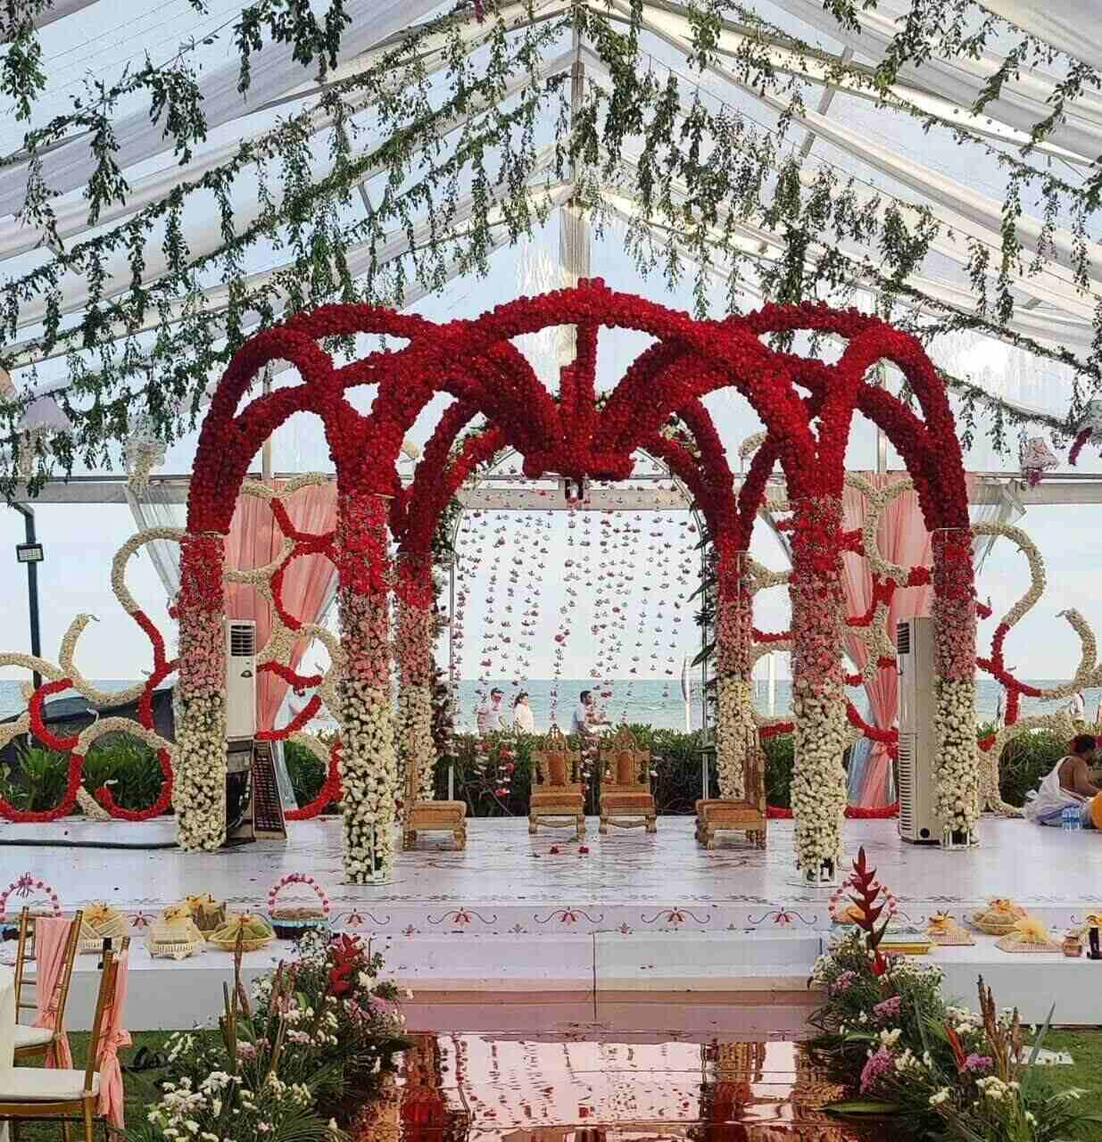
05 / YOUR CELEBRATION
1 / 5
Wedding, Baraat & Varmala
From the procession to the farewell, every moment considered.
NEED CONFIRM
YOUR REQUIREMENTS
Priest / ritual officiant
Wedding mandap, platform & backdrop
LED screen for ceremony viewing
Havan kund, puja materials & utensils
Wedding-song area with mattresses & cushions
Date: __________
Time: __________
Guests: ________
Sofas & chairs
Service tables
Notes / quantities / responsibility:
Choose → discuss → confirm
J.VARDHAN / CLIENT MEETING
13
Notes:
Wedding rituals & mandap / Priest / ritual officiant
PDF items: 101
Wedding rituals & mandap / Wedding mandap, platform & backdrop
PDF items: 102, 103, 104
Wedding rituals & mandap / LED screen for ceremony viewing
PDF items: 105, 128
Wedding rituals & mandap / Havan kund, puja materials & utensils
PDF items: 106
Wedding rituals & mandap / Wedding-song area with mattresses & cushions
PDF items: 107
Wedding rituals & mandap / Sofas & chairs
PDF items: 108, 109
Wedding rituals & mandap / Service tables
PDF items: 110
Tick slots: in PowerPoint edit view, select a blank text box inside a square and type a check mark (✓). The first column means requested; the second means arrangement confirmed. Use website for interactive ticking in a client meeting.

Slide 14
05 / YOUR CELEBRATION
2 / 5
Wedding, Baraat & Varmala
From the procession to the farewell, every moment considered.
NEED CONFIRM
YOUR REQUIREMENTS
Antarpat cloth & family ritual materials *
Ceremony timing, pheras & family-specific rituals
Floral canopy for the bridal entrance
Vidaai / farewell & car decoration
Procession band
Date: __________
Time: __________
Guests: ________
DJ
Turbans & turban-tying service
Notes / quantities / responsibility:
* Discuss the exact requirement together.
J.VARDHAN / CLIENT MEETING
14
Notes:
Wedding rituals & mandap / Antarpat cloth & family ritual materials
PDF items: 114
Clarify: Additional source wording is unclear; confirm the ritual names and materials with the priest.
Wedding rituals & mandap / Ceremony timing, pheras & family-specific rituals
PDF items: Added suggestion
Wedding rituals & mandap / Floral canopy for the bridal entrance
PDF items: Added suggestion
Wedding rituals & mandap / Vidaai / farewell & car decoration
PDF items: Added suggestion
Baraat & welcome / Procession band
PDF items: 111
Baraat & welcome / DJ
PDF items: 112
Baraat & welcome / Turbans & turban-tying service
PDF items: 113
Tick slots: in PowerPoint edit view, select a blank text box inside a square and type a check mark (✓). The first column means requested; the second means arrangement confirmed. Use website for interactive ticking in a client meeting.

Slide 15
05 / YOUR CELEBRATION
3 / 5
Wedding, Baraat & Varmala
From the procession to the farewell, every moment considered.
NEED CONFIRM
YOUR REQUIREMENTS
Horse / carriage
Golf cart / vintage car
Discuss an elephant entrance *
Guest welcome with roses & flowers *
Ponkhana welcome ritual & ceremonial tray
Date: __________
Time: __________
Guests: ________
Procession route & timing
Varmala stage, backdrop & concept
Notes / quantities / responsibility:
* Discuss the exact requirement together.
J.VARDHAN / CLIENT MEETING
15
Notes:
Baraat & welcome / Horse / carriage
PDF items: 115
Baraat & welcome / Golf cart / vintage car
PDF items: 116
Baraat & welcome / Discuss an elephant entrance
PDF items: 117
Clarify: Retained from the source for discussion; availability, venue approval and applicable requirements must be checked before confirmation.
Baraat & welcome / Guest welcome with roses & flowers
PDF items: 118
Clarify: Some flower-item names are unclear; confirm roses, garlands or petals.
Baraat & welcome / Ponkhana welcome ritual & ceremonial tray
PDF items: Added suggestion
Baraat & welcome / Procession route & timing
PDF items: Added suggestion
Varmala & guest experience / Varmala stage, backdrop & concept
PDF items: 119, 120
Tick slots: in PowerPoint edit view, select a blank text box inside a square and type a check mark (✓). The first column means requested; the second means arrangement confirmed. Use website for interactive ticking in a client meeting.

Slide 16
05 / YOUR CELEBRATION
4 / 5
Wedding, Baraat & Varmala
From the procession to the farewell, every moment considered.
NEED CONFIRM
YOUR REQUIREMENTS
Pair of wedding garlands
Glass ramp / stage & cold-spark effects *
Glass ramp & dry-ice effect
Photo / selfie area & props
Tea & water counter
Date: __________
Time: __________
Guests: ________
Children’s play area & entertainment *
Children’s snack station
Notes / quantities / responsibility:
* Discuss the exact requirement together.
J.VARDHAN / CLIENT MEETING
16
Notes:
Varmala & guest experience / Pair of wedding garlands
PDF items: Added suggestion
Varmala & guest experience / Glass ramp / stage & cold-spark effects
PDF items: 121
Clarify: Source says “glass stamp”; confirm whether a stage or ramp is intended.
Varmala & guest experience / Glass ramp & dry-ice effect
PDF items: 122
Varmala & guest experience / Photo / selfie area & props
PDF items: 123
Varmala & guest experience / Tea & water counter
PDF items: 124
Varmala & guest experience / Children’s play area & entertainment
PDF items: 125
Clarify: Source lists “jumping, dagla”; confirm the equipment, performers and supervision.
Varmala & guest experience / Children’s snack station
PDF items: 126
Tick slots: in PowerPoint edit view, select a blank text box inside a square and type a check mark (✓). The first column means requested; the second means arrangement confirmed. Use website for interactive ticking in a client meeting.

Slide 17
05 / YOUR CELEBRATION
5 / 5
Wedding, Baraat & Varmala
From the procession to the farewell, every moment considered.
NEED CONFIRM
YOUR REQUIREMENTS
Traditional seated dining / pangat *
Date: __________
Time: __________
Guests: ________
Notes / quantities / responsibility:
* Discuss the exact requirement together.
J.VARDHAN / CLIENT MEETING
17
Notes:
Varmala & guest experience / Traditional seated dining / pangat
PDF items: 127
Clarify: Source says “pancholu”; confirm the seating format and quantity with the family.
Tick slots: in PowerPoint edit view, select a blank text box inside a square and type a check mark (✓). The first column means requested; the second means arrangement confirmed. Use website for interactive ticking in a client meeting.

Slide 18

06 / YOUR CELEBRATION
1 / 2
Mehndi
An additional function—include it if it is part of your celebration.
NEED CONFIRM
YOUR REQUIREMENTS
Bridal mehndi artist & appointment
Mehndi artists for family & guests
Mehndi stage & decoration
Comfortable seating & task lighting
Floral jewellery & bangle counter
Date: __________
Time: __________
Guests: ________
Music, games & host
Snacks & drinks
Notes / quantities / responsibility:
Choose → discuss → confirm
J.VARDHAN / CLIENT MEETING
18
Notes:
Artists & styling / Bridal mehndi artist & appointment
PDF items: Added suggestion
Artists & styling / Mehndi artists for family & guests
PDF items: Added suggestion
Artists & styling / Mehndi stage & decoration
PDF items: Added suggestion
Artists & styling / Comfortable seating & task lighting
PDF items: Added suggestion
Artists & styling / Floral jewellery & bangle counter
PDF items: Added suggestion
Artists & styling / Music, games & host
PDF items: Added suggestion
Artists & styling / Snacks & drinks
PDF items: Added suggestion
Tick slots: in PowerPoint edit view, select a blank text box inside a square and type a check mark (✓). The first column means requested; the second means arrangement confirmed. Use website for interactive ticking in a client meeting.

Slide 19
06 / YOUR CELEBRATION
2 / 2
Mehndi
An additional function—include it if it is part of your celebration.
NEED CONFIRM
YOUR REQUIREMENTS
Mehndi drying area & helpers
Date: __________
Time: __________
Guests: ________
Notes / quantities / responsibility:
Choose → discuss → confirm
J.VARDHAN / CLIENT MEETING
19
Notes:
Artists & styling / Mehndi drying area & helpers
PDF items: Added suggestion
Tick slots: in PowerPoint edit view, select a blank text box inside a square and type a check mark (✓). The first column means requested; the second means arrangement confirmed. Use website for interactive ticking in a client meeting.

Slide 20
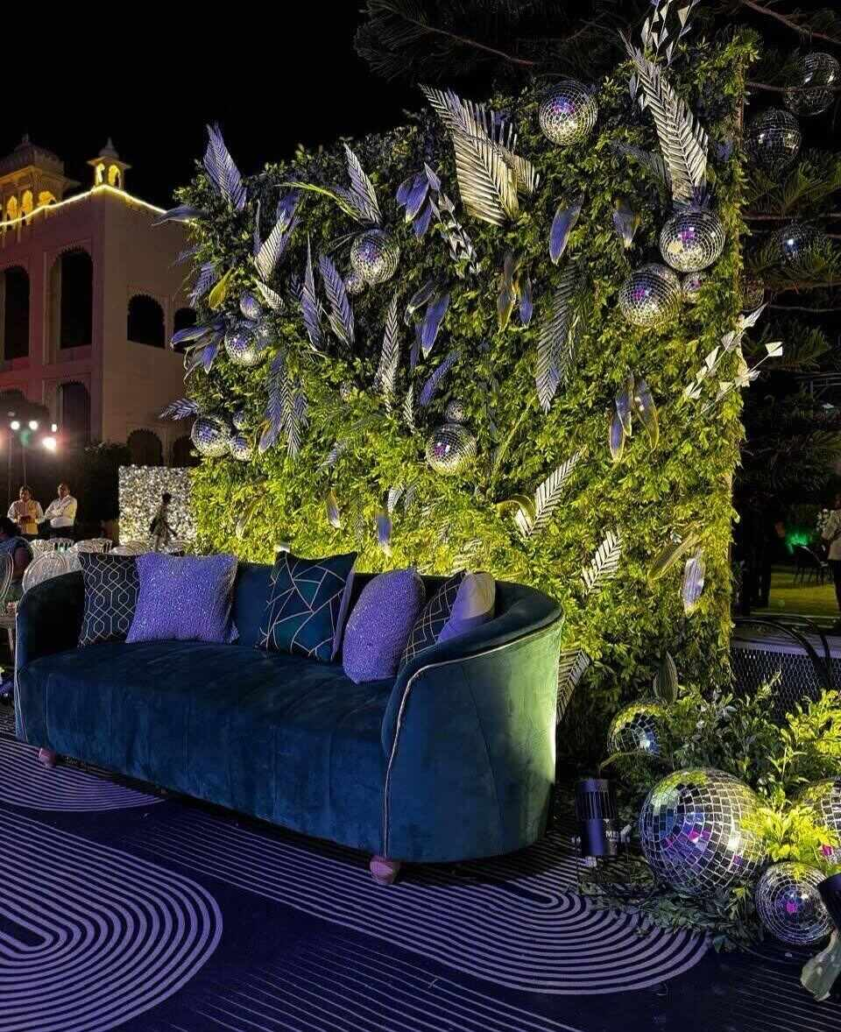
07 / YOUR CELEBRATION
1 / 2
Reception
An additional function for warm wishes and memorable reunions.
NEED CONFIRM
YOUR REQUIREMENTS
Couple’s stage & backdrop
Entrance, name signage & welcome desk
Guest seating & table plan
Photo queue coordination
Live music / DJ / emcee
Date: __________
Time: __________
Guests: ________
Cake & couple’s dance
Dining counters & menu
Notes / quantities / responsibility:
Choose → discuss → confirm
J.VARDHAN / CLIENT MEETING
20
Notes:
Guests & celebration / Couple’s stage & backdrop
PDF items: Added suggestion
Guests & celebration / Entrance, name signage & welcome desk
PDF items: Added suggestion
Guests & celebration / Guest seating & table plan
PDF items: Added suggestion
Guests & celebration / Photo queue coordination
PDF items: Added suggestion
Guests & celebration / Live music / DJ / emcee
PDF items: Added suggestion
Guests & celebration / Cake & couple’s dance
PDF items: Added suggestion
Guests & celebration / Dining counters & menu
PDF items: Added suggestion
Tick slots: in PowerPoint edit view, select a blank text box inside a square and type a check mark (✓). The first column means requested; the second means arrangement confirmed. Use website for interactive ticking in a client meeting.

Slide 21
07 / YOUR CELEBRATION
2 / 2
Reception
An additional function for warm wishes and memorable reunions.
NEED CONFIRM
YOUR REQUIREMENTS
Secure handling of gifts & envelopes
Return gifts & guest departures
Date: __________
Time: __________
Guests: ________
Notes / quantities / responsibility:
Choose → discuss → confirm
J.VARDHAN / CLIENT MEETING
21
Notes:
Guests & celebration / Secure handling of gifts & envelopes
PDF items: Added suggestion
Guests & celebration / Return gifts & guest departures
PDF items: Added suggestion
Tick slots: in PowerPoint edit view, select a blank text box inside a square and type a check mark (✓). The first column means requested; the second means arrangement confirmed. Use website for interactive ticking in a client meeting.

Slide 22
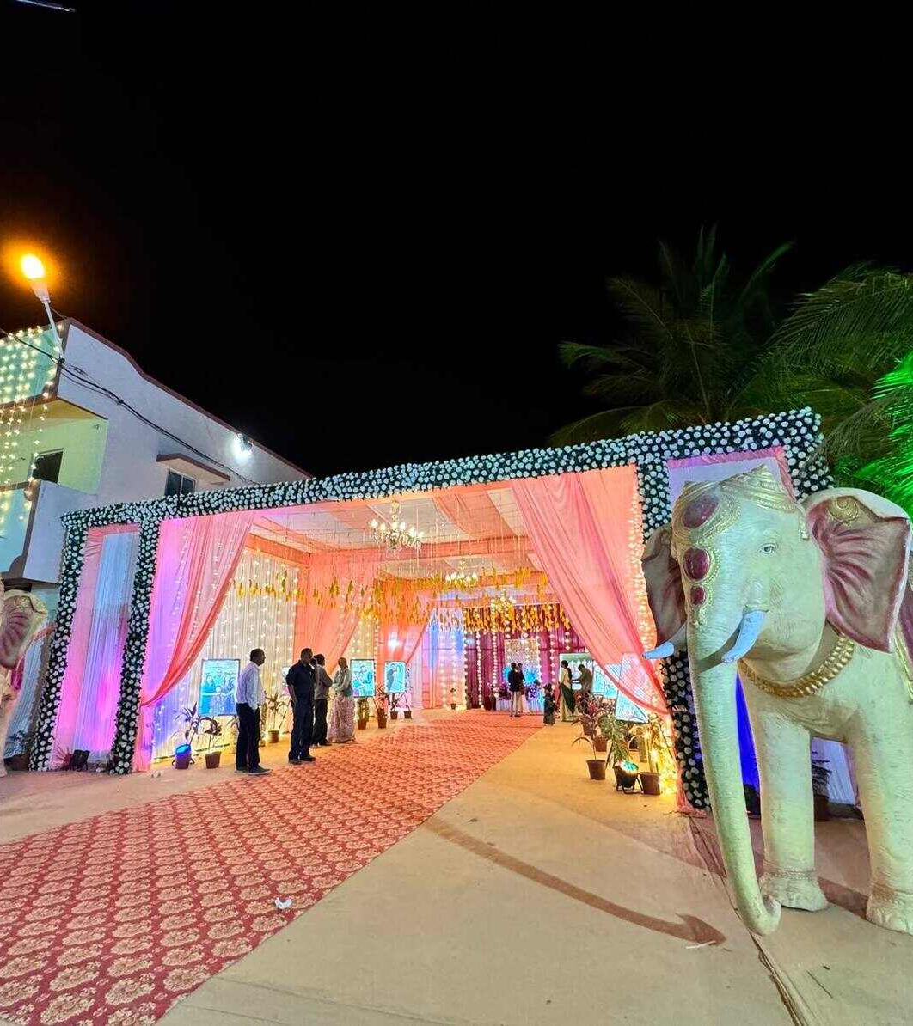
08 / YOUR CELEBRATION
1 / 5
Shared arrangements
The thoughtful details that keep every function running smoothly.
NEED CONFIRM
YOUR REQUIREMENTS
Ground & building lighting
Mango-tree decoration
Tree lighting
Coolers, fans & heaters
Electrical outlets
Date: __________
Time: __________
Guests: ________
Mobile charging station
Video crew tables & power
Notes / quantities / responsibility:
Choose → discuss → confirm
J.VARDHAN / CLIENT MEETING
22
Notes:
Lighting, power & venue / Ground & building lighting
PDF items: 129, 130
Lighting, power & venue / Mango-tree decoration
PDF items: 131
Lighting, power & venue / Tree lighting
PDF items: 144
Lighting, power & venue / Coolers, fans & heaters
PDF items: 132, 133, 134
Lighting, power & venue / Electrical outlets
PDF items: 135
Lighting, power & venue / Mobile charging station
PDF items: 136
Lighting, power & venue / Video crew tables & power
PDF items: 137
Tick slots: in PowerPoint edit view, select a blank text box inside a square and type a check mark (✓). The first column means requested; the second means arrangement confirmed. Use website for interactive ticking in a client meeting.

Slide 23
08 / YOUR CELEBRATION
2 / 5
Shared arrangements
The thoughtful details that keep every function running smoothly.
NEED CONFIRM
YOUR REQUIREMENTS
Background music around the venue
Silent generator
Generator fuel cost & responsibility *
Rain backup venue / cover
Setup, venue handover & dismantling schedule
Date: __________
Time: __________
Guests: ________
Security staff & personal security
Valet parking, desk, signage & tokens
Notes / quantities / responsibility:
* Discuss the exact requirement together.
J.VARDHAN / CLIENT MEETING
23
Notes:
Lighting, power & venue / Background music around the venue
PDF items: 143
Lighting, power & venue / Silent generator
PDF items: 150
Lighting, power & venue / Generator fuel cost & responsibility
PDF items: 151
Clarify: The source assigns diesel to the client; confirm responsibility in the final agreement.
Lighting, power & venue / Rain backup venue / cover
PDF items: Added suggestion
Lighting, power & venue / Setup, venue handover & dismantling schedule
PDF items: Added suggestion
Comfort & coordination / Security staff & personal security
PDF items: 138, 139
Comfort & coordination / Valet parking, desk, signage & tokens
PDF items: 140
Tick slots: in PowerPoint edit view, select a blank text box inside a square and type a check mark (✓). The first column means requested; the second means arrangement confirmed. Use website for interactive ticking in a client meeting.

Slide 24
08 / YOUR CELEBRATION
3 / 5
Shared arrangements
The thoughtful details that keep every function running smoothly.
NEED CONFIRM
YOUR REQUIREMENTS
Waste bins & cleaning
Fire extinguishers
Welcome arrangement “pyaro” — clarify details *
Return gifts for guests
Makeup, hairstyling & grooming
Date: __________
Time: __________
Guests: ________
Feedback box at the hotels
Accessibility for elderly & disabled guests
Notes / quantities / responsibility:
* Discuss the exact requirement together.
J.VARDHAN / CLIENT MEETING
24
Notes:
Comfort & coordination / Waste bins & cleaning
PDF items: 141
Comfort & coordination / Fire extinguishers
PDF items: 142
Comfort & coordination / Welcome arrangement “pyaro” — clarify details
PDF items: 145
Clarify: The meaning of this source term is unclear; ask the planner which item or person is intended.
Comfort & coordination / Return gifts for guests
PDF items: 146
Comfort & coordination / Makeup, hairstyling & grooming
PDF items: 147, 148
Comfort & coordination / Feedback box at the hotels
PDF items: 149
Comfort & coordination / Accessibility for elderly & disabled guests
PDF items: Added suggestion
Tick slots: in PowerPoint edit view, select a blank text box inside a square and type a check mark (✓). The first column means requested; the second means arrangement confirmed. Use website for interactive ticking in a client meeting.

Slide 25
08 / YOUR CELEBRATION
4 / 5
Shared arrangements
The thoughtful details that keep every function running smoothly.
NEED CONFIRM
YOUR REQUIREMENTS
Clean washrooms & attendants
First aid & emergency contacts
Child supervision & lost-property desk
Confirm venue rules for sound, effects & timings
Photography & videography
Date: __________
Time: __________
Guests: ________
Check availability & permissions for drone filming
Must-have shots & family photo groups
Notes / quantities / responsibility:
Choose → discuss → confirm
J.VARDHAN / CLIENT MEETING
25
Notes:
Comfort & coordination / Clean washrooms & attendants
PDF items: Added suggestion
Comfort & coordination / First aid & emergency contacts
PDF items: Added suggestion
Comfort & coordination / Child supervision & lost-property desk
PDF items: Added suggestion
Comfort & coordination / Confirm venue rules for sound, effects & timings
PDF items: Added suggestion
Memories & planning / Photography & videography
PDF items: Added suggestion
Memories & planning / Check availability & permissions for drone filming
PDF items: Added suggestion
Memories & planning / Must-have shots & family photo groups
PDF items: Added suggestion
Tick slots: in PowerPoint edit view, select a blank text box inside a square and type a check mark (✓). The first column means requested; the second means arrangement confirmed. Use website for interactive ticking in a client meeting.

Slide 26
08 / YOUR CELEBRATION
5 / 5
Shared arrangements
The thoughtful details that keep every function running smoothly.
NEED CONFIRM
YOUR REQUIREMENTS
Printed invites, digital invitations & RSVP
Budget, quotations & payment schedule
Vendor bookings, deposits & balances
Family point of contact & event coordinator
Change requests & final approvals
Date: __________
Time: __________
Guests: ________
Notes / quantities / responsibility:
Choose → discuss → confirm
J.VARDHAN / CLIENT MEETING
26
Notes:
Memories & planning / Printed invites, digital invitations & RSVP
PDF items: Added suggestion
Memories & planning / Budget, quotations & payment schedule
PDF items: Added suggestion
Memories & planning / Vendor bookings, deposits & balances
PDF items: Added suggestion
Memories & planning / Family point of contact & event coordinator
PDF items: Added suggestion
Memories & planning / Change requests & final approvals
PDF items: Added suggestion
Tick slots: in PowerPoint edit view, select a blank text box inside a square and type a check mark (✓). The first column means requested; the second means arrangement confirmed. Use website for interactive ticking in a client meeting.

Slide 27
09 / OPTIONAL
1 / 4
Hospitality & stays
Details from original pages 1–2. Include this section only if needed.
NEED CONFIRM
YOUR REQUIREMENTS
Event office / coordination desk
Team walkie-talkies
Guest pickup & drop-off *
Railway-station welcome
Luggage name tags
Date: __________
Time: __________
Guests: ________
Guest vehicle tags
Room tags / room allocation
Notes / quantities / responsibility:
* Discuss the exact requirement together.
J.VARDHAN / CLIENT MEETING
27
Notes:
Arrivals & accommodation / Event office / coordination desk
PDF items: 1
Arrivals & accommodation / Team walkie-talkies
PDF items: 2
Arrivals & accommodation / Guest pickup & drop-off
PDF items: 3
Clarify: Source specifies an Ertiga for three days; choose the vehicle, duration and quantity.
Arrivals & accommodation / Railway-station welcome
PDF items: 4
Arrivals & accommodation / Luggage name tags
PDF items: 5
Arrivals & accommodation / Guest vehicle tags
PDF items: 6
Arrivals & accommodation / Room tags / room allocation
PDF items: 7
Tick slots: in PowerPoint edit view, select a blank text box inside a square and type a check mark (✓). The first column means requested; the second means arrangement confirmed. Use website for interactive ticking in a client meeting.

Slide 28
09 / OPTIONAL
2 / 4
Hospitality & stays
Details from original pages 1–2. Include this section only if needed.
NEED CONFIRM
YOUR REQUIREMENTS
Luggage handling staff
Function signboards / standees
Itinerary leaflet in guest rooms
Emergency contact list
Wedding-party arrival & departure times
Date: __________
Time: __________
Guests: ________
Airport transfers & travel details
Hotel check-in, check-out & help desk
Notes / quantities / responsibility:
Choose → discuss → confirm
J.VARDHAN / CLIENT MEETING
28
Notes:
Arrivals & accommodation / Luggage handling staff
PDF items: 8
Arrivals & accommodation / Function signboards / standees
PDF items: 9
Arrivals & accommodation / Itinerary leaflet in guest rooms
PDF items: 10
Arrivals & accommodation / Emergency contact list
PDF items: 11
Arrivals & accommodation / Wedding-party arrival & departure times
PDF items: Added suggestion
Arrivals & accommodation / Airport transfers & travel details
PDF items: Added suggestion
Arrivals & accommodation / Hotel check-in, check-out & help desk
PDF items: Added suggestion
Tick slots: in PowerPoint edit view, select a blank text box inside a square and type a check mark (✓). The first column means requested; the second means arrangement confirmed. Use website for interactive ticking in a client meeting.

Slide 29
09 / OPTIONAL
3 / 4
Hospitality & stays
Details from original pages 1–2. Include this section only if needed.
NEED CONFIRM
YOUR REQUIREMENTS
Laundry & ironing
Massage service
Barber service
Beauty / makeup service
Shoe-polishing service
Date: __________
Time: __________
Guests: ________
Doctor / medical support arrangement
Room hamper: fruit, cookies, soft drinks & dry fruits
Notes / quantities / responsibility:
Choose → discuss → confirm
J.VARDHAN / CLIENT MEETING
29
Notes:
Guest services / Laundry & ironing
PDF items: 12
Guest services / Massage service
PDF items: 13
Guest services / Barber service
PDF items: 14
Guest services / Beauty / makeup service
PDF items: 15
Guest services / Shoe-polishing service
PDF items: 16
Guest services / Doctor / medical support arrangement
PDF items: 17
Guest services / Room hamper: fruit, cookies, soft drinks & dry fruits
PDF items: 18, 19, 20, 21
Tick slots: in PowerPoint edit view, select a blank text box inside a square and type a check mark (✓). The first column means requested; the second means arrangement confirmed. Use website for interactive ticking in a client meeting.

Slide 30
09 / OPTIONAL
4 / 4
Hospitality & stays
Details from original pages 1–2. Include this section only if needed.
NEED CONFIRM
YOUR REQUIREMENTS
Welcome drinks: sherbet, coconut water, tea, coffee & water
Water bottles with the family logo
Personalised guest gifts
Date: __________
Time: __________
Guests: ________
Notes / quantities / responsibility:
Choose → discuss → confirm
J.VARDHAN / CLIENT MEETING
30
Notes:
Guest services / Welcome drinks: sherbet, coconut water, tea, coffee & water
PDF items: 22, 23, 24, 25, 26
Guest services / Water bottles with the family logo
PDF items: 27
Guest services / Personalised guest gifts
PDF items: 28
Tick slots: in PowerPoint edit view, select a blank text box inside a square and type a check mark (✓). The first column means requested; the second means arrangement confirmed. Use website for interactive ticking in a client meeting.

Slide 31
10 / OPTIONAL
1 / 3
Dining & beverages
Optional dining from pages 1–2, with room for individual dietary needs.
NEED CONFIRM
YOUR REQUIREMENTS
Fruit juices
Ice cream
Hot milk
Soft drinks
Roasted dry fruits
Date: __________
Time: __________
Guests: ________
Fruit platters
Breakfast menu
Notes / quantities / responsibility:
Choose → discuss → confirm
J.VARDHAN / CLIENT MEETING
31
Notes:
Menu & service / Fruit juices
PDF items: 29
Menu & service / Ice cream
PDF items: 30
Menu & service / Hot milk
PDF items: 31
Menu & service / Soft drinks
PDF items: 32
Menu & service / Roasted dry fruits
PDF items: 33
Menu & service / Fruit platters
PDF items: 34
Menu & service / Breakfast menu
PDF items: 35
Tick slots: in PowerPoint edit view, select a blank text box inside a square and type a check mark (✓). The first column means requested; the second means arrangement confirmed. Use website for interactive ticking in a client meeting.

Slide 32
10 / OPTIONAL
2 / 3
Dining & beverages
Optional dining from pages 1–2, with room for individual dietary needs.
NEED CONFIRM
YOUR REQUIREMENTS
Lunch menu
Dinner menu
Dining tables, chairs & service tables
Jain / sattvic / vegetarian menu
Allergies, diabetic-friendly & other dietary needs
Date: __________
Time: __________
Guests: ________
Meals for children & elderly guests
Menu tasting & final meal count
Notes / quantities / responsibility:
Choose → discuss → confirm
J.VARDHAN / CLIENT MEETING
32
Notes:
Menu & service / Lunch menu
PDF items: 36
Menu & service / Dinner menu
PDF items: 37
Menu & service / Dining tables, chairs & service tables
PDF items: 38, 39, 40
Menu & service / Jain / sattvic / vegetarian menu
PDF items: Added suggestion
Menu & service / Allergies, diabetic-friendly & other dietary needs
PDF items: Added suggestion
Menu & service / Meals for children & elderly guests
PDF items: Added suggestion
Menu & service / Menu tasting & final meal count
PDF items: Added suggestion
Tick slots: in PowerPoint edit view, select a blank text box inside a square and type a check mark (✓). The first column means requested; the second means arrangement confirmed. Use website for interactive ticking in a client meeting.

Slide 33
10 / OPTIONAL
3 / 3
Dining & beverages
Optional dining from pages 1–2, with room for individual dietary needs.
NEED CONFIRM
YOUR REQUIREMENTS
Vendor & staff meals
Drinking water, hygiene & surplus-food plan
Date: __________
Time: __________
Guests: ________
Notes / quantities / responsibility:
Choose → discuss → confirm
J.VARDHAN / CLIENT MEETING
33
Notes:
Menu & service / Vendor & staff meals
PDF items: Added suggestion
Menu & service / Drinking water, hygiene & surplus-food plan
PDF items: Added suggestion
Tick slots: in PowerPoint edit view, select a blank text box inside a square and type a check mark (✓). The first column means requested; the second means arrangement confirmed. Use website for interactive ticking in a client meeting.

Slide 34
THE FAMILY BRIEF
The details that make it yours.
Client / family
Couple’s names
Dates & venue
Contact person / phone
Budget estimate
Theme, colours & priorities
All details are optional.
J.VARDHAN / LUXE WEDDINGS & EVENTS
CLIENT MEETING CHECKLIST / 34

Slide 35
OUR NEXT STEPS
Turn your choices into a plan.
Review your chosen functions and items
Confirm open details, designs and quantities
Agree family, planner and vendor responsibilities
Discuss quotations, availability and payments
Edit the text and tick boxes in PowerPoint. For live ticking and saved answers, use the website form.
A planning worksheet; not a booking or quotation.
J.VARDHAN / LUXE WEDDINGS & EVENTS
CLIENT MEETING CHECKLIST / 35

