Slide 1
PARTNERSHIP PROFILE
J.VARDHAN LUXE EVENTS
Resort, Hotel & Venue Partnership Profile
Wedding Design | Floral Styling | Mandap & Event Production
Working brand only. Legacy connection: Mali Mukesh Wedding Planning & Decoration.

Slide 2


PURPOSE
Why this deck exists
Premium venues do not need another decorator list.
They need a reliable production partner who helps them sell celebrations faster, protect their property, and deliver repeatable guest experience.
This draft converts the long pitch PDF into a sharper venue-owner presentation.
2

Slide 3

The venue owner's problem
Enquiry Pressure
Vendor Risk
Booking Delays
Families ask for decor before they commit.
Unvetted vendors create coordination pressure.
Setup and teardown delays affect the next booking.
Property Damage
Execution Dependency
Property damage risk sits with the venue team.
The venue's visual promise depends on outside execution.
3

Slide 4
OUR ROLE
The partnership promise
We become the decor and production layer that understands your venue rules.
We prepare site-specific options for mandaps, entrances, receptions, pathways, florals, lighting, and guest flow.
Your team stays focused on hospitality, F&B, rooms, and service.
4

Slide 5

Proof must be earned
The source PDF mentions strong proof points, but every one needs verification before it is published.
1
2
Years in Business
Floral Origin
[VERIFY: years in business]
[VERIFY: origin as early / first real-flower shop in Junagadh]
3
4
Venue & Hotel Work
Event Scale
[VERIFY: venue and hotel work]
[VERIFY: major private, cultural, and community events]
5

Slide 6




OUR STORY
Working credibility story
Local Floral Business
From a local floral business into full event production.
Full Production
From flowers and garlands into mandaps, stages, entrances, lighting, and execution planning.
Regional Expansion
From Junagadh and Bhavnath into a wider Saurashtra and Gujarat opportunity.
Keep this story humble until dates and proof are confirmed.
6

Slide 7
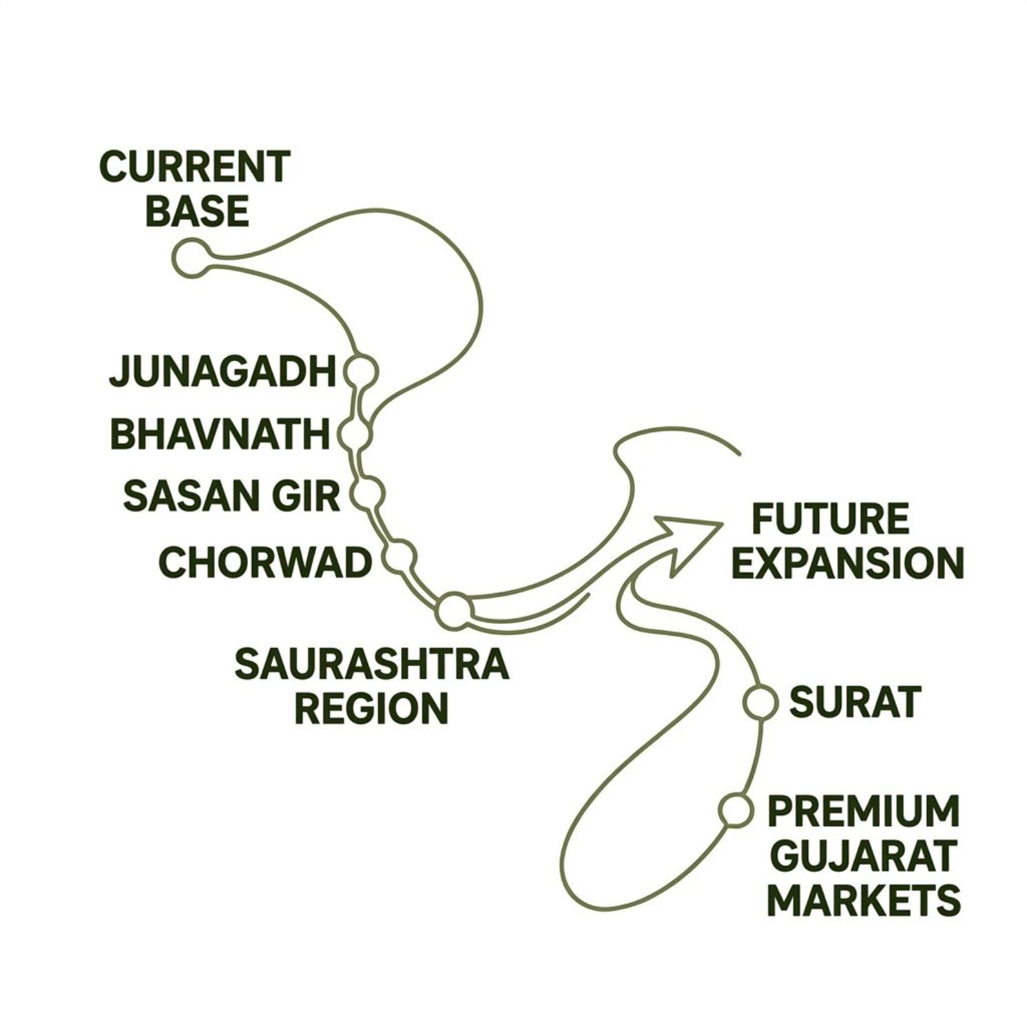

Geographic base and expansion
Current & Mentioned Operating Region
Junagadh
Bhavnath
Sasan Gir
Chorwad
Wider Saurashtra
Future Business Focus
Surat and premium Gujarat venue markets.
Do not imply coverage beyond evidence.
7

Slide 8






VALUE PROPOSITION
Venue value in one line
Better Decor Response
Cleaner Coordination
Faster Setup Planning
Stronger Guest-Facing Presentation
More Sales Content for the Venue
Less Operational Friction
8

Slide 9


What we can design around
Mandaps & Ceremony Structures
Custom-designed ceremony focal points built to venue specifications.
Entrance Gates & Toran-Style Arrivals
First impressions designed for the venue's approach and entry points.
Reception Stages & Lighting
There was an error generating this image
Stage builds, backdrop systems, and ambient lighting design.
Floral Walls, Garlands, Pathways & Centerpieces
Fresh and structured floral across all event zones.
Traditional, Modern & Luxury Decor Worlds
Inventory-led packages after verification.
9

Slide 10

Flower advantage
If proven, direct flower sourcing becomes a practical advantage across every event we produce.
1
Freshness
Speed
Farm Access
[VERIFY: direct farm access or flower farm ownership]
Customization
Availability
2
Cost Control
Varieties & Seasonality
[VERIFY: flower varieties and seasonality]
3
Storage & Freshness
[VERIFY: storage, freshness, sourcing, and backup suppliers]
10

Slide 11

Owned inventory advantage
Once documented, inventory turns the pitch from "beautiful decor" into "repeatable production capability."
1
2
3
Mandap Structures
Stages & Backdrops
Quantities & Condition
[VERIFY: owned mandap structures]
[VERIFY: stages, backdrops, gates, lighting, props, seating, floral structures]
[VERIFY: quantities, condition, transport needs, setup times]
11

Slide 12

Case proof placeholder: compressed setup
Source PDF mentions a major Chorwad private function and a compressed setup timeline.
Use this only if evidence confirms exact role, client permission, date, and documented setup window.
Public wording until verified:
[VERIFIED COPY HERE: event, role, timeline, scope, permission status]
12

Slide 13

Case proof placeholder: hotel relationship
Source PDF mentions Ashopalav Hotel, Bhavnath.
Do not use "exclusive" unless a written agreement confirms it.
Public wording until verified:
[VERIFIED COPY HERE: relationship type, scope, dates, permission status]
13

Slide 14
Case proof placeholder: cultural event scale
Source PDF mentions Mahashivratri at Bhavnath and Kirtidan Gadhvi Dayro at Ashopalav Hotel.
Do not imply main planner status if the business was a decorator, supplier, or subcontractor.
Public wording until verified:
[VERIFIED COPY HERE: event, role, scope, audience scale, date, permission status]
14

Slide 15
Case proof placeholder: premium properties
Source PDF mentions Bellevue Sarovar Premiere and The Fern Gir Forest Resort.
Use property names only with permission or clear publishable evidence.
Public wording until verified:
[VERIFIED COPY HERE: property, role, scope, date, permission status]
15

Slide 16
Cultural fluency
The PDF highlights Jain community event experience.
Safe claim direction
Careful planning around family customs, rituals, timing, spatial flow, and hospitality expectations.
Public wording until verified:
[VERIFIED COPY HERE: event types, protocols handled, permission status]
16

Slide 17
VENUE PROTECTION
Venue protection starts before design
01
02
Site Walk Before Proposal
Rules Checklist Before Client Commitment
We understand the space before we commit to any design.
Venue rules are locked in before the client brief is finalised.
03
04
Load-In & Load-Out Plan Before Event Week
Surface Protection Where Needed
Logistics are mapped before the event calendar is under pressure.
Floors, walls, and fixtures are protected as standard.
05
06
Escalation Contact for Venue Operations
Post-Event Debrief & Content Handover
One named contact for any on-site issue during the event.
Structured review and approved content delivered after every event.
17

Slide 18


Safety and welfare claims
Source PDF mentions labor medical policies, weather preparation, fire-retardant materials, and disaster resilience.
Until verified, use only process language:
1
2
Labor Insurance / Welfare Policy
Event Insurance
[VERIFY: labor insurance / welfare policy]
[VERIFY: event insurance]
3
4
Material Safety & Fire Treatment
Weather & Wind Planning
[VERIFY: material safety and fire treatment]
[VERIFY: weather and wind planning]
Never use "zero-damage guarantee."
18

Slide 19
HOW WE WORK
Operational model
One Planning Contact
One Site Rule File
One Setup Timeline
One Decor Scope
One Post-Event Review
The venue should feel less coordination pressure, not more.
19

Slide 20
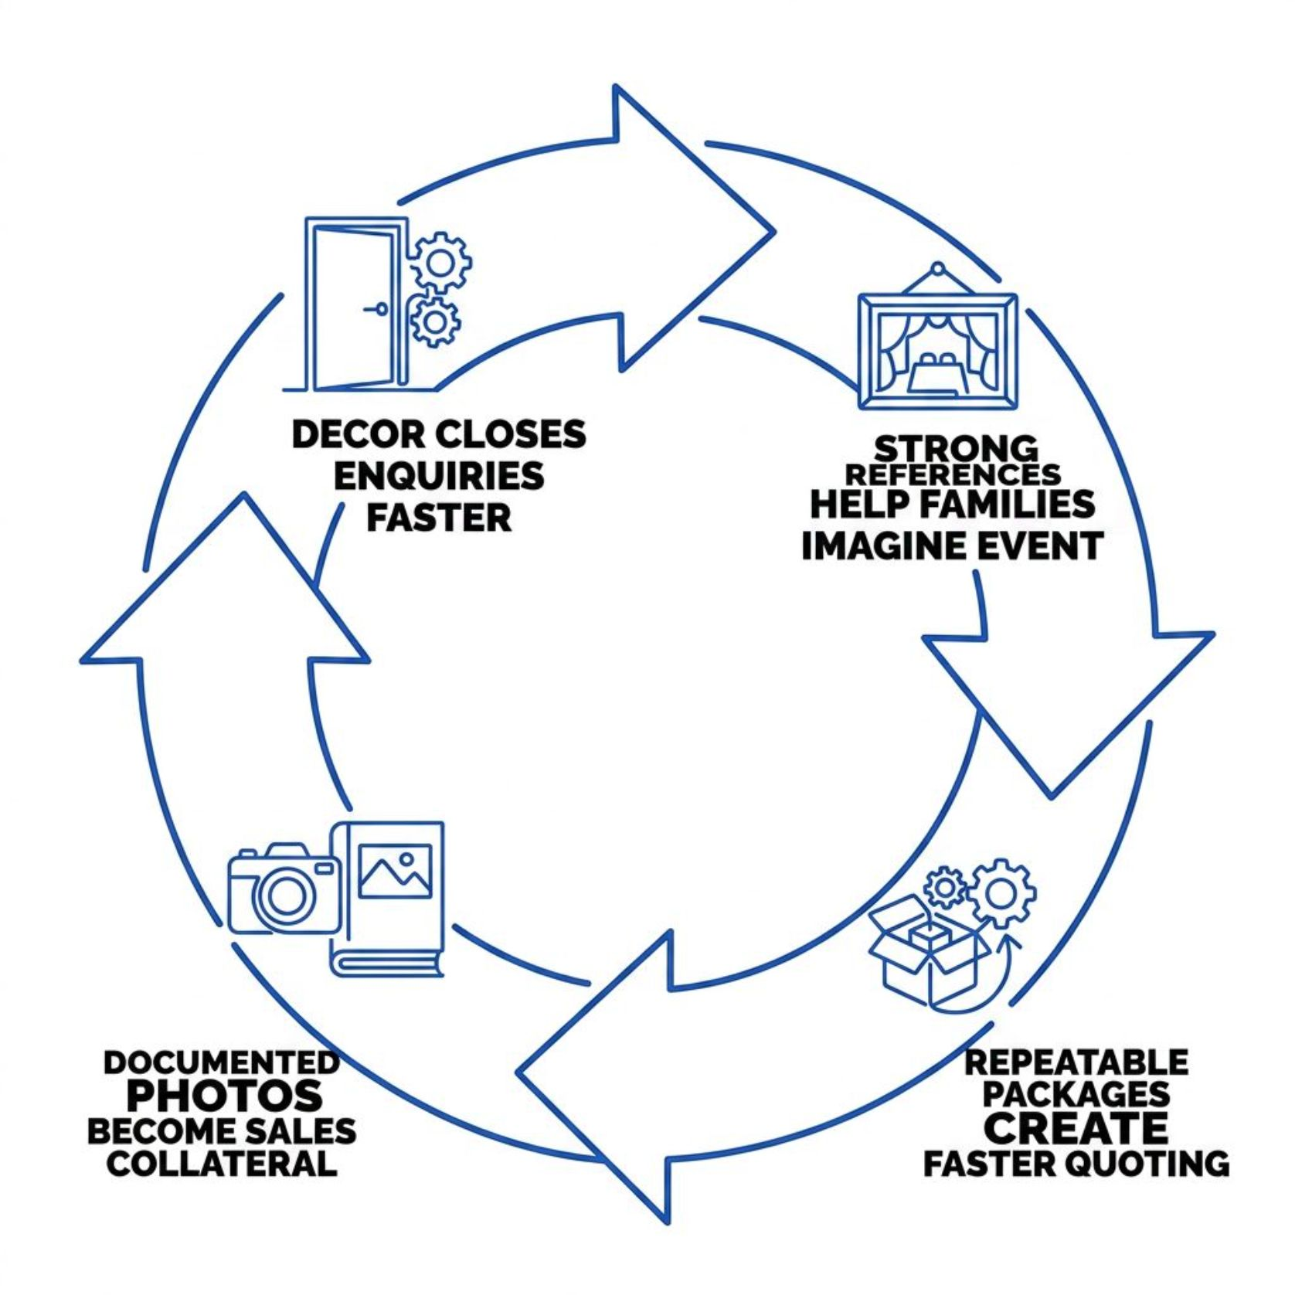
Revenue support for venues
The business case is conversion support, not decoration alone.
Decor can help a venue close enquiries faster.
Strong visual references help families imagine the event.
Repeatable packages create faster quoting.
Documented event photos become future sales collateral.
20

Slide 21





CONTENT & MARKETING
Marketing collaboration
Each approved event can create content for both brands.
Venue-Tagged Image Sets
Setup & Reveal Reels
Before / After Venue Transformations
Short-form video content showing the transformation of the space.
Curated photography attributed to both the venue and the production team.
Visual proof of the venue's potential across different event styles.
Seasonal Decor Lookbooks
Permission-Safe Case Studies
Curated reference guides for each season and event type.
Documented event stories published only with full approval.
21

Slide 22


PARTNERSHIP MODEL 1
Approved Vendor
Best for first relationship stage.
Shared Venue Rules
Defined Service Categories
Venue rules and restrictions are formally shared and acknowledged.
Clear scope of what we are approved to deliver on-site.
Referral Process
Event-by-Event Review
A defined path for the venue team to refer enquiries to us.
Each event is reviewed before the relationship progresses.
22

Slide 23
PARTNERSHIP MODEL 2
Preferred Decor Partner
Best once trust is proven.
Site-Specific Decor Menus
Priority Planning Support
Curated decor options designed specifically for your venue's spaces.
Your events receive first-priority scheduling and planning attention.
Co-Created Visual References
Quarterly Review with Venue Leadership
Mood boards and references built together for your venue's aesthetic.
Structured review meetings to align on performance and direction.
23

Slide 24



PARTNERSHIP MODEL 3
Co-Branded Packages
Best for high-intent wedding enquiries.
Venue Plus Decor Concept
Indicative Inclusions
A combined offering that presents the venue and decor as one seamless experience.
Clear scope of what is included in each package tier.
Photo References
Clear Inquiry Path
Visual references that help families picture the finished event.
A defined process for families to enquire and convert.
No pricing unless approved.
24

Slide 25
GETTING STARTED
Recommended pilot
Start with three events.
1
Event 1
Document rules, flow, setup, and content needs.
2
Event 2
Refine package language and visual references.
3
Event 3
Measure response speed, setup quality, guest experience, and venue-team feedback.
Then decide the partnership model.
25

Slide 26
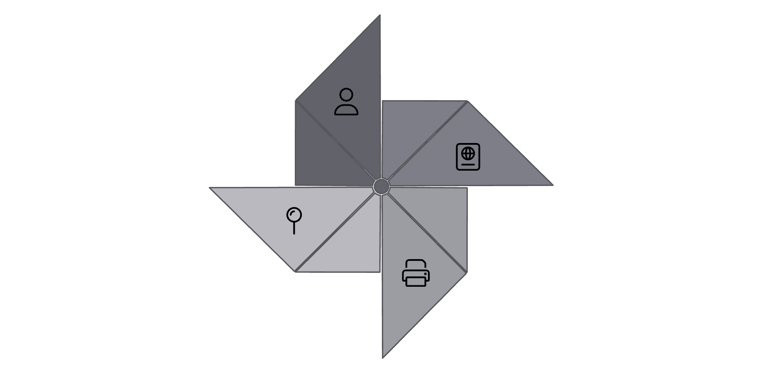
Outreach path
Target Contacts
General Managers
Directors of Sales
Banquet heads
Owners
Send Concise Deck
Target Decision‑Makers
Approach
Deliver Printed Premium Deck
Send a concise digital deck.
Follow with a printed premium deck for priority venues.
Offer a site walk, not a vague meeting.
Invite serious prospects to inspect a live setup when permission allows.
Offer Site Walk
26

Slide 27

Brand identity sample
Use the uploaded logo sample board image if provided.
Master Stacked Lockup
Seal / Avatar
Primary brand mark for all formal applications.
Compact circular mark for social and digital use.
Horizontal Nav Lockup
Favicon
Wide-format mark for website headers and banners.
Minimal mark for browser tabs and app icons.
Logo shown as concept system only. Final mark requires vector redraw and trademark search.
27

Slide 28
Logo direction for Gamma
Mark Direction
Colour System
Gold Asiatic lion, not a generic heraldic lion.
Short sparse Gir lion mane with visible ears.
No crowns, shields, sparkles, foil, script fonts, or black-and-gold cliche.
Gold Mark
Teal Wordmark
#CFAA6D
#0A5356
Ivory Background
Dark Teal Slides
#F9F6EF
#013C3C
28

Slide 29
What we need from the venue
01
02
Spaces to Prioritise
Rules and Restrictions
Which halls, lawns, entrances, and zones are available for event use.
Load-in windows, surface restrictions, noise curfews, and vendor access policies.
03
04
Event Calendar
Photo and Video Permissions
Upcoming bookings and available dates for pilot planning.
What can be captured, shared, and published from events at your property.
05
06
Decision-Maker for Approvals
Three Pilot Event Opportunities
One named contact who can approve decor scope, content, and partnership terms.
The starting point for building a documented, repeatable partnership.
29

Slide 30
NEXT STEP
Next step
1
Book a venue walk-through.
2
Share upcoming wedding or event dates.
3
Choose the first pilot event.
We will return with a venue-specific decor and production plan.
Contact
[PHONE / WHATSAPP / EMAIL HERE]
30

